Slide 1


Effective use of data
4. Interpreting and analysing data
Practitioners
Notes:
All information is correct as of May 2024
These slides are intended to support senior leaders, middle leaders and practitioners in schools and local authorities to explore the effective use of data for improvement. There are a set of six workshops available for senior leaders, middle leaders and practitioners. The workshops were co-designed with educators from across Scotland and are based on an Education Scotland literature review: The Effective use of data for improvement in education.
Establishing the purpose and use of data
Defining and classifying data
Creating effective processes and systems
Interpreting and analysing data
Developing a data informed culture
Using data for improvement
(hyperlinks for each workshops can be found on the next slide)
The PowerPoint is a template that presenters can adapt to suit their own context and style of presenting. The workshops can be delivered individually or grouped together and delivered in a longer session. Individual workshops have been designed for facilitators to deliver in 1 to 1.5 hours.
Within the slide notes key messages, suggested tasks, ‘talking-points’ and challenge questions are included.
It is anticipated the presenter will have read the Education Scotland literature review: The Effective use of data for improvement in education.

Slide 2


The national model of professional learning
The national model of professional learning | Professional Learning | Education Scotland
Notes:
Key Messages
This module has been designed using the national model of professional learning and the principles of adult learning or andragogy. It has been designed to think about:
The why – opportunities for participants to understand the rationale through professional standards, research, current policy landscape and national/local priorities.
The what – opportunities for participants to consolidate and develop relevant knowledge and skills
The how – opportunities for participants to take part in peer discussion, explore case studies or share experiences
Apply – a chance to reflect on learning, next steps and further support
A link to further information about the national model of professional learning can be found below.
edscot-model-of-professional-learning-outline.pdf (education.gov.scot)

Slide 3

Draft Group Agreement and Protocols
Work together
learn from, with, and on behalf of each other
create a safe space to share ideas and build learning
agree that everyone is an equal and valued participant
remain in the room (emails and phone protocol).
Notes:
Key messages
Take a moment to establish group protocols.
Ask participants to check and comment on anything they would like to add or amend.
The protocols on the slide are suggestions and may be amended for your school context.

Slide 4

Connector
In groups/pairs:
Share the job you thought you might do when you were a child/teenager?
Notes:
Key Messages
This is an example of a simple connecter activity. It is recommended that facilitators use a connector activity that allows participants to take part in an informal discussion.
This is to ensure that participants are relaxed, focused and ready for an interactive workshop.

Slide 5

Re-cap
In workshop 1 we looked at the purpose and use of data including: the meaning of data and evidence, the ways in which data is used and what we mean by ‘big’ and ‘small’ data.
In workshop 2 we considered different categories of data and how these may be intersected to support improvement.
In workshop 3 we examined how we create effective systems and processes
Notes:
Key Messages
This slide offers a brief recap of content covered in previous workshops.

Slide 6

Aims
In this workshop we will consider:
national guidance and research including signposting to national data sets
questions to explore when analysing and interpreting data
the use of comparator data, and
how to use a data analysis to inform next steps.
Notes:
Key Messages
This slide shows the aims of the session to be shared with participants.

Slide 7
Content coverage
National guidance and research
Using data
Getting started
Interpreting the data
Comparator data
Notes:
Key Messages
This slide shows the content covered throughout the workshop. Further details and suggested timings are provided below. Facilitators can amend content and timings to suit their needs and context.
National guidance and research – allow 5 mins for this section. It can be extended to 10-15 mins if facilitators wish to provide time for participants to read and discuss the relevant section of the evidence review.
Using data – allow 10 – 15 minutes for this section. It provides some introductory thoughts around using data for analysis. There is an activity which provides participants with an opportunity to discuss how confident they and their staff are in effectively analysing and using data. Allow 15 mins for this section including the activity.
Getting started – allow 20 minutes. This section provides ideas on what we could be looking for when we are looking to interpret data.
Interpreting the data – allow 25 - 35 minutes. This section provides examples of data interpretation and includes opportunities for discussion.
Comparator data – 10 minutes. Facilitator can make the decision on whether to include time to explore virtual comparator examples or only discuss comparator data and it’s purpose and how senior leaders use it.
Next steps – this section considers the next steps following an analysis of gaps, patterns or trends. It assumes that participants will be familiar with the messages delivered in workshop 2. Allow 10 mins for this section. However, facilitators may wish to extend this section and include an activity on intersecting data based on some of the gaps identified in the analysing data section.
It is expected that this workshop should take between 1 hour and 15 mins and 1.5 hours to deliver.

Slide 8
GTCS Standards for Full Registration and Career Long Professional Learning
Curriculum and Pedagogy
3.1.1 - Plan effectively to meet learners’ needs
3.1.4 - Effectively employ assessment, evaluate progress, recording and reporting as an integral part of the teaching process to support and enhance learning.
Professional Learning
3.3.2 - Engage in reflective practice to develop and advance career-long professional learning.
GTCS The Standard for Full Registration
GTCS - The Standard for Career-Long Professional Learning
Notes:
Key messages
The GTCS Standard for full registration and for Career Long Professional Learning highlights the importance of the use of data in decision-making.
The standard is the same for both groups.
This standard emphasises the importance of data being used to support planning and enhancing learning.
Reflective Questions
How wide ranging and robust is the data you are using in school? How do you know?

Slide 9
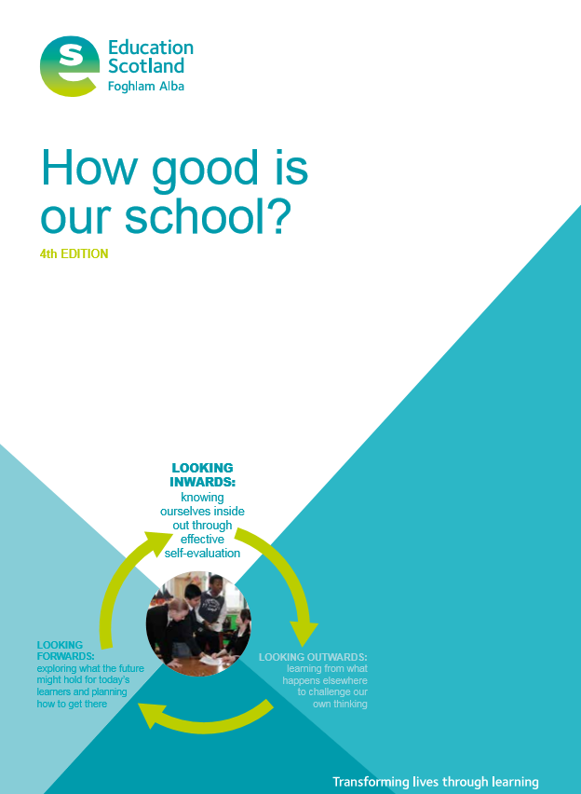
HGIOS 4
Staff make effective use of current available data on levels of child poverty and apply this to ensure equity (1.5)
All teachers have well-developed skills of data analysis which are focused on improvement (2.3)
We use data to evaluate the effectiveness of interventions designed to improve outcomes for all learners (2.3)
Notes:
Key Messages
How Good is Our School 4 describes the ways in which schools may use data effectively for improvement. This includes:
Gathering data to monitor and track progress
Regular interrogation of data
Making effective use of data on child poverty to ensure equity, and
Ensuring that all teachers have well developed skills of data analysis
Reflective Questions
How confident are we in using data to focus on improvement?

Slide 10
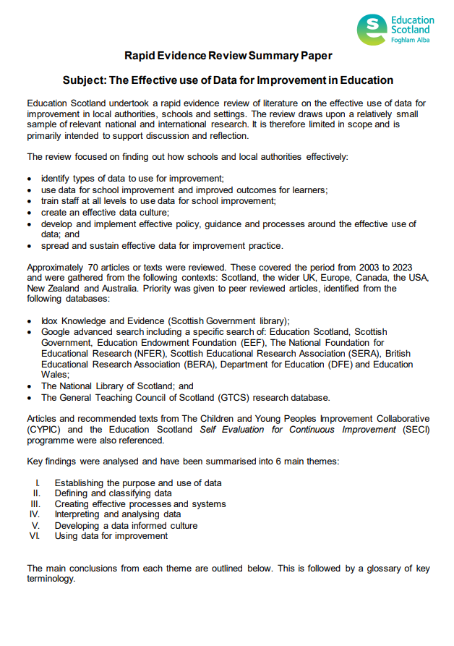

Rapid Evidence Review Paper
Section four of the Education Scotland Rapid Evidence Review on interpreting and analysing data highlights the points below.
Educators often report a lack of confidence in being able to interpret data.
Educators should be familiar with a range of key measures and measures should be embedded into improvement plans.
Educators should gather and analyse improvement data frequently and look for patterns, trends and variation.
It is important to intersect data and evidence to understand why a pattern, trend or gap exists.
Schools and settings should utilise local and national comparator data.
Notes:
Key Messages
Section four of the rapid evidence review on creating effective processes and systems highlights that:
Educators often report a lack of confidence in being able to interpret data.
Educators should be familiar with a range of key measures and measures should be embedded into improvement plans.
Educators should gather and analyse improvement data frequently and look for patterns, trends and variation.
It is important to intersect data and evidence to understand why a pattern, trend or gap exists.
Schools and settings should utilise local and national comparator data.
The Effective use of data for improvement in education
Talking Points
This may be a good point to ask participants to read section four on establishing the purpose and use of data.
Reflective Questions
What measures do you use for analysing and interpreting data? How do you analyse data? How do you identify patterns, trends, next steps?

Slide 11

Using data
Data analysis involves examining information and breaking it down for understanding and meaning.
To analyse data effectively educators should be confident in:
  reading and interpreting a range of common tables, charts and diagrams, and
  analysing and utilising the information gathered to inform improvement.
Notes:
Key Messages
Data analysis involves examining information and breaking it down for understanding and meaning.
To analyse data effectively educators should be confident in:
reading and interpreting a range of common tables, charts and diagrams, and
analysing and utilising the information gathered to inform improvement
Talking Points
Facilitators may wish to draw out the different skills involved in data analysis – confidence in reading a range of charts, tables and graphs as well as the ability to interpret the information gathered.

Slide 12
Reflection activity
“Using data is not separate from planning and from routine decisions in schools. Instead, data is a necessary part of an ongoing process of analysis, insight, new learning and changes in practice.”
(Lorna M Earl and Steven Katz, 2009)
How confident do we feel when it comes to analysing data?
What school / classroom level data do we currently analyse?
How do we currently utilise this data to inform improvement?
Notes:
Key Messages
An opportunity for participants to read the quote and reflect on the confidence of staff in analysing and interpreting data.
Emphasis should be put on the session being a safe space to talk honestly and without fear.
Talking Points
Facilitators may wish to draw out the range of confidence levels and whether this varies depending on the role of the educator. They may also wish to draw out whether school leaders are providing opportunities for all staff to engage with data and improve their skills of analysis.

Slide 13

How do we start to analyse data?
Key questions to ask:
What do we wish to explore or find out?
Which data sets will help us to do this?
Is the data we plan to look at easily available and reliable?
Notes:
Key Messages
These points will be covered over the next few slides

Slide 14
What are we looking for?
Examples:
evidence of progress/ lack of progress
surprising outcomes/anomalies (good and bad)
patterns or trends emerging over time
gaps in attainment
the impact of a change we have implemented
to make comparisons in relation to local/national data.
Notes:
Discussion
Before revealing the bullet points – ask practitioners to discuss what we might want to look for when we interpret and analyse data.
Allow time for discussion/brief feedback then reveal these bullets. Practitioners may contribute additional examples of what we might be looking for to those that will be revealed on the slide.
Key Messages
Are we clear about ‘why’ we need to analyse data? What issue are we exploring, what question to we wish to answer? What do we want to find out?
We can’t look for everything all of the time but we can start with some key areas and progress from there.
Often when we start to analyse data it can raise more questions as we go along.
Examples of some of these are on the next slide.
Talking Point
What other things might we be looking for?

Slide 15
Using attainment data
What are we looking for?
Examples
pattern
trend
The attainment gap between SIMD Q1 and SIMD Q5 in the current P4 has increased for the past three years (P2 – 15%, P3 – 20%, P4 – 22%)
anomaly
Girls are outperforming boys in all year groups in reading apart from P5.
There is under attainment of EAL boys in writing in most year groups.
There is a 20% gap between P4, SIMD Q1 learners and SIMD Q5 learners in numeracy.
gap
Notes:
Key Messages
When analysing data, we often use different language such as pattern, trend, anomaly or gap. It may be helpful to reflect on what we mean by these.
An example of a pattern might be: There is under attainment of EAL boys in writing in most year groups.
An example of a trend might be: The attainment gap between SIMD Q1 and SIMD Q5 in the current P4 has increased for the past three years (P2 – 15%, P3 – 20%, P4 – 22%)
An example of an anomaly might be: Girls are outperforming boys in all year groups in reading apart P5.
An example of a gap might be: There is a 20% gap between P4, SIMD Q1 learners and SIMD Q5 learners in numeracy.
We will continue to explore examples of how to use attainment data as we go through this workshop.

Slide 16

Which data sets will help us do this?
Examples:
class/setting checklists or spreadsheets
establishment tracking files (if available)
local authority tracking tools (if available)
national data tools, e.g. ACEL data, Insight data(secondary), BGE benchmarking tool.
Notes:
Key Messages
Refer back to the different data types covered in workshop two. The examples provided here are focused on quantitative data sets but emphasise the importance of triangulating data and using different types of data, e.g. qualitative and quantitative. Using contextual data is important. This is explored on the next slide.
Each local authority and establishment will have different data procedures in place and this could be brought into the discussion during this presentation as appropriate.

Slide 17
Using contextual information
Consider | Key demographic groups (boys, girls, English as an Additional Language (EAL), ASN, SIMD Q1 etc) Attendance and mobility
Analyse | How many learners are living in areas of disadvantage? Who are the significant demographic groups of learners within your context? What is the cohort attendance? What is the attendance of different demographic groups? What is the demographic profile of different cohorts? What stands out (i.e. because there is an imbalance or particularly large numbers of X)?
Understand | What implications might this data have for learning and teaching? Consider: Understanding needs Developing relationships Attainment and achievement including pedagogical approaches or curriculum offer What key questions might you ask?
Notes:
Key Messages
This table can be used to talk through the things to consider, analyse and understand when using contextual data (read through and discuss).
Talking Points
Facilitators may wish to draw out the difference in key demographic groups depending on context. For example, boys and girls will likely be a universal focus but not all schools will have children with an additional language or those from black minority ethnic groups (BME).
When looking at learners affected by poverty, the national approach is to compare SIMD Q1 against SIMD Q5. Where schools do not have SIMD Q1 or Q5 then other measures such as Free School Meals are sometimes used.

Slide 18
Using attainment data – part 2
Consider | The attainment of cohorts and key demographic groups in different subject areas. How groups compare to each other and local/national comparators. The attainment of learners living in the areas of deprivation (SIMD Q1) against those living in the least deprived areas (SIMD Q5).
Analyse | Attainment in each subject and cohort. Any trends, patterns, gaps or anomalies between groups of learners / subjects / cohorts. Think about: Boys, girls, SIMD Q1, FSM, EAL, BME, ASN, CE etc. How cohort compares to national / local groups.
Understand | Are there any ‘gaps’ between a specific group of learners and ‘all’ learners in your class? What is the poverty related attainment gap in subjects and cohorts? Are any one group doing particularly well? Above expected expectations? How does your whole class or cohort compare to the overall school picture, national or LA cohorts? Which groups of learners are most ‘at risk’ of underachievement for their age and stage? Are learners on track to meet their predictions? Which groups may need to be supported to make rapid or accelerated progress?

Slide 19
Availability and reliability
try to keep ongoing records e.g. assessment results
find out what data tools the local authority have available
triangulate data – one source is unlikely to give you the full story
look outwards – how does the data compare to local and national data?
Notes:
Key Messages
Try to record assessment results often. Not everything needs recorded as we need to be mindful of workload but keeping regular records can help us to spot patterns and trends. Building record keeping into our practice can make things easier for us in the long term.
No one data set will provide us with conclusive evidence, we need to ensure that we triangulate the data and also look for the story behind the data.
It is important to look outwards to see how our data fits into the wider picture, both locally and nationally. This is covered in more detail later in the workshop.

Slide 20

Digital tools
Example tools:
Microsoft Excel/ Google Sheets
Microsoft Forms/ Google Forms
Power BI
Graphs e.g. bar, line, scatter, etc
How to sort and filter your data in excel
Power BI Tutorial for Beginners
Notes:
Key Messages
Basic spreadsheet skills are highly beneficial when analysing data. Microsoft excel and google sheets are the most common spreadsheets used. We do not have to have advanced skills in using these, the link on the screen is to a short 6 minute video demonstrating how information can be sorted and filtered using excel. YouTube has many videos available on how to create various graphs and charts should participants want to explore this in their own time.
Forms will provide answers to online assessments in a spreadsheet and will also convert the data into graphs and charts if required. This can be good for assessments but also to seek views and opinions (perception data) to analyse and triangulate with other data.
Power BI is a new tool, it is more suited for those who feel more confident in using online data tools. We would not recommend using this for those who are new to analysing data. We have included as it is becoming a popular tool to use.

Slide 21
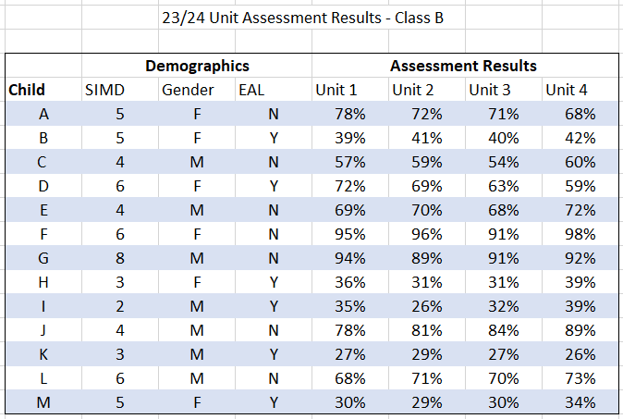
Analysing the data
Data for illustrative purposes only
Notes:
Key Messages
This is a discussion task. It might be helpful to print copies of this slide for participants.
Discussion
Use the data on the screen. In pairs/small groups explore the following questions:
Do any learners stand out? Why? What might be going on?
Focus on each of the different demographics, do we notice any patterns or trends emerging? What could this mean? What might we action as a result?
Are there any anomalies in the data as a whole? What might we do to explore these anomalies further?
Analysing the data in this task is more challenging in isolation as we don’t have the wider context, e.g. attendance, behaviour, relationships, etc
Some potential examples of interpretations can be found on the next slide.

Slide 22
Observational/statistical interpretation of data
Examples:
Child A and Child D’s results have continued to decline. Has there been a change in e.g. attendance, behaviour, confidence etc? How does this compare to other curricular assessments?
Child B, H, I, K & M’s results are lower than the rest of the cohort. We notice that these children are all EAL children.
Child J has a steady positive increase in their results. What could have impacted this change?
Notes:
Key Messages
These are not the only observations that could made in relation to the data, participants may have come up with other examples in the task on the previous slide.
Discussion
The important thing is what we do with these observations.
What actions could we take for each of these situations?

Slide 23
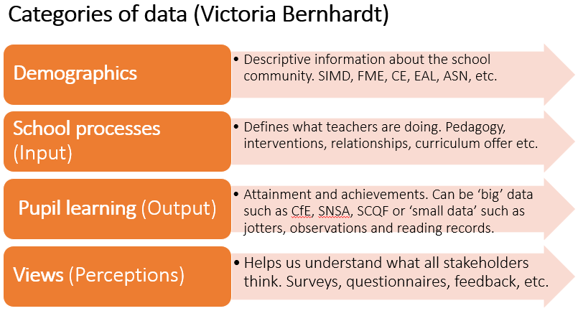
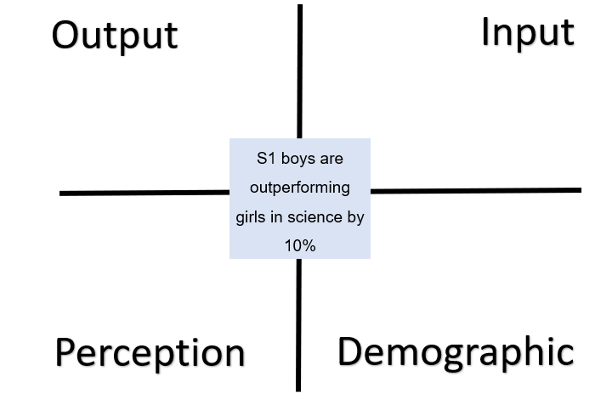
Intersecting data
Once data has been analysed, it is important to consider ‘why’ a gap, pattern or a trend may exist.
The next step may be to intersect different categories of data as, outlined in workshop 2, to understand ‘why.’
Notes:
Key messages
Once data has been analysed, it is important to consider ‘why’ a gap pattern or a trend may exist.
The next step may be to intersect different categories of data as, outlined in workshop 2, to understand ‘why.’
Facilitators may wish to recap on this activity from workshop 2 and ask participants to take one of the attainment observations and discuss which data they may need to intersect / explore further to find out the cause of the gap, pattern or trend.

Slide 24
You have a P3 class and you have identified from your assessments and observations that there is an attainment gap between boys and girls in reading.
Observational/statistical interpretation of data
Example:
You can see from tracking data that males are not progressing in first level as well as their female peers. Observational data would suggest that they don't read for enjoyment. You carry out a pupil voice survey and it confirms that that males don't enjoy reading in class or at home.
You decide to try test of change, using a Plan/Do/Study/Act (PDSA)* cycle. You will introduce some new genres and texts into the class library such as comic's and books of interest which pupils have suggested etc.
continued on next slide
*https://learn.nes.nhs.scot/2274/quality-improvement-zone/qi-tools/pdsa
Notes:
Key Messages
This is an example of how the interpreting and analysing cycle could work.
Each bullet will come in one at a time.
Example is continued on the next slide.
The PDSA model will be covered in more detail in workshop 6.

Slide 25
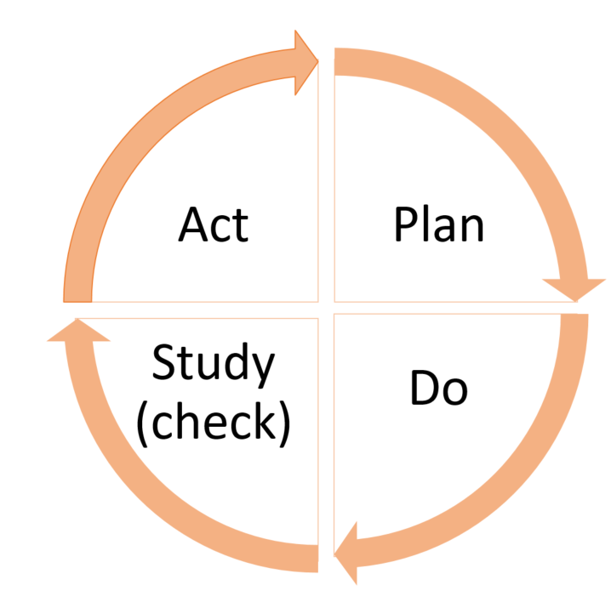
Based on the data and pupil voice you can see whether this has been successful and can be adopted or if a new theory can be tested.
Observational/statistical interpretation of data
Example continued:
You introduce some new texts to the class library/resources and you will track reading engagement with all pupils (with particular interest in the males) over the next 2 months.
Model for Improvement
Notes:
Key Messages
Continued from previous slide.
Each bullet will come in one at a time.
Observation data is key to test of changes like these as it can tell you to adapt or abandon during the cycle.
Has this change had an impact on any other groups of interest (positive or negative) as a result?
This example mentions the plan do study act approach – this will be covered again in workshop 6.

Slide 26

Local examples of data – tables, charts, graphs
This slide is a place holder for facilitators to consider adding in any local authority examples of data.
This slide can be added to or removed as appropriate.
Notes:
Key Messages
It may be helpful for facilitators to insert local examples of commonly used data, presented in the ways in which practitioners would be expected to read and analyse.
This would provide participants with an opportunity to review and check their understanding of how to read the data that they may access through the local authority if this is additional to / different from national data examples.

Slide 27
Analysing attainment data - summary
Look for attainment ‘gaps’ in subjects, cohorts, across the whole school and/or within specific demographic groups.
Identify groups of learners who are working below expected standards and highlight those who are showing particularly good progress.
Explore whether common trends or patterns are present within your school.
Consider progress against local and national comparators and use this information when considering expectations, target setting or collaborating with other schools/settings.
Identify a starting point for understanding ‘why’ a pattern, trend or a gap exists.

Slide 28
Making data comparisons
Why?
to self-evaluate
to make better informed decisions
What do we compare?
What are the benefits?
supports moderation process and encourages reflection
to identify trends, similarities and differences
to improve standards
stage partners within our own school
local authority comparator schools
national comparator schools
to support the interrogation, interpretation and analysis of data for improvement
previous cohorts
highlights best practice
can encourage collaboration across settings
can encourage further exploration
year on year data
Notes:
Key Messages
Using comparator data can help to support the interrogation, interpretation and analysis of data for improvement.
It can form part of the range of data and information to understand the social, economic and cultural context of the local community.
Using comparator data can help educators to consider their attainment or achievement against schools from a similar context. This may support schools to:
ask questions about levels of attainment, achievement and progress,
reflect on expectations in relation to learner outcomes, and
collaborate with similar schools to improve outcomes
Reflective questions
How are educators/participants using comparator data in their schools or settings?

Slide 29
Using nationally available comparator data
Attainment data can be compared against national or local authority data sets.
There are nationally available improvement tools, such as the BGE Benchmarking tool or Insight which have been created to support schools to make comparisons out with their own establishment.
In these tools a virtual comparator is created using learners from others schools with similar characteristics e.g. SIMD, ASN, Gender.
Virtual comparator values are included to provide context for the data.
  A virtual comparator is a sample group of pupils from other parts of Scotland who have similar characteristics to the young people in the school (e.g. matched on gender, additional support needs, stage and the social context in which they live).
Notes:
Key messages
Attainment data can be compared against national or local authority data sets.
Some nationally available improvement tools, such as the BGE Benchmarking tool or Insight, also allow for comparisons to be made against comparator schools or virtual comparators. The characteristics used for virtual comparators may differ slightly across improvement tools. For example, the BGE Benchmarking tool includes Free School Meal Entitlement but Insight does not.
Virtual comparator values are included to provide context for the data.
The virtual comparator is the standard benchmarking measure provided to schools.
The virtual comparator is a sample group of pupils from other parts of Scotland who have similar characteristics to the young people in the school (matched on gender, additional support needs, stage and the social context in which they live).
Important to note - Insight and BGE Toolkit use a different characteristics for the VC.
Reflective questions
Are participants and school staff familiar with nationally available data sets and virtual comparators?
If relevant, virtual comparator tools can be accessed through the following links: BGE Benchmarking tool for the BGE benchmarking tool and Insight for Insight benchmarking tool.
BGE Benchmarking tool - A Scottish Government toolkit which enables headteachers and local authority officers to consider school data in relation to national comparator schools. This is based on the impact of pupil characteristics including SIMD, Gender, FSM, Ethnicity, EAL, Gaelic Medium, Denomination and Urban/Rural. Access to this requires a password from the LA.
Insight - the benchmarking tool for analysing attainment data in the senior phase. Access to Insight requires an individual username and password.

Slide 30
Comparator data within and across schools and settings
Comparisons can also be made within settings and across settings in order to: support self-evaluation, improve standards, support the interrogation, interpretation and analysis of data.
Data can be used to compare cohorts and attainment and progress over time.
Comparisons can also be made with stage partners within schools and departments, as part of moderation processes, and also with other local authority groupings.
Notes:
Key messages
Importantly, comparisons can be made within schools and settings and across schools and settings to: support self-evaluation, improve standards, support the interrogation, interpretation and analysis of data.
Data can be used in schools to compare cohorts and attainment and progress over time.
Comparisons can also be made with stage partners within schools, as part of moderation processes, and also with cluster and local authority comparator schools.

Slide 31
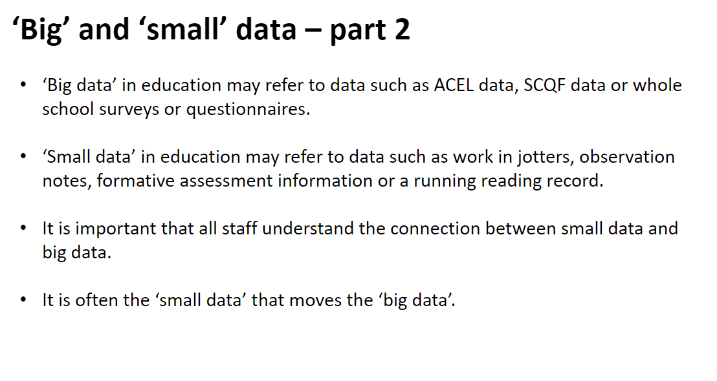
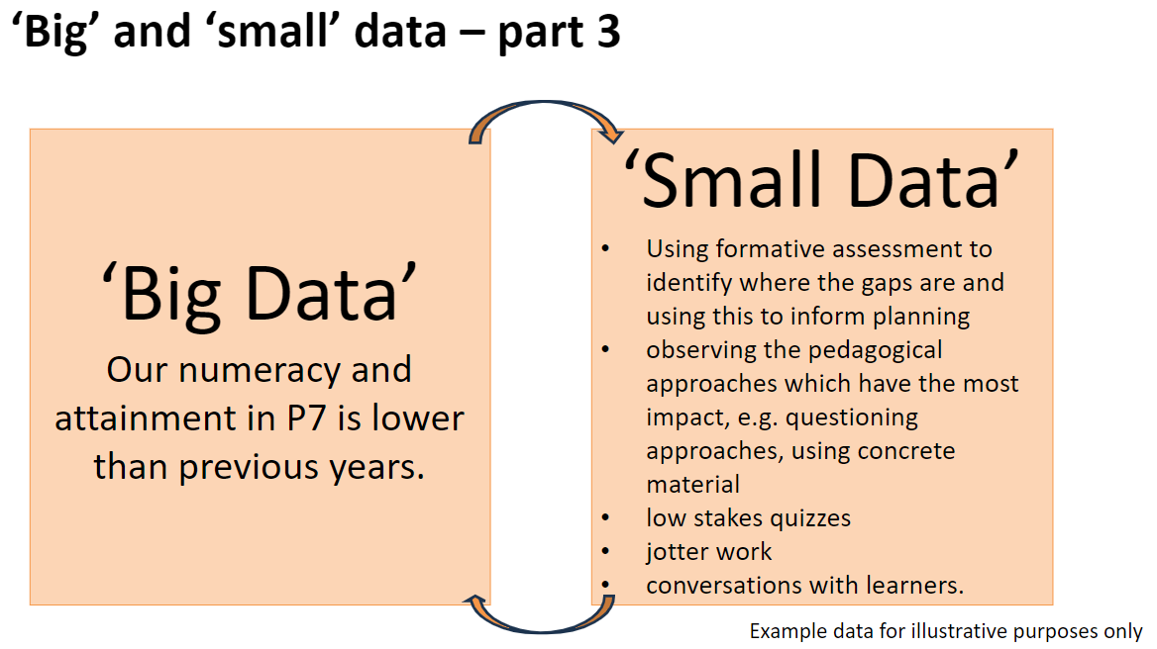
Comparator data within and across schools and settings -part 2
Comparisons can also be made between big data and small data, as outlined in workshop 1
This may involve practitioners exploring whether whole school patterns, trends and gaps are reflected in class level data.
Notes:
Key messages
Comparisons can also be made between big and small data.
Facilitators may wish to recap on key messages from workshop 2 around big and small data.
Reflective questions
Do we make comparisons between big and small data?

Slide 32
Reflect
What do you compare when analysing data to review the progress of learners?
How does this inform our teacher professional judgements?
How confident do you feel when using comparator data?
Notes:
Key Messages
An opportunity for participants to stop and reflect on how they use comparator data.
Talking Points
Facilitators may wish to draw out the range of confidence levels in using comparator data. They may also wish to draw out the types of comparator data that could be used for supporting the analysis and interpretation of data.

Slide 33
Aims Review
In this workshop we will consider:
national guidance and research including signposting to national data sets
questions to explore when analysing and interpreting data
the use of comparator data, and
how to use a data analysis to inform next steps.
Notes:
Key Messages
This slide shows the aims of the session to be shared with participants.

Slide 34

Reflection Activity
TASK
How confident do we feel effectively analysing data?
What key messages or actions have you taken from the workshop?
What might you do differently in school?
Notes:
Reflective Questions
A final reflective task. Ask participants to consider the question and then feedback into the room.

Slide 35

Feedback
Insert you own evaluation code here
Notes:
You can insert your own feedback link here.
Thank-you. We hope that you found this resource useful.
Please provide feedback on the materials here https://forms.office.com/e/viKTsvQj9d
Your comments are appreciated and will be used to inform future resources.
This link should not be shared with the audience.

