Slide 1


Effective use of data
3. Creating effective processes and systems
Senior and middle leaders
Notes:
All information is correct as of May 2024.
These slides are intended to support senior leaders, middle leaders and practitioners in schools and local authorities to explore the effective use of data for improvement. This is the third of a set of six workshops available for senior leaders and middle leaders. The workshops were co-designed with educators from across Scotland and are based on an Education Scotland literature review: The Effective use of data for improvement in education.
Establishing the purpose and use of data
Defining and classifying data
Creating effective processes and systems
Interpreting and analysing data
Developing a data informed culture
Using data for improvement
(hyperlinks for each workshop can be found on the next slide)
The PowerPoint is a template that presenters can adapt to suit their own context and style of presenting.
The workshops can be delivered individually or grouped together and delivered in a longer session. Individual workshops have been designed for facilitators to deliver in 1 to 2 hours.
Suggested timings for each workshop can be found on the content coverage slide.
Within the slide notes key messages, suggested tasks, ‘talking-points’ and reflective questions are included.
It is anticipated the presenter will have read the Education Scotland literature review: The Effective use of data for improvement in education.

Slide 2
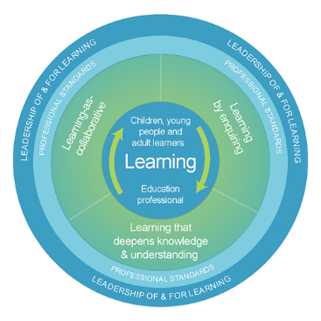

The national model of professional learning
The national model of professional learning | Professional Learning | Education Scotland
Notes:
Key Messages
This module has been designed using the national model of professional learning and the principles of adult learning or andragogy. It has been designed to think about:
The why – opportunities for participants to understand the rationale through professional standards, research, current policy landscape and national/local priorities
The what – opportunities for participants to consolidate and develop relevant knowledge and skills
The how – opportunities for participants to take part in peer discussion, explore case studies or share experiences
Apply – a chance to reflect on learning, next steps and further support
A link to further information about the national model of professional learning can be found below.
edscot-model-of-professional-learning-outline.pdf (education.gov.scot)

Slide 3

Draft Group Agreement and Protocols
Work together
Learn from, with, and on behalf of each other
Create a safe space to share ideas and build learning
Agree that everyone is an equal and valued participant
Remain in the room (emails and phone protocol).
Notes:
Key messages
Take a moment to establish group protocols.
Ask participants to check and comment on anything they would like to add or amend.
The protocols on the slide are suggestions and may be amended for your school context.

Slide 4

Connector
In groups/pairs:
Share the grown-up job you thought you wanted to do when you were a child.
TASK
Notes:
Key Messages
This is an example of a simple connecter activity. It is recommended that facilitators use a connector activity that allows participants to take part in an informal discussion.
This is to ensure that participants are relaxed, focused and ready for an interactive workshop.

Slide 5

Aims
In this workshop we will consider:
the importance of effective data processes and systems
what we mean by data processes and systems
how to ensure data processes and systems are effective; and
approaches to data processes and systems within different scenarios.
Notes:
Key Messages
This slide contains the aims of the workshop to share with participants.

Slide 6
Content coverage
National guidance and research
Defining data processes
Effective data processes
Data systems
Scenarios activity
Reflection and feedback
Notes:
Key Messages
This slide shows the content covered throughout the workshop. Further details and suggested timings are provided below. Facilitators can amend content and timings to suit their needs and context.
National guidance and research – allow 10 mins for this section. It can be extended to 15-20 mins if facilitators wish to provide time for participants to read and discuss the relevant section of the evidence review.
Defining data processes – this section contains information on what we mean by data processes and an activity to support participants to reflect on the effectiveness of processes they have in school. Allow 30 minutes for this section. The activity should be approximately 5 mins individual reflection, 10 mins discussion and then 5 mins feedback.
Effective data processes – allow 5-10 mins for this section.
Data systems – allow 5-10 mins for this section
Scenarios activity – this is an activity that allows participants time to share approaches to data systems and processes within fictional scenarios. Allow 30 mins for the activity.
Reflection and feedback – allow 5-10 mins for this section
It is expected that the workshop will take between 1 hour 30 minutes and 1 hour 45 minutes.

Slide 7

Re-cap
In workshop 1 we looked at the purpose and use of data including: the meaning of data and evidence, the ways in which data is used and what we mean by ‘big’ and ‘small’ data.
In workshop 2 we considered different categories of data and how these may be intersected to support improvement.
Notes:
Key Messages
This slide offers a brief recap of content covered in previous workshops.

Slide 8
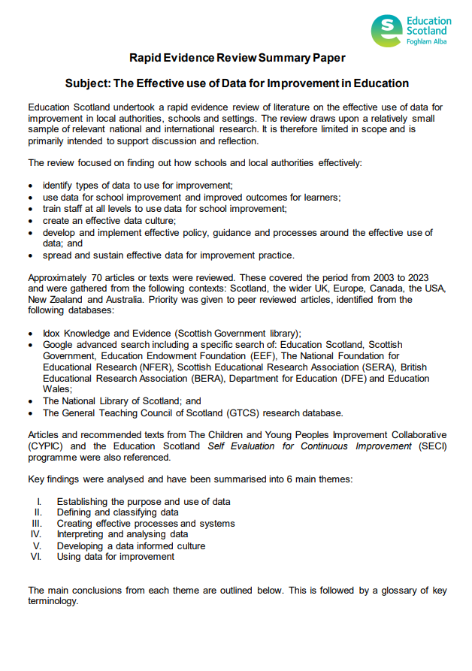

Rapid Evidence Review Paper
Section three of the Education Scotland Rapid Evidence Review on creating effective processes and systems highlights that:
It is important to be clear which data to gather, how this collected and by whom.
Data must be accurate, and procedures should be built in to allow data to be regularly checked and updated.
Consideration must be given to how data collection or the ‘data cycle’ fits into the improvement cycle.
Tracking systems should be intuitive and minimise workload, but sophisticated enough to allow educators to explore patterns, trends and understand needs.
Notes:
Key Messages
Section three of the rapid evidence review on creating effective processes and systems highlights that:
It is important to be clear which data to gather, how this is collected and by whom.
Data must be accurate, and procedures should be built in to allow data to be regularly checked and updated.
Consideration must be given to how data collection or the ‘data cycle’ fits into the improvement cycle.
Tracking systems should be intuitive and minimise workload, but sophisticated enough to allow educators to explore patterns, trends and understand needs.
The Effective use of data for improvement in education
Talking Points
This may be a good point to ask participants to read section three on establishing the purpose and use of data.
Reflective Questions
What data processes and systems are in place within you setting?

Slide 9
GTCS Standard for Middle Leadership
Self-evaluation
3.4.4 undertake regular and systematic review of a range of processes which enable colleagues to contribute to the overall monitoring and review of change through the improvement planning cycle.
Standard for Middle Leadership
Notes:
Key messages
The GTCS standard for middle leadership highlight the importance of undertaking a systematic review of a range of processes which enable colleagues to contribute to the overall monitoring and review of change thought the improvement planning cycle.

Slide 10
GTCS Standard for Headship
Self-evaluation
3.4.4 establish, sustain and review a range of strategic processes which enable colleagues to contribute to the overall monitoring and review of change through the improvement planning cycle.
The Standard for Headship
Notes:
Key messages
The GTCS standard for headship is like the standard for middle leaders. It highlights the importance establishing sustaining and reviewing a range of strategic processes which enable colleagues to contribute to the overall monitoring and review of change through the improvement planning cycle.
Both standards highlight the importance of processes in school improvement.
The development of processes to support the effective use of data are an important factor in ensuring that data and evidenced can be accessed and used effectively by all stakeholders as appropriate.

Slide 11

How good is our school? (4th Edition)
Challenge questions:
How well do we use digital solutions to support the interrogation of data? (1.1)
What range of data and information do we utilise to understand the social, economic and cultural context of the local community? (1.3)
To what extent are our tools for change impacting positively on staff and improving outcomes for all learners? (1.3)
Notes:
Key Messages
HGIOS4 offers some challenge questions that can be linked to data processes.
Talking Points
Facilitators may wish to draw out the way in which participants do use digital solutions and the impact of these tools on the effective use of data in school.

Slide 12
What are data processes?
"The carrying out of operations on data, especially by a computer, to retrieve, transform, or classify information"
Oxford Dictionary
Notes:
Key Messages
Processing is about collection and organisation.
The Oxford languages dictionary describes it as ‘the carrying out of operations on data, especially by a computer, to retrieve, transform, or classify information’.
Talking Points
Facilitators may wish to draw out that data processes are often but not always digital/by computer and share some digital (SEEMIS) and non digital (writing jotters, running reading records) examples.

Slide 13
What do we mean by data processes?
Assessment data: Gathering information from tests, quizzes, and other assessments to evaluate learner's understanding and progress in specific subjects or skills.
Census data: Inputting demographic learner information used to understand the progress and achievement of groups and individuals.
Attendance records: Tracking learner's attendance to monitor regularity and identify potential issues with engagement, lateness or absence.
Grading systems: Recording grades used to assess and analyse learner's achievement and inform instructional decisions.
Notes:
Key messages
There are some examples of data processes on the screen to read through and discuss.
The words in bold are highlighted as key actions involved in data processing – gathering, inputting, tracking, monitoring, recording.
Reflective questions
What types of data processes are there in your setting? What systems do you use for tracking and collecting data?

Slide 14
LOVE THE PROCESS AND YOU’LL LOVE WHAT THE PROCESS PRODUCES
Jon Gordon
Notes:
Key Messages
This quote is included for participants to reflect on the important place of processes in data for improvement.
Without effective processes it is difficult to collect, analyse and use data.
Jon Gordon is a best selling author

Slide 15

Reflecting on data processes
Identify three or four different data processes that you have in school.
How would you rate their effectiveness on a scale of 0-5 and why?
Process | Rating | Reason
Notes:
Key messages
This is a task. Participants should think of three or four different data processes in school. Ask them to note the process and give each a success rating from 0-5. They should then briefly note down the reasons for this rating.
Facilitators may wish to complete a brief table for participants to complete during this activity or ask participants to jot their responses down on paper/laptops.
Participants can begin by doing this individually and then share and discuss with a partner or small group.
Feedback can then be taken by the facilitator.
Talking Points
Facilitators may wish to draw out those processes that were effective/less effective and look for commonality in the reasons for this.
Facilitators may find common themes such as consistency of application, staff clarity or providing appropriate levels of training.

Slide 16
Developing effective data processes
Before gathering data, it is important to consider why we need the information. It may help to ask:
  What impact do we want the data to have?
  How do we want to use the data?
  Do we already collect this data in a way that we could easily use or adapt?
Understanding ‘why’ will help educators to develop appropriate data processes and reduce the risk of collecting data without a clear purpose.
Notes:
Key Messages
The messages on this slide focus on things participants may consider to ensure processes are effective.
Before gathering data, it is important to consider why we need the information. It may help to ask:
What impact do we want the data to have?
How do we want to use the data?
Do we already collect this data in a way that we could easily use or adapt?
Understanding ‘why’ will help educators to develop tailored and meaningful data processes and reduce the risk of collecting data without a clear purpose.
Reflective Questions
Have you ever been overwhelmed by the amount of data / data processes?
Is everyone in school always clear about the reasons for a process?
Does everyone understand why data is being collected?
Do we ensure to use existing systems where possible to reduce bureaucracy / for ease of adoption?

Slide 17
Developing effective data processes – part 2
It is important to consider who will be gathering the data and how the data will be stored.
It may help to think about who will need access to the data, how often it will need to be collected and whether data needs to be recorded in a consistent way to support analysis.
It is important to consider the accuracy of data. For example, it is difficult to analyse attainment data by demographic information if the information is incomplete or inaccurate.
Notes:
Key Messages
The messages on this slide continue to support participants to consider how to develop effective data processes.
It is important to consider who will be gathering the data and how the data will be stored. Data should be stored in accordance with GDPR.
It may help to think about who will need access to the data, how often it will need to be collected and whether data needs to be recorded in a consistent way to support analysis.
It is important to consider the accuracy of data. For example, it is difficult to analyse attainment data by demographic information if the information is incomplete or inaccurate.
Talking Points
Facilitators may which to take time to draw out some thoughts from participants around who is involved in data gathering and the risks of limiting access to data (absence / member of staff moves on).
Facilitators may wish to highlight the need for consistency in recording and when this may be most important for example, attendance coding.
Facilitators may wish to draw out the importance of having accurate data and ask participants to share how they ‘cleanse’ (check) their data is accurate.

Slide 18
A BAD SYSTEM WILL BEAT A GOOD PERSON EVERY TIME
W E Deming
Notes:
Key Messages
Systems, as well as processes, are important to ensure data can be used effectively.
W Edwards Deming was a quality improvement scientist who believed that a bad system would beat a good person every time.
Reflective Questions
How often do we consider our processes and systems and their specific influence on the effective use of data?

Slide 19
Data systems
A system is a set of things working together as parts of a mechanism or an interconnecting network; a complex whole.
A system is made up of people, processes and resources. In education there are many different data systems.
Whole school examples might include tracking and monitoring of whole school attainment, attendance or wider achievement.
At a classroom level, data systems might include tracking and monitoring interventions, tracking individual progress in a subject through a level or completing and analysing a class health and wellbeing survey.
Notes:
Key Messages
A system is a set of things working together as parts of a mechanism or an interconnecting network; a complex whole.
A system is made up of people, processes and resources. In education there are many different data systems.
Whole school examples might include tracking and monitoring of whole school attainment, attendance or wider achievement.
At a classroom level, data systems might include tracking and monitoring interventions, tracking individual progress in a subject through a level or completing and analysing a class health and wellbeing survey.

Slide 20
Data systems - part 2
A system may also refer to a specific database into which information is entered or a tool that supports data insight or analysis.
There are many different databases used by schools and local authorities to manage data.
INSIGHT is an example of system tool that is used across Scotland to analyse pupil attainment through the senior phase.
The Scottish Index of Multiple Deprivation (SIMD) is a national tool that provides information on geographical areas of least and most deprivation across Scotland.
Notes:
Key Messages
A system may also refer to a specific database into which information is entered or a tool that supports data insight or analysis.
There are many different databases used by schools and local authorities to manage data.
INSIGHT is an example of system tool that is used across Scotland to analyse pupil attainment through the senior phase.
The Scottish Index of Multiple Deprivation (SIMD) is a national tool that provides information on geographical areas of least and most deprivation across Scotland.

Slide 21
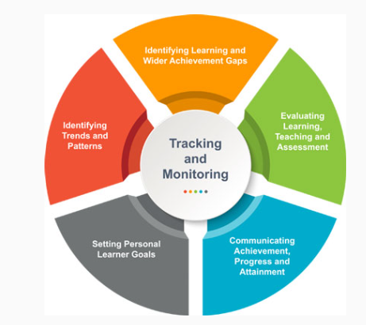

Effective tracking and monitoring systems
Education Scotland have developed a resource to support schools in developing effective tracking and monitoring systems.
The link can be accessed through the QR code.
Resources to support effective tracking and monitoring | Resources | Education Scotland
Notes:
Key Messages
This is a link to a resource Education Scotland have developed to support schools in developing effective tracking and monitoring systems.
Resources to support effective tracking and monitoring | Resources | Education Scotland

Slide 22
Scenarios Activity
Pick one of the scenarios below and discuss in your groups:
I am a principal teacher of guidance. I need to monitor my allocated pupil data. How can I effectively collect, process and analyse data about health and wellbeing, academic performance and attendance?
I am a depute headteacher. I need to collect and analyse data to see if our S4 attainment is on track. How can I do this effectively?
I am a principal teacher. I need to collect and analyse data regarding the performance of pupils in my secondary department or for literacy/numeracy attainment across my primary school. How can I do this effectively?
I am a headteacher. I need to collect and analyse attendance data to understand the reasons our data is below our local and national comparator. How can I do this effectively?
Notes:
Key Messages
This is an activity to support leaders to think about the processes and systems they would need to put in place for these scenarios. This can be carried out in small groups or pairs. Allow 15 mins per scenario. Participants may do one and feedback to another group/the room.
It may help to provide a frame or questions to scaffold their discussion. For example:
What data will you need to collect?
What processes need to be put in place and why?
Who will be responsible for collecting/analysing the data?
How can you ensure everyone involved is clear about their role in the process?
How will you ensure your data is accurate?

Slide 23
Aims review
In this workshop we will consider:
the importance of effective data processes and systems
what we mean by data processes and systems
how to ensure data processes and systems are effective; and
approaches to data processes and systems within different scenarios.
Notes:
Key Messages
This slide contains the aims of the workshop to reflect back on at the end of the session.

Slide 24


Individual Reflection
Think about the things we have covered today.
Why are data processes and systems important?
Are there any actions you can take in your school or setting to make your data processes and systems more effective?
Notes:
Key Messages
This is a reflection activity. Participants can be encouraged to reflect on learning, future actions and next steps in their school or setting.

Slide 25

Feedback
Insert you own evaluation code here
Notes:
You can insert your own feedback link here.
Thank-you. We hope that you found this resource useful.
Please provide feedback on the materials here https://forms.office.com/e/viKTsvQj9d
Your comments are appreciated and will be used to inform future resources.
This link should not be shared with the audience.

