Slide 1


Effective use of data
1. Establishing the purpose and use of data
Senior and middle leaders
Notes:
All information is correct as of May 2024
These slides are intended to support senior leaders, middle leaders and practitioners in schools and local authorities to explore the effective use of data for improvement. This is the first of a set of six workshops available for senior leaders and middle leaders. The workshops were co-designed with educators from across Scotland and are based on an Education Scotland literature review: The Effective use of data for improvement in education.
Establishing the purpose and use of data
Defining and classifying data
Creating effective processes and systems
Interpreting and analysing data
Developing a data informed culture
Using data for improvement
The PowerPoint is a template that presenters can adapt to suit their own context and style of presenting.
The workshops can be delivered individually or grouped together and delivered in a longer session. Individual workshops have been designed for facilitators to deliver in 1 to 2 hours.
Suggested timings for each workshop can be found on the content coverage slide 6.
Within the slide notes key messages, suggested tasks, ‘talking-points’ and reflective questions are included.
It is anticipated the presenter will have read the Education Scotland literature review: The Effective use of data for improvement in education.

Slide 2
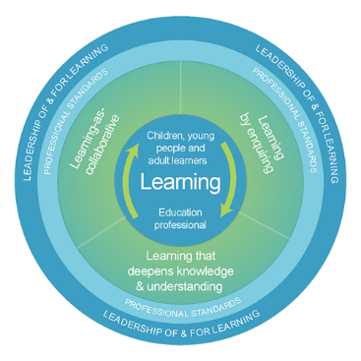

The national model of professional learning
The national model of professional learning | Professional Learning | Education Scotland
Notes:
Key Messages
This module has been designed using the national model of professional learning and the principles of adult learning or andragogy. It has been designed to think about:
The why – opportunities for participants to understand the rationale through professional standards, research, current policy landscape and national/local priorities.
The what – opportunities for participants to consolidate and develop relevant knowledge and skills
The how – opportunities for participants to take part in peer discussion, explore case studies or share experiences
Apply – a chance to reflect on learning, next steps and further support
A link to further information about the national model of professional learning can be found below.
edscot-model-of-professional-learning-outline.pdf (education.gov.scot)

Slide 3

Draft agreement and protocols
We all work together
We learn from, with and on behalf of each other
We create a safe space to share ideas and build learning
We agree that everyone is an equal and valued participant
We remain ‘in the room’ (follow email and phone protocol)
Notes:
Key Messages
Take a moment to establish group protocols.
Ask participants to comment on anything they would like to add or amend.
Is there anything that participants feel is missing or anything they would like to remove?
The protocols on the slide are suggestions to be amended for your context.

Slide 4

Connector
In groups or pairs:
Agree on something you like.
Agree on something you dislike.
TASK
Notes:
Key Messages
This is an example of a simple connecter activity. It is recommended that facilitators use a connector activity that allows participants to take part in an informal discussion.
This is to ensure that participants are relaxed, focused and ready for an interactive workshop.

Slide 5

Aims
In this workshop we will consider:
the meaning of data and evidence in education
what guidance and research says about the importance of data and evidence
the role of data in closing the poverty related attainment gap; and
the difference between ‘big’ and ‘small’ data.
Notes:
Key Messages
These are the aims of the workshop which will support participants to consider:
The meaning of data and evidence in education
What guidance and research says about the importance of data and evidence
The role of data in closing the poverty related attainment gap

Slide 6
Content coverage
Data definitions and the importance of using data for improvement
National guidance and research
The purpose of using data
Data and equity
Big and small data
Data bias
Group activity
Notes:
Key Messages
This slide shows the content covered throughout the workshop. Further details and suggested timings are provided below. Facilitators can amend content and timings to suit their needs and context.
Data definitions and the importance of using data for improvement – allow 10-15 minutes for this section which includes a 5–10-minute discussion task.
National guidance and research – allow 10 minutes for this section. It can be extended to 15-20 minutes if facilitators wish to include an extra activity that allows participants to read the relevant section of the national evidence review.
The purpose of using data – allow 5 minutes for this section
Data and equity – allow 5 minutes for this section.
Big and small data – allow 15-20 minutes for this section which includes an activity where participants are asked to read a short article and discuss.
Data bias – allow 5 minutes for this section
Group activity – allow 30-40 minutes for this activity including feedback and discussion from each group. The group activity provides an opportunity for participants to pull together and reflect on learning.
In total, this workshop can be expected to take between 1 hour 35 minutes and 2 hours to complete.

Slide 7

What is data?
"Data is information, especially facts or numbers, collected to be examined and considered and used to inform decision making."
Cambridge Dictionary
Quantitative data refers to data that deals with numbers and can be measured.
Qualitative data refers to data that deals with descriptions. It can be observed and recorded but not necessarily measured.
Notes:
Key Messages
Data is information, especially facts or numbers, collected to be examined and considered and used to inform decision making.
In education we often refer to data as quantitative or qualitative.
Quantitative data refers to data that deals with numbers and can be measured.
Qualitative data refers to data that deals with descriptions. It can be observed and recorded but not necessarily measured.
Reflective Questions
What types of data do you use in your school or setting?
Do you use quantitative and qualitative data? Do you use one more than another?

Slide 8

What is evidence?
"Evidence can be described as information used to demonstrate impact and support decision making. Evidence can be data, in many forms, and a knowledge base about what works."
Rapid Evidence Review
Notes:
Key Messages
Evidence can be described as information used to demonstrate impact and support decision making. Evidence can be data, in many forms, and also a ‘knowledge base about what works’.
A knowledge base can be drawn from a number of sources including research, shared practice and case studies.
Talking Points
Consider the difference between evidence and felt knowledge (felt knowledge refers to feelings or professional hunches). Why is evidence important?
Reflective questions
How do you form your ‘knowledge base about what works’ in your school or setting?
How effectively do you use a range of evidence to demonstrate impact?

Slide 9
The importance of data
Which of these quotes resonate with you and why?
TASK
1. Too many schools are not using data effectively to track and monitor at a whole school level. As a result, some schools cannot put in place appropriate strategies or interventions to address gaps. (Addressing the Poverty Related Attainment Gap, Education Scotland, 2018-20).
2. Without data you are just another person with an opinion. (W. Edward Deming)
3. The goal is to turn data into information, and information into insight. (Carly Fiorina, former CEO, HP)
4. Data use provides a lever for school improvement, but if the process isn’t implemented effectively it won’t deliver. (Datnow and Park, ‘Data use for Equity’, Educational Leadership, 2015.)
5. Using data is not separate from planning and from routine decisions in schools. Data is a necessary part of an ongoing process of analysis, insight, new learning and changes in practice. (Lorna M Earl and Steven Katz, 2009)
Notes:
Task
This is a task. Participants can read the quotes and consider which resonate with them and why?
Talking Points
Participants can discuss with a partner or reflect individually and feedback into the room. The facilitator can take feedback and discuss with the group. The facilitator may wish to draw out:
The importance of the effective use of whole school data to inform improvement planning and identify gaps (quote 1)
The role of data in providing evidence for improvement (quote 2)
Data as an important first step, or a ‘line of enquiry’ from which educators can gain understanding and clarity (quote 3)
The importance of the ‘what’. Once data has been used to identify a pattern or trend, it relies on next steps/action for improvement (quote 4)
The need for data to be embedded throughout every stage of school improvement. For it to become regular and routine (quote 5)

Slide 10
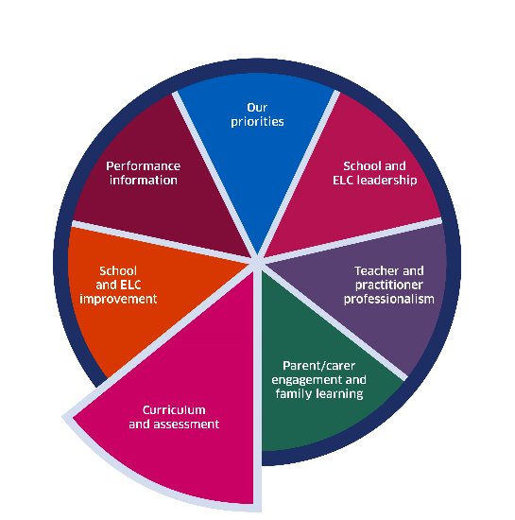
The National Improvement Framework
Where progress is good or better, senior leaders and staff track children’s and young people’s progress carefully.
They use assessment information and data effectively to understand the progress children and young people make.
Achieving Excellence and Equity - 2024 National Improvement Framework and Improvement Plan (www.gov.scot)
Notes:
Key Messages
The National Improvement Framework highlights that the most effective schools use data to carefully track progress and use assessment information to understand the progress children and young people make.
Reflective Questions
How effectively do you use data to understand progress in school? How is this done and who is involved?

Slide 11
GTCS Standard for Middle Leadership
Professional responsibilities
2.2.3 know how and when to make decisions and use a wide range of robust and credible data to support and inform your judgements
Self-evaluation
3.4.2 develop and sustain the effective use of a wide range of robust and credible information to support and inform decisions and improvements across the school and learning community in line with agreed strategic and operational priorities
Standard for Middle Leadership
Notes:
Key messages
The GTCS Standard for Middle Leadership also indicates the importance of the use of data in self-evaluation, as shown here. (Allow time for reading).
The focus is similar as the standards for head teachers but with a clear emphasis on the role of middle leaders in influencing practice.
Talking Points
Facilitators may wish to draw out from head teachers how effectively their middle leads are using data to shape practice and what opportunities they are providing for them to do this.
Facilitators working with middle leaders may wish to ask them to consider the vital role they have in school of using data to inform practice and support colleagues to identify priorities and improve outcomes.

Slide 12
GTCS Standards for Headship
Professional responsibilities
2.2.3 know how and when to make decisions and use a wide range of robust and credible data to support and inform your judgements;
Self-evaluation
3.4.2 develop and sustain the effective use of a wide range of robust and credible information to support and inform decisions and improvements across the school and learning community in line with agreed strategic and operational priorities
The Standard for Headship
Notes:
Key Messages
The General Teaching Council for Scotland highlights the importance of data within the head teacher standards on self-evaluation.
The focus is on using data and evidence to:
Create opportunities for educators, learners and the wider community to engage with data and evidence,
Inform and review change through the improvement planning cycle.
Reflective Questions
What role does data play throughout the planning, implementation and self-evaluation cycle of improvement?

Slide 13
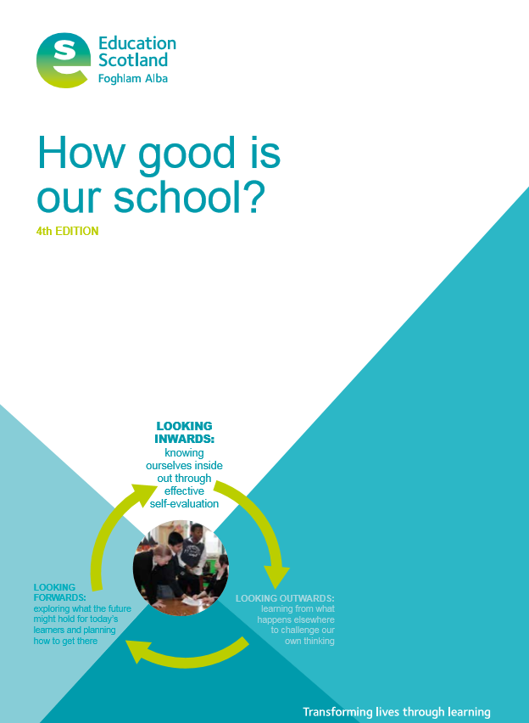
HGIOS 4
We gather a range of data and information to monitor and track progress for all learners (1.1)
We regularly interrogate data (1.1)
Staff make effective use of current available data on levels of child poverty and apply this to ensure equity (1.5)
All teachers have well-developed skills of data analysis (2.3)
Notes:
Key Messages
The image of How Good is our school can be replaced with other HGIO publications.
How Good is Our School 4 describes the ways in which schools may use data effectively for improvement. This includes:
Gathering data to monitor and track progress
Regular interrogation of data
Making effective use of data on child poverty to ensure equity, and
Ensuring that all teachers have well developed skills of data analysis
Reflective Questions
How confident are staff in school in the effective use of data?
Are leaders' ‘gatekeeping’ data in school or is data shared and used by everyone?

Slide 14
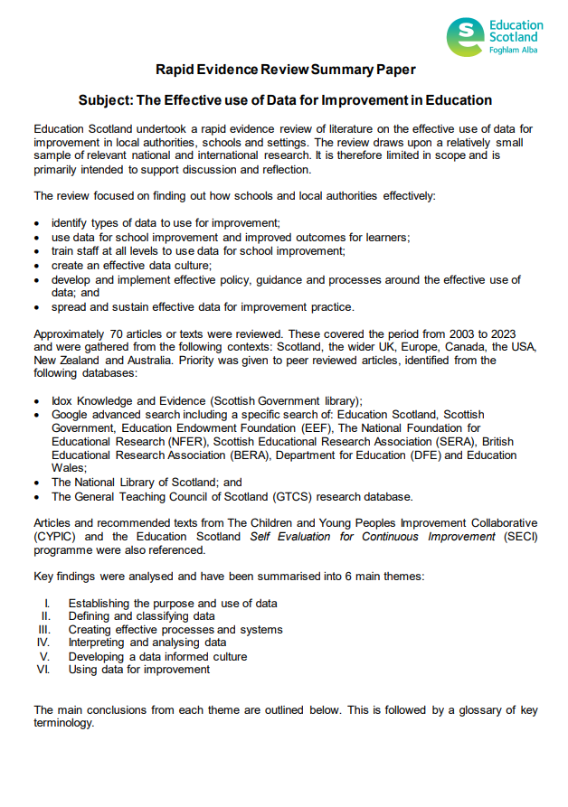

Rapid Evidence Review Paper
Section one of the Education Scotland Rapid Evidence Review on establishing the purpose and use of data highlights that:
data and evidence should be used continuously and for a range of purposes throughout each stage of a school improvement cycle
educators should be clear about the link between ‘big’ and ‘small’ data
data is ‘everyone's responsibility’, and
educators should be aware of the strengths, limitations and potential bias of data.
Notes:
Key Messages
Section one of the rapid evidence review on establishing the purpose and use of data highlights that:
data and evidence is used continuously and for a range of purposes throughout each stage of a school improvement cycle
educators should be clear about the link between ‘big’ and ‘small’ data
data is ‘everyone's responsibility’, and
educators should be aware of the strengths, limitations and potential bias of data .
The Effective use of data for improvement in education
Talking Points
This may be a good point to ask participants to read section one on establishing the purpose and use of data and discuss in small groups or pairs.
Reflective Questions
How do you use data in school? How do different staff view data and why might this be?

Slide 15
The purpose of data
To identify next steps
To measure the impact of interventions and approaches
To understand progress or otherwise
To inform planning
To diagnose needs
Data is used to understand ‘why’ learners have specific gaps.
Planning for improvement is data informed. The data used is effective because it has been triangulated.
Data is used to track and monitor progress throughout the improvement cycle.
Data effectively informs next steps for learners and families.
Schools use data to evidence the impact of interventions and approaches.
Notes:
Key Messages
Data can have several purposes in schools including:
Diagnosing needs – using data to understand why learners have specific gaps.
To inform planning – Triangulated data is used to inform improvement planning. Triangulating data refers to a process of utilising several different sources of information to draw the same conclusion.
To understand progress or otherwise – data should be used to track and monitor progress throughout an improvement cycle. Measures should be built into the planning process.
To identify next steps – data is used to inform next steps for learners and families.
To measure the impact of interventions and approaches – data should be used to track and monitor the impact of specific interventions or approaches introduced to close gaps.
Reflective Question
Do participants use data for any other / different purposes?

Slide 16

The purpose of data – part 2
To diagnose needs
To inform planning
To understand progress or otherwise
To identify next steps
To measure the impact of interventions
and approaches
Consider how effectively staff use data in school for a range of purposes. Discuss in groups or pairs.
Notes:
Key Messages
This is a discussion tasks. Ask participants to consider how effectively staff use data in school for a range of purposes. Discuss in groups or pairs.

Slide 17

Data and equity
Features of highly effective practice include:
Effective use of a wide range of qualitative and quantitative data and evidence to understand the poverty-related attainment gap and the interconnections between additional support needs and poverty.
Interventions are effective because they are informed by robust analysis of data.
Scottish Attainment Challenge - Self-evaluation resource (education.gov.scot)
Notes:
Key Messages
Data plays an important role in closing gaps for learners including learners affected by poverty.
The Scottish Attainment Challenge - Self-evaluation resource (education.gov.scot) highlights features of effective practice including:
Effective use of a wide range of qualitative and quantitative data and evidence to understand the poverty-related attainment gap and the interconnections between additional support needs and poverty.
Interventions are effective because they are informed by robust analysis of data.

Slide 18

Data and Equity – Stretch Aims
…set high expectations, including annual, ambitious locally identified stretch aims, to help ensure significant progress is made…
…through local stretch aims, drive improved outcomes for children and young people impacted by poverty in the local authority.
The Scottish Attainment Challenge: Framework for Recovery and Accelerating Progress (www.gov.scot)
Notes:
Key Messages
The Framework for Recovery and Accelerating progress sets out an expectation for local authorities to use data to set stretch aims.
This is about setting high expectations to help ensure significant progress is made towards recovery from C-19 and closing the poverty related gap
It is expected that local authorities and schools use local stretch aims to drive improvement.
It is important that all staff are aware of stretch aims and their role in helping to achieve them – improvement happens and is supported most effectively by those working closest to/with learners and their families.
Reflective Questions
How are you using stretch aims in school?
Are all staff aware of the school stretch aims and their role in helping to achieve them?

Slide 19


‘Big’ and ‘small’ data
Read the blog post by Pasi Salberg and consider:
What do we mean by big and small data?
What are the strengths/limitations of big and small data?
Big Data or Small Data: What’s the key to unlocking learning opportunities? | Pasi SahlbergPasi Sahlberg
Notes:
Key Messages
This is a task. It can be helpful to think of data as ‘big’ or ‘small’. Read the short blog by Pasi Salberg and consider the following questions:
What do we mean by big and small data?
What are the strengths/limitations of big and small data?
Talking Points
The facilitator may wish to draw out the following points:
‘Big’ data as the ‘wider view’, whole school data. It can be quantitative such as ACEL, SCQF data or qualitative such as whole school surveys.
‘Small’ data as more localised and closer to the learner. For example, observations, jotters, Afl, informal/smaller scale tests such as reading records or quizzes.
It is the link between small and big data that is important. ‘Small’ data helps us to understand the patterns and trends we see in the ‘big’ data.

Slide 20
‘Big’ and ‘Small’ Data – part 2
‘Big data’ in education may refer to data such as ACEL data, SCQF data or whole school surveys or questionnaires.
‘Small data’ in education may refer to data such as work in jotters, observation notes, AfL information or a running reading record.
It is important that all staff understand the connection between small data and big data.
It is often the ‘small data’ that moves the ‘big data’.
Notes:
Key Messages:
‘Big data’ in education may refer to data such as ACEL data, SCQF data or whole school surveys or questionnaires.
‘Small data’ in education may refer to data such as work in jotters, observation notes, AfL information or a running reading record.
It is important that all staff understand the connection between small data and big data.
It is often the ‘small data’ that moves the ‘big data’.
Thinking back to our ‘big data’ in the form of stretch aims or whole school improvement measures – the improvement will happen closest to the children and young people and will be informed by small data.

Slide 21
‘Big’ and ‘Small’ Data – part 3
‘Big Data’
There is a whole school attainment gap in writing.
Boys appear to be making less progress than girls.
‘Small Data’
How does the curriculum engage boys?
What are their perceptions of writing?
Looking at jotters and assessment for learning - what are the specific gaps?
Notes:
Key Messages
This diagram provides an example of the way in which big and small data are connected.
Imagine that the big data indicates that there is a whole school attainment gap in writing and boys appear to be making less progress than girls. Looking at the small data will provide detailed information on why that is the case and help educators to plan appropriate actions.

Slide 22
Bias
It is important to be aware of the potential bias in or limitations of data. What questions might you have about the example data below?
100% of girls in P4 achieved first level in writing.
95% of parents and carers said that their child was happy in school.
Attendance in S3 has increased by 2%.
Example data for illustrative purposes only
Notes:
Key Messages
This is a discussion task.
We often are presented with data but how often do we stop and consider the potential bias or limitations of what we are looking at?
What questions might you have if you were presented with the examples of the screen?
Talking points
The facilitator may wish to draw out:
How many girls were in P4? Statistical significance increases with the number of learners. Also, what was the attainment of boys like?
How many parents answered the survey? What do we mean by happy? Does other data such as pupil surveys, playground incident data triangulate with this?
What was the attendance of the S3 group? How are they comparing to local and national data? Which learners' attendance increased and in which time period/frame?

Slide 23
Group task
Record all the different types of data and evidence gathered in school.
Colour code or organise the data as either ‘big’ or ‘small’ data.
As a group, organise the data by effectiveness.
Add a key to show:
  which types of data is particularly helpful for closing attainment gaps?
  which types of data is used by teachers, school leaders, support staff, learners, families or partners?
Notes:
Key Messages
This is a task designed to allow participants to reflect on key messages from throughout this workshop. Participants should follow the steps below. It is recommended that facilitators allow at least 20 minutes for the task and 10 minutes for feedback.
On post it notes or using an online virtual tool, record all the different types of data and evidence gathered in school. Colour code it as either ‘big’ or ‘small’ data (two pen colours or two post it colours).
As a group, organise the data by effectiveness. Organise it in a way that suits the group – in a pyramid, in a table etc.
Add a key to show:
which types of data is particularly helpful for closing attainment gaps?
which types of data is used by teachers, school leaders, support staff, learners, families or partners?
Talking Points
During feedback facilitators may wish to explore:
The range of data in terms of whether it is qualitative or quantitative and whether there is more ‘big data’ or more ‘small data’.
Which types of data leaders find most effective and why?
What participants think of as an effective piece of data and why – what makes data effective?
Which types of data participants think is most helpful for closing attainment gaps.
The use of data across school – who is utilising different types of data? Is it different for different types e.g. ‘big’ and ‘small’.

Slide 24
Aims review
In this workshop we will consider:
the meaning of data and evidence in education
what guidance and research says about the importance of data and evidence
the role of data in closing the poverty related attainment gap; and
the difference between ‘big’ and ‘small’ data.
Notes:
Key Messages
Refer to the session aims. Have these been met?

Slide 25

Individual Reflection Activity
Think about the things we have covered today.
What ‘take-aways’ or key reflections do you have?
What actions might you take?
How might this impact practice in school?
Notes:
Key Messages
This is a reflection activity. Participants can be encouraged to reflect on learning, future actions and next steps in their school or setting.

Slide 26
Feedback
Insert you own evaluation code here
Notes:
You can insert your own feedback link here.
Thank-you. We hope that you found this resource useful.
Please provide feedback on the materials here https://forms.office.com/e/viKTsvQj9d
Your comments are appreciated and will be used to inform future resources.
This link should not be shared with the audience.

