Slide 1







Inclusion Wellbeing & Equalities Professional Learning Framework
Expectations and Consequences
Informed Level
@ESInclusionTeam
For Scotland's learners, with Scotland's educators
Do luchd-ionnsachaidh na h-Alba, le luchd-foghlaim Alba
Notes:
Purpose of these Slides
Read title​
This professional learning is pitched at an informed level and suitable for anyone working with children and young people in an educational context.
How to use the slides:
To be used to facilitate professional learning in a group or whole-setting, or as a self-directed learning activity as an individual.
General Guidance
There is a requirement to cover all the slides.
Please do not change the provided slides.
Facilitators are welcome to add slides or activities relevant to your own setting, to support discussion and exploration of the topic. Facilitators will know their participants’ needs best.
Anyone who works in an educational setting can be a facilitator and use these slides.
It is important to establish a safe space which encourages respect and honesty to ensure that everyone is able to participate.

Slide 2







Interconnectivity
Notes:
All of the professional learning in the Framework fits into one of these four themes. The four themes are interconnected and interdependent.​
This activity forms part of the professional learning in the Relationship theme.

Slide 3

How to use this resource
These slides can be used to facilitate professional learning in a group or
whole-setting, or as a self-directed learning activity as an individual.
Facilitation notes are included at the bottom of each slide.
Please do not remove or change any of the slides included.
Facilitators are welcome to add slides or activities relevant to your own setting, to support discussion and exploration of the topic. Facilitators will know their participants’ needs best.
Anyone who works in an educational setting can be a facilitator and use these slides.
For reflection or discussion activities, it is important to establish a safe space which encourages respect and honesty to ensure that everyone is able to participate.
Notes:
Option to skip slide as these are instructions for facilitators only. No need to read to audience.

Slide 4

National Model for Professional Learning
This professional learning resource will support you to deepen your knowledge and understanding.
You will have the opportunity to consider how to take this learning forward on your own and with others.
The National Model of Professional Learning (education.gov.scot)
Notes:
This professional learning forms part of the national model for professional learning and is designed to help you gain more knowledge and have a deeper understanding of inclusion, wellbeing and equalities​​
On completion of this professional learning, you will be asked to consider what your next steps will be​​.
Please take some time to consider the reflection questions at the end

Slide 5
Welcome
This session provides an opportunity to:
To revisit expectations, structures and boundaries
To consider the importance of values and language
To consider consequences – positive, natural and logical
To explore and reflect on the principles behind logical consequences
Notes:
Link activity to national model

Slide 6
Expectations, Structure & Boundaries:
are necessary to support emotional, psychological, and physical safety
are an expression of what is important to us (our values) and what we expect of ourselves and each other
provide points of reference for respectful interaction
can be explicitly linked to positive consequences that are a result of respecting them
Notes:
Expectations, structure and boundaries are necessary to support emotional, psychological, and physical safety. They provide points of reference for respectful interaction and are an expression of what is important to us and what we expect of ourselves and each other. Unlike rules which are directly linked to negative consequences if they are broken, expectations and boundaries can be explicitly linked to positive consequences that are a result of everyone in the learning community realising and respecting them.

Slide 7
Expectations, Structures and Boundaries (Shared and Agreed )
Values
Expectations
Policies
These should be developed by, and lived by, everyone in the learning community: learners, parents, staff & partners
Wee HGIOS
Learner participation
CIRCLE Framework
Dignity in Schools
Notes:
Rights (children’s and human) should be at the heart of agreeing boundaries, routines and shared expectations about how people treat one another. In line with UNCRC Article 12 children and young people should be full partners in agreeing what the shared expectations and boundaries are. The Children’s Parliament have created a very helpful Hub for Rights Based Practice: Dignity in School. Additionally the CIRCLE Framework is a useful tool for examining boundaries and routines at establishment and class level.

Slide 8
Changing language changes culture
Rules
Sanctions
Negative & Reactive
Expectations
Consequences
Positive/Negative & Proactive/Reactive
Notes:
Changing our language, from rules to expectations and from sanctions to positive consequences, in this context helps to support cultural change and a shift in mindset away from consequences only being perceived as negative towards focusing on the benefits experienced when everyone meets the agreed expectations.
With a cultural shift we can move away from being reactive to being proactive in teaching children about pro-social ways to behave that helps them and others.

Slide 9
Consequences:
Are simply the resultant experience of the actions we take (our behaviour) Can be positive or negative Can be natural or imposed Are about learning Are not punishments
Notes:
We need a shift in mindset away from consequences only being perceived as negative and focusing on the benefits experienced when everyone meets the shared and agreed expectations.
Consequences are simply the resultant experience of the actions we take (our behaviour)
We need to experience consequences if we are to properly understand ‘cause and effect’.
Consequences can be positive or negative, natural or imposed (usually by an adult)
Learners need to understand consequences if they are to become both successful learners and responsible citizen. For example, if I work hard I get good grades, OR if I damage something I’ll have to try to fix it.
Consequences are about learning and are not about punishment.

Slide 10
Positive Consequences:
Can make a behaviour more likely in the future, they reinforce behaviour Can be externally provided and include positive attention, praise and rewards [care should be taken to ensure rewards don’t become tokenistic or have a negative effect on those who don’t often receive them] Can however also encourage internal motivation [for example, feeling good after positive feedback on a piece of work can encourage a learner to try to keep producing good work] Used proactively often means you need to use negative consequences less
Notes:
The advantages of promoting positive consequences that they can make a behaviour more likely in the future, they reinforce behaviour. I liked the result of that so I’m going to do more of it. This feeds into social modelling. When others see the positive effect of a particular behaviour they will be more inclined to try the same thing to get the same benefit.
They can be externally provided and include positive attention, praise and rewards [care should be taken to ensure rewards don’t become tokenistic or have a negative effect on those who don’t often receive them]
They can however also encourage internal motivation [for example, feeling good after positive feedback on a piece of work can encourage a learner to try to keep producing good work – never underestimate the impact of the feel good factor]
Used proactively often means you need to use negative consequences less

Slide 11
Natural Consequences:
Are things that happen automatically, for example, a natural consequence of forgetting a coat could mean we get wet when it rains
Teach us about cause and effect and often provide us with opportunities to learn how to make better choices in the future
In the context of educational settings, they can be enough to help a child learn a better way of doing things without any intervention from an adult
Support the development of responsibility, independence, and motivation

Slide 12

Negative (Logical) Consequences:
When behaviour causes disruption or distress to others it should never be ignored or dismissed.
It is not caring or fair to a child or young person to allow them to think being unkind is OK.
Can make a behaviour less likely in the future if it involves learning better ways of behaving Should be related to the behaviour you want to discourage – logical for the learner Should help learners think about the issues, help them learn to be responsible and accountable for their actions, and to look inward to learn how they could do things differently in the future Should involve the question “what does this child need to learn?”
Notes:
When behaviour causes disruption or distress to others it should never be ignored or dismissed.
It is not caring or fair to a child or young person to allow them to think being unkind is OK.
Negative consequences however applied by adults are different from punishments, they don’t cause shame, inflict harm, or force compliance. These consequences when delivered respectfully create learning opportunities. If used appropriately, consequences applied by adults can encourage the development of self-regulation skills and help learners become responsible citizens.
They can make a behaviour less likely in the future if it involves learning better ways of behaving
They should be related to the behaviour you want to discourage – logical for the learner
They should help learners think about the issues, help them learn to be responsible and accountable for their actions, and to look inward to learn how they could do things differently in the future
They should involve the question “what does this person need to learn?”

Slide 13
Principles for Logical Consequences
Related
Respectful
Reasonable
to the negative behaviour
in the way it is communicated and enforced
proportionate & developmentally appropriate
Notes:
If adults need to intervene and apply consequences, the purpose should always be for the child or young person to learn the impact of their behaviour and an alternative way of behaving that doesn’t cause damage or harm to them or to others. These are often referred to logical consequences.
Logical consequences are related to what’s happened. They are respectful, and they are reasonable. What does this mean in practical terms?
Related - If a consequence isn’t related to the behaviour, then it’s likely to be, or be perceived to be, a punishment, and is likely to cause resentment rather than be an opportunity for learning.
Respectful - If a consequence is delivered in a manner that is humiliating or instils fear, then the learner will focus on feeling bad and not on the learning opportunity.
Reasonable - If a consequence isn’t reasonable, even if it is related, it may be difficult to follow through, cause resentment and make future consequences ineffective

Slide 14
Points to remember
No one definitive consequences list works for all learners If used appropriately consequences can build a learner’s emotional health and strengthen relationships with the adults working with them them Expectations convey the belief to learners - you think they have the ability to behave positively - this portrayed belief helps build learners self-esteem Consequences don’t happen in a vacuum - they have to fit with an ethos and culture which helps learners understand, and help develop, expectations
Notes:
There is no one definitive consequences list works for all learners
If used appropriately consequences can build a learner’s emotional health and strengthen relationships with the adults working with them them
Expectations convey the belief to learners - you think they have the ability to behave positively - this portrayed belief helps build learners self-esteem
Consequences don’t happen in a vacuum - they have to fit with an ethos and culture which helps learners understand, and help develop, expectations

Slide 15
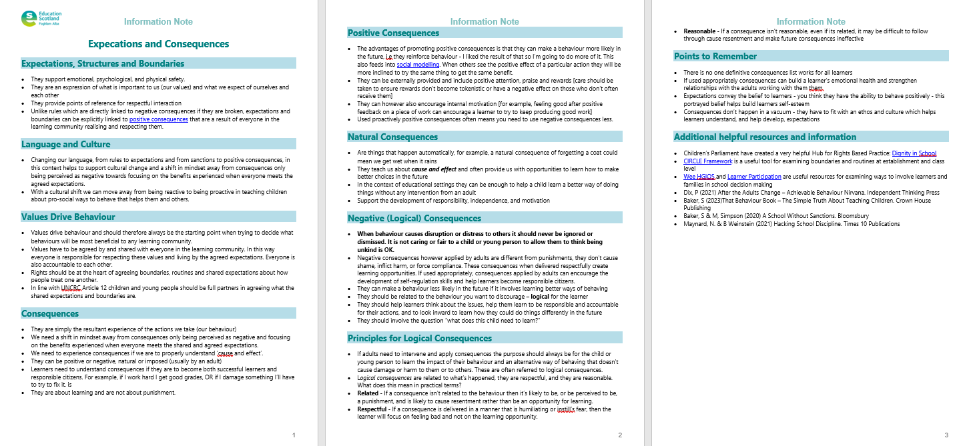
Resources and Information to help

Slide 16

Reflection
From what you have learned so far, think about:
How has this made you feel?
What has this made you think about?
What one action would you like to take forward?
How can you link what you plan to do with others in your setting?
How you will know that this learning has made a difference?
Notes:
Facilitation notes:
You can do this in groups...
Encourage educators to take this forward in an enquiry
Consider impact of the actions / learning

Slide 17


We value your feedback
From now until March 2024 we will be taking feedback on these resources so that we can make changes in advance of a formal launch of the Professional Learning Framework in June 2024
Your feedback could help us improve this resource
Please complete this short form, using the link or QR code, to let us know what you thought of it and any suggestions you have on how it could be improved
LINK: https://forms.office.com/e/b5PCpJJJ3P

Slide 18

For Scotland's learners, with Scotland's educators
Do luchd-ionnsachaidh na h-Alba, le luchd-foghlaim Alba
Education Scotland
Denholm House
Almondvale Business Park
Almondvale Way
Livingston EH54 6GA
T +44 (0)131 244 5000
E enquiries@educationscotland.gsi.gov.uk

