Slide 1


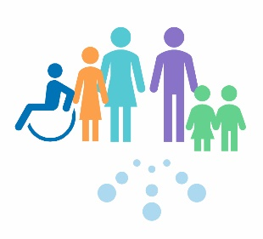

Introduction to Child Protection
For Scotland's learners, with Scotland's educators
Do luchd-ionnsachaidh na h-Alba, le luchd-foghlaim Alba

Slide 2
What do we mean by ‘Child Protection?’
Child protection refers to the processes involved in consideration, assessment and planning of required action, together with the actions themselves, where there are concerns that a child may be at risk of harm.
Child protection guidance provides overall direction for agencies and professional disciplines where there are concerns that a child may be at risk of harm.
Child protection procedures are initiated when police, social work or health professionals determine that a child may have been abused or may be at risk of significant harm.
National Guidance for Child Protection in Scotland 2021 - gov.scot (www.gov.scot)
For Scotland's learners, with Scotland's educators
Do luchd-ionnsachaidh na h-Alba, le luchd-foghlaim Alba
Notes:
This is an internal page in blue and can be duplicated to create additional pages. Always keep the heading and footer as shown. Use the corresponding blue internal and back pages if you are using this page.

Slide 3
What do we mean by ‘Safeguarding’
This is a much wider concept than child protection and refers to promoting the welfare of children, young people and protected adults. It encompasses:
Protecting from maltreatment
Preventing impairment of their health or development
Ensuring that they are growing up in circumstances consistent with the provision of safe and effective care
Taking action to enable all children, young people and protected adults to have the best outcome
It must be understood that everyone who works with children and young people has a responsibility to safeguard them and promote their welfare.
For Scotland's learners, with Scotland's educators
Do luchd-ionnsachaidh na h-Alba, le luchd-foghlaim Alba
Notes:
This is an internal page in blue and can be duplicated to create additional pages. Always keep the heading and footer as shown. Use the corresponding blue internal and back pages if you are using this page.

Slide 4
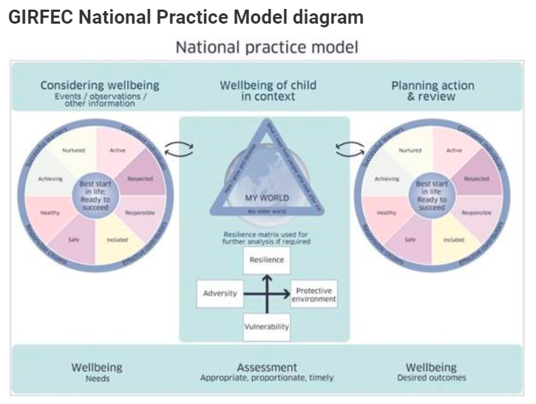
How do you know if you are getting it right?
In Scotland, child protection has to be seen in the context of the wider Getting It Right For Every Child (GIRFEC) approach, the Early Years Framework and the UN Convention on the Rights of the Child.
GIRFEC promotes action to improve the wellbeing of all children and young people in eight areas. The primary indicator for child protection
is to keep a child safe and, in so doing, attention is given to other areas of wellbeing as appropriate.
The ‘Wellbeing Wheel’ outlines the eight indicators of wellbeing that every adult should consider when observing or recording strengths and risks to a child’s or young person’s wellbeing. These observations should inform any assessment of a child’s or young person’s wellbeing, therefore it is essential that every adult is clear about what each these indicators mean.
The GIRFEC ‘National Practice Model’ presents a series of tools that are integral to promotion and assessment of wellbeing and is comprised of several elements: the Wellbeing Indicators; the My World Triangle; and the Resilience Matrix.
For Scotland's learners, with Scotland's educators
Do luchd-ionnsachaidh na h-Alba, le luchd-foghlaim Alba

Slide 5
Current Legislation
Children (Scotland) Act 1995
This remains one of the primary pieces of legislation providing the range and scope of local authority intervention in the lives of children and their families.
Local Government in Scotland Act 2003
Parts 2 and 3 of this legislation are concerned with scope and establishment of local Child Protection Committees.
The Children and Young People (Scotland) Act 2014:
places a duty on local authorities and schools to ensure the wellbeing of children and young people is safeguarded, supported and promoted. The voice of the child or young person is essential in understanding their needs and ensuring their wellbeing is safeguarded, supported and promoted. Fostering strong relationships between staff and children and young people is essential to this practice.
Prevent, Section 26 of the Counter-Terrorism and Security Act, 2015
This legislation places a duty on central bodies to have due regard to the need to prevent people being drawn into terrorism.
Overarching legislation:
Human Rights Act 1998.
United Nations Convention on the Rights of the Child (UNCRC).
United Nations Convention on the Rights of Persons with Disabilities (UNCRPD).
Data Protection Act.
The Equality Act 2010.
For Scotland's learners, with Scotland's educators
Do luchd-ionnsachaidh na h-Alba, le luchd-foghlaim Alba
Notes:
This is an internal page in blue and can be duplicated to create additional pages. Always keep the heading and footer as shown. Use the corresponding blue internal and back pages if you are using this page.

Slide 6
What does this mean for you?
Receive / listen
  Listen carefully
  Take all concerns seriously and act promptly
  Inform that this information will be passed onto the relevant people
Capture details of the concern
  Record information in writing as soon as possible
Refer
  DO NOT investigate
  It is not your job to decide if a child has been abused but it is our responsibility to report our concerns
Record
  Follow local authority Child protection / safeguarding procedures
  Always seek advice if you are unsure and always follow up to see what action has been taken
Do NOT delay!
For Scotland's learners, with Scotland's educators
Do luchd-ionnsachaidh na h-Alba, le luchd-foghlaim Alba
Notes:
This is an internal page in blue and can be duplicated to create additional pages. Always keep the heading and footer as shown. Use the corresponding blue internal and back pages if you are using this page.

