Slide 1




EQUITY: Mitigating the impact of poverty
on Scotland’s children and young people
Group session 2:
Planning and reflecting
Notes:
This PowerPoint is intended to support local authority facilitators to deliver the second group session on the Equity: Mitigating the impact of poverty on Scotland’s children and young people. This session will take place once programme participants have completed PLAs 1-3.
This PowerPoint is a template that facilitators can adapt to suit their own context and style of presenting. It can be added to, but please do not remove any slides as they are all essential to the Introductory session. You may wish to add the date, a logo alongside the Education Scotland one, and /or to add a link to a feedback form into the last slide.
Within the slides, suggested timings, key messages to get across, facilitator notes and reflective questions are included.
The session this PowerPoint is intended to support has been designed to be delivered by facilitators in 60/90 minutes, depending if the session is being delivered in person or online. We would encourage you to use that time for (more) discussion of the reflective questions and perhaps invite some feedback. Suggested approximate timings can be found in the notes for each slide.
IMPORTANT NOTES:
This PowerPoint refers to the Education Scotland Equity: Mitigating the impact of poverty on Scotland’s children and young people (Equity: Mitigating the impact of poverty on Scotland’s children and young people | Leading professional learning | Professional Learning | Education Scotland). It is anticipated the presenter will be familiar with the content of these pages. It will be particularly useful to be familiar with PLAs 1-3 before delivering this session.
While use of the Equity PL Reflective Workbook is optional, we would encourage its use as part of this facilitated programme. If used, it will be helpful for participants to have it to hand during this session.
This PowerPoint is to support group session 2, of the 4 that are part of the EQUITY programme.
You might also want to consider planning follow up sessions to check in/support those engaged in the learning, and to share learning from Professional Learning Activities undertaken throughout the programme.
NEXT TIME:
For group session 3, the group will need to bring along some data from their setting, as the focus is on taking a close look at the data, then beginning to plan a collaborative enquiry based on that specific data. It will be helpful to tell the group this at the end of this session, and to send an email reminder ahead of group session 3.

Slide 2

Ways of working together
We all work together
We learn from, with and on behalf of each other
We create a safe space to share ideas and build learning
We agree that everyone is an equal and valued participant
We remain ‘in the room’ (follow email and phone protocol)
Notes:
Slide 2
Suggested timing:
5 minutes
Key messages:
Take a moment to remind the group about the group protocols (or ‘group agreement’) from group session 1.
Ask participants to comment on anything they would like to add or amend.
Is there anything that participants feel is missing or anything they would like to remove?
The protocols on the slide are suggestions to be amended for your context.
Facilitator notes:
You may have some people present who missed session 1, so it's important to revisit the ways of working together at each session.
Why establish group protocols (reminder from session 1)
Effective professional learning goes beyond simply delivering information. It fosters a learning community where educators can learn with, from, and on behalf of one another. To achieve this, the facilitator of this learning should establish clear protocols and a positive learning environment at the outset. The general notes below will support the facilitator to help everyone feel comfortable participating and contribute to a rich learning experience.
1. Contract a Safe Space: Co-create a Safe Space agreement with your group. This agreement outlines expectations for respectful communication and active listening. A safe space allows trust to flourish, fostering a collaborative environment where everyone feels comfortable sharing ideas and taking risks.
2. Shift from Top-Down to Collaborative Learning: Move beyond the traditional model where one person imparts knowledge. Embrace a collaborative approach where all participants actively engage. This means learning with, from, and on behalf of one another. By leveraging the diverse perspectives within the group, gaining a richer understanding and creating a more impactful learning experience for everyone.
3. Holding the Ladder: Shared Expertise and Recognition : Holding the ladder signifies a two-fold approach: Sharing Expertise: Those with experience can share their knowledge and insights. Recognize Everyone's Contribution: Actively listen and be open to learning from the unique perspectives and experiences of colleagues. Build on each other's ideas to foster a collaborative environment where everyone feels valued, and their contributions are respected.
4. Hold Space for Silence and Respectful Discussion: Hold space for silence after someone speaks or asks a question. It can be tempting to jump in to fill silence but allowing time for quiet can avoid interrupting thought and produce more thoughtful responses. Everyone deserves to be heard and understood. Adapt the time allocation based on the size of the group and the complexity of the topic.
5. Schedule Regular Breaks: Schedule regular breaks throughout the session. This allows participants to process information, refocus, and return with renewed energy, leading to a more productive learning experience.
6. Centre Learning in Real Life: Connect the learning to real-life experiences by encouraging participants to share relevant personal anecdotes or applications. This strengthens understanding and makes the learning more relatable and impactful for all.

Slide 3

Today’s session
In this session we will:
Take part in a connector activity
Do a personal reflection
Reflect on and share learning from PLAs 1-3
Think about our next steps.
Notes:
Slide 3
Suggested timing:
1 minute
Facilitator notes:​
​This slide shows what will be looked at in this session, to be shared with participants. Invite any questions they may have.

Slide 4
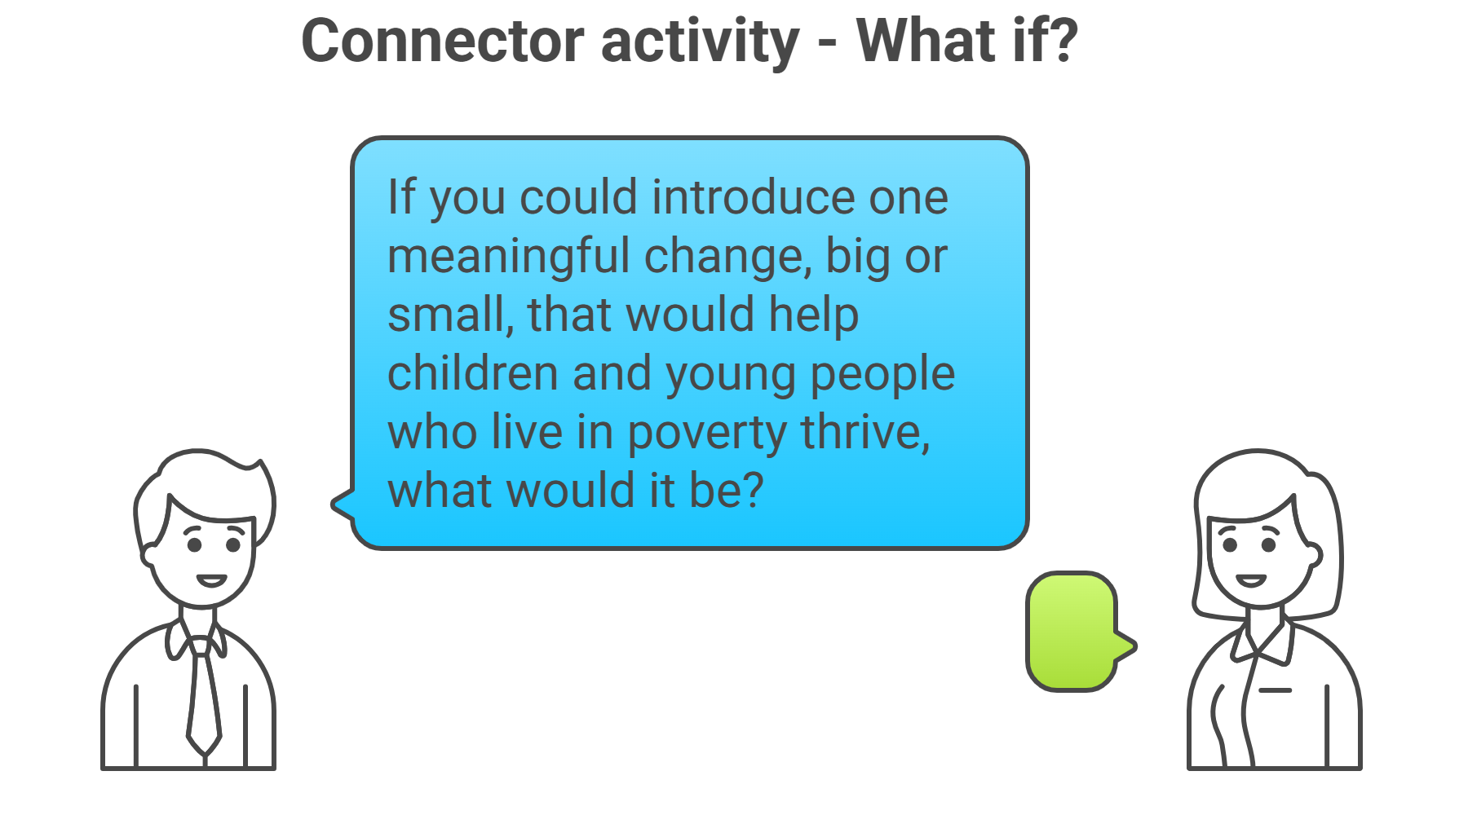
Connector activity
Notes:
Slide 4
Suggested timing:
12 minutes
Facilitator notes:
Ask the group to consider the question and to share their answers.
If in person – work in small groups to share ideas, or use ‘Think, Pair, Share’ process.
If online – You could use breakout spaces if you like, or of the group chooses, or stay in the main room and use the chat pane to share ideas, and draw out common themes.
Time for feedback is important, but you may need to manage time carefully, depending on how long you have and how big the group is.

Slide 5


Personal reflection
You might find it useful to refer to your Reflective Workbook (if using) and/or notes from group session 1.
Last session you considered aspects of your own upbringing or professional journey shape how you might view this Equity programme and how your lived experience differ from that of your learners and/or the families that you work with.
Have a think about what has challenged your thinking since the first session.
Has anything changed? What and why?
Notes:
Slide 5
Suggested timing:
5 -10 minutes (sometimes in person the share back may take longer)
Facilitator notes:
Remind the group that we looked at these questions in group session 1. Our understanding of equity is shaped by our own lived experiences—both personal and professional. Recognising the differences between our experiences and those of our learners and families helps us approach equity with empathy and humility.
Whether in person or online, this is an individual, personal reflection and you should allow silence while people think and make notes if they want to. Try to hold the silence.
1. Introduction and framing Remind the group about the 2 reflective questions from group session 1:
“What aspects of your own upbringing or professional journey shape how you view this Equity PL programme?”
“How might your lived experience differ from that of your learners and/or the families you work with?”
2. Individual reflection Invite participants to either think back to how they answered this in session 1, or to refer to their notes or Reflective Workbook, and jot down thoughts in response to the last question about what has challenged their thinking. If online, invite participants to share reflections in the chat pane.
Remember to consider, as they did in the first session:
Socioeconomic background
Educational experiences
Career path and roles
Family, community or cultural influences
And, additionally for this session, the learning that they’ve done on the programme so far, in PLAs 1-3.
3. Optional share back
Emphasise that this is a safe space for honest reflection—there are no right or wrong answers. Invite volunteers to share key insights or themes with the wider group. Capture common threads or tensions that could inform future learning or action.

Slide 6




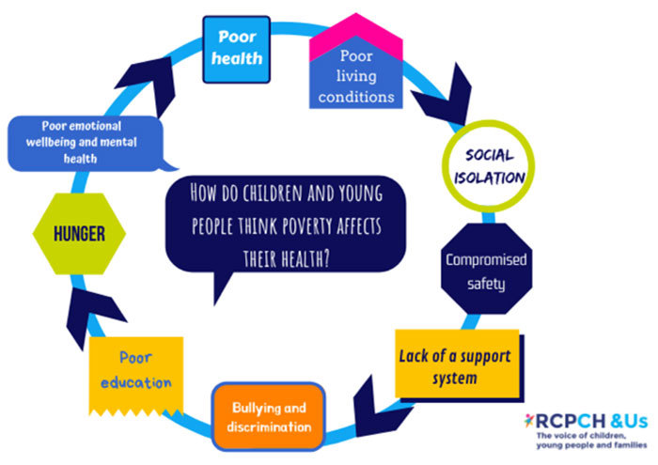

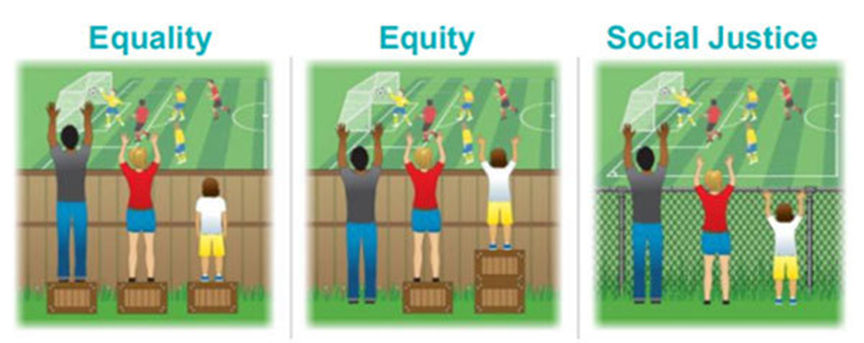
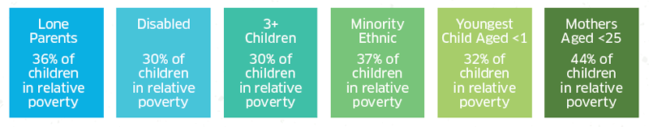
Reflecting on PLA 1: What is poverty?
Notes:
Slide 6
Suggested timing:
10- 15 minutes
Key messages:
This part of the session is for looking back at prior learning and sharing key insights, surprises, anything that challenged thinking.
The images on the slide are to remind the group about the content of PLA1. The learning steps were:
Step 1. Definitions of social justice and equity, types of poverty and Scottish facts and figures
Step 2. Causes of poverty and who is at risk
Step 3. Circumstances and consequences of poverty
Step 4. Real life examples
Step 5: Impact step
The resources included:
Joseph Rowntree Foundation (JRF) report defining poverty and a short film with 4 individuals with lived experience
The Children’s Society short film about growing up in poverty
Children’s Poverty Action Group (CPAG) overview of the effects of poverty
Facilitator notes:
Remind the group about the learning steps in PLA 1 and some of the resources they looked at. The images on the slide should help remind them.
You may have some people present who missed session 1, so it's important to revisit the ways of working together at each session. Your role here is simply to facilitate discussion. This could be in pairs or groups if in person, or in breakouts if you’re working online. As there will be a similar activity for PLAs 2 and 3, you might opt to have 3 groups, each discussing a different PLA at the same time, then bring the whole group back together to share reflections from each of the 3 groups and invite comments from the rest. You may prefer to stay as a whole group and use the prompt questions below to invite reflections and discussion.
If you keep the whole group together, you may need less time time for PLA1 and more for PLA 3, so use your time accordingly.
However, you decide to organise the participants, take a back seat and allow the space and time for them to reflect together. They may feel more comfortable in a pair or small group, at least to begin with.
You could use a selection of prompt questions (some are drawn from the Reflective Questions from PLA1).
What did you already know?
What was new for you?
Did anything surprise you?
Did anything challenge your thinking?
What resonated in relation to your own context?
Is there hidden poverty in your context and how would we know?
What consequences of poverty do you see in your context?
How does your current practice reduce/lower barriers facing by learners experiencing poverty?
What has been the overall impact on you of this learning?

Slide 7



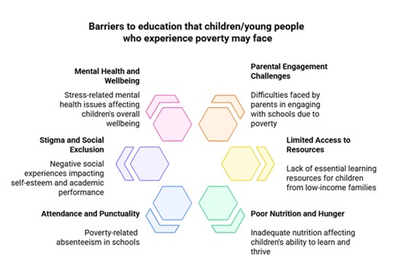
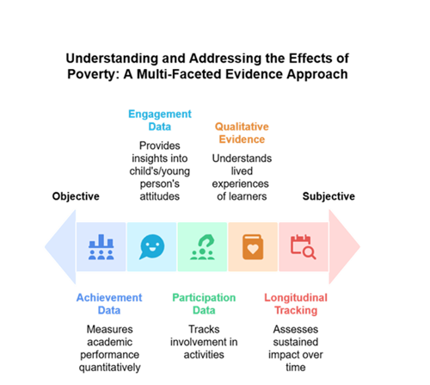

Reflecting on PLA 2: The impact of poverty
Notes:
Slide 7
Suggested timing:
10-15 minutes
Key messages:
This part of the session is for looking back at prior learning and sharing key insights, surprises, anything that challenged thinking.
The images on the slide are to remind the group about the content of PLA2. The learning steps were:
Step 1. Impact of poverty on the child/young person
Step 2. Barriers that experience of poverty brings
Step 3. Impact on wellbeing, making decisions and behaviours
Step 4. Impact on attainment and other outcomes
The resources included:
The Safeguarding Network’s webpage on the impact of poverty
UNICEF article on long-lasting effects of poverty
EIS Briefing paper on food insecurity
Education Scotland toolkit on building parental and family engagement
Child Poverty Action Group’s How poverty feels to children (the central image in the slide)
Facilitator notes: (as slide 6)
Remind the group about the learning steps in PLA 2 and some of the resources they looked at. The images on the slide should help remind them.
You may have some people present who missed session 1, so it's important to revisit the ways of working together at each session. Your role here is simply to facilitate discussion. This could be in pairs or groups if in person, or in breakouts if you’re working online. As there will be a similar activity for PLAs 1 and 3, you might opt to have 3 groups, each discussing a different PLA at the same time, then bring the whole group back together to share reflections from each of the 3 groups and invite comments from the rest. You may prefer to stay as a whole group and use the prompt questions below to invite reflections and discussion.
However, you decide to organise the participants, take a back seat and allow the space and time for them to reflect together. They may feel more comfortable in a pair or small group, at least to begin with.
You could use a selection of prompt questions (some are drawn from the Reflective Questions from PLA2).
What did you already know?
What was new for you?
Did anything surprise you?
Did anything challenge your thinking?
What resonated in relation to your own context?
How does poverty affect learners in your setting?
What might be the causes of poverty in your context?
How might the impact of poverty show up in behaviours?
How do our policies support learners experiencing poverty?

Slide 8

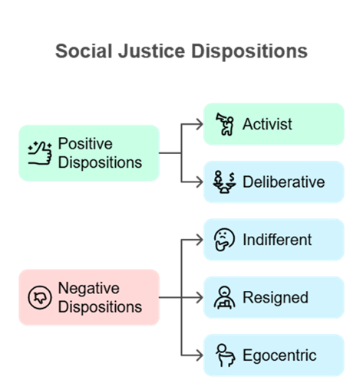

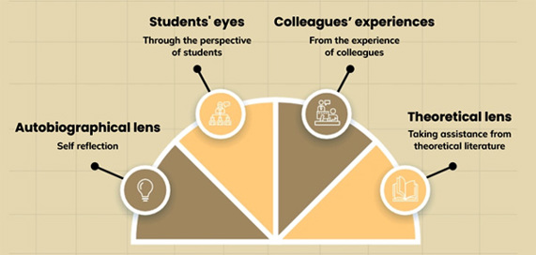
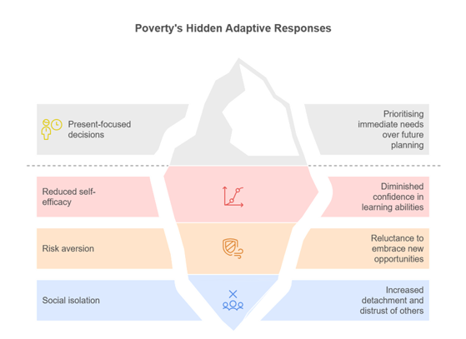


Reflecting on PLA 3: Personal, social
and cultural attitudes to poverty
A framework for social justice leadership development
Notes:
Slide 8
Suggested timing:
10-15 minutes (+2)
Key messages:
This part of the session is for looking back at prior learning and sharing key insights, surprises, anything that challenged thinking.
The images on the slide are to remind the group about the content of PLA3. The learning steps were:
Step 1. Your positionality as an educator
Step 2. Social justice values and leadership actions
Step 3. The stigma of poverty and its impact
Step 4. Social justice dispositions
The resources included:
Brookfield’s model of reflection
The virtual schoolbag
Professional standards, values and ethics: GTCS, CLD Standards Council and SSSC
Framework for social justice leadership (Christine Forde & Deirdre Thomas)
Report of the Cross-party group Inquiry into the stigma of poverty
News article on stigma in the media
Facilitator notes: (as slides 6 and 7)
Remind the group about the learning steps in PLA 3 and some of the resources they looked at. The images on the slide should help remind them.
You may have some people present who missed session 1, so it's important to revisit the ways of working together at each session. Your role here is simply to facilitate discussion. This could be in pairs or groups if in person, or in breakouts if you’re working online. As there will be a similar activity for PLAs 2 and 3, you might opt to have 3 groups, each discussing a different PLA at the same time, then bring the whole group back together to share reflections from each of the 3 groups and invite comments from the rest. You may prefer to stay as a whole group and use the prompt questions below to invite reflections and discussion.
However, you decide to organise the participants, take a back seat and allow the space and time for them to reflect together. They may feel more comfortable in a pair or small group, at least to begin with.
You could use a selection of prompt questions (some are drawn from the Reflective Questions from PLA3).
What did you already know?
What was new for you?
Did anything surprise you?
Did anything challenge your thinking?
What resonated in relation to your own context?
What aspects or identities of your own positionality influence your practice?
What are your reflections on your professional standards and how they refer to social justice?
What compassionate approaches are currently embedded in your own practice?
How is your social justice disposition reflected in what you do as an educator?
Once the group has reflected on PLAs 1-3 (in whichever way you have organised this), remind them to ensure they have used the ‘Complete Activity’ button in each PLA to enable the system to log their completed learning. Invite any final thoughts on the programme so far.

Slide 9

Next steps
Getting started on PLA 4 self directed online Professional Learning Activity (PLA) to be completed before Group Session 3 .
Notes:
Slide 9
Suggested timing:
2 minutes
Key messages:
Remind the group that all the learning for the programme is contained in Education Scotland Equity: Mitigating the impact of poverty on Scotland’s children and young people (Equity: Mitigating the impact of poverty on Scotland’s children and young people | Leading professional learning | Professional Learning | Education Scotland). Remember an account is required to access the PLAs. Once logged in, the links to the PLAs will work.
Hopefully the group now feel ready to get started PLA 4.
Facilitator notes:
You may wish to screen-share the relevant webpage as part of the session, or if participants have devices, allow some time for them to access the pages and read through them.
Some participants may need more time for PLAs 1-3. Assure them this is ok. The target is to have completed PLAs 1-4 by the next group session (3).
Remind the group a PDF summary of each PLA, with reflections, can be downloaded once complete for their records. They can also download a certificate.
Participants can also use the Reflective Workbook to record thoughts as they go through the PLA and perhaps when they have completed it as well.
Negotiate and agree a timeframe for completing PLA 4 and convening group session 3, with the group and /or leadership team. OR, if this has already been agreed, remind the group of the target date for completing PLA 4 (which should be in time for group session 3) and the date, time and location for group session 3. You may wish to add a slide with these details, or add them to the final slide.

Slide 10

Aims Review
In this session we will:
Take part in a connector activity
Do a personal reflection
Reflect on and share learning from PLAs 1-3
Think about our next steps.
Notes:
Slide 10
Suggested timing:
2 minutes
Key Messages
Have we met the aims of today’s session?
Facilitator Notes
What are our key takeaways? As the session ends, encourage participants to take a few minutes to reflect quietly. Ask them to think about what resonated, what challenged them, and how they’ll set aside time to work through PLA 4 before the next group session.

Slide 11



Feedback
Notes:
Slide 11
Suggested timing:
1 minute
Facilitator Notes
Thank the group for their time and engagement and make sure they know who to approach with any questions and how to contact them. You may wish to add these details to the slide.
You may also wish to add a link or QR code for your own feedback form at this slide.
If you would like to provide feedback on this resource, as a facilitator, please go to https://forms.office.com/e/SZsihk0m6d
NEXT TIME:
*For group session 3, the group will need to bring along some data from their setting, as the focus is on taking a close look at the data, then beginning to plan a collaborative enquiry based on that specific data. It will be helpful to tell the group this at the end of this session, and to send an email reminder ahead of group session 3.

