Slide 1

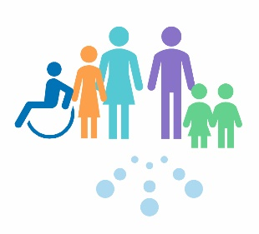
Relational Approaches Skills Building Programme
How to be attuned to support engagement?
Supporting practitioners to understand and address barriers to learning
Informed Level
For Scotland's learners, with Scotland's educators
Do luchd-ionnsachaidh na h-Alba, le luchd-foghlaim Alba

Slide 2
How to be attuned to support engagement?

Slide 3
What do children and young people say?
Behaviour in Scottish Schools Research (2016)
Pupils highlighted the following aspects of teachers’ manner and demeanour as important :
‘the teacher being happy’
‘the teacher smiling when you come in to class’
‘when the teacher is enthusiastic’
using ‘humour’
‘being calm’
‘not shouting’.
‘If a teacher is kind, it travels across the class and puts everyone in a good mood’
- Pupil in Children in Scotland study
Notes:
A recent yougov poll of 586 (2018) children from 6-15 years were asked what makes a good teacher and they answered.
Kind – 27%, listens – 15%, fun – 13%, funny – 10%, helpful – 9%, knowledgeable – 9%, friendly – 8%, engaging – 8%, clear – 7%, fair – 6%, patient – 4%, strict – 4%, caring – 4%, doesn’t shout – 3%

Slide 4
Empathy
Attunement
Supportive and healing relationships
Empathy and attunement feed into each other.
Notes:
Empathy is the ability to share someone else's feelings or experiences by imagining what it would be like to be in that person's situation (Cambridge Dictionary)
Attunement is about giving appropriate responses.
Empathy and attunement together underpin a therapeutic type of relationship.
When we empathically attune to another we gently tune into, sense, and resonate with their experience making it possible for us to reflect back accurately to them that you have understood how they are feeling, that they have been heard. Effective empathetic communication (active listening) requires your full attention and emotional presence.
There is a great deal of evidence that shows how empathy and attunement are among the most effective elements of a therapeutic relationship (Cooper, 2008).

Slide 5
What is attunement, and what do we need to know about it?
Attunement:
describes how we recognise and respond to another persons emotional needs and moods
is the process by which we form relationships
Dr. Dan Siegel says, "Children need attunement to feel secure and to develop well, and throughout our lives we need attunement to feel close and connected.”
When working with children, attunement comes across as:
genuinely caring about them
truly listening to them and caring about their response
noticing when a they are in a mood, or when they’re unusually quiet, or when they’re struggling

Slide 6
Principles of attunement: the what and the why?
(Based on Biemens Contact Principles)
Positive Relationships
What we do to be attuned
Deepening Discussion
Helped to manage and learn
How it makes the other person feel
Guiding & Supporting
Open to learning and new ideas with support
Becoming Attuned Together
Engaged in enjoyable and equal interactions
Receiving
You have been listened to - someone is interested in you and what you have to say
Encouraging
The other person is interested in what you think an you are encouraged to offer your own ideas
Being Attentive
Feel recognised and important
Notes:
When you are attuning to children, what messages are they getting from you – look at the right hand side.

Slide 7
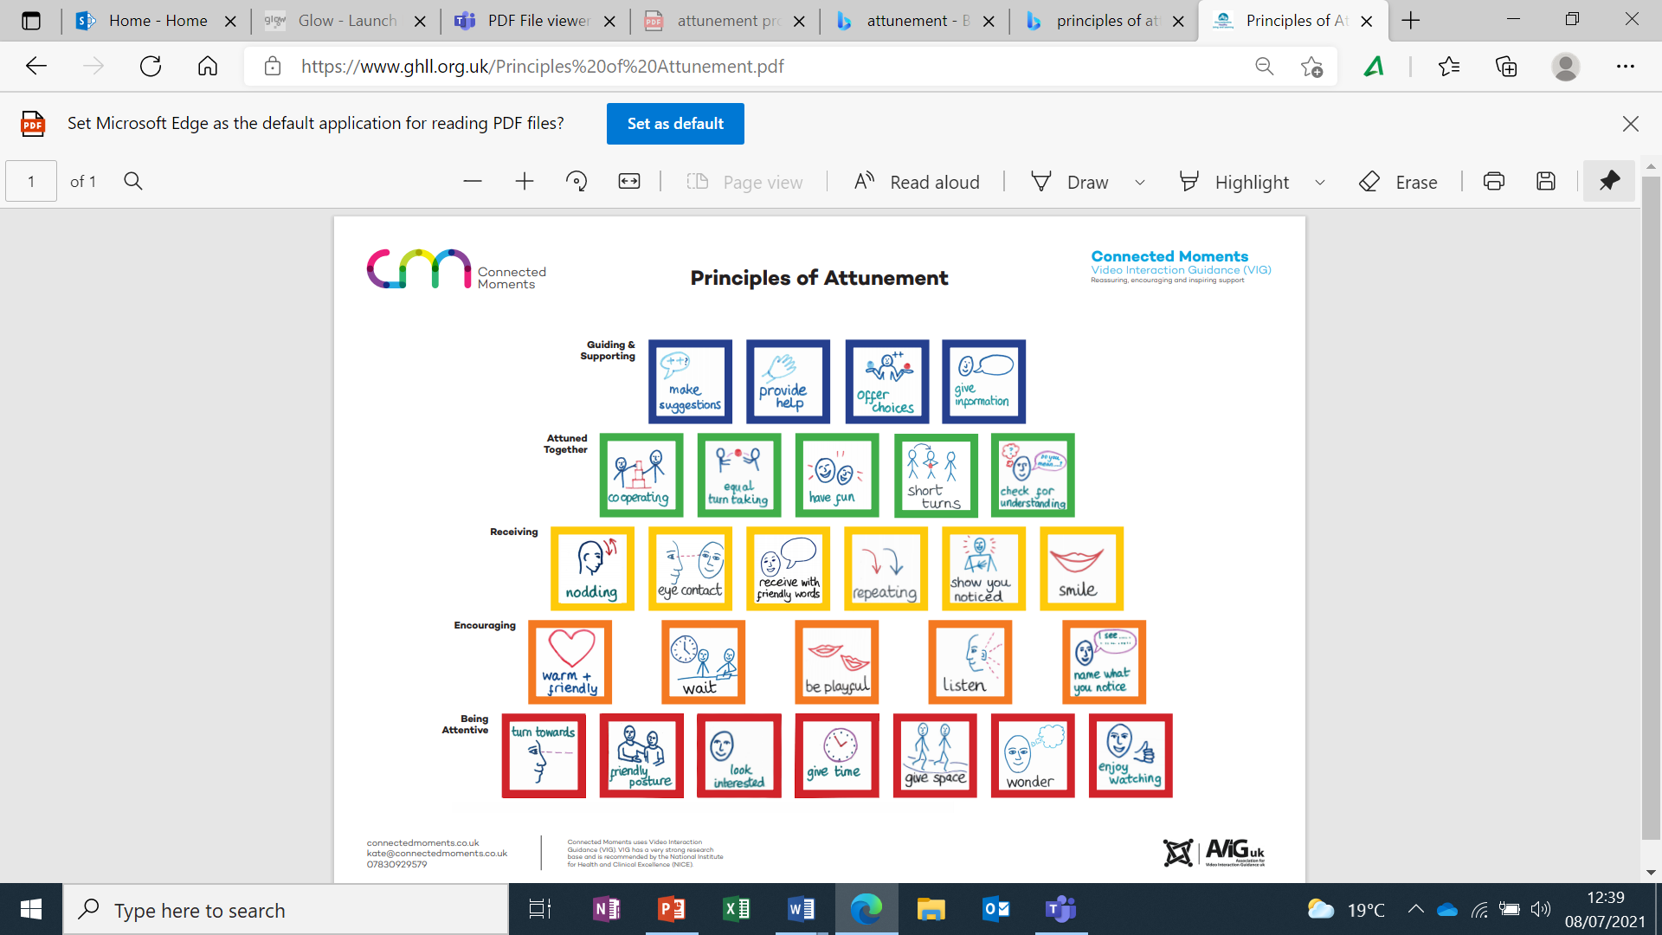
Attunement principles (first 5)
Schematic produced by:
Notes:
This diagram shows the development of each of these principles and what they look like in practical terms. Notice how the principles progress from working towards being attuned to mediated learning.

Slide 8

What do we mean by being attentive?
Turning towards someone
Looking at someone
Making eye contact
Using friendly intonations
Using friendly facial expressions
Using friendly postures
https://youtu.be/7TvoblpMv4I

Slide 9
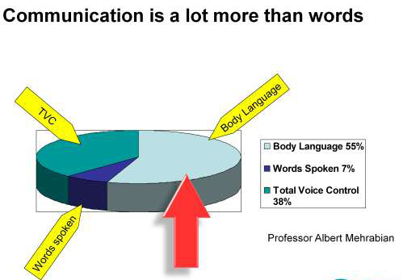
The importance of non-verbal communication
Square (or slightly angled)
Open
Lean forward
Eye contact (appropriate)
Relaxed
Also consider personal space, sitting down if appropriate, and using non-threatening gestures
Notes:
Professor Albert Mehrabian pioneered the understanding of the communication of feeling and attitudes in the 1960s. His diagram refers to how we effectively communicate feelings and attitude through our words, the way we speak and our facial expression not how we communicate factual information. He found that when we communicate our feeling the person receives: 7% through our words., 38% from the way the words are said – tone, pitch, pace etc.. and 55% through our facial expression – smiling, raised eyebrows, frowning, sneering, etc.
The 'Mehrabian formula‘ is particularly useful for describing situations where the words did not match the facial expression. His research showed people tended to believe the expression they saw, not the words spoken.
SOLER can be a useful aide memoire for considering our non-verbal communication:
Sit beside or slightly angled towards the person – not facing directly as this could be threatening
Keep an open body position as it portrays an open-minded attitude – avoid crossed arms or legs
Lean forward to indicate you are interested in what they are saying
Eye contact also shows you are listening and can create a connection with the person. Avoid staring as this could be threatening.
Be relaxed to try to encourage them to relax – eg. sit if appropriate …..

Slide 10
What do we mean by encouraging?
Waiting
Listening actively
Showing emotional warmth through intonation
Naming positively what you see, think or feel
Using friendly and/or playful intonation
Saying what they are doing
Looking for initiatives
Notes:
By waiting we are often allowing the other person to start the interaction/conversation first and then we can respond – requires us to pay careful attention to what they say and/or their non-verbal communication which could be subtle
We can help encourage them to speak/interact by noticing, commenting, naming things positively –not asking lots of questions, after each interaction initiated by them – wait patiently to see if there is any response
Sometimes for a less confident child – it can be helpful to be playful in how you encourage this, e.g. make a pretend mistake in what you are saying, make a joke – this requires knowing the child a little so that it is appropriate.

Slide 11
What do we mean by receiving?
Showing you have heard, noticed the other’s initiative
Receiving with body language, matching or mirroring
Being friendly and/or playful as appropriate
Returning eye contact, smiling, nodding in response
Receiving what the other is saying or doing in words
Repeating/using the other’s words or phrases
Wondering aloud
https://youtu.be/e-dOGlhP6-0
Notes:
This is more about how you respond to the others initiative and take it forward – often better to wait for the child or young person to initiate first and then you receive or respond to them – often their initiatives will be subtle – looking towards you, a slight nod, looking at something else in the environment which you need to then receive in a way that helps them to feel noticed, heard, listened to but not overwhelmed. Some children may enjoy you responding in an animated and excited way, others may prefer for you to be more calm and quiet in your response – it is important in attunement to respond in the way that best suits the needs of the child.

Slide 12
What do we mean by being attuned together?
To and fro - receiving and then responding - contributing equally
Checking the other is understanding you
Waiting attentively for your turn
Having fun
Giving a second and further turn on the same topic
Giving and taking short turns
Cooperating – helping each other
Notes:
This moves beyond the act of simply encouraging or receiving and instead is part of the dance by which we interact in an equal and responsive way – become more attuned. A key part of this is giving and taking short turns – although this can be difficult in a classroom – there are opportunities through discussions and other activities where the teacher or other adult can be a more equal partner in the conversation with the child and encourage shorter turns.
Research demonstrates that shorter turns help the interaction to be more attuned and go on for longer.

Slide 13
What do we mean by guiding and supporting?
Scaffolding (for example, engage, simplify, problem solve, model enthusiasm)
Extending, building on the others response
Judging the amount of support required and adjusting
Giving information when needed
Providing help when needed
Offering choices that the other can understand
Making suggestions that the other can follow
https://youtu.be/nGYyEuyEaYc
Notes:
This is an area where teachers often feel more comfortable – the concept of guiding – this is what we spend a large part of our day doing but it is important to realise that for many children and young people, this won’t be as effective if we are unable to get the earlier attunement principles in place. Children will be less amenable to guiding if they don’t feel that we are being attentive; encouraging and receiving their initiatives or attuning to them.
Part of the attunement process is to also judge how much support and guidance a child/yp requires – this relates to the idea of dependence and interdependence. Some children will not want support and guidance – dependent on their early attachment experiences – they may avoid interdependence and through our attuned responses we may need to help them to be more comfortable with that so that we can guide them. Some children will be over dependent and want a lot of mediation and guidance – again we have to help them to move away from this.

Slide 14
What do we mean by deepening discussion (sixth principle)
Asking activating questions
Receiving their opinion
Giving your opinion on what they have said
Responding with own opinion and question
Naming difference in opinion
Checking for reception of your opinion
Notes:
This is a skill that teachers often learn to take the discussion forward in a classroom but not simply a matter of asking questions and then making comments – need to be attuned to the young person – really hear what they are saying so that you can respond appropriately.

Slide 15
How can I use attunement to support engagement?
Reflection Activity (individually or as a group):
How do I know when: Someone gets me? Someone cares about me? Someone thinks about me? How does it make me feel?
How could I develop attuned practice in my setting particularly for children and young people who have experienced adversity and trauma?
Deepening Discussion
Guiding & Supporting
Becoming Attuned Together
Receiving
Encouraging
Being Attentive

Slide 16
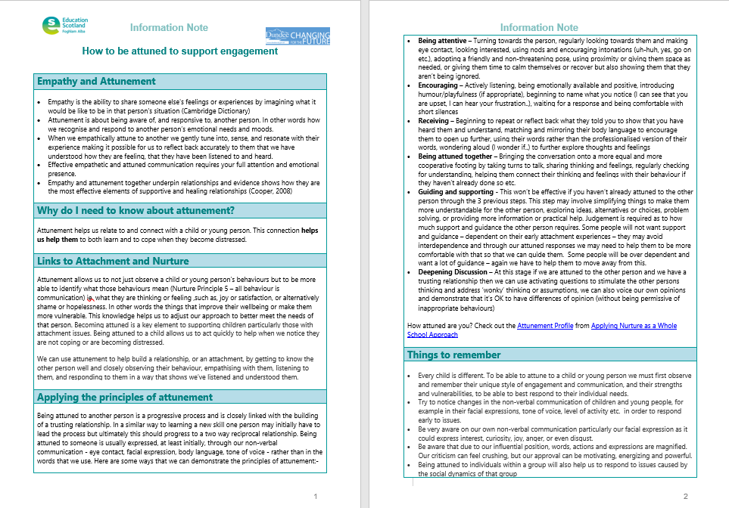
Further reading – Attunement Information Note

Slide 17
Education Scotland
Denholm House
Almondvale Business Park
Almondvale Way
Livingston EH54 6GA
T +44 (0)131 244 5000
E enquiries@educationscotland.gsi.gov.uk
For Scotland's learners, with Scotland's educators

