Slide 1


Coaching Skills – Establishing and building coaching relationships
Coaching Skills – Establishing and building coaching relationships
Notes:
Facilitator Notes Slide
Target Audience: This workshop is designed for teachers/educators/leaders to build practical knowledge and skills in taking a coaching approach.
Workshop Content:
There are 4 sections.
1. Establishing a coaching relationship – Contracting (approx 30 mins)
2. Building the coaching relationship – Listening (approx 30 mins)
3. Building the coaching relationship - Questioning (approx 30 mins)
4. Coaching Skills: Trying it out (approx 30 mins)
But these sections could be longer given the topics - please feel free to adapt.
Adapting the presentation:
Facilitators can adapt this presentation. We encourage customisation to suit the specific needs and context of your setting.
Consider adding local examples or case studies of coaching within your setting.
Tailor the activities or discussion prompts to address specific challenges or areas of focus for your educators.
Duration:
The presentation can be delivered in 60 - 75 minutes. However, the total workshop experience can be extended depending on the chosen activities and level of discussion.
This PLR can be broken down into multiple shorter sessions. If opting for multiple sessions, consider incorporating activities or discussions from the presentation into follow-up sessions to deepen learning and explore coaching implementation strategies.
Groupings:
Group work is encouraged throughout the presentation to foster collaboration and shared learning. Activities can be designed for small groups of 2-4 participants or larger groups depending on the activity and the number of educators involved.
Pre-reading:
There are no mandatory pre-reading requirements for either the facilitator or participants.
However, to enhance the learning experience, facilitators may consider reviewing resources on coaching in education (websites, articles) Coaching in Education | Self-directed professional learning | Professional Learning | Education Scotlandto gain a deeper understanding of the t opic.
Optionally, facilitators can share relevant resources with participants beforehand to spark their initial interest in coaching.

Slide 2
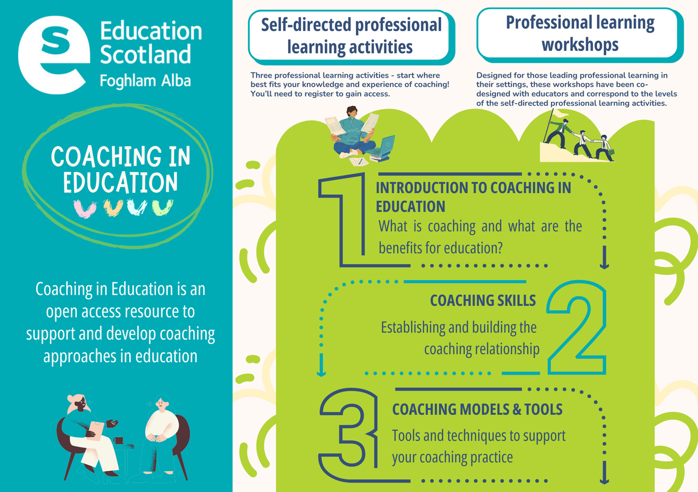
Coaching in Education Open Access Resource
This
workshop
is one of three
resources.
Notes:
Slide 2.
Facilitator Notes:
There are 3 self-led professional learning activities to support the development of coaching
1. Introduction to Coaching
2. Coaching Skills
3. Coaching Models and Tools
Each of these self-directed learning activities also has a corresponding workshop or professional learning resource.
This workshop is 2. Coaching Skills and it's suggested it's split across 2 sessions (Part A and Part B) with some learning and practice in-between the sessions.
This workshop links with the self-directed Professional Learning Resource (PLA) Building Coaching Skills.

Slide 3
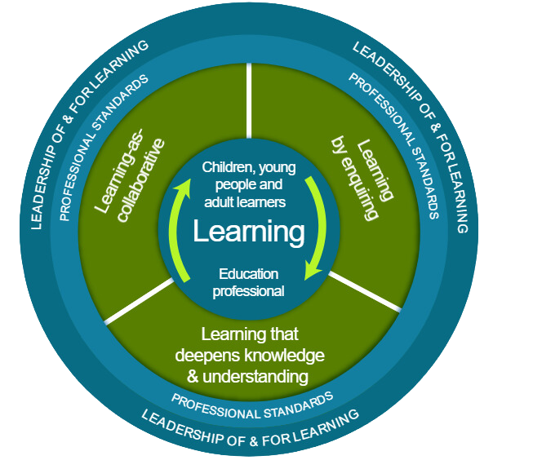


National model of professional learning
National model of professional learning
Notes:
Slide 3.
Time Allocation : 5 minutes
This resource aligns with our National Model of Professional Learning (NMPL) by focusing on the education professional as a learner, leadership of and for learning, collaborative learning, learning by enquiring, and deepening knowledge and understanding of coaching principles.
Building Coaching Skills explores the key coaching skills (What), and equips educators with practical strategies for implementation (How), while encouraging them to consider applications within their specific school context (Apply).
Key Messages
The NMPL emphasizes the importance of professional learning for educators to:
• Stimulate critical thinking and ensure practices are critically informed and up-to-date.
• Build capacity and promote collaborative practices.
This PLR directly supports these goals by encouraging educators to:
• Engage critically with coaching concepts.
• Develop skills through activities and self-reflection.
• Collaborate with colleagues for peer learning.
Alignment with National Model:
• The education professional as a learner: The PLR encourages educators to explore coaching and its application in their professional development.
• Leadership of and for learning: The resource delves into how coaching can support leadership practices by equipping educators with tools to guide and empower colleagues.
• Professional standards and policy context: The PLR is linked to relevant professional standards, including the General Teaching Council (Scotland) Standards, the Scottish Social Services Council National Occupational Standards (ELC practitioners), the Community Learning and Development (CLD) Standards Council Competences Framework and the National Model of Professional Learning.
• Learning as collaborative: The resource encourages collaborative learning through group discussions and activities, fostering peer-to-peer learning and knowledge sharing.
• Learning by enquiring: The presentation prompts participants to think critically about coaching by exploring its definitions, benefits, and applications in education.
• Learning that deepens knowledge and understanding: This PLR goes beyond basic definitions to provide a deeper understanding of coaching principles and its role in professional learning.
Additional Resources:
• Explore the NMPL further: https://education.gov.scot/professional-learning/national-approach-to-professional-learning/the-national-model-of-professional-learning/
• See the full list of Professional Standards:
Teachers - https://www.gtcs.org.uk/knowledge-base/articles/a-guide-to-the-professional-standards
CLD Practitioners - https://cldstandardscouncil.org.uk/resources/competent-practitioner-framework/
ELC Practitioners - Social Service | Children and Young People | SCQF 7 | National Occupational Standards (NOS) Navigator (sssc.uk.com)

Slide 4

Ways of working together
Ways of working together
  We all work together
  We learn from, with and on behalf of each other
  We create a safe space to share ideas and build learning
  We agree that everyone is an equal and valued participant
  We remain ‘in the room’ (follow email and phone protocol)
Notes:
Slide 4.
Key Messages
Take a moment to establish group protocols.
Ask participants to comment on anything they would like to add or amend.
Is there anything that participants feel is missing or anything they would like to remove?
The protocols on the slide are suggestions to be amended for your context.
- Why establish group protocols
Effective professional learning goes beyond simply delivering information. It fosters a learning community where educators can learn with, from, and on behalf of one another. To achieve this, the facilitator of this learning should establish clear protocols and a positive learning environment at the outset. The general notes below will support the facilitator to help everyone feel comfortable participating and contribute to a rich learning experience.
1. Contract a Safe Space:
Co-create a Safe Space agreement with your group. This agreement outlines expectations for respectful communication and active listening. A safe space allows trust to flourish, fostering a collaborative environment where everyone feels comfortable sharing ideas and taking risks.
2. Shift from Top-Down to Collaborative Learning:
Move beyond the traditional model where one person imparts knowledge. Embrace a collaborative approach where all participants actively engage. This means learning with, from, and on behalf of one another. By leveraging the diverse perspectives within the group, gaining a richer understanding and creating a more impactful learning experience for everyone.
3. Holding the Ladder: Shared Expertise and Recognition
Holding the ladder signifies a two-fold approach:
Sharing Expertise: Those with experience can share their knowledge and insights.
Recognize Everyone's Contribution: Actively listen and be open to learning from the unique perspectives and experiences of colleagues. Build on each other's ideas to foster a collaborative environment where everyone feels valued, and their contributions are respected.
4. Hold Space for Silence and Respectful Discussion:
Hold space for silence after someone speaks or asks a question. It can be tempting to jump in to fill silence but allowing time for quiet can avoid interrupting thought and produce more thoughtful responses. Everyone deserves to be heard and understood.
Adapt the time allocation based on the size of the group and the complexity of the topic.
5. Schedule Regular Breaks:
Schedule regular breaks throughout the session. This allows participants to process information, refocus, and return with renewed energy, leading to a more productive learning experience.
6. Centre Learning in Real Life:
Connect the learning to real-life experiences by encouraging participants to share relevant personal anecdotes or applications. This strengthens understanding and makes the learning more relatable and impactful for all.

Slide 5

Session aims
Session aims
  Build an understanding of the importance of contracting as the first step to establishing coaching relationships
  Build an understanding of the importance of listening in coaching relationships
  Build an understanding of the power of questioning
  Explore practical ways to build coaching relationships through contracting, questioning and listening.
Notes:
Slide 5.
Key Messages
These are the aims of the PLR which will support participants to consider: (Read the aims of the session from the slide)

Slide 6

Connector
Connector
In groups or pairs, chat about a time a colleague helped you with a supportive conversation.
  How did it feel?
  Who found the ‘solution?’
  What happened next?
Notes:
Key Messages
Slide 6.
This is an example of a simple connecter activity. It is recommended that facilitators use a connector activity that allows participants to take part in an informal discussion.
This is to ensure that participants are relaxed, focused and ready for an interactive workshop.

Slide 7
Content Overview
Content Overview
  Establishing coaching relationships – Contracting
  Building coaching relationships – Listening
  Building coaching relationships - Questioning
  Coaching Skills: Trying it out
Notes:
Slide 7.
Key Messages
Outline the content covered in this session

Slide 8
Part 1. Establishing coaching relationships
Part 1. Establishing coaching relationships
Coaching Skills
Notes:
Part 1: Establishing a coaching relationship.
Contracting is an important first step when establishing a coaching relationship.
Key Message
Contracting: By participating in coaching conversations, you can develop skills, collaborate with colleagues, gain self-awareness, and ultimately, become more confident and effective as an educator. Thinking about contracting is an important first step which can help to build an understanding of the purpose and process of coaching.
Contracting doesn’t need to be complicated, it can be simply to help you explore the "why" and "how" of coaching and can spark important conversations about what you want the coaching to achieve and how you’ll work together to get there.
This step will support you to think about the importance of contracting and what is useful to consider as the first part of building a coaching relationship.
Contracting works both when you are in a one to one coaching relationship and when you are using a coaching approach with a group or team in your setting.

Slide 9

Description of Coaching
‘The main characteristics of a coaching style are partnership and collaboration as opposed to command and control. Coaching is a conversation between equals.’
Whitmore, J. (2017)
Coaching for Performance: The Principles and Practice of Coaching and Leadership. Nicholas Brearley.
Notes:
Time Allocation:
Slide - 5 mins presentation
Key Messages:
Think about some of the challenges you face as educators. Coaching can be a powerful tool to address those challenges and elevate your practice.
By participating in Coaching conversations, you can develop your skills, collaborate with colleagues, gain self-awareness, and ultimately, become a more confident and effective educator. Thinking about contracting is an important first step which can help to build an understanding of the purpose and process of coaching.
Contracting doesn’t need to be complicated, it can help you both explore the "why" and "how" of coaching and can spark important conversations about what your colleague wants to achieve and how you'll work together to get there.
This step will support you to think about the importance of contracting and what is useful to consider as the first part of building a coaching relationship.
Coaching fosters a supportive learning environment where educators can share best practices and learn from each other. This sense of community can be incredibly valuable to us all!

Slide 10
Coaching Contract: Clear Path to Success
Coaching Contract: Clear Path to Success
An initial ‘coaching contract’ is fundamental to establishing a successful coaching relationship with a colleague. Here's why thinking about contracting is important at the start of a coaching conversation or relationship:
  Sets Expectations: Ensures everyone's on the same page for goals and approach.
  Healthy Boundaries: Protects both parties with clear communication styles and time commitments.
  Builds Trust: Open communication about confidentiality encourages honest sharing.
  Focuses Sessions: A structured approach keeps coaching on track and productive.
Notes:
Time Allocation:
Slide - 5 mins presentation
Key Messages:
The four aspects to include when contracting are:
Set clear expectations: A contract ensures there is an understanding of what to expect from each other. It can simply be agreeing the expectations for the conversation.
Set healthy boundaries: The contract helps set boundaries around topics like confidentiality, communication style, and time commitment. This protects both the coach/mentor and the colleague.
Open communication: Discussing confidentiality upfront fosters trust and allows your colleague to feel comfortable sharing openly.
Structured approach: The contract establishes a timeframe for the sessions and the preferred meeting format (in-person, virtual, etc.). This promotes structure and keeps the coaching conversation focussed.
Remember, contracting works both when you are in a one to one coaching relationship and when you are using a coaching approach with a group or team in your setting. You don’t need to be in a formal coaching relationship to be able to take a coaching approach with colleagues.

Slide 11








Activity - contracting in practice
Activity - contracting in practice
Individually
In pairs
As a group
Consider the aspects of contracting which are important to you:
Goals/Objectives
Confidentiality
Share these goals with your partner. How can this be applied within your own setting?
Share these goals as a whole group. Consider how this could used across your setting?
Notes:
Time Allocation:
Slide - 5 mins presentation
Activity - 5 - 10 minutes depending on size of group.
Key Messages:
Here's what you can include in your coaching contract with your colleague:
Goals and objectives: Clearly define the desired outcomes of the coaching conversation. What specific areas does the colleague want to explore for example. This sets expectations for the coaching conversation.
Confidentiality: Establish clear expectations regarding confidentiality of information shared during the sessions. This sets healthy boundaries for the coaching conversation.
Communication and feedback: Agree on preferred communication methods and the approach to providing feedback. This ensures open communication throughout the coaching conversation.
Timeframe and frequency: Determine the duration of each coaching conversation, how often you will have one, and perhaps how many you will have in total. This helps provide structure for the coaching conversations.
By establishing a clear coaching contract, you can lay the groundwork for a productive and supportive relationship that benefits both you and your colleague.
Remember, contracting works both when you are in a one to one coaching relationship and when you are using a coaching approach with a group or team in your setting. You don’t need to be in a formal coaching relationship to be able to take a coaching approach with colleagues.

Slide 12
Part 2. Building the coaching relationship:
Questions
Part 2. Building the coaching relationship:
Questions
Coaching Skills
Notes:
Building the coaching relationship:
Questions

Slide 13

Questioning
Coaching supports learning and for this to occur, the person being supported through coaching needs to find their solutions within their own experience. The coach’s primary tool for making this happen is asking questions. During a coaching conversation we ask questions...
Q
U
E
S
T
I
O
N
I
N
G
Q
U
E
S
T
I
O
N
I
N
G
To gain
clarity
To create
awareness
To generate commitment
To generate
responsibility
To encourage enquiry and
discovery
Notes:
Key Messages:
Building the coaching relationship requires you to ask a range of questions to facilitate thinking and reflection and ultimately learning. Great questions also support us to see things differently and to help find solutions to problems and situations we are struggling with. They also help to build trust which is essential in building a supportive coaching relationship.

Slide 14

Activity
Activity
We are going to watch 2 videos to help us consider the power of questions and then reflect on some questions as a group

Slide 15

Video 1
Watch Nancy Kline's 10 Components of Thinking Environments
Notes:
https://www.youtube.com/watch?v=wutIaSf37lI
Activity : 5 - 10 minutes
Key Messages:
This video gives an overview of Nancy Kline Ten Components which can generate quality thinking
‘The quality of everything we do depends on the quality of the thinking we do first
The quality of our thinking depends on the way we treat each other while we are thinking’
The ten behaviours that generate the finest thinking, and have become known as The Ten Components of a Thinking Environment, are:
Attention, Equality, Ease, Appreciation, Encouragement, Feelings, Information,
Difference, Incisive Questions, Place.
Each Component is powerful individually, but the presence of all ten working together gives this process its transformative impact.

Slide 16
Recap Activity
Activity
Quick recap
Share with someone what you heard in one sentence
Notes:
Activity Timescale : 5 - 10 minutes depending on size of the group
Key Messages:
Quick Recap of video.
Activity: Share with someone what you heard in one sentence.

Slide 17
Video 2
Watch
How to tame your Advice Monster
Notes:
https://www.youtube.com/watch?v=Kl0rmx7aa0w
Activity : 5 - 10 minutes
Key Messages:
In this funny and provocative talk, Michael Bungay Stanier explains how advice-giving goes bad; the three personas of your Advice Monster; and why the powerful act of staying curious a little longer is the secret to taming your Advice Monster.
You know your Advice Monster! Someone starts to talk … and it looms up out of the shadows wanting to “add value”.

Slide 18
Recap Activity 1
Activity
Quick recap
Share with someone what you heard in one sentence
Notes:
Activity Timescale : 5 - 10 minutes depending on size of the group
Key Messages:
Quick Recap of video.
Activity: Share with someone what you heard in one sentence.

Slide 19

What insights are you having about learning about the power of questions
What insights are you having about learning about the power of questions:
  What squares with your thinking?
  What is still circling around your mind?
  What questions do you have now about questions?
  What opportunities do you have in your current role to use a coaching approach and practice your questioning skills?
Notes:
Slide 5 minutes
Activity : 5 - 10 minutes
Key Messages:
Discuss these questions with the whole group and ask for responses.

Slide 20
Part 3.
Building the coaching relationship:
Listening
Part 3.
Building the coaching relationship:
Listening
Coaching Skills
Notes:
Building the coaching relationship:
Questions
Proposed in this section is
1. Slides on the practical approaches to improving listening for the facilitator to present (10 mins)
2. Discussion : what might distract us from listening (10 mins)
3. Video on listening (10 mins)

Slide 21

Listening
Being a good listener is essential to developing a good coaching approach.
L
I
S
T
E
N
I
N
G
L
I
S
T
E
N
I
N
G
Clarify purpose
as you go
Be
present
Listen from
the coaching perspective
Listen to more
than just
their
words
Clarify - what did you hear?
Notes:
Being a good listener is essential to developing a good coaching approach.
To start thinking about listening in your coaching relationship, here we will consider five useful tips on how to be a good listener:
1. Be present
2. Listen to more than just their words
3. Make sure you have heard correctly - clarify
4. Listen from the coaching perspective
5. Clarify the conversation as you go

Slide 22
1. Be present
1. Be present
Work hard at listening – give people your total attention; listen with all your five senses. When you feel yourself drifting off into other thoughts, purposefully bring yourself back to the coachee.
Empathise with where the client is coming from; put yourself in their shoes.
Make sure you receive the coachee’s complete message in totality without reacting. As you become more experienced you will see patterns, you will often know the answer for the coachee, or what they are about to say. You need to let them come to their own insight, not just give them the answer. Coaching is about forwarding the process of active learning. Hold yourself back, listen intently and give the client your complete focus.
Notes:
Being a good listener is essential to developing a good coaching approach.
Tip 1. Be present
Work hard at listening – give people your total attention; listen with all your five senses. When you feel yourself drifting off into other thoughts, purposefully bring yourself back to your colleague or coachee.
Empathise with where your colleague or coachee is coming from; put yourself in their shoes.
Make sure you receive your colleague or coachee’s complete message in totality without reacting. As you become more experienced you will see patterns, you may think you will know the answer for them, or what they are about to say. You need to let them come to their own insight, not just give them the answer. Coaching is about forwarding the process of active learning. Hold yourself back, listen intently and give your coaching partner your complete focus.

Slide 23
2. Listen to more than just their words
2. Listen to more than just their words
There are three levels of listening: words, tone of voice and body language. Listen to all three at once.
  The words a coachee uses can give you insight into where they are. Once you have worked with them for a few sessions you will know their speech pattern and will notice when it changes. For example, they may be using pronouns ‘they’ and ‘we’ in place of ‘I’, indicating blame or feeling like a victim or avoiding responsibility. If they are swearing or using humour inappropriately, they may be masking other feelings.
  The tone of voice can give away how someone is feeling.
  Body language can give away what people are thinking. Be conscious of the way people sit, hold themselves, touch themselves (often for comfort) and look at you. You can listen carefully for shifting around, body movements etc. – this gives some indication of the level of comfort/discomfort a person is feeling.
Notes:
Being a good listener is essential to developing a good coaching approach.
Tip 2. Listen to more than just their words
There are three levels of listening: words, tone of voice and body language. Listen to all three at once.
The words your colleague or coachee uses can give you insight into where they are. Once you have worked with them over a period of time, you will get to know their speech pattern and will notice when it changes. For example, they may be using pronouns ‘they’ and ‘we’ in place of ‘I’, indicating blame, feeling like a victim or avoiding responsibility. If they are swearing or using humour inappropriately, they may be masking other feelings.
The tone of voice can give away how someone is feeling.
Body language can give away what people are thinking. Be conscious of the way people sit, hold themselves, touch themselves (often for comfort) and look at you. You can listen carefully for shifting around, body movements etc. – this gives some indication of the level of comfort/discomfort a person is feeling.

Slide 24
3. Make sure you have heard correctly - clarify
3. Make sure you have heard correctly - clarify
So often what we think people have said is not what they meant. During a coaching conversation it is important to be really clear that you have heard exactly what the coachee is meaning, not just what they are saying. Consider this deeply.
It is often valuable to say things back to ensure you have captured their ‘meaning’.
Clarifying skills you can use to do this are:
  Mirroring – saying back exactly what they said – this builds up trust by letting the client know you are listening carefully
  Paraphrasing – reflecting back using your own words – if you summarise and feedback what they have said more succinctly, it helps bring focus and clarity to the conversation
  Summarising – repeating back in their own words a summary of what you are hearing.
  If you do paraphrase and change the words they use, you may change the meaning, so remember to check that you have grasped the meaning of their words.
Notes:
Being a good listener is essential to developing a good coaching approach.
Tip 3. Make sure you have heard correctly - clarify
So often what we think people have said is not what they meant. During a coaching conversation it is important to be really clear that you have heard exactly what the coachee is meaning, not just what they are saying. Consider this deeply.
It is often valuable to say things back to ensure you have captured their ‘meaning’.
Clarifying skills you can use to do this are:
Mirroring – saying back exactly what they said – this builds up trust by letting the client know you are listening carefully
Paraphrasing – reflecting back using your own words – if you summarise and feedback what they have said more succinctly, it helps bring focus and clarity to the conversation
Summarising – repeating back in their own words a summary of what you are hearing.
If you do paraphrase and change the words they use, you may change the meaning, so remember to check that you have grasped the meaning of their words.

Slide 25
4. Listen from the coaching perspective
4. Listen from the coaching perspective
We all have an agenda when we listen to others. When we coach, it might be to ‘appear smart’ or to ‘be liked’ by the coachee. To be a powerful listener you need to be able to notice your agenda and put it aside, making the coachee’s agenda your own. This is one of the real challenges of coaching.
Some keys to this are:
  Resist the distraction of trigger words – e.g. ‘I didn’t do my actions’ or ‘I can’t pay you this week’. Watch out for getting charged up about a conversation – you are no longer listening to the coachee when you are reacting to something they say.
  Listen without judgement – e.g. if a coachee says they hate something that you value, how do you listen to them for that? How does this influence the way you listen? If a coachee makes statements that conflict with your values, you need to be aware of judgements that you may be making and put them to one side.
  Above all, listen as someone totally committed to the coachee realising their potential
Notes:
Being a good listener is essential to developing a good coaching approach.
Tip 4. Listen from the coaching perspective
We all have an agenda when we listen to others.
When we coach, it might be to ‘appear knowledgeable’ or to ‘be liked’. To be a powerful listener you need to be able to notice your agenda and put it aside, making your colleague or coachee’s agenda your own. This is one of the real challenges of coaching.
Some useful tips:
Be aware of how what someone is saying might make you feel, and be careful not to jump into giving advice based on your own experience.
Listen without judgement – e.g. if a coachee or colleague makes statement that conflicts with your values, how does this influence the way you listen? You need to be aware of judgements that you may be making and put them to one side.
Above all, listen as someone totally committed to your coachee or colleague realising their potential and believing they have the answer themselves.

Slide 26
5. Clarify the conversation as you go
5. Clarify the conversation as you go
Clarifying is getting to the core of the conversation. It is saying something back to someone in a way that makes the essence of the conversation clearer. It is not just paraphrasing, which is saying the same thing back in different words; it is saying something back in a way that is of real value to the client and to the process.
To clarify effectively you are answering questions within your own experience, like:
  What is the person trying to say?
  What are they not saying?
  What is the emotional context for what they are saying
  What is ‘behind’ their words?
  What gets in the way of clarifying? To clarify effectively you need to be totally focused on the coachee. Thinking too much about what they are saying gets in the way, as does worrying about ‘getting it right’. Effective clarifying requires you to be relaxed and at ease, in tune with the coachee and open to your intuition.
Notes:
Being a good listener is essential to developing a good coaching approach.
Tip 5. Clarify the conversation as you go
Clarifying is getting to the core of the conversation. It is saying something back to someone in a way that makes the essence of the conversation clearer. It is not just paraphrasing, which is saying the same thing back in different words; it is saying something back in a way that is of real value to the client and to the process.
To clarify effectively you are answering questions within your own experience, like:
What is the person trying to say?
What are they not saying?
What is the emotional context for what they are saying
What is ‘behind’ their words?
What gets in the way of clarifying? To clarify effectively you need to be totally focused on the coachee. Thinking too much about what they are saying gets in the way, as does worrying about ‘getting it right’. Effective clarifying requires you to be relaxed and at ease, in tune with the coachee and open to your intuition.

Slide 27

Discussion Activity
What might distract from our listening?
Discuss in pairs/small groups then share.
Notes:
Activity 10 - 15 minutes, depending on group size.
Key Messages:
1. Ask the participants to consider the question - What might distract from our listening?
2. For 10 minutes work in pairs/small groups to answer the question.
3. Ask each group to share one or two key points.

Slide 28

Video
Watch
this video on effective listening
Notes:
https://www.youtube.com/watch?v=eLfXpRkVZaI
Activity : 5 - 10 minutes
Key Messages:
Listening is the most underrated of leadership skills, leading to a disconnect between leaders and the situation.
This video gives an overview of the four levels of listening as described by Otto Scharmer.

Slide 29
Recap Activity 2
Activity
Quick recap
Share with someone what you heard in one sentence
Notes:
Activity Timescale : 5 - 10 minutes depending on size of the group
Key Messages:
Quick Recap of video.
Activity: Share with someone what you heard in one sentence.

Slide 30
Part 4.
Trying it out
Part 4.
Trying it out
Coaching Skills
Notes:
Key Messages:
Coaching skills: Trying it out
As a facilitator or someone leading on coaching in your setting, if you want to embed coaching practices, you need to ensure time is given in the professional learning session for participants to try some of the learning out, even just for a short while.
If participants have had time to practice, they are much more likely to apply it in their work context afterwards (and in the next few slides, we'll also give time to planning for that application in work contexts).

Slide 31
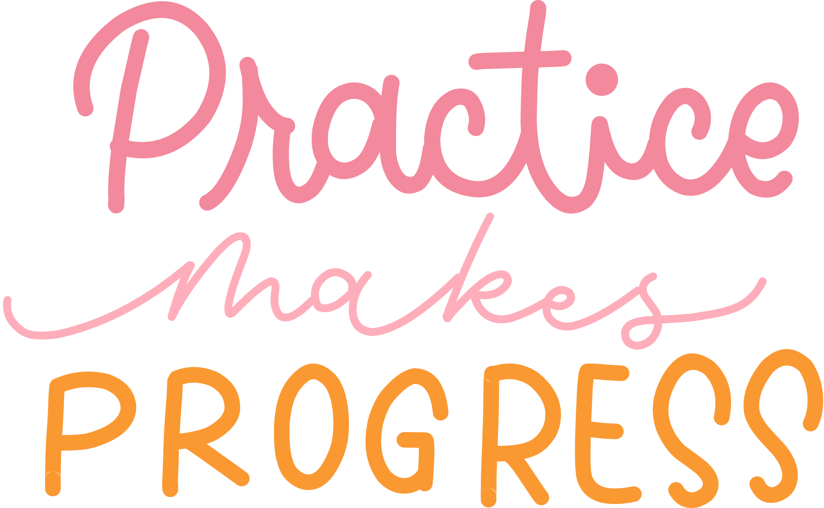

Trying it out
Trying it out
Based on what you’ve learned over the session, partner up and
  contract for a very short coaching approach conversation
  test out listening
  try a few questions
Any topic - professional or personal. What problem are you trying to solve? Or what are you curious about ?
Notes:
Time Allocation: 5 minutes
Key Messages:
Use this time to support people to engage in the trying out a coaching conversation.
Reassure people to enable them to give it a go! Can you observe some people testing it out? What does that tell you about embedding coaching in your setting?

Slide 32

Quick Recap
Quick recap
How did the trying out go?
Notes:
Activity : 5 - 10 minutes

Slide 33
Aims Review
Aims Review
  Build an understanding of the importance of contracting as the first step to establishing coaching relationships
  Build an understanding of the importance of listening in coaching relationships
  Build an understanding of the power of questioning
  Explore practical ways to build coaching relationships through contracting, questioning and listening.
Notes:
Closing Slides
Aims Review
Key Messages
Refer to the session aims. Have these been met?

Slide 34
Reflection Activity
Reflection Activity
  What future opportunities do we have to build coaching approaches in our setting?
  What potential impact would more coaching approaches have on our ways of working together?
Notes:
Closing Slides
Time Allocation: 5 - 10 minutes depending on level of discussion.
Key Messages:
This is a reflection activity. Participants can be encouraged to reflect on learning, future actions and next steps in their school or setting.
Professional Learning Activity (PLA) - This links to the Building Coaching Skills self-directed learning PLA
Suggested further reading:
https://education.gov.scot/professional-learning/self-directed-professional-learning/coaching-in-education/

Slide 35
Thank you
Thank you
Notes:
Facilitator Evaluation: As a facilitator of this workshop we would be grateful if you would complete the following evaluation about this resource, thank you - https://forms.office.com/e/peiYJF1jFn

