Slide 1
How do we embed rights?
For Scotland's learners, with Scotland's educators
Notes:
This is an internal page in blue and can be duplicated to create additional pages. Always keep the heading and footer as shown. Use the corresponding blue internal and back pages if you are using this page.

Slide 2
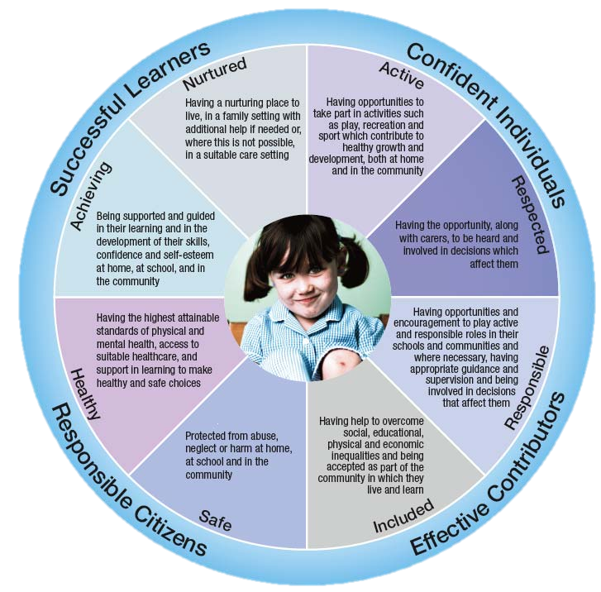

Wellbeing indicators and the articles
Which articles support each of the indicators of wellbeing?
For Scotland's learners, with Scotland's educators
Notes:
Children’s Rights and wellbeing are intrinsically linked. The indicators are overlapping and connected areas that are fundamental to understanding what children and young people need in order to grow, develop and thrive. The implementation of the UNCRC is a mechanism through which wellbeing can be achieved. Where a child’s rights have been respected, protected and fulfilled, their wellbeing should improve.
Optional Activity (if longer time for training – if not, just highlight the connection with wellbeing indicators) pick an article and place on the wheel
Facilitator reads out a few articles – participants to put in chat which wellbeing indicator it relates to.
Activity invites participants to see the articles at the heart of GIRFEC by sorting the cards into the 8 indicators of wellbeing.
In a similar way to the previous sorting activities, participants should take turns to discuss the articles and use the A3 SHANARRI wheel to write the article numbers and keywords.
Background information:
Previously outlined the link between UNCRC and GIRFEC
(http://www.scotland.gov.uk/Resource/0041/00417256.pdf)
Jamboard Activity
Pick out a few articles and discuss where it might sit with regard to the indicators.

Slide 3
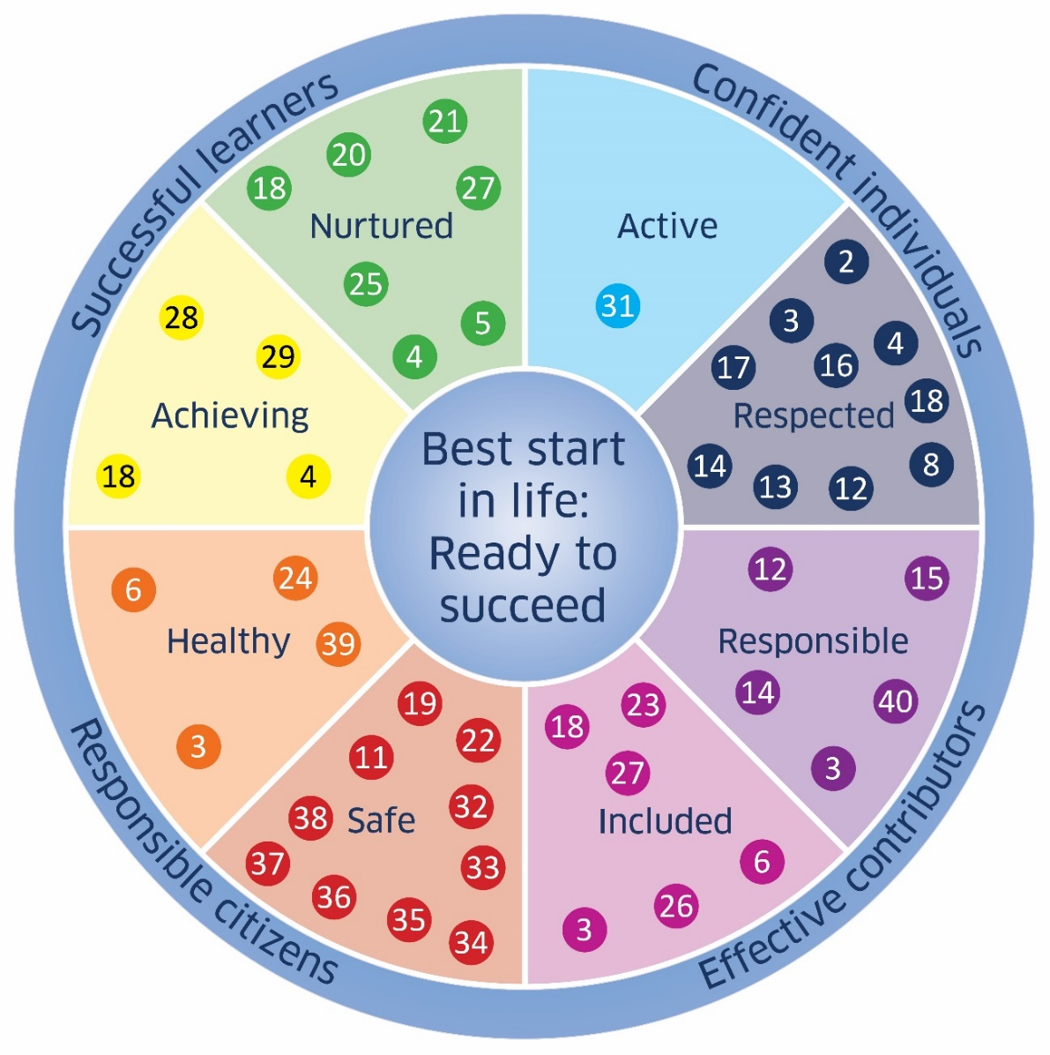

UNCRC Articles and the Wellbeing indicators
UNCRC: The Foundation of Getting it Right for Every Child
For Scotland's learners, with Scotland's educators
Notes:
What the government came up with.
http://www.scotland.gov.uk/Resource/0041/00417256.pdf

Slide 4
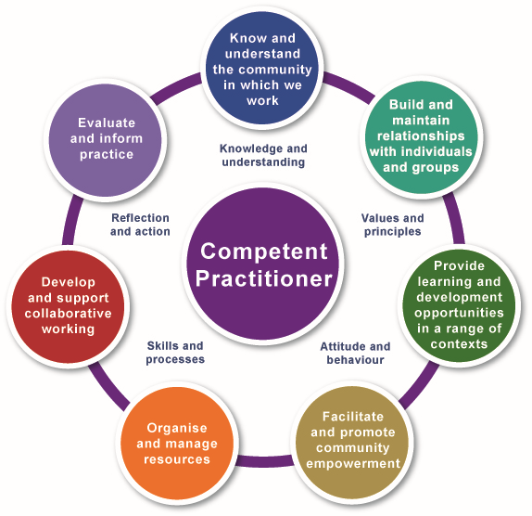
Competency Wheel
The Values of CLD:
Self-determination
Inclusion
Empowerment
Working collaboratively
Promotion of learning as a lifelong activity
http://www.cldstandardscouncil.org.uk
For Scotland's learners, with Scotland's educators
Notes:
Make it clear moving into CLD practice stuff!
Competences for CLD
http://www.cldstandardscouncil.org.uk/the_competences/Competences_for_Community_Learning_and_Development
Competent CLD workers
Competent CLD workers will ensure that their work supports social change and social justice and is based on the values of CLD*. Their approach is collaborative, anti-discriminatory and equalities-focused and they work with diverse individuals, communities of place or interest and organisations to achieve change. They can influence or lead people, understanding when this is or is not appropriate. Central to their practice is challenging discrimination and its consequences and working with individuals and communities to shape learning and development activities that enhance quality of life and sphere of influence.
They have good interpersonal and listening skills and their practice demonstrates that they value and respect the knowledge, experience and aspirations of those involved. They will initiate, develop and maintain relationships with local people and groups and work with people using:
non-formal contact;
informal support; and
informal and formal learning and development opportunities
Competent CLD workers will also have self-management skills, such as time management and communication, that are appropriate to the level at which they are practising. While these are not detailed in the competences, they are covered through the SCQF framework and the National Occupational Standards.
Critically Reflective CLD workers
CLD practitioners are aware of their values and principles and critically reflect on their practice and experience so that they integrate their knowledge, skills, values and attitudes and use these effectively in their work. They use self-assessment, participative processes and evidence of the impact of their work to plan and manage their activities.
These are essential to their ability to develop and manage their own practice and identify their own learning and development needs.
*The values of CLD are:
Self-determination - respecting the individual and valuing the right of people to make their own choices.
Inclusion - valuing equality of both opportunity and outcome, and challenging discriminatory practice.
Empowerment - increasing the ability of individuals and groups to influence issues that affect them and their communities through individual and/ or collective action.
Working collaboratively – maximising collaborative working relationships with the many agencies which contribute to CLD and/or which CLD contributes to, including collaborative work with participants, learners and communities.
Promotion of learning as a lifelong activity – ensuring that individuals are aware of a range of learning opportunities and are able to access relevant options at any stage of their life

Slide 5
National Occupational Standards for Youth Work
In 2018, CLD Standards Council Scotland was successful in its bid to review and develop the Youth Work NOS. This involved consulting with industry experts across the four nations within the UK, amending existing NOS where appropriate and developing new NOS according to the roles the sector representatives identified. The new NOS were published in 2019.
“Youth work involves engaging with young people to facilitate their personal, social and educational development and enable them to gain a voice, influence and a place in society. Youth Workers help young people to engage with their local communities, taking account of cultural diversity. They support the young person to realise their potential and to address life’s challenges critically and creatively.”
You can access the Youth Work NOS on CLD Standards Council website or by searching for ‘Youth Work’ in the NOS Database website here: https://www.ukstandards.org.uk/
For Scotland's learners, with Scotland's educators
Notes:
Ask participants to think about the connections between these standards and rights-based approach

Slide 6



Exploring values - Activity
What are the core values in your youth/community setting?
How do staff/volunteers share their values and use these to inform their practice?
How does a rights-based agenda help inform your values?
Menti Code 25 66 30 3
Link https://www.menti.com/cdo96yk5s4
For Scotland's learners, with Scotland's educators
Notes:
Part 1. 1st bullet point – wordcloud then answers to 2nd and 3rd in chat pane
Menti Code 25 66 30 3
Link https://www.menti.com/cdo96yk5s4

Slide 7

Exploring values - Activity
If I was to walk into your youth/community setting, what would I see, hear, feel that would show your professional values in action, particularly in relation to rights?
If I asked young people to write down 5 words describing how it feels to be in your setting, what would they write down?
Menti Code 25 66 30 3
Link https://www.menti.com/cdo96yk5s4
For Scotland's learners, with Scotland's educators
Notes:
Part 1. 1st bullet point – wordcloud then answers to 2nd and 3rd in chat pane
Part 2. Further menti wordcloud
PHOTO

Slide 8
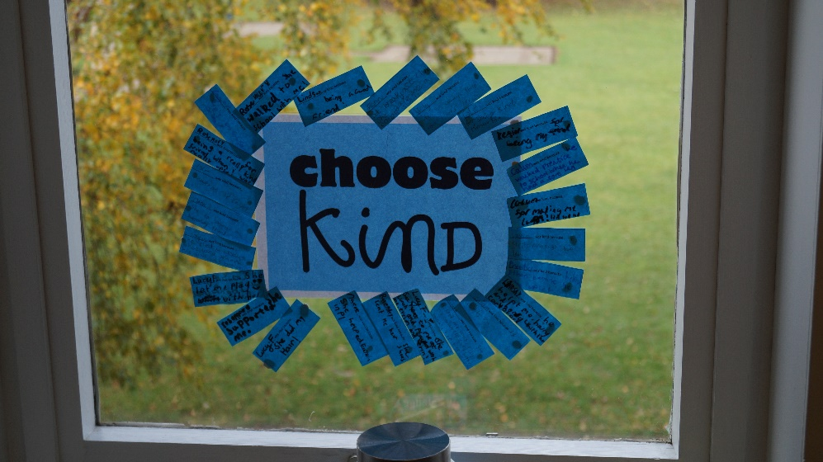
Activity – What is rights-based practice?
Jamboard Activity
What rights-based practice is
What rights-based practice isn’t
For Scotland's learners, with Scotland's educators
Notes:
If we have time this could be breakout rooms
Maybe have some examples for this?
https://jamboard.google.com/d/1tZsb1TVaLy7B3L5xY6ObHFY8B9qrxDw7uIeBeJnfp3k/edit?usp=sharing

Slide 9
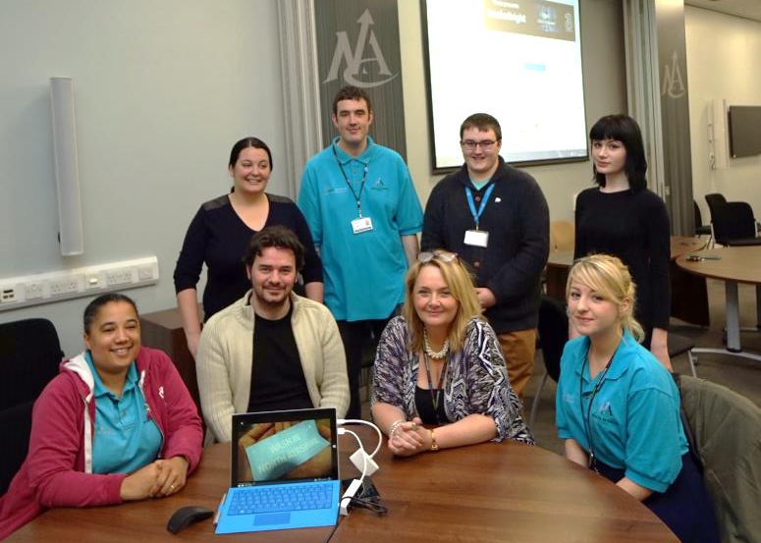
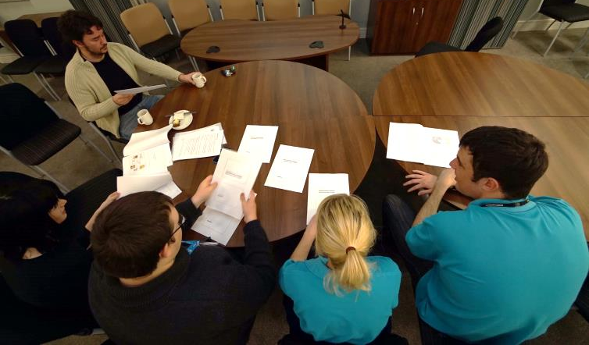
Realising Children’s Rights – North Ayrshire Council
Youth Council identified schools toilets as a priority issue
Concern about safety, privacy and adequacy of facilities
Youth-led investigation and research
Recommendations Report
Implementation / Impact
For Scotland's learners, with Scotland's educators
Notes:
Flushed for success
‘Flushed for success’ is one example of a successful initiative led by North Ayrshire Youth Council as part of the Councils overall rights based approach to youth engagement:
Flushed for success - case study
The North Ayrshire Youth Council identified school toilets as a priority issue for children and young people.
There were indications that people felt unsafe using toilets, voicing issues with privacy and inadequate facilities.
The Youth Council embarked on a project to investigate this in more detail, including carrying out surveys with children and young people in primary and secondary school, engaging with local decision makers and running events to identify what would improve school toilet facilities.
The outcome was a report which provided guidance for the design of the ‘ideal school toilet facilities’, with recommendations such as full-height doors and cubicles to improve privacy.
This guidance has informed schools building work, with as much of the recommendations being implemented as possible when design of new school toilets and refurbishing existing facilities.
For further information on the work of NAC Youth Services team contact – Angela Morrell, North Ayrshire Council Youth Service team manager

Slide 10
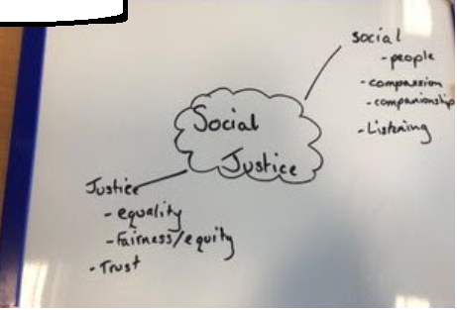
Realising Childrens Rights
Stirling Social Justice Ambassadors
The Social Justice Ambassadors is a project initially co-designed by Stirling Youth Forum with the vision of all young people being confident in using their voice and being heard.
Using a problem-based learning approach to understanding the socio-economic challenges facing young people, the group applied backward mapping, to identify areas they felt the wider group of young people would benefit from.
The group co-designed an interactive/fun learning sessions for young people. This was the prototype of the Stirling ‘Toolkit’ which has now been further adapted into a Digital interactive toolkit.
The intention is to upskill a diverse group of learners from each school to become young researchers. Currently there are 60 active participants across 7 high schools. In each of the schools, participants are currently leading on the first round of their research (January 2021).
Stirling High School - Social Justice Ambassadors
For Scotland's learners, with Scotland's educators
Notes:
The young researchers will lead a piece of research to understand challenges within their school community, capturing the wider schools experiences. Following this, the young researchers work within a collaborative team (staff and pupils) to identify resources/spend to tackle the challenges.
Ask for additional examples / case studies

Slide 11

Realising Children’s rights - Activity
How might a particular priority in your setting fit with the Articles?
How can the links with the articles be made more evident to both duty-bearers and rights-holders?
For Scotland's learners, with Scotland's educators
Notes:
Think about a specific approach/intervention/improvement plan priority in your setting and discuss how you think that this might fit with the articles from UNCRC
How can the links with the articles be made more evident (to both the duty-bearers and to children/young people to help empower them to claim their rights?)
Answers in chat pane?? Examples
Jamboard

Slide 12
Realising children’s rights – Youth participation
ARTICLE 12 OF THE UNCRC PROVIDES:
“1. States Parties shall assure to the child who is capable of forming his or her own views the right to express those views freely in all matters affecting the child, the views of the child being given due weight in accordance with the age and maturity of the child.
2. For this purpose the child shall in particular be provided the opportunity to be heard in any judicial and administrative proceedings affecting the child, either directly, or through a representative or an appropriate body, in a manner consistent with the procedural rules of national law.”
For Scotland's learners, with Scotland's educators
Notes:
Introducing the topic of youth participation

Slide 13
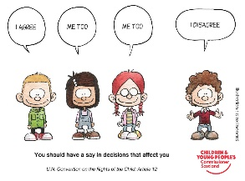

What does youth participation mean to you?
What does youth participation mean to you?
How do children and young people in your setting learn about the UNCRC?
For Scotland's learners, with Scotland's educators
Notes:
Chat pane
This is guidance for schools and early learning and childcare centres to support learner participation in their settings. It provides:
A definition of learner participation
Principles for learner participation
Benefits and rationale for learner participation
Four arenas of learner participation
Video case studies
Support materials to support implementation

Slide 14
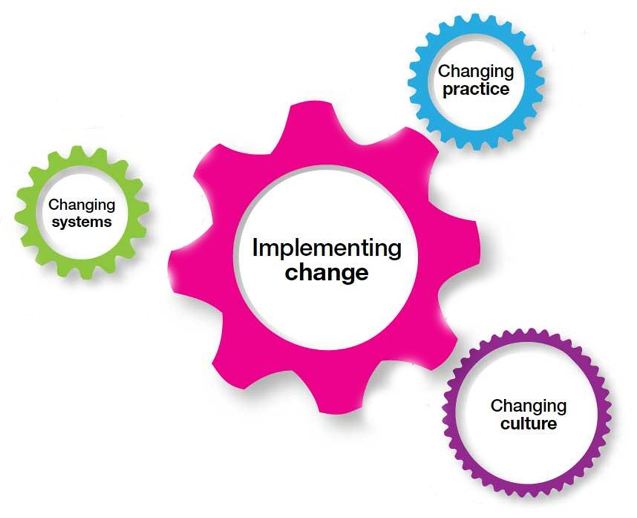
Implementing change to support rights-based practice
UNCRC and MY practice
UNCRC and OUR practice
What next?
For Scotland's learners, with Scotland's educators
Notes:
It is important to take time to reflect on what the UNCRC means for those who work with children and young people.
There are 3 levels for this reflection:
How well do I know and support the articles of the UNCRC in my practice?
Which of the articles particularly pertain to the work I do with children/young people? How effectively do I currently support and promote these articles in and through my work? How do I know that what I do is effective?
What can I do now? What can I do better?
Is this a clear improvement priority?
What is our starting point? How do we know?
Is our Ethos currently based on rights?
Who will lead the rights agenda with staff? How?
Who will lead the rights agenda with pupils? How?
When will we learn about rights?
What support/resources are available?
What improvement is feasible in this year?
How will we know we have grown in how we realise children’s rights?
How will good practice be recognised and shared?

Slide 15
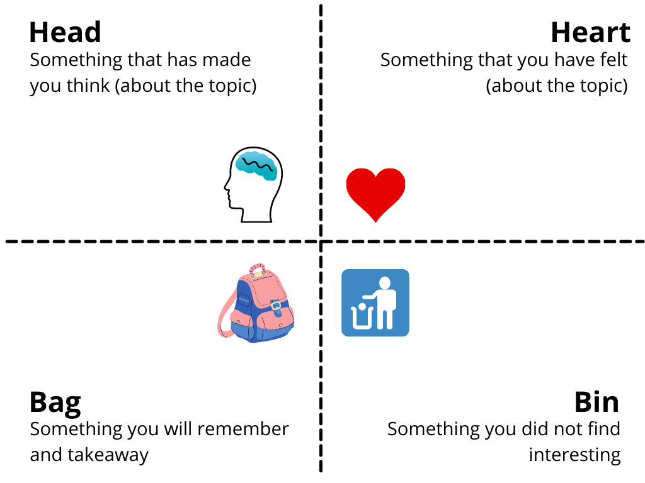
QUESTIONS &
JAMBOARD (pg. 8) EVALUATION
For Scotland's learners, with Scotland's educators
Notes:
JAMBOARD
https://jamboard.google.com/d/1tZsb1TVaLy7B3L5xY6ObHFY8B9qrxDw7uIeBeJnfp3k/edit?usp=sharing
Evaluation link – chat box

Slide 16





Contact details:
Julie.Beckett@educationscotland.gov.scot
Susan.Epsworth@educationscotland.gov.scot
srobertson@youthlinkscotland.org
For Scotland's learners, with Scotland's educators
Notes:
This is a back cover page in blue. You may edit the address if needed only. It can only be once and at the end of the PowerPoint presentation. Use the corresponding blue internal and back pages if you are using this page.

