Slide 1


Effective use of data
1. Establishing the purpose and use of data
Practitioners
Notes:
All information is correct as of May 2024
These slides are intended to support senior leaders, middle leaders and practitioners in schools and local authorities to explore the effective use of data for improvement. There are a set of six workshops available for delivery to senior leaders and middle leaders and a set of six workshops for delivery to practitioners. The workshops were co-designed with educators from across Scotland and are based on an Education Scotland literature review: The Effective use of data for improvement in education. The literature review contains six sections outlined below. There is a workshop for each section.
Establishing the purpose and use of data
Defining and classifying data
Creating effective processes and systems
Interpreting and analysing data
Developing a data informed culture
Using data for improvement
(hyperlinks for each workshops can be found on the next slide)
The PowerPoint is a template that presenters can adapt to suit their own context and style of presenting. The workshops can be delivered individually, or they can be grouped together and delivered in a longer session. Individual workshops have been designed for facilitators to deliver in 1-to-2-hour sessions.
Within the slide notes key messages, suggested tasks, ‘talking-points’ and challenge questions are included.
It is anticipated the presenter will have read the Education Scotland literature review: The Effective use of data for improvement in education.

Slide 2
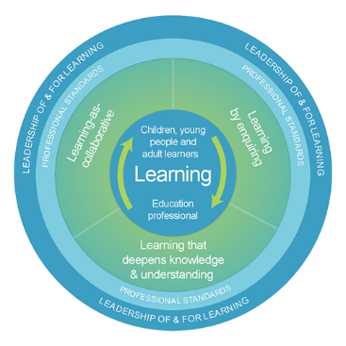
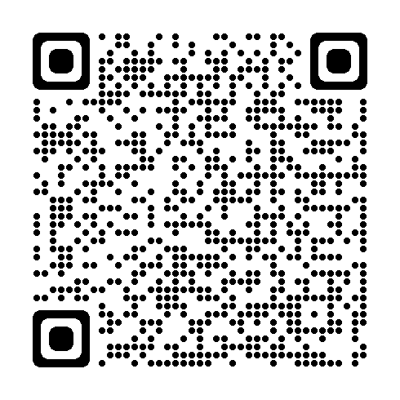
The national model of professional learning
The national model of professional learning | Professional Learning | Education Scotland
Notes:
Key Messages
This module has been designed using the national model of professional learning and the principles of adult learning or andragogy. It has been designed to think about:
The why – opportunities for participants to understand the rationale through professional standards, research, current policy landscape and national/local priorities.
The what – opportunities for participants to consolidate and develop relevant knowledge and skills
The how – opportunities for participants to take part in peer discussion, explore case studies or share experiences
Apply – a chance to reflect on learning, next steps and further support
A link to further information about the national model of professional learning can be found below.
edscot-model-of-professional-learning-outline.pdf (education.gov.scot)

Slide 3

Draft agreement and protocols
We all work together
We learn from, with and on behalf of each other
We create a safe space to share ideas and build learning
We agree that everyone is an equal and valued participant
We remain ‘in the room’ (follow email and phone protocol)
Notes:
Key Messages
Take a moment to establish group protocols.
Ask participants to comment on anything they would like to add or amend.
Is there anything that participants feel is missing or anything they would like to remove?
The protocols on the slide are suggestions to be amended for your context.

Slide 4

Connector
In groups or pairs:
Agree on something you all like
Agree on something you all dislike.
TASK
Notes:
Key Messages
This is an example of a simple connecter activity. It is recommended that facilitators use a connector activity that allows participants to take part in an informal discussion.
This is to ensure that participants are relaxed, focused and ready for an interactive workshop.

Slide 5

Aims
In this workshop we will consider:
the meaning of data and evidence in education
what guidance and research says about the importance of data and evidence
how data and evidence can inform our decision-making
the difference between ‘big’ and ‘small’ data.
Notes:
Key Messages
These are the aims of the workshop which will support participants to consider:
The meaning of data and evidence in education
What guidance and research says about the importance of data and evidence
how data and evidence can inform our decision-making
the difference between ‘big’ and ‘small’ data.

Slide 6
Content coverage
Data definitions and the bigger picture
National guidance and research
The purpose of using data
Big and small data
Data bias and limitations
Impact of data
Reflections
Notes:
Key Messages
This slide shows the content covered throughout the workshop. Further details and suggested timings are provided below. Facilitators can amend content and timings to suit their needs and context.
Data definitions and bigger picture – allow 15 - 20 minutes for this section which includes 2 short discussion tasks.
National guidance and research – allow 10 minutes for this section. It can be extended to 15-20 minutes if facilitators wish to include an extra activity that allows participants to read the relevant section of the national evidence review.
The purpose of using data – allow 5 - 10 minutes for this section
Big and small data – allow 15 minutes for this section which includes an activity where participants are asked to read a short article and discuss.
Data bias and limitations – allow 5 minutes for this section
Impact of data – allow 5 minutes for this section
Reflections – allow 15 - 20 minutes for this activity including feedback and discussion from each group. The group activity provides an opportunity for participants to pull together and reflect on learning.
In total this workshop can be expected to take between 70 minutes and 1.5 hours to complete.

Slide 7
Data as we know it
Discuss all the different things that you think could be classed as data within your classroom/setting.
Make a list.
TASK
Notes:
Key Messages
Can be done in pairs or small groups.
This task is designed to get the group warmed up and thinking about data.
Suggested time 5 minutes, including time for feedback

Slide 8
What is data?
“Educational data is any information, textual or numerical, that can be used in a systematic way to inform educational practice.”
The Evidence Institute
Notes:
Key Messages
Data is information, especially facts or numbers, collected to be examined and considered and used to inform decision making.
In education we often focus on numerical data but there are many other types of data that we need to consider in our roles. This session will explore this.

Slide 9

What is evidence?
"Evidence can be described as information used to demonstrate impact and support decision making. Evidence can be data, in many forms, and a knowledge base about what works."
Rapid Evidence Review
Notes:
Key Messages
Evidence can be described as information used to demonstrate impact and support decision making. Evidence can be data, in many forms, and also a ‘knowledge base about what works’.
A knowledge base can be drawn from a number of sources including research, shared practice and case studies.
Talking Points
Consider the difference between evidence and felt knowledge (felt knowledge refers to feelings or professional hunches). Why is evidence important?
Reflective questions
How do you form your ‘knowledge base about what works’ in your school or setting?
How effectively do you use a range of evidence to demonstrate impact?

Slide 10

Types of data – quantitative and qualitative
Talking Point
Data can be split into two main categories:
Quantitative
Deals with information that can be counted or measured
Data which can be given a numerical value
Qualitative
Deals with descriptions
Data that can be observed and recorded but not necessarily measured
Can you think of examples of where you use quantitative or qualitative data in your classroom or school?
Notes:
Key Messages
Examples of quantitative data could be the number of learners in a class/school, SIMD data, ACEL data, exam pass rates. This is sometimes called hard data
Examples of qualitative data could be responses from learner/parent/teacher focus groups, observations of a learner. This is sometimes called soft data
Sometimes people will have a preference or view that one type of data is superior to another – for example, that quantitative data is better because numerical data is more objective, or that qualitative data is better because some things that are very important (e.g., quality of relationships) can’t be measured using numbers. In reality, both types of data have a role in education and it is important to be aware of the strengths and limitation of each type of data. Quantitative data is often the data that can alert us that something is happening (e.g., attendance is improving, attainment in a subject is worsening), but qualitative data is often that data that provides important details about why or how something is happening.

Slide 11
What do we mean by data?
Defining ‘data’:
Different people have different definitions of data:
  For some, data means only numerical data
  For others, data means all evidence and information
When thinking about data use in education, it can be helpful to define data as information that has been systematically collected in some way, as this helps differentiate data from professional judgements or opinions.
Notes:
Key Messages
While different people have different definitions of data, the idea of data being systematically collected information can help us draw distinctions between what is data and what is opinion/judgement when making decisions. For example, based on observations over time, we may decide that some learners in our class have negative views of a certain activity (e.g., writing). This could be based on a range of informal observations e.g., overheard comments, facial expressions, body language, putting in less effort over time – these observations are very useful, but haven’t been systematically collected.
In contrast, information that was collected in a more formal way – e.g., through learner surveys or focus groups – could be said to be systematically collected and thought of as data, and we may find that the ‘data’ gathered confirms or contradicts our informal impression or judgement.
A benefit of collecting data is that it means we have to be explicit about what information we are gathering and why, and this means that systematically collected data is more ‘transparent’ to others. For example, we may have informally made a judgement that using a particular pedagogical approach has really helped a class to make progress with their learning, but if we were gathering data we would need to be clear on what we meant by progress in learning and how were measuring this (e.g., ACEL data, less formal assessments, learner self-report etc.).

Slide 12
The bigger picture
Being clear about what type of information we are using and why helps us to think about what we know and what we don’t know.
Each ‘way of knowing’ has its own advantages and disadvantages, and we should aim to avoid making significant decisions based on solely one element.
Formal Research
Practitioner Research
‘Big’ Data (formal)
‘Small’ Data (informal)
Professional Judgement
Model adapted from Van Lommel Teachers’ decision-making: Data based or intuition driven? | Request PDF (researchgate.net)
Notes:
Key Messages
Data forms part of a wider range of information and evidence that we use to inform decision-making. Diagram illustrates the bigger picture.
This model for evidence-informed decision-making can help us to think about where data sits in relation to other sources of evidence
It can help us reflect on what we tend to use when making decisions, and whether we are using a good balance of evidence or are overly reliant on one way of thinking.
It’s important to note that the different parts of this model interact with each other. For example: Formal research (e.g., on working memory) may inform the focus for a practitioner enquiry - Big data (e.g., attainment data) may affect what formal research we engage with (e.g., attendance has been worsening, what research is available on approaches to improve attendance)

Slide 13
The bigger picture – part 1
Talking Point
Formal Research
Practitioner Research
‘Big’ Data (formal)
‘Small’ Data (informal)
Professional Judgement
Notes:
Key Messages
Formal research – refers to larger-scale research (or summaries of research) carried out by professional researchers. Formal research is useful in helping us think beyond our own experience and immediate settings, but it can be challenging to know exactly how to implement findings – for example, what does that look like in our setting for our learners?
Practitioner research – refers to smaller-scale research carried out by individuals or small groups of practitioners, within or across settings, and includes activities like practitioner enquiry, action research and collaborative enquiry. Practitioner research helps us to think about what happens when we try an idea of approach in our setting, but findings may not be generalizable – meaning that something that has been effective for a specific class or teacher may not be easily transferable to another class, school or teacher.
Talking Point
Time-permitting, invite the group to think of their experiences of using either formal research or practitioner research - can they think of examples of when they have used either to inform their thinking? Was it useful for them?
In their opinion, what are the advantages or disadvantages or using formal research or practitioner research?
Practitioner Enquiry – not about proving something. Instead asking “What happens when…” and being systematic about it

Slide 14
The bigger picture – part 2
Formal Research
Practitioner Research
‘Big’ Data (formal)
‘Small’ Data (informal)
Professional Judgement
Notes:
Key Messages
Professional Judgement –
refers to expertise built up based on experience. This allows us to make judgements quickly – e.g., this lesson is going really well, that learner is struggling – without going through a formal process of gathering and analysing information.
can often feel almost intuitive, and is very helpful in situations where time for in-depth analysis is limited (e.g., mid-lesson in a classroom).
This definition is based on research on expert decision-making, which tells us that experienced practitioners in different fields can become skilled at quickly processing a wide variety of different information and using this to make decisions. This differs from using data because this information isn’t gathered in a systematic and focused way, but is built up based on informal observations and impressions.
It’s important to note that for experts this information-processing can happen so quickly that is almost unconscious, and when we are thinking in this way we can reach conclusions almost without knowing how we got there. Being able to make decisions quickly like this is essential to working well in fast moving environments – especially a classroom – where we don’t have time to stop and gather and analyse data carefully for every decision we’re making.
A potential challenge of this type of decision-making is that they can be more prone to personal bias. We can also make these types of judgements so quickly and automatically that they can almost feel like common sense, which means that we can incorrectly assume that other people will understand a situation in the same way as us
Using other sources of information can help us check our thinking – for example, we may feel that a sequence of lessons has gone well, but if this doesn’t match a post-topic assessment we may need to dig deeper.

Slide 15
The bigger picture – part 3
Formal Research
Practitioner Research
‘Big’ Data (formal)
‘Small’ Data (informal)
Professional Judgement
Notes:
Key Messages
Over the next few slides we will start to explore what data is and some of the different types.

Slide 16
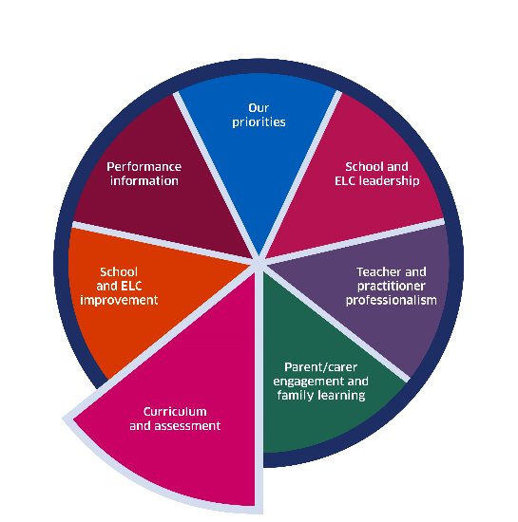
The National Improvement Framework
Where progress is good or better, senior leaders and staff track children’s and young people’s progress carefully. They use assessment information and data effectively to understand the progress children and young people make.
Achieving Excellence and Equity - 2024 National Improvement Framework and Improvement Plan (www.gov.scot)
Notes:
Key Messages
The National Improvement Framework highlights that the most effective schools use data to carefully track progress and use assessment information to understand the progress children and young people make.
Reflective Questions
How effectively do you use data to understand progress in school? How is this done and who is involved?

Slide 17
GTCS Standards for Full Registration and Career Long Professional Learning
Curriculum and Pedagogy
3.1.1 - Plan effectively to meet learners’ needs
3.1.4 - Effectively employ assessment, evaluate progress, recording and reporting as an integral part of the teaching process to support and enhance learning.
Professional Learning
3.3.2 - Engage in reflective practice to develop and advance career-long professional learning.
GTCS The Standard for Full Registration
GTCS - The Standard for Career-Long Professional Learning
Notes:
Key messages
The GTCS Standard for full registration and for Career Long Professional Learning highlights the importance of the use of data in decision-making.
The standard is the same for both groups.
This standard emphasises the importance of data being used to support planning and enhancing learning.
Reflective Questions
How wide ranging and robust is the data you are using in school? How do you know?

Slide 18
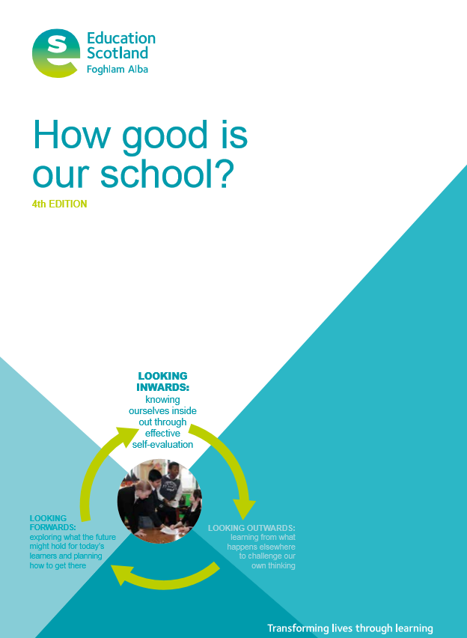
HGIOS 4
Staff make effective use of current available data on levels of child poverty and apply this to ensure equity (1.5)
All teachers have well-developed skills of data analysis which are focused on improvement (2.3)
We use data to evaluate the effectiveness of interventions designed to improve outcomes for all learners (2.3)
Notes:
Key Messages
The image of How Good is our school can be replaced with other HGIO publications.​
How Good is Our School 4 describes the ways in which schools may use data effectively for improvement. This includes:​
​
Gathering data to monitor and track progress​
Regular interrogation of data​
Making effective use of data on child poverty to ensure equity, and​
Ensuring that all teachers have well developed skills of data analysis​
Reflective Questions
How confident are we in using data to focus on improvement?

Slide 19
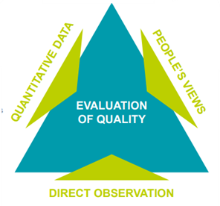
Triangulation of data
How good is our school? (4th edition) (education.gov.scot)
Notes:
Key messages
Triangulation is the process used to ensure evaluative statements about strengths and aspects for development are grounded in a robust evidence base. The triangulation of evidence-based information and data, people’s views and direct observation of practice should involve all school staff, learners, partners and other stakeholders. This process leads to a shared assessment of risk and an understanding of your school’s capacity for continuous improvement.

Slide 20
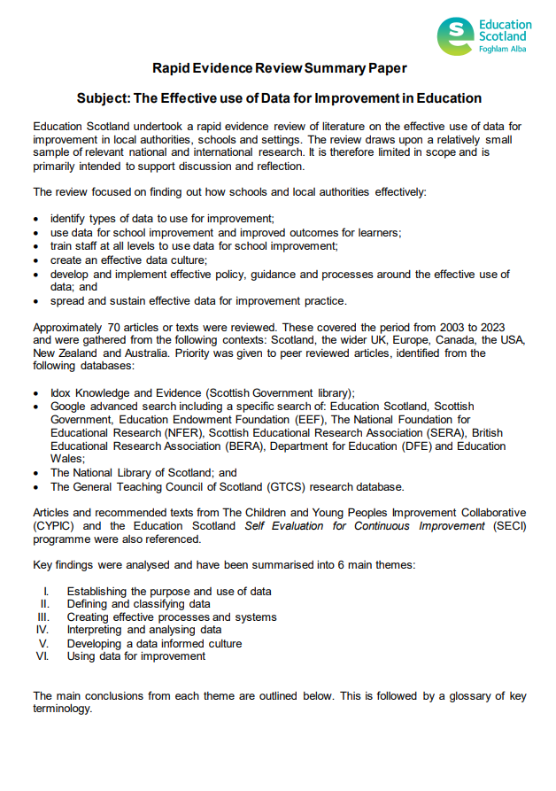

Rapid Evidence Review Paper
Section one of the Education Scotland Rapid Evidence Review on establishing the purpose and use of data highlights that:
data should be used for a range of purposes by educators at all levels in the system and it is ‘everyone’s responsibility’
data can be used to encourage practitioner reflection and influence pedagogy/practice
educators should be clear about the link between ‘big’ and ‘small’ data and
educators should be aware of the strengths, limitations and potential bias of data.
Notes:
Key Messages
Section one of the rapid evidence review on establishing the purpose and use of data highlights that:
data should be used for a range of purposes by educators at all levels in the system and it is ‘everyone’s responsibility’
data can be used to encourage practitioner reflection and influence pedagogy/practice
educators should be clear about the link between ‘big’ and ‘small’ data and
educators should be aware of the strengths, limitations and potential bias of data.
The Effective use of data for improvement in education
Talking Points
This may be a good point to ask participants to read section one on establishing the purpose and use of data and discuss in small groups or pairs.

Slide 21

Data and equity
Features of highly effective practice include:
Effective use of a wide range of qualitative and quantitative data and evidence to understand the poverty-related attainment gap and the interconnections between additional support needs and poverty.
Interventions are effective because they are informed by robust analysis of data.
Scottish Attainment Challenge - Self-evaluation resource (education.gov.scot)
Notes:
Key Messages
Data plays an important role in closing gaps for learners including learners affected by poverty.
The Scottish Attainment Challenge - Self-evaluation resource (education.gov.scot) highlights features of effective practice including:
Effective use of a wide range of qualitative and quantitative data and evidence to understand the poverty-related attainment gap and the interconnections between additional support needs and poverty.
Interventions are effective because they are informed by robust analysis of data.

Slide 22
The purpose of data
To identify next steps
To measure the impact of interventions and approaches
To understand progress or otherwise
To inform planning
To diagnose needs
Data is used to understand ‘why’ learners have specific gaps.
Planning for improvement is data informed. The data used is effective because it has been triangulated.
Data is used to track and monitor progress throughout the improvement cycle.
Data effectively informs next steps for learners and families.
Schools use data to evidence the impact of interventions and approaches.
Notes:
Key Messages
Data can have several purposes in schools including:
Diagnosing needs – using data to understand why learners have specific gaps.
To inform planning – Triangulated data is used to inform improvement planning. Triangulating data refers to a process of utilising several different sources of information to draw the same conclusion.
To understand progress or otherwise – data should be used to track and monitor progress throughout an improvement cycle. Measures should be built into the planning process.
To identify next steps – data is used to inform next steps for learners and families.
To measure the impact of interventions and approaches – data should be used to track and monitor the impact of specific interventions or approaches introduced to close gaps.
Reflective Question
Do participants use data for any other / different purposes?

Slide 23

The purpose of data – part 2
To diagnose needs
To inform planning
To understand progress or otherwise
To identify next steps
To measure the impact of interventions
and approaches
Consider how effectively we use data in our own class/setting for a range of purposes. Discuss in groups or pairs.
Notes:
Key Messages
This is a discussion tasks. Ask participants to consider how effectively we use data in our own class/setting for a range of purposes. Discuss in groups or pairs.

Slide 24

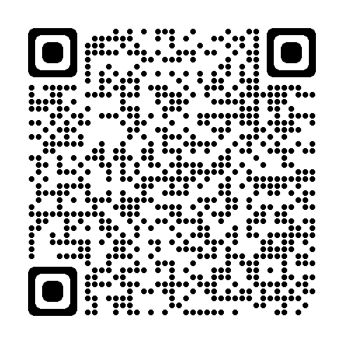
‘Big’ and ‘small’ data
Read the blog post by Pasi Salberg and consider:
What do we mean by big and small data?
What are the strengths/limitations of big and small data?
Big Data or Small Data: What’s the key to unlocking learning opportunities? | Pasi SahlbergPasi Sahlberg
Notes:
Key Messages
This is a task. It can be helpful to think of data as ‘big’ or ‘small’. Read the short blog by Pasi Salberg and consider the following questions:
What do we mean by big and small data?
What are the strengths/limitations of big and small data?
Talking Points
The facilitator may wish to draw out the following points:
‘Big’ data as the ‘wider view’, whole school data. It can be quantitative such as ACEL, SCQF data or qualitative such as whole school surveys.
‘Small’ data as more localised and closer to the learner. For example, observations, jotters, Afl, informal/smaller scale tests such as reading records or quizzes.
It is the link between small and big data that is important. ‘Small’ data helps us to understand the patterns and trends we see in the ‘big’ data.

Slide 25
‘Big’ and ‘small’ data – part 2
‘Big data’ in education may refer to data such as ACEL data, SCQF data or whole school surveys or questionnaires.
‘Small data’ in education may refer to data such as work in jotters, observation notes, formative assessment information or a running reading record.
It is important that all staff understand the connection between small data and big data.
It is often the ‘small data’ that moves the ‘big data’.
Notes:
Key Messages:
‘Big data’ in education may refer to data such as ACEL data, SCQF data or whole school surveys or questionnaires.
‘Small data’ in education may refer to data such as work in jotters, observation notes, AfL information or a running reading record.
It is important that all staff understand the connection between small data and big data.
It is often the ‘small data’ that moves the ‘big data’.
Thinking back to our ‘big data’ in the form of stretch aims or whole school improvement measures – the improvement will happen closest to the children and young people and will be informed by small data.

Slide 26
‘Big’ and ‘small’ data – part 3
‘Big Data’
Our numeracy and attainment in P7 is lower than previous years.
‘Small Data’
Using formative assessment to identify where the gaps are and using this to inform planning
observing the pedagogical approaches which have the most impact, e.g. questioning approaches, using concrete material
low stakes quizzes
jotter work
conversations with learners.
Example data for illustrative purposes only
Notes:
Key Messages
This diagram provides an example of the way in which big and small data are connected.
Imagine that the big data indicates that numeracy attainment in P7 is lower than previous years. Looking at the small data will provide detailed information on why that is the case and help educators to plan appropriate actions. E.g. which specific learners do we need to focus on and how will we do this?

Slide 27
‘Big’ and ‘small’ data – part 4
LA Literacy
Whole School
Literacy
Identify schools with lowest literacy attainment.
Identify the patterns – area of literacy, groups across the LA.
Offer targeted / universal support and challenge.
Identify patterns across school: cohorts, groups of learners.
Intersect data to ask questions about ‘why?’ which may help inform ‘what?’.
Tailor expectations, professional learning, support and QA processes to improvement.
Support a holistic approach as required e.g. pastoral support.
Progress check ins.
Notes:
Key Messages
Big data moves to small data. LA to School to practitioner
Practitioners are the key people who improve the big data by focusing on the small data

Slide 28
‘Big’ and ‘small’ data – part 5
Practitioner
Literacy
Identify specific learners / groups of learners within the class.
Forensic analysis to identify gaps and needs.
Tailor curriculum and pedagogy to learner needs.
Differentiate to close the gaps.
Develop learner confidence and enthusiasm.
Daily/weekly monitoring and tracking.
Ensure high quality feedback that learner engages with.
Adjust/seek further support as required.
Moderate / engage in professional dialogue to support learning with colleagues and partners.
Apply whole school approaches and training.
Engage in progress discussions and implement any agreed actions.
Identify next steps.
Notes:
Key Messages
there will never be enough time to systematically gather data on everything
we should be selective and think about where systematically gathering small data is likely to be most useful for us
big data can help us focus us our thinking. For example, if we are seeing a decline in literacy attainment between first and second level, what more do we need to find out about why this is happening?
It's important to note that data use is most effective when it is used to prompt questions rather than jump to conclusions. For example, this trend could be reflective of something that could be improved in teaching across second level, or may reflect differences in how learners are being assessed in first and second level – collaborative discussion of data drawing on professional judgement and appropriate 'small' data.
A similar process can help us build on successes – for example, if attendance has improved, do we know why and how this has happened?

Slide 29
Bias
Data can be biased when it is limited in ways which mean that it provides an inaccurate or incomplete picture. Bias is often unintentional. For example:
Sampling bias – where the group that data is gathered from is not representative
Confirmation bias – tendency to look for data that confirms rather than challenges our views
Notes:
Key Messages
It’s important to note that while data can be deliberately biased it’s much more likely to happen by accident. For example:
Sampling bias – e,g. – we are trying to gather a representative sample of views through a survey, but only 27% of people responded. In this case we should be aware that this might not be a random sample – for example, it may be the case that parents who are more likely to respond to school surveys may be more engaged and more likely to be in favour of more homework than the parent group as a whole, or vice-versa
Confirmation bias – this refers to a tendency to interpret data in ways that confirms our existing thinking, or gather data that supports rather than challenges our current thinking. For example, we might see that all learners who had been receiving support with reading had improved their reading scores over the intervention period. However, you would also expect some improvement over time even if they weren’t receiving additional support – how can we actually know that it is the support that is making the difference?

Slide 30
Limitations
It is important to be aware of any potential limitations of the data we are using. For example:
Would SNSA scores be the most appropriate way for us assess if a new approach to teaching a specific reading skill in literacy is effective for a S2 class?
If learners respond to a survey that they are ‘confident’ or ‘very confident’ in using concrete resources in mathematics can we assume that we would see these used consistently and effectively in class?
Notes:
Key Messages
Time-permitting, you could allow for discussion of the two questions above, or just go through the points below:
It’s important to be aware of the limitations of different types of data, for example:
In the first example we may be talking about a relatively small-scale change. In this case, SNSA data is unlikely to be sensitive enough to give us a full understanding of what is happening – the new approach may be effective, but simply not have a big enough impact to show up as a significant change in SNSA data. Also, as SNSA data is not going to be available until S3 it will not tell us quickly enough what we’re wanting to know – if the approach is effective, and whether it should be developed, adjusted, or abandoned. In this case, formally or informally gathering some ‘small’ data – learner feedback, observations, performance on in class tasks and assessments – is more appropriate
The second example highlights the importance of being clear about what we’re actually measuring. Firstly, if the survey is asking how confident you are, this isn’t the same as asking whether you are using an approach consistently or effectively. Secondly, questions like these are quite subjective – how can you be sure that your understanding of what ‘very confident’ means is that same as other people completing the survey? So, while a survey like this might yield quantitative data such as ‘85.3% of out learners are confident or very confident’, without triangulating data from other sources it might not actually tell us very much about what is happening in classrooms – are the strategies being used, and, more importantly, are they being used in a way that is impactful for learners?

Slide 31
Bias – part 2
It is important to be aware of the potential bias in or limitations of data. What questions might you have about the example data below?
All learners made progress in their latest spelling assessment.
Was the assessment appropriately challenging for each learner? Are learners able to apply this across their learning consistently?
80% of parents and carers said that more homework should be sent home.
How many people actually completed the survey? Was this a good representation? Does it identify specific homework tasks which are seen as most beneficial?
100% of girls achieved third level in writing.
Is this the whole cohort or a smaller specific group of learners? How robust was this judgement, what was it based on? How does this trend over time?
Examples data for illustrative purposes only
Notes:
Key Messages
This is a discussion task.
We often are presented with data but how often do we stop and consider the potential bias or limitations of what we are looking at?
What questions might you have if you were presented with the examples of the screen?
Talking points
The facilitator may wish to draw out:
Are there examples of confirmation bias here?
What are the limitations are evident here?

Slide 32
Impact of data
Think of a time when access to data has had a direct impact on the learning and teaching in your classroom/setting.
What was the data and how was it collected?
What did you differently as a result?
What impact did your changes have on the learning and teaching in your classroom/setting?
Share/discuss with colleagues.
TASK
Notes:
Key Messages
This is a discussion task
Talking points
The facilitator may wish to draw out
Might be spotting similar spelling mistakes when marking jotters, or changing your H&WB plans because you've noticed in your class discussions that several pupils didn't feel valued or felt they belonged in your school, or even using diagnostic assessments in maths to identify specific gaps in learning for a group of children.

Slide 33
Aims review
In this workshop we will consider:
the meaning of data and evidence in education
what guidance and research says about the importance of data and evidence
how data and evidence can inform our decision-making
the difference between ‘big’ and ‘small’ data.
Notes:
Key Messages
Refer to the session aims. Have these been met?

Slide 34

Individual reflection
Think about the things we have covered in this session.
What ‘take-aways’ or key reflections do you have?
What actions might you take?
How might this impact your practice?
Notes:
Key Messages
This is a discussion task to allow reflection on the key messages within this session.

Slide 35
Feedback
Insert you own evaluation code here
Notes:
You can insert your own feedback link here.
Thank-you. We hope that you found this resource useful.
Please provide feedback on the materials here https://forms.office.com/e/viKTsvQj9d
Your comments are appreciated and will be used to inform future resources.
This link should not be shared with the audience.

