Slide 1




Domestic Abuse
Information for staff in schools, early learning and childcare, and community learning and development settings
For Scotland's learners, with Scotland's educators
Notes:
This is a front cover page and can only be used once. Use the corresponding blue internal and back pages if you are using this page. You may add a title and a subtitle if needed only. Do not add anything else or move elements around.

Slide 2
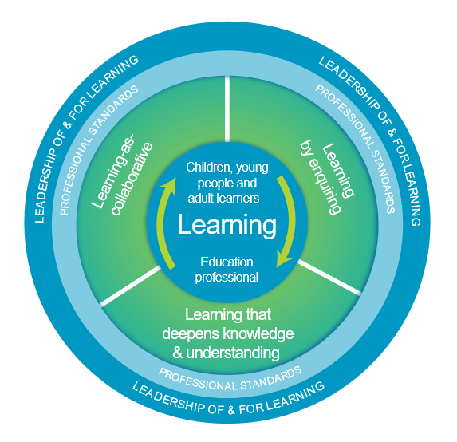
Welcome
This presentation aims to support your professional learning.
After participating in this learning activity you will have an awareness of:
The nature of domestic abuse
The impact on children and young people
Signs of abuse
The role of adults in supporting learners
You will have an opportunity to explore and reflect on the implications for your setting.
The National Model of Professional Learning
Notes:
It is important to remember that members of staff may have been impacted by domestic abuse. It is helpful to acknowledge that domestic abuse is common and you are available to talk to afterwards if this input raises issues for anyone who takes part. Posters/notices with the Domestic abuse and forced marriage national helpline number can be made available in staffrooms and toilets.
The National Model of Professional Learning developed by Education Scotland underlines that professional learning should challenge and develop thinking, knowledge, skills and understanding and should be underpinned by developing skills of enquiry and criticality.
The National model also emphasises that professional learning needs to be interactive, reflective and involve learning with and from others.
Further information on the national model of professional learning is available on the National Improvement Hub.

Slide 3


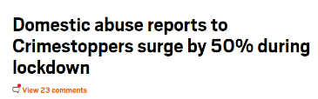
Domestic Abuse
Statistically at least one child in every class will have experience of domestic abuse.
One in 5 children in the UK will have experienced domestic abuse by the time they reach 18.
Notes:
Domestic abuse is endemic in our society. As educators we won’t know which of the children in front of us, or which of the staff around us, has been affected. It is therefore important for all staff to be aware of domestic abuse and be proactive in supporting learners.
The police recorded 60,641 incidents of domestic abuse in Scotland in 2018-19. We know, however, that most cases of domestic abuse go unreported and the figures we have do not reveal the true extent of the problem. Where gender was recorded, four out of five victims were women.
Scottish Government (2020) ‘Domestic abuse: statistics 2018-2019’
Scottish Government and COSLA (2008) National Domestic Abuse Delivery Plan for Children and Young People
As a result of the COVID-19 lockdown measures, women, children and young people experiencing domestic abuse are at increased levels of risk. They have less access to safe places, less support from family and friends and even further restrictions on freedom.
https://www.cosla.gov.uk/news/may-2020/tackling-violence-against-women-and-girls-during-covid-19
Services report that, in some cases, children have experienced domestic abuse more severely during lockdown. They will have had less time in safe places such as school, youth clubs or at grandparents.
Children's support services reported challenges experienced around engaging with and supporting children remotely during lockdown.
Scottish Government Report ‘Coronavirus (COVID-19): domestic abuse and other forms of violence against women and girls - 30/3/20-22/05/20’
The headlines in the slide are headlines published during the pandemic.

Slide 4
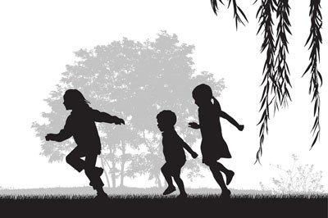
What is domestic abuse?
Domestic abuse is a pattern of behaviour that instils fear and is used by abusers to maintain control. It includes any pattern of controlling, bullying, threatening or violent behaviour towards a partner or ex-partner including psychological and emotional abuse (coercive control).
Notes:
Domestic abuse is disproportionately perpetrated by men and experienced by women. It is a form of gender-based violence which has its roots in the systemic gender inequality in society.
Behaviours constituting domestic abuse can include: physical abuse, sexual abuse, isolating the survivor from family and friends, monitoring and regulating the survivor’s activities, controlling their money and/or activities, depriving them of their freedom of action and frightening, humiliating or degrading them.
It can be present in LGBTIQ relationships and can take place anywhere, including online.

Slide 5
Children and young people and domestic abuse
Children and young people can experience domestic abuse:
directly from the abuser
indirectly via the abuse of their non-abusing parent
young people can experience domestic abuse in their own intimate relationships
Notes:
Children’s experiences of domestic abuse are detailed on the next slide.

Slide 6
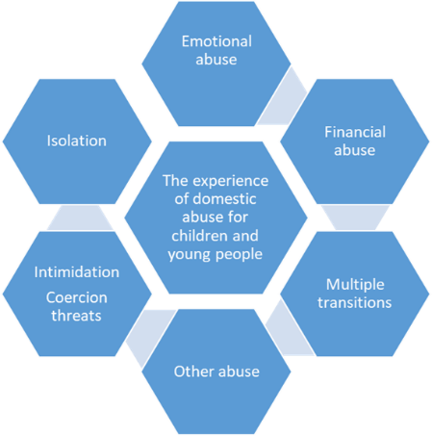
The experience of domestic abuse for children and young people
Violation
of children’s rights
Notes:
Whether or not the abuse is physical or emotional, in plain sight or behind closed doors, children are extremely aware of and are impacted by the abusive actions of the perpetrator.
Isolation The abuser may prevent the children spending time with their non-abusive parent, visiting friends and relatives, going on days out or participating in clubs or after-hours activities at school. The isolation imposed on children can reduce their opportunities to build relationships with trusted adults outside the home.
Emotional abuse This can include name calling, demeaning or shaming comments. It might be pressurising the child to join in the abuse of the parent/caregiver or to keep frightening secrets. The actions of the perpetrator can lead children and young people to live in a heightened state of fear and anxiety, walking on eggshells in case action or inaction triggers further abuse.
Financial abuse This might mean that, even in a home with a reasonable income, the abused partner and child may experience poverty, for example being refused access to funds to buy basic needs such as sanitary products or clothing. Money might be used to control behaviour.
Multiple transitions Children and young people will often have to move home and schools to escape abuse and there may be several changes of accommodation needed with all the related upheaval involved. As well as interrupted learning, this can lead to loss of support networks and social isolation.
Other abuse Children who experience domestic abuse are at higher risk of experiencing multiple forms of abuse. There is an overlap between domestic abuse and child physical and sexual abuse. Domestic abuse is one of the most common reasons for children being placed on the child protection register and was present in almost two-thirds of significant case reviews in Scotland of children who have died..
Intimidation, coercion and threats Abusers can build fear through abusive acts or threats of these towards their partner, other loved ones or a pet. It may be a ‘look’ that warns children that abuse is about to escalate. The abuser might threaten children with punishment if they defend their parent or speak to others about what is happening at home.
There is often an escalation of abuse when the abused parent tries to leave their abuser, a period in which the abused partner and children are at heightened risk of physical violence and domestic homicide. Manipulation and abuse can continue to be experienced through contact arrangements following parental separation.
Children’s Rights Experiencing domestic abuse violates children’s rights. There may be rules imposed on when they can speak or act and they may be denied the right to play, to be involved in decisions affecting them and have been denied the right to live safe from violence.
Katz, E (2016) Beyond the physical incident model: how children living with domestic violence are harmed by and resist regimes of coercive control. Child Abuse Review, 25(1), pp.46-59
Jouriles, E. N., PhD., McDonald, R., PhD., Slep, A. M. S., PhD., Heyman, R. E., PhD., & Garrido, E., PhD. (2008). Child abuse in the context of domestic violence: Prevalence, explanations, and practice implications. Violence and Victims, 23(2), 221-35.
SASW (2020) Domestic abuse and child welfare: a practice guide for social workers
United Nations Convention on the Rights of the Child Ratified by the UK in 1991

Slide 7
The impact of domestic abuse for children and young people
Impact is not inevitable: supportive adults can make a difference
Feelings
Fear, Powerlessness, Depression or sadness
Anger and guilt
Anxiety
Negative impact on social relationships, educational achievement and family relationships
Mental Wellbeing
Increased internalising and externalising difficulties
Post –traumatic stress
Difficulty regulating emotions
High separation distress
Physical health – links to obesity, asthma and bodily complaints
Notes:
Impact depends on a number of factors including frequency, severity and length of abuse and the ability of the non-abusive parent to provide parenting support in these very difficult situations.
Emphasise that impacts are risks rather than inevitable-key supportive adults can reduce these risks.
See Appendix 1 for risk by developmental stage-it may be helpful to print this out for participants.

Slide 8
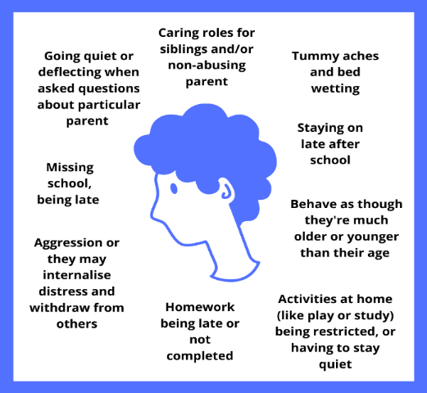
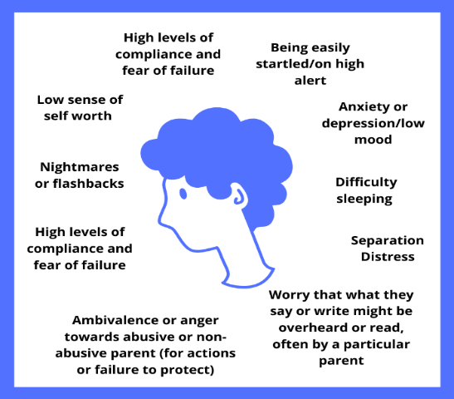
Activity: Signs of domestic abuse
Notes:
Activity-discuss whether any of these signs might be specific to domestic abuse.
Conclusion-these can be signs of other issues but when these signs are present domestic abuse should be considered.
Parents may also present signs e.g. one partner speaking for the other, one appearing more dominant and controlling of the other, regular calls to notify of absences, non-attendance at parents meetings and school events.

Slide 9
Domestic abuse in teenage relationships
6% of reported cases of domestic abuse involved young people under 18 (Scotland 2018-19)
The last major survey of abuse in young people’s relationships (2009) found:
75% of girls and 50% of boys experienced emotional abuse of some form
25% of girls and 18% of boys experienced physical abuse
33% of girls and 16% of boys experienced sexual abuse
One in 6 girls reported severe abuse.
Abuse in teenage relationships can include the factors already outlined for adults and may also include sexting, requesting or sharing of images, sharing of pornography, sexual coercion and grooming.
These behaviours can be considered ‘normal’ in peer groups.
Notes:
Pornography viewing by young people may also be influencing what is seen as normal.
https://www.theguardian.com/society/2020/jul/08/sharp-increase-in-uk-child-sexual-abuse-during-pandemic
Recent National Crime Agency (NCA) figures that at least 300,000 people in the UK pose a risk of committing physical or online child abuse, more than double the 140,000 reported last year. And NCA figures shared exclusively with the Guardian show that during each of the 13 weeks of lockdown, around 350 cases of online child sexual abuse were passed to police, a 10% increase on the same period last year.
Internet Watch Foundation (IWF), a charity that reports and removes online child abuse, revealed in May that during lockdown, three major internet companies logged 8.8m hits to child sexual abuse imagery from the UK alone.

Slide 10

It is vital that young people have the opportunity to have a safe space to discuss their experiences to help them identify healthy and unhealthy relationships.
This is a film by young people for young people about abuse in relationships.
Notes:
An animation produced by Scottish Women's Aid Young Expert Group (Yello!) in collaboration with Media Co-Op. The film is for young people experiencing domestic abuse during the 2020 COVID-19 pandemic and lockdown.
https://www.youtube.com/watch?v=neN_bdi89XM Length of animation 1 minute
A further animation will be available soon which is not lockdown specific.

Slide 11
Activity: Responding to disclosures of domestic abuse
Activity
In pairs, discuss what you would do if a child or young person disclosed domestic abuse.
Consider
What might you say to the child or young person?
What you would do next?
Read the suggestions on P. 9.
What are your child protection guidelines in this situation?
What should you do if you have concerns but no one has made a disclosure?
Notes:
P.9 of the guide ‘Domestic Abuse: information for educators’ needs to be available to participants.
The presenter needs to be able to clearly outline the relevant part of the establishment or organisation’s child protection policy.

Slide 12
What can help?
A curriculum and culture that promotes positive relationships and respect
Many abused children will not be identified so a nurturing, trauma informed response is crucial for all learners
Staff who are trained and aware (including non-teaching staff)
Clear safeguarding policies and guidance
Strong partnerships with local specialist domestic abuse services-for support for children and families and for professional development
Including the views of children and young people who have experienced abuse
Awareness raising for learners on keeping safe and seeking help if they don’t feel safe
Notes:
P.7-9 of Guide

Slide 13
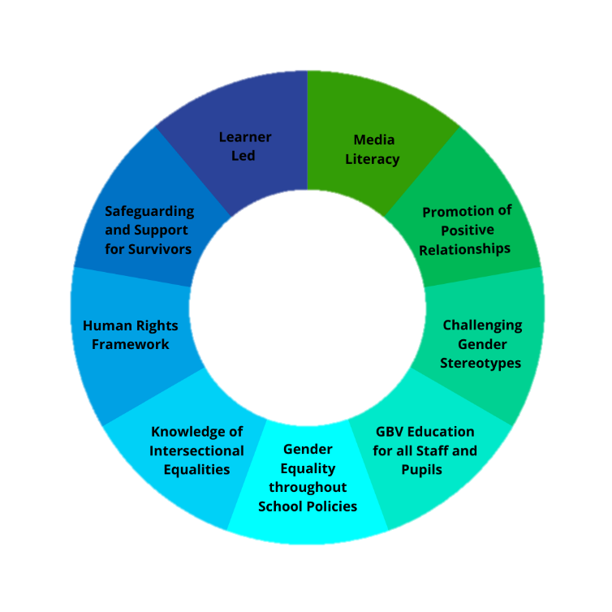
A whole school approach to ending gender-based violence
Whole school approach to ending gender-based violence
Notes:
The whole school approach is one that promotes an ethos and culture of equality throughout the curriculum and the whole school. Not only will this help tackle the roots causes of gender-based violence but will also support a climate where young people and families experiencing abuse are more likely to come forward and ask for help. https://www.endviolenceagainstwomen.org.uk/wp-content/uploads/EVAW-Coalition-Schools-Guide.pdf

Slide 14
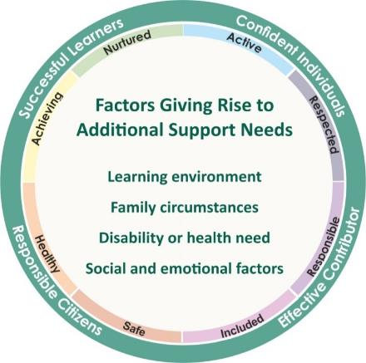
Domestic abuse and additional support needs
There are a wide range of factors which may lead to some children and young people having a need for additional support. These fall broadly into the four overlapping themes highlighted in the graphic.
Activity
Consider what you have learned to date about domestic abuse.
What additional support needs might arise?
Notes:
Some education staff might not have considered that children who have experienced domestic abuse are likely to have additional support needs. The diagram above outlines the factors which might give rise to the need for additional support.
Activity
As a group discuss what needs might arise for learners who have experienced domestic abuse.

Slide 15

Activity : Responding effectively to domestic abuse
This activity can be done individually or with colleagues – make a note of your reflections
Focus – How effective is our response to domestic abuse?
Reflection | In my class | In our learning community | In our local authority
What I /we do well
What needs to improve
How to improve
Notes:
This tool can help staff consider what is already done well and what can be done to improve our response.

Slide 16


Scotland’s Domestic abuse and Forced Marriage 24 hour helpline 0800 027 1234
For Scotland's learners, with Scotland's educators
Notes:
This is a back cover page in blue. You may edit the address if needed only. It can only be once and at the end of the PowerPoint presentation. Use the corresponding blue internal and back pages if you are using this page.

