Slide 1







Inclusion Wellbeing & Equalities Professional Learning Framework
Attunement - being aware and responsive to emotions
Informed Level
@ESInclusionTeam
For Scotland's learners, with Scotland's educators
Do luchd-ionnsachaidh na h-Alba, le luchd-foghlaim Alba
Notes:
Purpose of these Slides
Read title​
This professional learning is pitched at an informed level and suitable for anyone working with children and young people in an educational context.
How to use the slides:
To be used to facilitate professional learning in a group or whole-setting, or as a self-directed learning activity as an individual.
General Guidance
There is a requirement to cover all the slides.
Please do not change the provided slides.
Facilitators are welcome to add slides or activities relevant to your own setting, to support discussion and exploration of the topic. Facilitators will know their participants’ needs best.
Anyone who works in an educational setting can be a facilitator and use these slides.
It is important to establish a safe space which encourages respect and honesty to ensure that everyone is able to participate.

Slide 2







Interconnectivity
Notes:
All of the professional learning in the Framework fits into one of these four themes. The four themes are interconnected and interdependent.​
This activity forms part of the professional learning in the Relationships theme.

Slide 3

How to use this resource
These slides can be used to facilitate professional learning in a group or
whole-setting, or as a self-directed learning activity as an individual.
Facilitation notes are included at the bottom of each slide.
Please do not remove or change any of the slides included.
Facilitators are welcome to add slides or activities relevant to your own setting, to support discussion and exploration of the topic. Facilitators will know their participants’ needs best.
Anyone who works in an educational setting can be a facilitator and use these slides.
For reflection or discussion activities, it is important to establish a safe space which encourages respect and honesty to ensure that everyone is able to participate.
Notes:
Option to skip slide as these are instructions for facilitators only. No need to read to audience.

Slide 4

National Model for Professional Learning
This professional learning resource will support you to deepen your knowledge and understanding.
You will have the opportunity to consider how to take this learning forward on your own and with others.
The National Model of Professional Learning (education.gov.scot)
Notes:
This professional learning forms part of the national model for professional learning and is designed to help you gain more knowledge and have a deeper understanding of inclusion, wellbeing and equalities​​
On completion of this professional learning, you will be asked to consider what your next steps will be​​.
Please take some time to consider the reflection questions at the end

Slide 5
Welcome
This session provides an opportunity to:
To reflect on what learners tell us makes a good teacher
To understand why being emotionally attuned is important
To learn how we can ‘attune’ to a learner and use attunement to build trusting relationships
To reflect on our own practice and explore our next steps in learning
Notes:
Link activity to national model

Slide 6
Empathy
The ability to share someone else's feelings or experiences by imagining what it would be like to be in that person's situation
Supportive and healing relationships
Attunement
Is about giving emotionally appropriate responses
Notes:
Empathy is the ability to share someone else's feelings or experiences by imagining what it would be like to be in that person's situation (Cambridge Dictionary)
Attunement is about giving appropriate responses.
Empathy and attunement together underpin a therapeutic type of relationship.
When we empathically attune to another we gently tune into, sense, and resonate with their experience making it possible for us to reflect back accurately to them that you have understood how they are feeling, that they have been heard. Effective empathetic communication (active listening) requires your full attention and emotional presence.
There is a great deal of evidence that shows how empathy and attunement are among the most effective elements of a therapeutic relationship (Cooper, 2008).
Attunement helps us relate to and connect with another person. In the context of education, this connection helps us help learners to both learn and to cope when they become distressed.

Slide 7
What learners have told us?
Behaviour in Scottish Schools Research (2016)
Learners highlighted the following aspects of their teacher’s * manner and demeanour as being important :
‘the teacher being happy’
‘the teacher smiling when you come in to class’
‘when the teacher is enthusiastic’
using ‘humour’
‘being calm’
‘not shouting’
‘If a teacher is kind, it travels across the class and puts everyone in a good mood’
Children in Scotland study
*In the survey they refer to ‘teachers’ however the responses could equally apply to any practitioner working with any learner (child, young person or adult)
Yougov survey (2018) What makes a good teacher? Learners (6-15yo) said:
27% Kind 15% Listens 13% Fun 10% Funny 9% Helpful 9% Knowledgeable
8% Friendly 8% Engaging 7% Clear 6% Fair 4% Patient 4% Strict
4% Caring 3% Doesn’t shout
Notes:
In the BiSSR (2016) they refer to teachers however the responses could equally apply to any practitioner working with any learner (child, young person, or adults).
Highlight the Children in Scotland Survey quote. ‘If a teacher is kind, it travels across the class and puts everyone in a good mood’
This YouGov poll (2018) of 586 children from 6-15 years were asked what makes a good teacher and they answered.
Interestingly only 9% of the respondents that a teacher knowledge made them a good teacher with kindness being a listener, and being fun or funny scoring much higher as qualities that make a good teacher.

Slide 8
Attunement – being aware and responsive to emotions
Attunement:
describes how we recognise and respond to another person's emotional needs and moods
is the process by which we form relationships
Dr. Dan Siegel says, "Children need attunement to feel secure and to develop well, and throughout our lives we need attunement to feel close and connected.”
When working with others (learners, colleagues, parents/carers,..), attunement comes across as:
genuinely caring about them
truly listening to them and caring about their response
noticing: when a they are in a mood, when they’re unusually quiet, when they’re struggling, ….
Notes:
Attunement allows us to not just observe a learner’s behaviours but to be more able to identify what those behaviours mean (Nurture Principle 5 – all behaviour is communication) ie. what they are thinking or feeling ,such as, joy or satisfaction, or alternatively shame or hopelessness. In other words the things that improve their wellbeing or make them more vulnerable. This knowledge helps us to adjust our approach to better meet the needs of that person. Becoming attuned is a key element to supporting children particularly those with attachment issues. Being attuned to a child allows us to act quickly to help when we notice they are not coping or are becoming distressed.
We can use attunement to help build a relationship, or an attachment, by getting to know the other person well and closely observing their behaviour, empathising with them, listening to them, and responding to them in a way that shows we’ve listened and understood them.

Slide 9
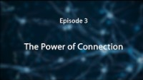
The Power of Connection – Dr Bruce Perry
7.03 min
From
The Neurosequential Network
If viewing as a PDF please click this link to watch the film https://youtu.be/oElS6AGwuxU

Slide 10
Principles of attunement- the what and the why?
(Based on Biemens Contact Principles)
Positive Relationships
What to do to be Attuned
6
How it makes the other person feel
Deepening Discussion
Helped to manage and learn
5
Guide & support
Open to learning and new ideas with support
4
Attuned together - share thoughts
An equal in the conversation - engaged
3
Receiving - Listen with purpose
You have been listened to – the other person is interested in you and in what you have to say
2
Encourage them to talk
The other person is interested in what you think
You are encouraged to offer your own ideas
1
Attending – show them you notice ‘how’ they are/feel
Feel recognised and important
Notes:
Being attuned to another person is a progressive process and is closely linked with the building of a trusting relationship. In a similar way to learning a new skill one person may initially have to lead the process but ultimately this should progress to a two way reciprocal relationship.
When you are attuning to someone else, what messages are they getting from you – look at the right hand side.

Slide 11
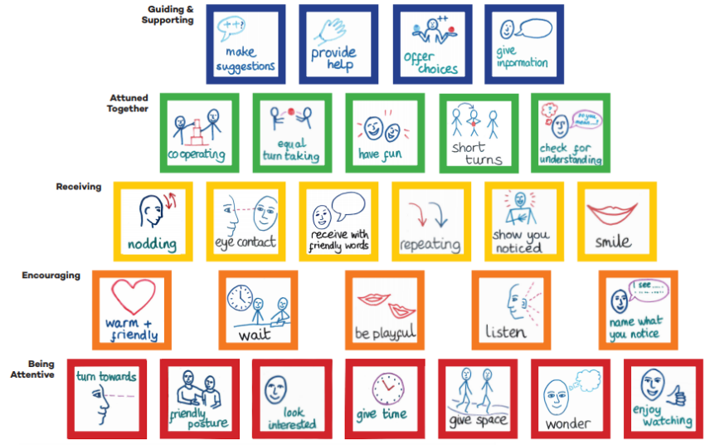





Attunement principles (first 5)
Schematic produced by:
Notes:
This diagram shows what the principles of attunment look like in practical terms. Notice how the principles progress from attunement to mediated learning.

Slide 12
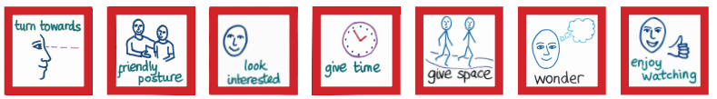
1 Being attentive
Turning towards someone
Looking at someone
Making eye contact
Using friendly intonations
Using friendly facial expressions
Using friendly postures
Notes:
Turning towards the person, regularly looking towards them and making eye contact, looking interested, using nods and encouraging intonations (uh-huh, yes, go on etc.), adopting a friendly and non-threatening pose, using proximity or giving them space as needed, or giving them time to calm themselves or recover but also showing them that they aren’t being ignored.

Slide 13
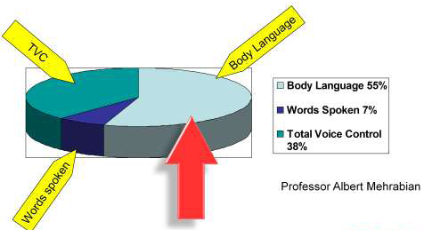
The importance of non-verbal communication
S quare or slightly angled
O pen no crossed arms or legs
L ean forward showing interest
E ye contact appropriate to the individual
R elaxed loose hands, relaxed shoulders
Also consider personal space, height difference (sitting down if appropriate), using non-threatening gestures, …
Notes:
Being attuned to someone is usually expressed, at least initially, through our non-verbal communication - eye contact, facial expression, body language, tone of voice - rather than in the words that we use.
Professor Albert Mehrabian pioneered the understanding of the communication of feeling and attitudes in the 1960s. His diagram on the left refers to how we effectively communicate feelings and attitude through our words, the way we speak and our facial expression, not how we communicate factual information. He found that when we communicate our feeling the person receives: 7% through our words., 38% from the way the words are said – tone, pitch, pace etc.. and 55% through our facial expression – smiling, raised eyebrows, frowning, sneering, etc.
The 'Mehrabian formula‘ is particularly useful for describing situations where the words did not match the facial expression. His research showed people tended to believe the expression they saw, not the words spoken.
SOLER (on the right) can be a useful aide memoire for considering our non-verbal communication:
Sit beside or slightly angled towards the person – not facing directly as this could be threatening
Keep an open body position as it portrays an open-minded attitude – avoid crossed arms or legs
Lean forward to indicate you are interested in what they are saying
Eye contact also shows you are listening and can create a connection with the person. Avoid staring as this could be threatening.
Be relaxed to try to encourage them to relax
Also consider personal space, height difference (sitting down if appropriate), using non-threatening gestures, …

Slide 14

2 Encouraging
Giving them time to start to talk - waiting before jumping in
Actively listening (see separate module)
Showing emotional warmth through voice intonation
Being friendly and/or playful in intonation and body language
Naming what you notice about them
Encouraging and eliciting further discussion (ah ha, yes, tell me more about that, ……)
Notes:
By waiting, we are often allowing the other person to start the interaction/conversation first and then we can respond. This requires us to pay careful attention to what they say and/or their non-verbal communication which could be subtle.
We can help encourage them to speak/interact by noticing, commenting, naming things positively –not asking lots of questions, after each interaction initiated by them – wait patiently to see if there is any response
Sometimes for a less confident child – it can be helpful to be playful in how you encourage this, e.g. make a pretend mistake in what you are saying, make a joke – this requires knowing the child a little so that it is appropriate.
Actively listening, being emotionally available and being comfortable with short silences is essential at this stage.

Slide 15

3 Receiving
Receiving with body language, matching or mirroring
Being friendly and/or playful as appropriate
Returning eye contact, smiling, nodding in response
Showing you have heard, noted what they’ve said
Reflecting back the other’s words or phrases
Wondering aloud (I wonder if ……)
Notes:
This is more about how you respond to the other's initiative and take it forward – often better to wait for the child or young person to initiate first and then you receive or respond to them – often their initiatives will be subtle – looking towards you, a slight nod, looking at something else in the environment which you need to then receive in a way that helps them to feel noticed, heard, listened to but not overwhelmed. Some children may enjoy you responding in an animated and excited way, others may prefer for you to be more calm and quiet in your response – it is important in attunement to respond in the way that best suits the needs of the child.

Slide 16
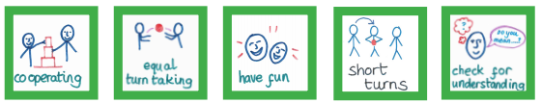
4 Attuned together
To and fro - receiving and then responding - contributing equally
Waiting attentively for your turn
Having fun
Giving and taking short turns (potentially a few times on each topic)
Cooperating – helping each other
Checking understanding (their understanding of what you’ve said and that you’ve understood them)
Notes:
This moves beyond the act of simply encouraging or receiving and instead is part of the dance by which we interact in an equal and responsive way – become more attuned. A key part of this is giving and taking short turns – although this can be difficult in a classroom – there are opportunities through discussions and other activities where the teacher or other adult can be a more equal partner in the conversation with the child and encourage shorter turns.
Research demonstrates that shorter turns help the interaction to be more attuned and go on for longer.

Slide 17

5 Guiding and supporting
Scaffolding (for example, engage, simplify, problem solve, model enthusiasm)
Extending the discussion by building on their responses
Judging the amount of support required and adjusting
Giving information and providing help (when needed)
Offering choices that the other can understand
Making suggestions that the other can follow
Notes:
This is an area where teachers often feel more comfortable – the concept of guiding – this is what we spend a large part of our day doing but it is important to realise that for many children and young people, this won’t be as effective if we are unable to get the earlier attunement principles in place. Children will be less amenable to guiding if they don’t feel that we are being attentive; encouraging and receiving their initiatives or attuning to them.
Part of the attunement process is to also judge how much support and guidance a child/yp requires – this relates to the idea of dependence and interdependence. Some children will not want support and guidance – dependent on their early attachment experiences – they may avoid interdependence and through our attuned responses we may need to help them to be more comfortable with that so that we can guide them. Some children will be over dependent and want a lot of mediation and guidance – again we have to help them to move away from this.

Slide 18
6 Deepening the discussion
Asking activating (thought provoking) questions
Gaining their opinion
Giving your opinion
Checking for how your opinion and responses are being received
Asking follow-up questions
Naming (and allowing if appropriate) differences in opinion
Always being prepared to go back a step (or 2) if necessary
Notes:
This is a skill that teachers often learn to take the discussion forward in a classroom but not simply a matter of asking questions and then making comments – need to be attuned to the young person – really hear what they are saying so that you can respond appropriately.

Slide 19
Things to remember:
Every learner is different - To attune to a learner we must first observe and remember their unique style of engagement and communication, and their strengths and vulnerabilities, to be able to best respond to their individual needs
The power of noticing - Try to notice changes in the non-verbal communication of learners, for example, facial expressions, tone of voice, level of activity in order to respond early to issues
Be very aware of our own non-verbal communication particularly our facial expression as it could express interest, curiosity, joy, anger, or even disgust
Remember due to our influential position, words, actions and expressions are magnified. Our criticism can feel crushing, but our approval can be motivating, energizing and powerful
Being attuned to individuals within a group will also help us to respond to issues caused by the social dynamics of that group

Slide 20
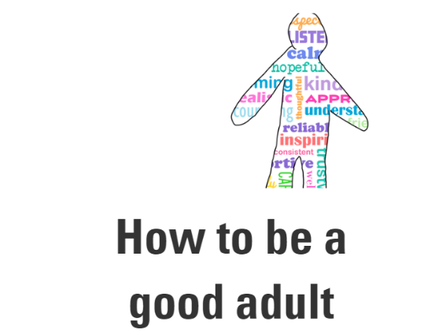
Further reading and viewing
NHS Education Service and Children in Scotland, in consultation with children and young people have produced this wonderful resource:
In the resource children and young people:
tell us what they need from adults
provide ‘A Good Adult’ job description with
  Essential and Desirable Criteria
  Skills and Experience required
Please take the time to look through the resource
How to be a good adult | The Knowledge and Skills Framework (nhs.scot)
https://www.digitallearningmap.nhs.scot/how-to-be-a-good-adult/

Slide 21
How can I use attunement to support engagement?
Reflection Activity (individually or as a group):
How do I know when: Someone gets me? Someone cares about me? Someone thinks about me? How does it make me feel?
How could I develop attuned practice in my setting particularly for anyone who has experienced adversity and trauma?
Deepening Discussion
Guiding & Supporting
Becoming Attuned Together
Receiving
Encouraging
Being Attentive
Notes:
How do I know when: Someone gets me? Someone cares about me? Someone thinks about me? How does it make me feel?
How could I develop attuned practice in my setting particularly for anyone who has experienced adversity and trauma? - Expand your thinking to include learners, parents/carers, or colleagues and even groups such as care experienced learners, young carers, refugees etc..

Slide 22
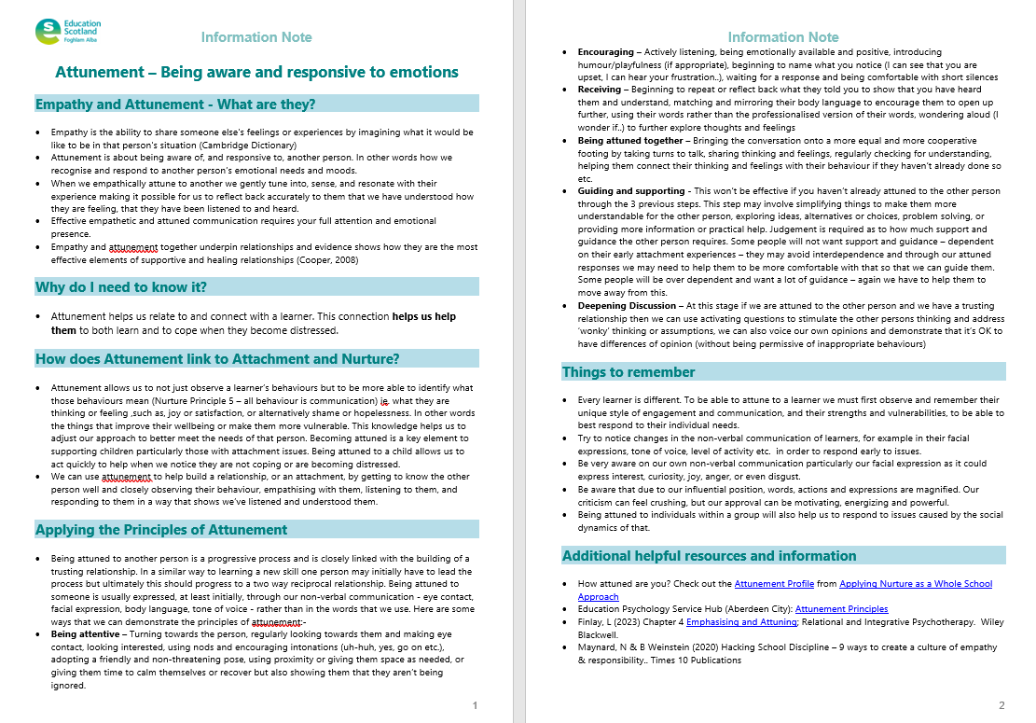
Resources and Information to help

Slide 23

Reflection
From what you have learned so far, think about:
How has this made you feel?
What has this made you think about?
What one action would you like to take forward?
How can you link what you plan to do with others in your setting?
How you will know that this learning has made a difference?
Notes:
Facilitation notes:
You can do this in groups...
Encourage educators to take this forward in an enquiry
Consider impact of the actions / learning

Slide 24


We value your feedback
From now until March 2024 we will be taking feedback on these resources so that we can make changes in advance of a formal launch of the Professional Learning Framework in June 2024
Your feedback could help us improve this resource
Please complete this short form, using the link or QR code, to let us know what you thought of it and any suggestions you have on how it could be improved
LINK: https://forms.office.com/e/b5PCpJJJ3P

Slide 25

For Scotland's learners, with Scotland's educators
Do luchd-ionnsachaidh na h-Alba, le luchd-foghlaim Alba
Education Scotland
Denholm House
Almondvale Business Park
Almondvale Way
Livingston EH54 6GA
T +44 (0)131 244 5000
E enquiries@educationscotland.gsi.gov.uk

