Slide 1



Autism & Inclusive Practice
Professional Learning Module
Session 6. Social and Emotional Wellbeing
For Scotland's learners, with Scotland's educators
Do luchd-ionnsachaidh na h-Alba, le luchd-foghlaim Alba
Notes:
The module An Introduction to Autism and Inclusive Practice is designed to provide an introduction for educational staff and anyone with an interest in supporting autistic learners in the settings that they work and support. This introductory module aims to help you develop an awareness of what autism is, its impact and how it can be supported within an inclusive school community. It may also be of interest if you work in the voluntary sector or simply have an interest in autism and inclusive practice.

Slide 2

This week’s session
Terminology
The Scottish context for autism and inclusion
Understanding Autism
Assessment and Monitoring
Supporting Learners and Families
Social and Emotional Wellbeing
Transitions
Notes:
The module and this supporting programme for reflection is split into seven sections:
Terminology
The Scottish context for autism and inclusion
Understanding Autism
Assessment and Monitoring
Supporting Learners and Families
Social and Emotional Wellbeing
Transitions
Today we will explore the sixth section of the module, Social and Emotional Wellbeing.

Slide 3
Recap of Section 6
Social and Emotional Wellbeing
6.1 | Social interaction and emotional wellbeing
6.2 | Mental health and wellbeing
6.3 | Play, leisure and autism
6.4 | Relationships
6.5 | Bullying
Notes:
These are the subsections, included within the section on Social and Emotional Wellbeing:
6.1 Social interaction and emotional wellbeing
6.2 Mental health and wellbeing
6.3 Play, leisure and autism
6.4 Relationships
6.5 Bullying

Slide 4

6.1 Social interaction and emotional wellbeing
For further information on supporting wellbeing, go to the Coping and Resilience section of the Toolbox.
Coping Strategies and Resilience | Autism Toolbox
Notes:
Notes from module:
Everyone working in an education setting should have a shared understanding of health and wellbeing as it is the responsibility of everyone.
For autistic learners, it is important to remember that emotional health and emotional wellbeing is often best supported through the physical and social environment.
For example, when a child is distressed about noisy corridors, instead of talking to them about their emotional wellbeing, a better approach would be to plan for them to use the corridor at a quieter time.
Talking therapies can require a level of metacognition that even many teenagers have not reached.
Some might require a level of support to begin to talk about likes, dislikes and to grade whether something is a small, medium or big problem before they are ready to spend time learning emotion vocabulary.
Where a child and family raise a discussion point around the individual’s understanding of their own diagnosis, seek support from the team around the child and those with the right experience to meet this need. It is not recommended that children share personal diagnoses publicly, for example to the class or at an assembly. This is something they can never un-tell and can have unforeseen consequences in future.
Self and mutual regulation are really important for emotional wellbeing.
Learners may need support with relationships in and out of school, perspectives, and issues relating to bullying.
An autistic learner may be less comfortable than peers to engage in shared experiences, which may impact on their motivation to join in group activities, such as social games and sports. Misunderstandings may arise with the social use of language and in interpersonal engagement and unspoken aspects of communication. For example, missing the social contexts of situations. This can leave the autistic child or young person on the periphery and can cause isolation and loneliness; for some autistic learners, this may contribute towards a mental health difficulty.
Autism is a social and emotional learning difference and autistic learners can experience difficulties as they interpret the world around them and by the way they are perceived by the peers and adults with whom they interact. However, there are also many positive aspects of autism which should not be underestimated.
To support the emotional wellbeing of their autistic learners, educational practitioners need to be aware of factors which can have both a negative and positive impact. They should:
recognise and maximise positive impacts
support to reduce negative impacts.
An autistic learner may have a single-minded focus on developing friendships. They may desperately want a friend and can misinterpret kindness for friendship and become attached to someone who does not consider them a friend. Inflexibility of thought and a lack of appreciation of the others’ feelings may result in rejection.

Slide 5
6.2 Mental health and wellbeing
Notes:
Notes from module:
Good health and wellbeing are central not only to effective learning but have an impact on a child or young person’s life at home and outside school. The social and sensory demands of early years settings and school can create challenges for autistic learners. This can affect their confidence and self-esteem and can contribute to high levels of stress and anxiety. They may struggle with relationships, perspectives and empathy, and issues relating to bullying.
Autistic learners can worry about a wide variety of everyday things. Sometimes they might worry particularly about performance with schoolwork or struggle with ‘perfectionism’. Some of this is developmental, such as worrying about being first in the line or winning and losing, but if children continue to focus on this as they get older, other people find it unexpected. Autistic children and young people may also be ‘rule followers’ and have a tendency to ‘police’ other people who they perceive as not following the rules.
Some individuals are sometimes described as ‘catastrophising’, when they have a big reaction that can seem to be out of proportion to the size of the problem. It is common for autistic individuals to find it hard to grade the size of a problem, or to match the size of a problem to the expected size of their reaction.
Knowing the signs of anxiety for an individual learner will help adults around them to be responsive and can inform support plans going forward. For example, making adaptations to the physical and social environment to prevent the same situation from arising again.
Anxiety can be expressed in an overt way, for example, a worried expression and body language, refusal or protesting actions.
Individuals may also appear smiling and quiet or not overtly anxious. Masking and camouflaging (Mandy, 2019) are recognised experiences in autistic individuals, which are used to ‘appear fine’ but actually can add to feelings of stress and anxiety. Just because an autistic person doesn’t look worried, does not mean they are not worried.
Autistic individuals may have strong and specific interests, which other people may describe as obsessions or enthusiasms. These may be more apparent when anxiety is raised.
As a response to stress, anxiety, feeling out of control or unhelpful thoughts, children and young people might try to alleviate their anxiety by performing compulsive rituals, for example, counting or washing their hands repeatedly. Others may withdraw or become selectively mute (not speaking at all in some circumstances).
Adults who know the learners well can ‘listen’ to what they say and do and to observe whether they are initiating and participating confidently.
All autistic learners will benefit from a more individualised approach being taken to explore or discuss emotional events and experiences that are relevant to them. For this, it is important to ‘tune in’ to the particular, and sometimes unusual or unexpected, emotional responses, emotional triggers and regulation strategies of an autistic learner. Planning activities based on this information will ensure that emotional learning is meaningful and relevant to a child’s needs.
An autistic learner may benefit from support to develop an awareness of self by recognising their strengths and needs, likes and dislikes, emotions and feelings. If support is at the correct developmental level, this can help develop individuals to feel calm or to manage stress and anxiety, as well as increase resilience. Some able, verbal autistic learners may also benefit from having more information and discussion around their diagnosis.
A ‘fragile sense of self’ may leave pupils vulnerable to secondary mental health issues. Some autistic adults report that their mental health improved following diagnosis, perhaps as it helped them make sense of their experiences.
It is important to be aware that individuals might be using self-regulation or coping strategies in the context of the underlying anxiety. Rather than trying to stop the individual engaging in the observed behaviour, adults can support them to learn helpful self-regulation and mutual regulation strategies (see Zones of Regulation).
We can’t take away all the sources of anxiety for the child or young person, but we can try to reduce them. Anticipatory approaches are key.

Slide 6
6.3 Play, leisure and autism
Stages of play
Play and autism
Adult play partners
Peer play
For further information on play and leisure, go to the Play and Leisure page on the Toolbox.
http://www.autismtoolbox.co.uk/play-and-leisure
Notes:
Notes from module:
What is play?
Free play is what happens when children and young people follow their own ideas and interests in their own way, and for their own reasons. They can do this on their own or with others. It can happen inside or outside. Children and young people should be given the choice of how and when they play. Play is just as important for a teenager as it is for a baby or young child.
Stages of play
sensorimotor
organising
functional
pretend
stages of social play.
Play and autism
Play is a recognised area of difference in autism. Some children’s pretend play may be viewed as repetitive and stereotypic. Some may engage in more solitary play. Play patterns will vary from child to child.
Adult play partners
At an early developmental stage, play can be most successful one to one with an adult partner. Adults should observe and talk with people who know the child well to find out what is motivating for them. This could include particular toys or characters, movement, sensory experiences, surprise, for example, peekaboo, pop up toys or repetition. Some individuals may prefer non-toy items or parts of items to traditional toys and games. Look for opportunities to incorporate preferred sensory experiences/toys/interests into play situations.
Get down to the child’s level. Play alongside or join the child in play by bringing your own toy into the interaction. Reduce your language; it can be helpful to comment on what is happening in the play rather than ask lots of questions. Keep a gentle pace and remember to wait – give the child time to respond.
Create social routines, for example, Row the Boat, peekaboo. Predictability and repetition can be calming and reassuring. Look for ways to make play have a predictable start and end and, if the child appears to have enjoyed it, repeat and build on previous play experiences. Think about engagement before introducing turn-taking.
Peer play
For some autistic learners, play with a peer or peers may need to be supported. Adaptations to the physical and social environment and to routines and structures should be considered before looking at the learner’s skills. Rather than telling an autistic child how to ask others to play with them or writing them a Social Story about how to play with friends, adults around the child should ask themselves:
Are games, toys and activities motivating to the learner?
Is the play on offer at the right developmental level?
Is the play predictable?
Are peers and adults seeking to include the child in the play and responsive to their initiations?
Is the learner provided with opportunities to participate?
Is there a clear role for the learner?

Slide 7
6.4 Relationships
Notes:
Notes from module:
Throughout our lives we are involved in and develop many different relationships with the multitude of people with whom we are in contact. Some of these will be fleeting and superficial, others may grow into lasting friendships or loving relationships.
The benefits of friendships are many: from having someone to share interests and spend time with to the increased independence, self-confidence and self-esteem a social life provides. It is important to acknowledge that individuals have different levels of motivation to have friendships with peers, and there are many ways a friendship can operate. It is helpful to understand each individual’s perspective on friends and peer relationships and to acknowledge that this may change over time. Autistic children and young people may or may not have strong peer relationships at school and this may or may not be a concern.
Some individuals find friends with shared interests outside of school and benefit from opportunities to engage in preferred activities with others who like the same thing.
Making and maintaining friendships can, however, be difficult for autistic learners due to the nature of the differences they experience relating to social interaction and communication. When supporting children and young people with a current interest in forming and maintaining peer friendships in school, Social Thinking resources may be of interest.
There is, fortunately, a range of supports that can help both autistic learners and families.

Slide 8
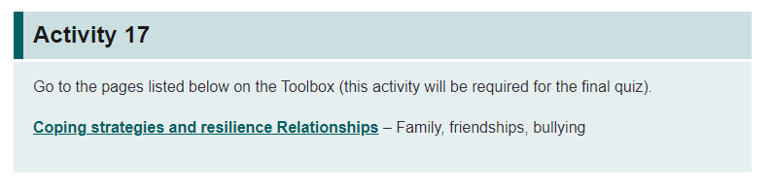
6.5 Bullying
http://www.autismtoolbox.co.uk/coping-strategies-and-resilience-0
Notes:
Research has shown that autistic learners are far more likely to be bullied than their peers. They are also far more likely to be bullied than other groups of learners who require additional support e.g. dyslexic learners. Siblings and parents of children with autism are also at greater risk of being bullied.

Slide 9
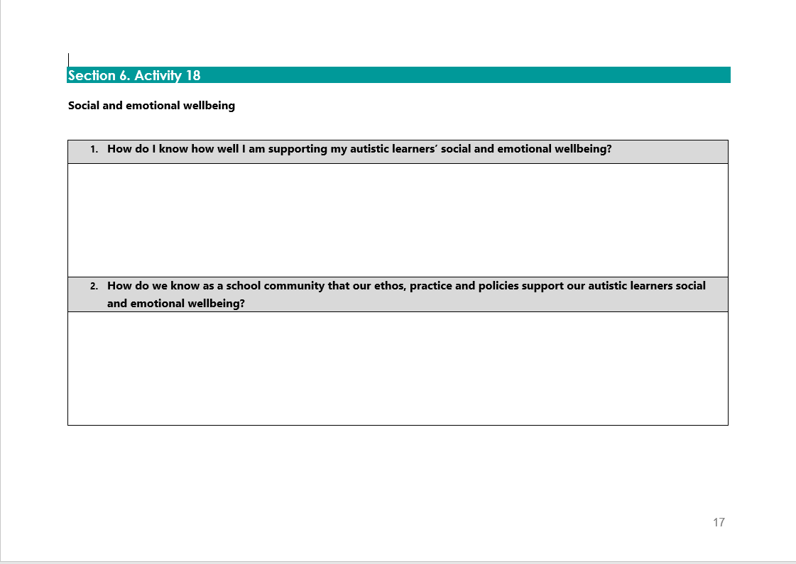
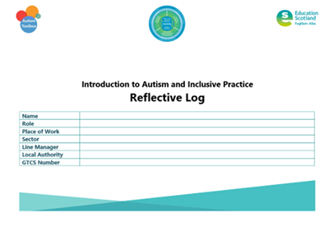
Activity 18
Notes:
Reflective log, page 17

Slide 10

Reflections:
Social and Emotional Wellbeing
How do I know how well I am supporting my autistic learners’ social and emotional wellbeing?
How do we know as a school community that our ethos, practice and policies support our autistic learners’ social and emotional wellbeing?

Slide 11

Gap Task
Complete sections:
7. Transitions
Activity 17 – Autism Toolbox
Reflective Log:
Activity 18, page 17
Notes:
Tasks for completion between this session and next. 4-6 weeks between each group learning session is optimal.

Slide 12

Next session
Terminology
The Scottish context for autism and inclusion
Understanding Autism
Assessment and Monitoring
Supporting Learners and Families
Social and Emotional Wellbeing
Transitions
Notes:
Next session, we will explore the section Transitions.

Slide 13
Education Scotland
Denholm House
Almondvale Business Park
Almondvale Way
Livingston EH54 6GA
T +44 (0)131 244 5000
E enquiries@educationscotland.gsi.gov.uk
For Scotland's learners, with Scotland's educators
Notes:
This is a back cover page in blue. You may edit the address if needed only. It can only be once and at the end of the PowerPoint presentation. Use the corresponding blue internal and back pages if you are using this page.

