Slide 1

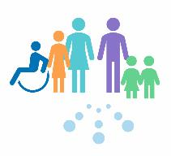

Introduction to Speech, Language and Communication Needs.
Informed Level
For Scotland's learners, with Scotland's educators
Do luchd-ionnsachaidh na h-Alba, le luchd-foghlaim Alba

Slide 2

Communication is a fundamental life skill.
It allows us to express ourselves and to have our needs met, it affects the way we in which we form our relationship, negotiate the classroom, get through interviews, hold down a job and interact with our family.
Scottish Executive Social Research (2007) communication Support needs. A review of literature.

Slide 3

What are speech, language and communication needs?
Speech, language and communication needs (SLCN) is an umbrella term.
Children and young people with SCLN may have difficulty with any or many aspects of communication. These can include difficulties with:
Fluency
Forming sounds and words
Formulating sentences
Understanding what other say
Using language socially.
I Can Talk (2009) No 7

Slide 4
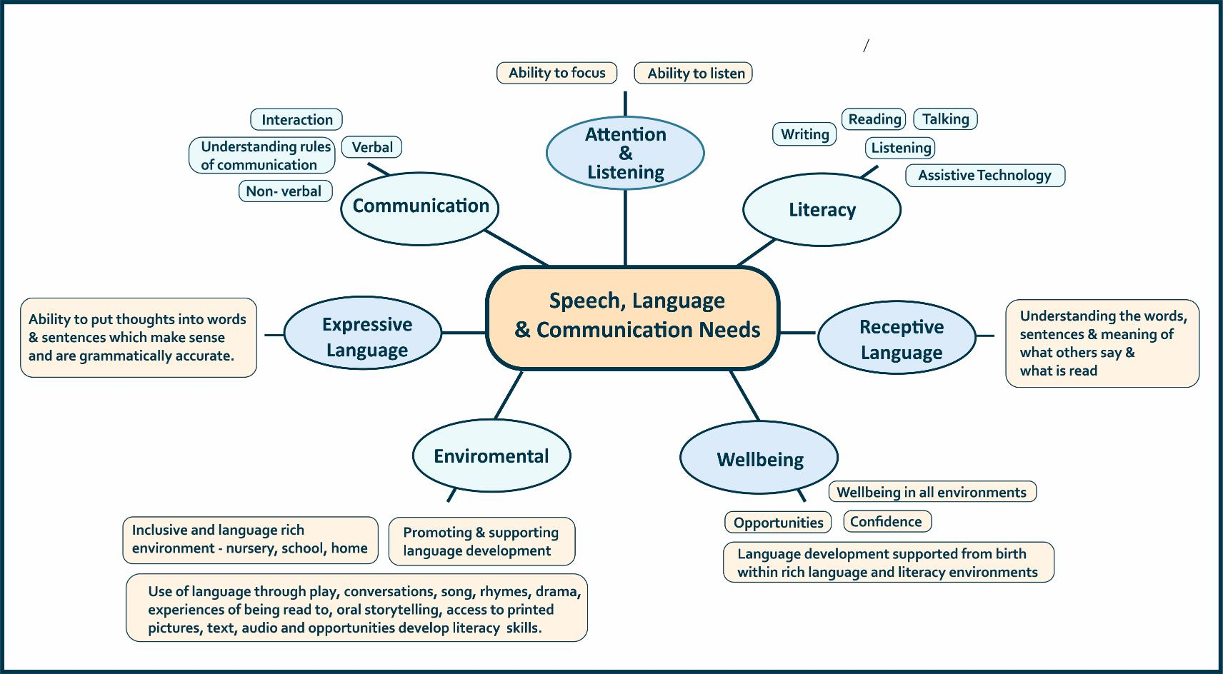

Slide 5
Prevalence and impact of SLCN
It is estimated that almost 20% of the population will experience communication difficulties during their lifespan. These problems may a raise due to neurodevelopmental differences or due to reduced opportunities which have limited the child’s language development.
Children and young people growing up with socio-economic disadvantage are more likely to have limited language skills. Research has also shown that children living in areas of social disadvantage, as well as having an increased risk of having language, are also more at risk of language disorders.
All Party Parliamentary Group on Speech and Language Difficulties (2013)

Slide 6
Prevalence and impact of SLCN
There is clear evidence of a link between SLCN and life outcomes. There is a strong relationship between early life experiences and how children learn. Inequalities experienced by parents and children can affect speech, language and communication development and lead to further inequalities later in life. These early learning experiences are vital in forming the building blocks from which more formal literacy learning can be developed.
A literacy rich environment promotes, supports and enriches listening, talking, reading and writing and there is growing evidence that intervention can make a significant positive difference.

Slide 7
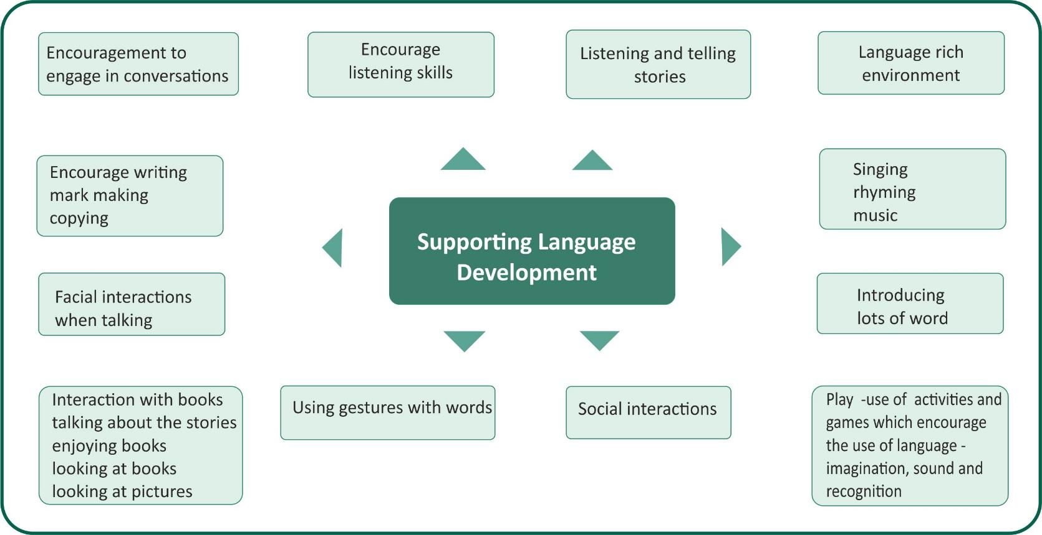
Helpful approaches which can support good language development in young children.

Slide 8

Education Scotland
Denholm House
Almondvale Business Park
Almondvale Way
Livingston EH54 6GA
T +44 (0)131 244 5000
E enquiries@educationscotland.gsi.gov.uk
For Scotland's learners, with Scotland's educators

