Slide 1


Slide 2

Using observations to improve learning
Professional Learning Resource – part 3

Slide 3
Introduction
The purpose of this presentation is to revisit the core features of successful observation practice.
Throughout the presentation, reflections on research and practice will be offered.
There will be opportunities offered throughout for you to pause and reflect on your own practice and to invite you to consider whether there is scope for improvement.
There is no right or wrong way to use this resource. It can be used by individuals and teams. It can be used from beginning to end in one session or it can be used in several sections over time.

Slide 4

Why observe?
Think about or discuss these quotation.
What do you think having an open mind means in the context of gathering observations of children?
“Children approach their learning with wide eyes and open minds, so their educators too need wide eyes and open minds to see clearly and to understand what they see.”
C. Nutbrown (1996) Respectful Educators – Capable Learner

Slide 5
Why observe?
Think about or discuss the second part of this quotation.
Can you think of a time when you have fallen into such a trap?
What can be done practically to help ensure that these mistakes are not made?
“If educators are blinkered, having tunnel vision, they may not have the full picture – so it’s not simply a case of understanding what is seen but it is first crucial to see what is really happening and not what adults sometimes suppose to be happening.”
C. Nutbrown (1996) Respectful Educators – Capable Learner

Slide 6
Why observe?
- To gain knowledge of what a child can do.
- To understand their strengths.
- To understand where a child likes to learn best.
- To understand how a child is disposed to learning.
Want to read more?
- To understand their stage of development.
L. Sancisi & M. Edgington (2015) Developing High Quality Observation, Assessment and Planning in the Early Years

Slide 7
Child-centred observation
Think about or discuss this quotation.
What does Cathy Nutbrown mean when advocating to ‘really see’?
What are some of the barriers you face in doing this?
How can these be overcome?
“Adults need to make detailed and sensitive observations to really “see” what children are doing, to make sense of their actions, to recognise their achievement and to create further learning opportunities.”
C. Nutbrown (1996) Respectful Educators – Capable Learner, page 47

Slide 8
Child-centred observation
“Each child is unique and a competent and active learner whose potential needs to be encouraged and supported. Each child is a curious, capable and intelligent individual. The child is a co-creator of knowledge who needs and wants interaction with other children and adult.”
Think about or discuss this quotation.
What do you do in your practice to show that you value children as capable and competent learners?
Early Childhood Education and Care: providing all our children with the best start for the world of tomorrow. European Commission, 2011 in Building the Ambition (2014)
Want to read more?
Scottish Government (2014) Building the Ambition Section 3.1 The Image of the Child

Slide 9
Child-centred observation
Think about or discuss these statements.
What is your understanding of the term ‘holistic judgement’?
In your setting, what role so parents/carers and families have in gathering observations of children?
Observation is the key method for young children as it provides an holistic judgement of the child’s progress.
What we learn from observation is deepened and put in a larger context by using information supplied by parents, carers and families.

Slide 10
What is ‘noticing’?
Skilled practitioners observe all the time. They use observations to make accurate judgements about how to support further children’s learning.
Skilled practitioners continually carry-out informal observations. They notice the subtleties of what children are doing and saying.
This informal and on-going approach is an essential part of tuning-in to and supporting children’s learning.
This form of observing is a key part of responsive planning, where responses to children are made ‘in the moment’ and successfully supports and extends learning.

Slide 11
How good are you at noticing learning? – case study
Brian is playing bingo with 4 children. He has set-up the game to find out which children can identify written numerals 1-5. Brian has the drawn-up a simple recording sheet for the observation (click here for example).
Brian gives the children ‘bingo cards’ and leaves the counters in the middle of the table. He explains that he is going to call out a number and that the children are to cover the number if they have it on their board.
Before they start, Sami begins to sort the counters by selecting a colour for each player. He counts the numbers of each of the boards and gives 10 counters of one colour to each child.
Brian is keen to get started and thanks Sami for helping and explains that the colour of the counters don’t matter for the game. Sami stops sorting the counters and the game starts.
The first number called is ‘three’. All of the children have a ‘3’ on their board. Roseena chooses a yellow counter from the middle. Sami changes it for a blue counter, the colour that he given her. Roseena laughs and says, ‘now it’s green’.

Slide 12
Brian’s recording sheet
Outcome: recognise numerals 1-5 | 1 | 2 | 3 | 4 | 5
Poppy | Yes/No | Yes/No | Yes/No | Yes/No | Yes/No
Fred | Yes/No | Yes/No | Yes/No | Yes/No | Yes/No
Sami | Yes/No | Yes/No | Yes/No | Yes/No | Yes/No
Roseena | Yes/No | Yes/No | Yes/No | Yes/No | Yes/No

Slide 13
Discussion points
1. In what way does Brian’s sheet help him or hinder him in gathering meaningful observations of children?
2. In what way is Brian guilty of having ‘tunnel vision’ in respect of the observations he is gathering?
3. What important information might be significant and that Brian should be noticing? To what extent could Brian have predicted these behaviours? What implications are there for the way that he is gathering his observations?
Notes:
Voice over:
It is our duty as practitioners to ensure that parents understand why we are observing, what this means and how we value their role as first educator of their child. Parents could be made aware in discussions with keyworker how observations will be collected and used to support their child’s progress.
Observations can only be shared with outside agencies with the consent of the parent/carer. The only exception to this is where practitioners must pass on information concerning child protection
It is good practice to involve children in helping to gather information about learning. This can be a simple, as a child choosing a photograph to exemplify and activity or piece of learning.
Making learning visible, by using photographs and child voice is a good way of helping children to see why we observe and record what they are doing and learning
Article 3 of the United Nations Convention on the Rights of the Child guides us to consider how we act to ensure the best interests of the child. When we are observing are we ensuring that we are observing the child where they are comfortable and where they will show us their strengths and capabilities. We need ensure that we are respectful to the child during observations, for example, praising or supporting a child if they need this or being responsive to the child’s needs and action during the course of play. Practitioners own views can affect their observations. Being aware of and able to challenge our own values, attitudes and feelings is crucial.

Slide 14
Making assessment fit for purpose
“Judgements about children’s and young people’s learning need to be dependable. This will mean that assessments are valid and reliable.”
Curriculum for Excellence
Building the Curriculum, 5: a framework for assessment
Consider. How confident are you that the observations you gather are dependable?
How do you know?

Slide 15

Making assessment fit for purpose
The following observations relate to the same observed learning episode.
Julie reacted when Colin came over to play. She gathered the dolls and went to the other side of the home corner. Colin asked Julie to play. Julie did not respond or look at Colin.
Julie finds it difficult to play and share with other children.
Discuss. Which observation is most dependable? Why?

Slide 16
Making assessment fit for purpose
Observations need to be non-biased.
Observations need to context free.
Observations need to be non-judgemental.
Observations need to be factual.

Slide 17
Making assessment fit for purpose
Using this non-biased observation, write biased statement.
Jamie spent 25 minutes at the art easel. He used all of the colours offered, including some from the painting table. Jamie said that he was painting ‘a garden with lots of roses’.

Slide 18
Making assessment fit for purpose
Non-biased
Jamie spent 25 minutes at the art easel. He used all of the colours offered, including some from the painting table. Jamie said that he was painting ‘a garden with lots of roses’.
Jamie is very artistic.
Biased

Slide 19
Making assessment fit for purpose
Using this context free observation, write a statement that focuses on context.
Jamie spent 25 minutes at the art easel. He used all of the colours offered, including some from the painting table. Jamie said that he was painting ‘a garden with lots of roses’.

Slide 20
Making assessment fit for purpose
Context free
Jamie spent 25 minutes at the art easel. He used all of the colours offered, including some from the painting table. Jamie said that he was painting ‘a garden with lots of roses’.
Jamie can paint flowers very well.
Context driven

Slide 21
Making assessment fit for purpose
Using this non-judgemental observation, write a judgemental statement.
Jamie spent 25 minutes at the art easel. He used all of the colours offered, including some from the painting table. Jamie said that he was painting ‘a garden with lots of roses’.

Slide 22
Making assessment fit for purpose
Non-judgemental
Jamie spent 25 minutes at the art easel. He used all of the colours offered, including some from the painting table. Jamie said that he was painting ‘a garden with lots of roses’.
Jamie has a very sensitive side to his personality. He enjoys activities that girls enjoy.
Judgemental

Slide 23
Language of observation
“Learning how to observe and find the words, the ‘right’ kind of language, to describe complex dynamic behaviour is more difficult than one might think. It is an art, almost akin to writing a short story, though this is not fiction, even if everyone is inevitable writing from within their own perspective.”
M. Fawcett (2009) Learning Through Child Observation

Slide 24

Reflection Task
Look at a recent observation you made of a child.
How factual is the account of what happened? Does the observation contain any guesses about what you think was happening?
Does the observation include any words uttered by the child?
In what ways does the observation give you an insight into what is really happening?

Slide 25
Recording ‘significant’ learning
Using the questions below, look at some observations you have recorded recently, and analyse how could you improve the quality of these.
What do I now know different about the child?
What can the child do?
What has changed for the child?
What may the child wish to know?
How are they doing this?
Is there another method which would give me more reliable information?
Want to read more?
Children in Scotland (2013) The Cycle of Observation Assessment and Planning
Tackling bureaucracy
http://ow.ly/BsIv3027STe

Slide 26
Making judgements about progress
Making a judgement about children’s learning and progress requires reflecting on observations gathered across a range of contexts and situations.
Using these observations, what evaluation would you make about Skye’s literacy development?
29 April 2016
Skye offered the suggestions ‘nose’ and ‘clothes’ as alternatives for ‘nose’ in song Little Peter Rabbit.
3 May 2016
Skye correctly sang all of the words to her favourite pop song and made-up a dance. She showed this to her friends.
24 April 2016
Skye successfully tapped out on the drum the correct number of syllables in her name and her friends names.

Slide 27
Recording ‘significant’ learning
You are about to see and hear about the practice at Ferguslie Pre-Five Centre in Renfrewshire explaining the importance of observing children at play.
As you listen, note the key words you hear. Consider. Which of these descriptions apply to you in your own setting?
What other words or phrases could you use to explain the role you play in observing children?
Now click here to watch.

Slide 28
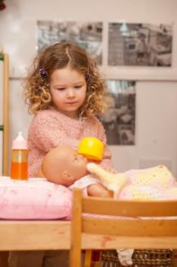
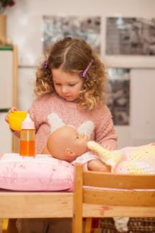
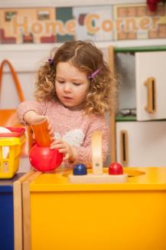
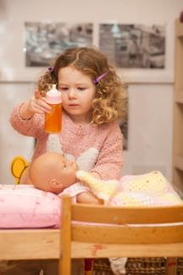
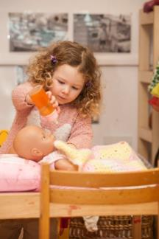

Observing learning unfold
Now Listen.

Slide 29
Reflecting upon what you do
To what extent are your observations of children helping you to engage sensitively in children’s play?
Look at the observations you are gathering for individual children. Do these take well enough account of children’s prior learning?
Children need time to play. Does the play flow in your setting without being interrupted?
Are you committed to gathering observations of child during their self-directed play?

