Slide 1



Autism & Inclusive Practice
Professional Learning Module
Session 4. Assessment and Monitoring
For Scotland's learners, with Scotland's educators
Do luchd-ionnsachaidh na h-Alba, le luchd-foghlaim Alba
Notes:
The module An Introduction to Autism and Inclusive Practice is designed to provide an introduction for educational staff and anyone with an interest in supporting autistic learners in the settings that they work and support. This introductory module aims to help you develop an awareness of what autism is, its impact and how it can be supported within an inclusive school community. It may also be of interest if you work in the voluntary sector or simply have an interest in autism and inclusive practice.

Slide 2

This week’s session
Terminology
The Scottish context for autism and inclusion
Understanding Autism
Assessment and Monitoring
Supporting Learners and Families
Social and Emotional Wellbeing
Transitions
Notes:
The module and this supporting programme for reflection is split into seven sections:
Terminology
The Scottish context for autism and inclusion
Understanding Autism
Assessment and Monitoring
Supporting Learners and Families
Social and Emotional Wellbeing
Transitions
Today we will explore the fourth section of the module, Assessment and Monitoring.

Slide 3
Recap of Section 4
Assessment and Monitoring
4.1 | Assessing and monitoring
4.2 | Identification of autism
4.3 | Supporting learners – staged levels of intervention
4.4 | Autism support, planning and monitoring
4.5 | Partnership working and roles
Notes:
These are the subsections, included within the section on Assessment and Monitoring:
4.1 Assessing and monitoring
4.2 Identification of autism
4.3 Supporting learners – staged levels of intervention
4.4 Autism support, planning and monitoring
4.5 Partnership working and roles

Slide 4

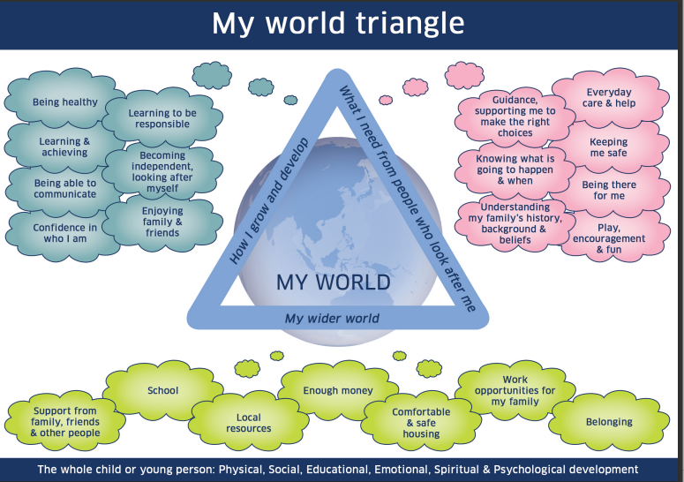
4.1 Assessing and monitoring
https://www.gov.scot/publications/shanarri/
Notes:
Notes from module:
Assessment and monitoring are dynamic and symbiotic processes in which an autistic learner (and every learner) is at the centre. As a result, it should not be divorced from other aspects of the child’s life either at school, home or in the community.
Assessment is an integral part of learning and teaching which takes place in every classroom each day. It helps to provide a picture of a learner’s progress and achievements and to identify next steps in learning. Assessment should identify if particular strategies and supports continue to be appropriate for individual pupils.
Assessment can be for a variety of purposes. These may include reviewing and revising individualised educational/learning/support plans or compiling risk assessments, as well as monitoring progress in curriculum areas. Information may be required as part of a ‘joined-up’ assessment, towards development of a pupil profile, diagnostic information or for a coordinated support plan, consistent with the principles of the ‘Getting it right for every child’ approach to provide a holistic view of the child.
Assessing autism
The assessment of autism in Scotland:
Is a process rather than an end-product. The information provided in the assessment should support the learner’s next steps for learning.
Should be a holistic and collaborative process which takes place over a period of time, drawing on a range of observational and assessment methods.
It is the responsibility of all who work with children to respond appropriately to their needs. Recognising early signs of difficulties and adapting learning and teaching approaches are a regular part of the daily routine for teachers supporting all children in an education environment. For those learners who may have additional learning needs, such as those arising from autism, it is important that these needs are met in the best possible way by accurate and timely identification.
My World Triangle is one approach which can be used to gather more information from a range of sources (some of it possibly specialist), to identify the strengths or wellbeing concerns in the child or young person’s world.
Access and download a copy of the My World Triangle and Further resources, images and information on the My World Triangle.

Slide 5


4.2 Identification of autism
Early identification of autism
Good practice for the identification of autism
Further information about the DSM-5 can be found on
the National Autistic Society website.
Further information about ICD can be found on the
World Health Organisation website.
Notes:
Notes from module:
In Scotland, there is currently a move towards assessing and diagnosing autism as part of a range of neurodevelopmental conditions. We recognise that autistic young people can have other co-occurring difficulties that also need to be recognised, especially if they are to understand their own strengths and difficulties. Currently, a diagnosis of autism is given through the local health authority (NHS) but across Scotland there are a range of pathways and professionals involved. The Diagnostic and Statistical Manual (DSM-5) and the International Statistical Classification of Diseases and Related Health Problems (ICD) are used by clinicians to identify autism. In 2013, DSM-5 redefined autism. The terms ‘Autistic Disorder’, ‘Asperger’s Disorder’ and ‘PDD-NOS’ were replaced by the diagnosis of Autism Spectrum Disorder. The ICD is the diagnostic classification standard for all clinical and research purposes used to identify autism and this version of the manual.
Early identification of autism
Early identification of autism can be helpful as it can allow professionals to understand and respond to the child or young person’s unique pattern of strengths and difficulties, and thus allow the learner to flourish. Health professionals and education partners should therefore be aware of the possibility of autism when they notice a pattern of features in the areas of:
‘social interaction and play, speech, language and communication difficulties and behaviour’.
(Sign 145, 2016)
In early years and childcare settings and in schools, assessment involves the gathering of information about the learner’s strengths and difficulties and will include a wellbeing assessment. In collaboration with parents and the learner, a profile of the learner is established; this may result in a request for further assessment by speech and language therapy services and potentially educational psychology services.
If the information gathered indicates that the learner may be autistic, a request for assistance can be made to the local specialist autism or neurodevelopmental diagnostic team. For a range of reasons, some parents decide that they do not wish to move to formal identification. This does not stop the team around the child planning to support and meet the needs of that child or young person.
Good practice for the identification of autism
Good practice in terms of identification of autism involves the gathering of information by a multi-disciplinary team with the relevant skills and experience. Information should include the child or young person’s strengths and difficulties, and a diagnostic assessment based on the current version of DSM-5 or ICD.
‘Specialist assessment should involve a history-taking element, a clinical observation/assessment element, and the obtaining of wider contextual and functional information.’
(Sign 145)
The team uses this information to decide if the child or young person fits the criteria for autism. A report is usually compiled based on the gathered information and post-diagnostic support is normally offered to the family.
Back to previous pagePrevious

Slide 6
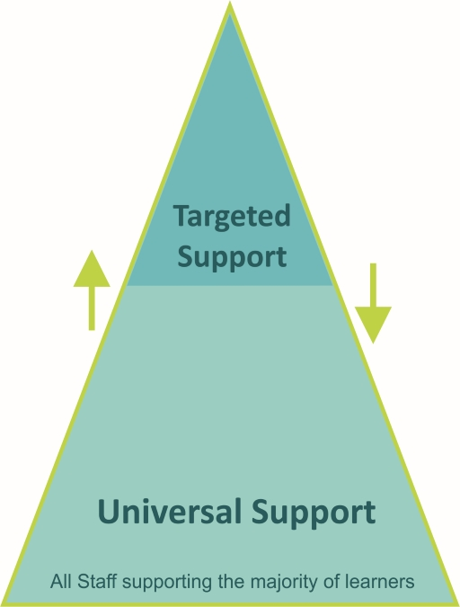
4.3 Supporting learners – staged levels of intervention
Notes:
Notes from module:
In Scottish schools, the staged intervention is used as a means of identification, assessment, planning, recording and review to meet the learning needs of children and young people, including autistic learners. Staged intervention:
provides a solution-focused approach to meeting needs at the earliest opportunity and with the least intrusive level of intervention
involves the child, parents/carers, school staff and, at some levels, other professionals, all working in partnership to get it right for every child.
Staged intervention is designed to be flexible and allows for movement between stages depending on progress. There are variations between local authorities regarding the number of stages within their process
Universal support
Universal support starts with the ethos, climate and relationships within every learning environment. It is the responsibility of all practitioners to take a child-centred approach that promotes and supports wellbeing, inclusion equality and fairness. The entitlement to universal support for all children and young people is provided from within the existing pre-school and school settings.
An environment which is caring, inclusive, fair and focused on delivering learning to meet individual needs will encourage all children and young people to strive to meet their learning potential. Every child and young person is entitled to support to enable them to gain as much as possible from the opportunities which Curriculum for Excellence can provide. When a child or young person may require some additional support, this is initially the responsibility of the classroom teacher. The majority of children and young people’s needs are met through universal support.
Some examples of universal support are below. This list is not exhaustive.
personalised learning plans
literacy, numeracy or health and wellbeing support
enhanced transition – macro and micro
use of ICT e.g. digital learning and teaching resources such as digital course material and SQA exams
quiet spaces
visual timetables and supports.
Targeted support
Children and young people can benefit from additional or targeted support, tailored to their individual circumstances. This could be at any point on their learning journey.
This targeted support is any focused support that children or young people may require for short or longer periods of time, in order to help them overcome barriers to learning or to ensure progress in learning.
Targeted support is usually, but not exclusively, coordinated and provided by staff with additional training and expertise through a staged intervention process. This may be by staff other than the class teacher and outside the pre-school or school setting, but within education services.
Some examples of targeted support are below. This list is not exhaustive.
higher attaining children (ensuring progression)
bereavement peer support group
input from Allied Health Professionals e.g. Speech and Language Therapist
trauma informed interventions designed for a care experienced child/young person
complex needs e.g. sessions in a sensory room.
Back to previous pagePrevious4.2 Identification of autism
Go to next pageNext

Slide 7
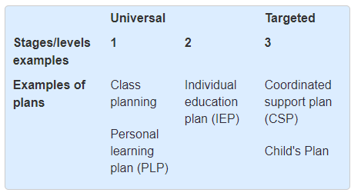
4.4 Autism support, planning and monitoring
Notes:
Notes from module:
A key message highlighted through this module is that a diagnosis of autism is not the end of a journey in supporting an autistic learner; it can aid an ongoing process of support which will require planning and monitoring.
The principles of Curriculum for Excellence and the ‘Getting it right for every child’ approach place the child at the centre of all planning. Central to supporting pupils with autism is:
Planning to support emotional and social wellbeing.
Knowledgeable staff who can provide a flexible approach, reflect on their own teaching styles and adapt to their knowledge of the pupil.
Consistency from all staff, developing trust and reducing anxieties.
It is important that schools recognise that any adjustments made to support pupils with autism will potentially benefit all pupils.
Personalised support and planning
Recap: Section 2 highlighted
‘Many autistic learners may only require minimal levels of support in class. Their needs will be met by a small number of reasonable adjustments within an inclusive classroom environment. This might include providing a visual timetable to enable them to better understand the structure of their day. A smaller number of autistic learners will need a more personalised, tailored approach.’
Through Curriculum for Excellence, all children and young people should have frequent and regular opportunities to engage with an adult who knows them well and with whom they have a mutually trusting relationship to review and discuss their learning and progress. Cognisance must be given to the individual developmental needs of learners when staff plan and support this engagement. For Social and Language partners, different methods of establishing their preferences are required. This key member of staff has the holistic overview of the child or young person’s learning and personal development.
There are variations between local authorities regarding the number of stages within their process and their terminology used to describe planning documents. An overview using common terms is provided in the table below.
Personal learning planning (PLP)
Personalised learning is at the heart of supporting learning in which the learning environment is a crucial factor. Conversations about learning, reviewing progress and planning next steps are central to this process. All children and young people should be involved in personal learning planning (PLP).
Autistic learners (as are all learners) are entitled to have opportunities for achievement which focus on learning and progress made through activities across the full range of contexts and settings in which the curriculum is experienced. The 2017 Code of Practice says that children with additional support needs should be involved in their personal learning planning. It also says that, for many, this will be enough to meet their needs.
Individualised educational programme (IEP)
If a PLP does not enable sufficient planning to support an autistic learner, their PLP can be supported by an individualised educational programme (IEP). An IEP is a non-statutory document used to plan specific aspects of education for learners who need some of or their entire curriculum to be individualised. IEPs are usually provided when the curriculum planning required is to be ‘significantly’ different from the class curriculum. Involvement with group work or extraction for a number of sessions a week does not normally meet the criteria for an IEP.
Coordinated support plan (CSP) – targeted support
A CSP is the only statutory educational plan in Scotland. It is a legal document and aims to ensure that all the professionals, the child/young person and the parents/carers work together and are fully involved in the support. It was developed to help coordinate services for children or young people whose additional support needs:
arise from complex or multiple factors
have a significant adverse effect on their school education
are likely to last at least a year, and which require support to be provided by an education authority and at least one other non-education service or agency.
Child’s Plan – targeted support
In line with the Children and Young People Act 2014 and the ‘Getting it right for every child’ approach, many children and young people will now have a Child’s Plan. Child’s Plans are created if a child or young person needs some extra support to meet their wellbeing needs, such as access to mental health services or respite care or help from a range of different agencies. The Child’s Plan will contain information about:
why a child or young person needs support
the type of support they will need
how long they will need support and who should provide it.
All professionals working with the child would use the plan, which may include an IEP or a CSP. Where there is a Child’s Plan and targeted interventions to support a child or young person and parents, there will be a Lead Professional to coordinate that help.
Reporting
Educational reporting
Reporting ‘provides clear, positive and constructive feedback … [on] learning and progress’ to parents and learners and ‘creates an agenda for discussions … about their next steps in learning.'
(Building the Curriculum 5)
Staff supporting learners who require additional support are familiar with this kind of reporting whether for review meetings, evaluating plans and targets with learners, or as a report for parents or carers.
Curriculum planning and monitoring considerations
Intervention at all levels is managed in close collaboration with parents, allied health professionals (if there are signs that this is warranted) and others who may be able to give support either directly or indirectly. Where a collaborative plan of intervention requires to be developed, all parties involved may require meeting with parents/carers to ensure a common strategy for supporting the child. A record should be kept of any such meetings and retained with the paperwork for the Staged Process of Assessment and Intervention.
Effective monitoring of autistic learners’ learning is essential to support their progress and positive experiences of learning. This will guide staff to use appropriate levels of assessment and inform their planning.
The information gathered throughout the assessment process and diagnostic conclusions should support the planning for the autistic learner’s next steps. This will require monitoring due to the changes and challenges which will occur as they grow, and their curriculum develops as both they and their peers develop. For example, the difficulties experienced in P6 may not be exactly the same in S3 – they may be harder or easier and other challenges may replace them.
Listed below are areas that help schools achieve effective planning for their autistic learners.
Participation of autistic learners and families incorporated in planning.
Consideration of autistic learners and families incorporated in planning.
Whole staff awareness of autism and inclusive practice.
Whole staff awareness and understanding of effective planning to support autistic learners – including professional and legislative duties.
Awareness of the impact of sensory environment in social areas.
Accurate profiling which identifies strengths as well as barriers to learning
Appropriate assessment and reporting procedures.
Forward planning for transitions – across the school and at times of personal changes.
Coordinated communication regarding pupils.
Collaborative partnership working with families and other agencies.
Effective self-evaluation of school ethos, policies and practices.

Slide 8
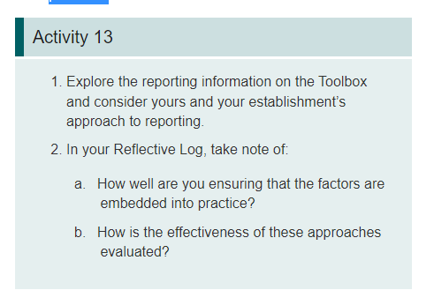
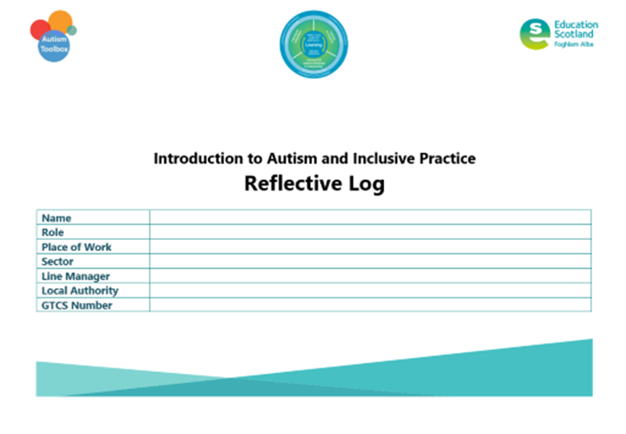
Activity 13
Notes:
***This isn’t in the Reflective Log pack***
Use Additional notes page

Slide 9
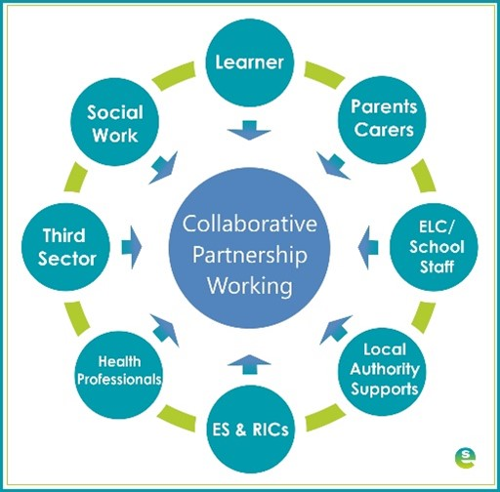
4.5 Partnership working and roles
Notes:
Notes from module:
Supporting learners is a collaborative process that involves effective partnership working between professionals, families and the learner, where possible. This is particularly important and helpful when identifying and planning support for an autistic learner.
The role and views of the parents, carers, and child or young person are extremely important and can provide valuable information to support assessment and monitoring. Learning targets are more likely to be reinforced at home if parents have also been centrally involved in planning.
Planning is considered to be most effective when the young person's views are taken into account. There is a clear consensus that joint planning at the earliest possible stage is most helpful in meeting children's and young people's needs. Early and good communication between education staff, allied health professionals and parents is more likely to lead to coordinated and appropriate planning, support and monitoring for each individual child.

Slide 10
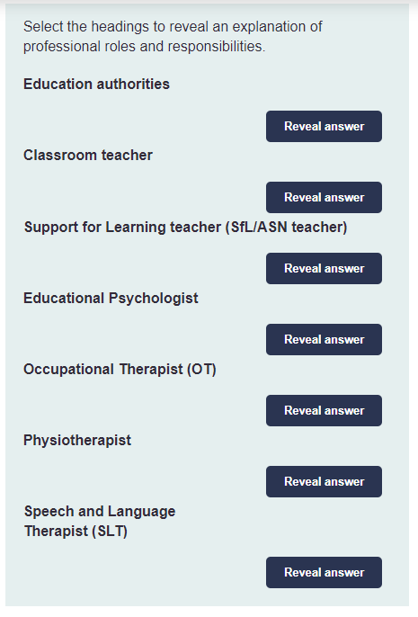
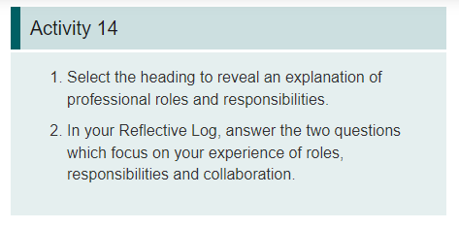
Activity 14
Notes:
Notes from module:

Slide 11
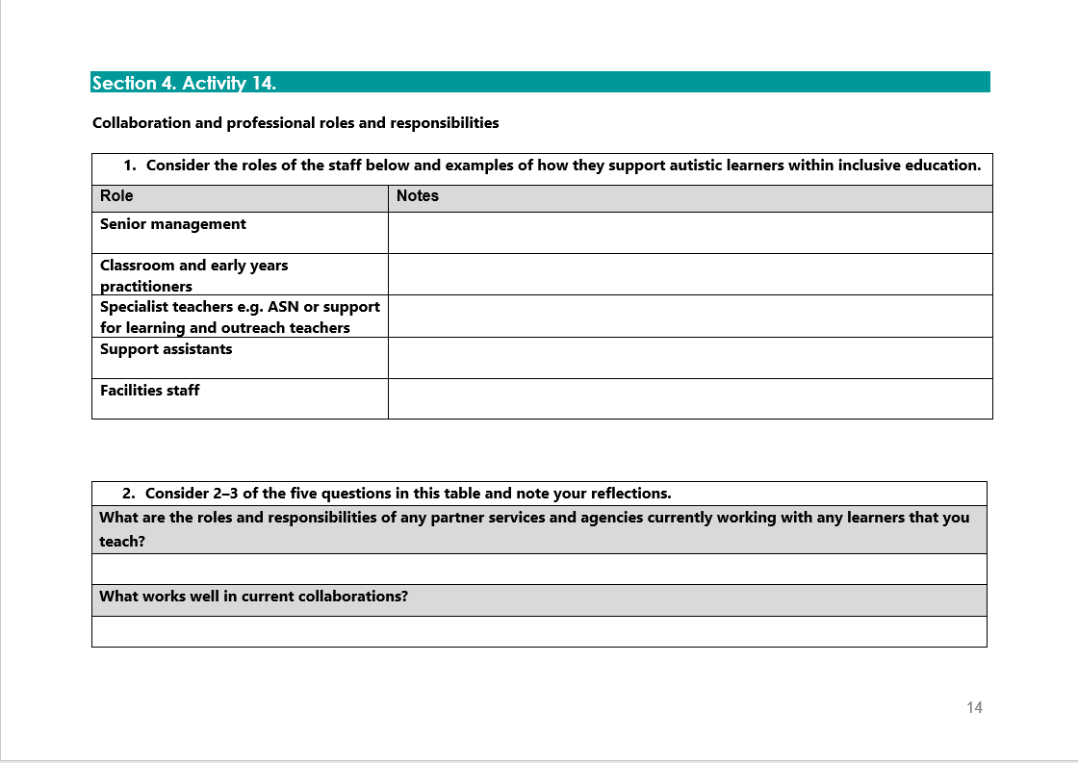

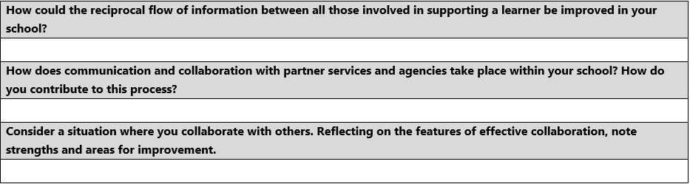
Activity 14
Notes:
Reflective log, page 14 and 15

Slide 12

Gap Task
Complete sections:
5. Supporting Learners and Families
Reflective Log:
Activity 13
Activity 14
Notes:
Tasks for completion between this session and next. 4-6 weeks between each group learning session is optimal.

Slide 13
Next session
Terminology
The Scottish context for autism and inclusion
Understanding Autism
Assessment and Monitoring
Supporting Learners and Families
Social and Emotional Wellbeing
Transitions
Notes:
Next session, we will explore the section Supporting Learners and Families.

Slide 14
Education Scotland
Denholm House
Almondvale Business Park
Almondvale Way
Livingston EH54 6GA
T +44 (0)131 244 5000
E enquiries@educationscotland.gsi.gov.uk
For Scotland's learners, with Scotland's educators
Notes:
This is a back cover page in blue. You may edit the address if needed only. It can only be once and at the end of the PowerPoint presentation. Use the corresponding blue internal and back pages if you are using this page.

