Slide 1
Larbert High School
Skills Framework
Supporting Skills Development

Slide 2


Skills Development
National Improvement Framework and HGIOS4 place skills development (particularly SfLLW) at the centre of learning.
Focus on:
  what skills pupils are developing in our classrooms
  the reason pupils are developing these skills
  how pupils might be able to apply these skills in the future

Slide 3
The Skills Framework
In response to the issues identified by the Skills SIG it was decided that Larbert High should:
  Create a common language for skills that can be used across our school
  Use language that clearly and consistently describes skills so as to allow for a shared understanding amongst staff, pupils and parents
  Create a resource that succinctly categorises and exemplifies the most common skills used by our pupils
  Provide simple graphics that can be used easily across the school to highlight the importance of skills development in all learning and teaching.
As a result, using advice in BTC4 and following an audit of skills with input from staff pupils and parents, the Skills SIG have produced the LHS Skills Framework.

Slide 4
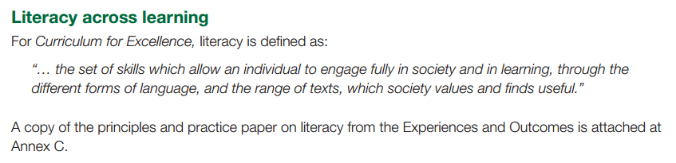
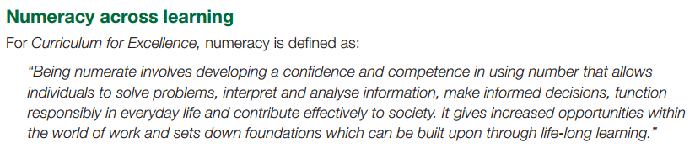
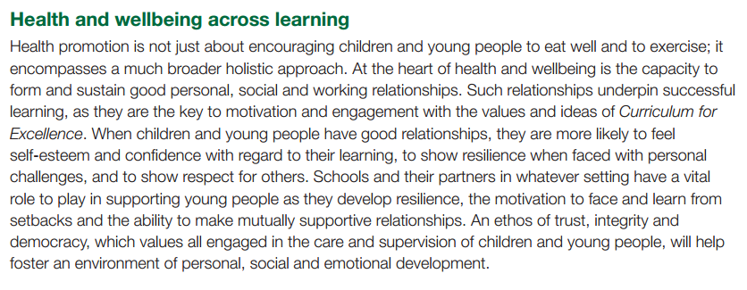
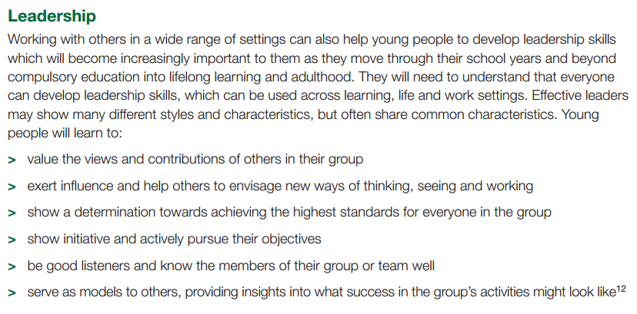
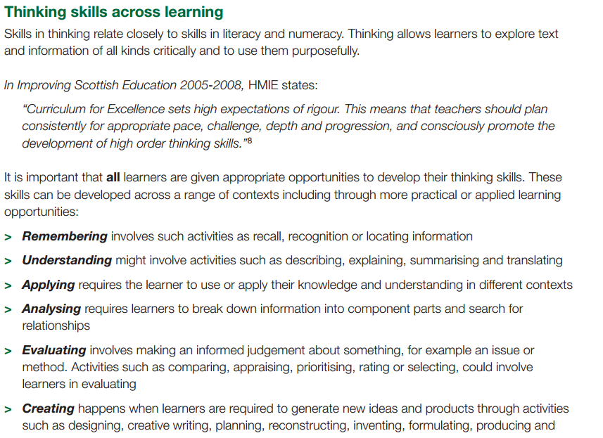
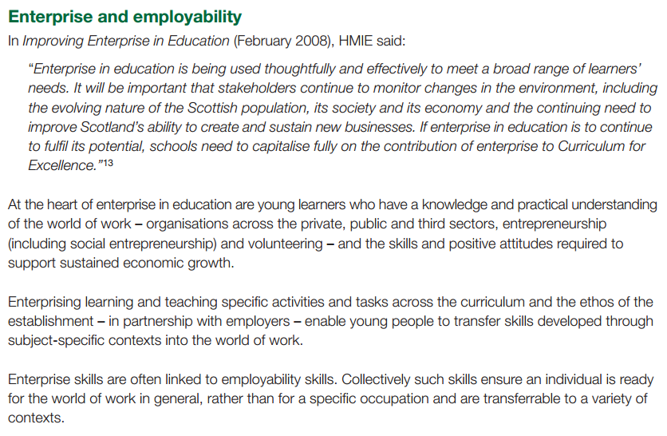

Slide 5
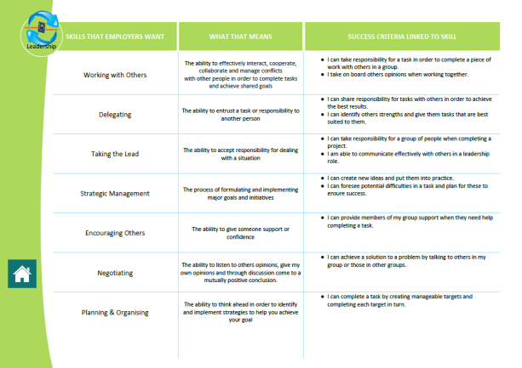
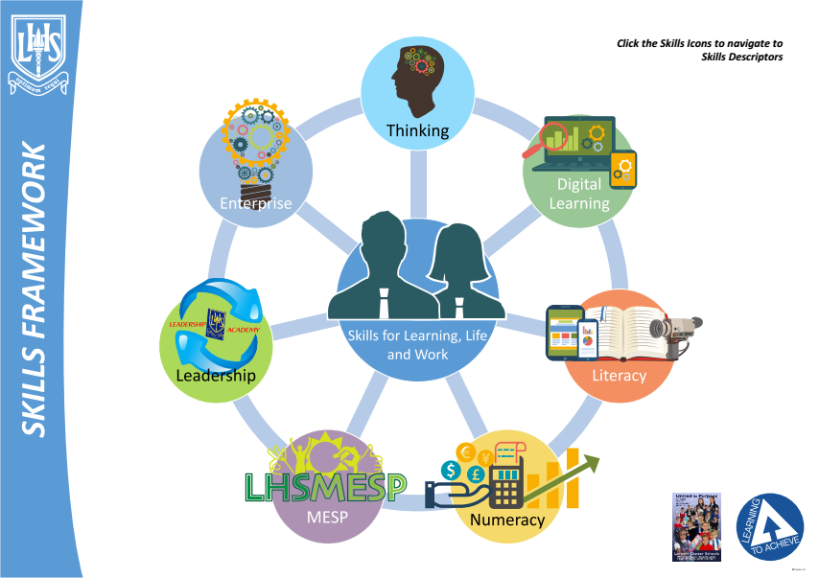
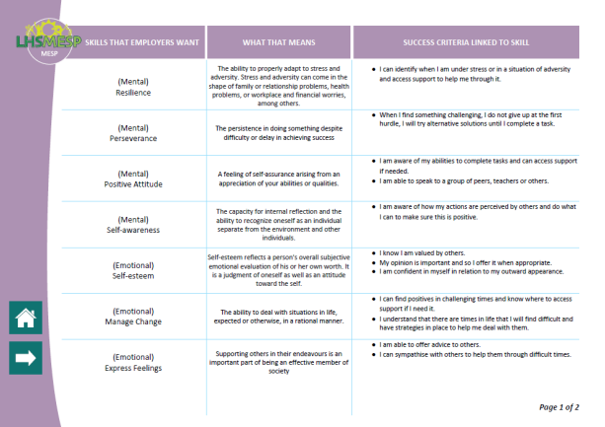
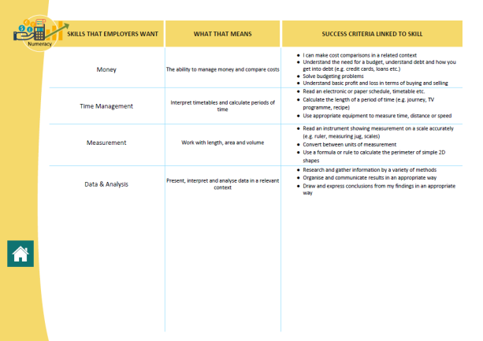
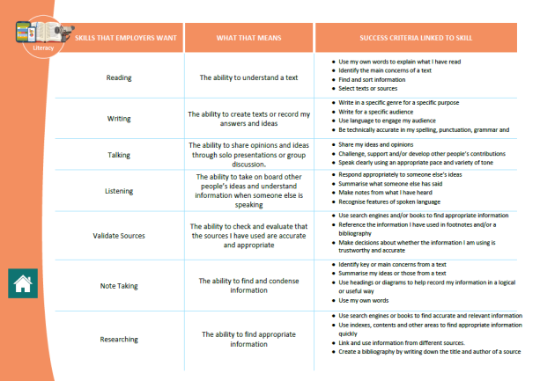
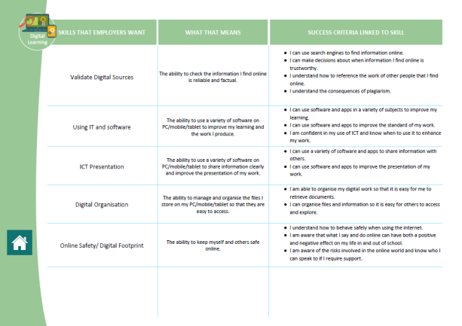
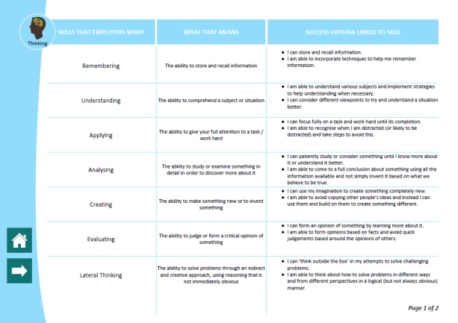
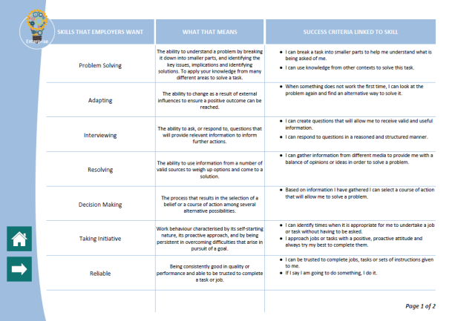
The Skills Framework
The Skills Framework exists as an interactive PDF on Shared for Staff and OTB.
Clicking each icon will take you to a different skills category.

Slide 6
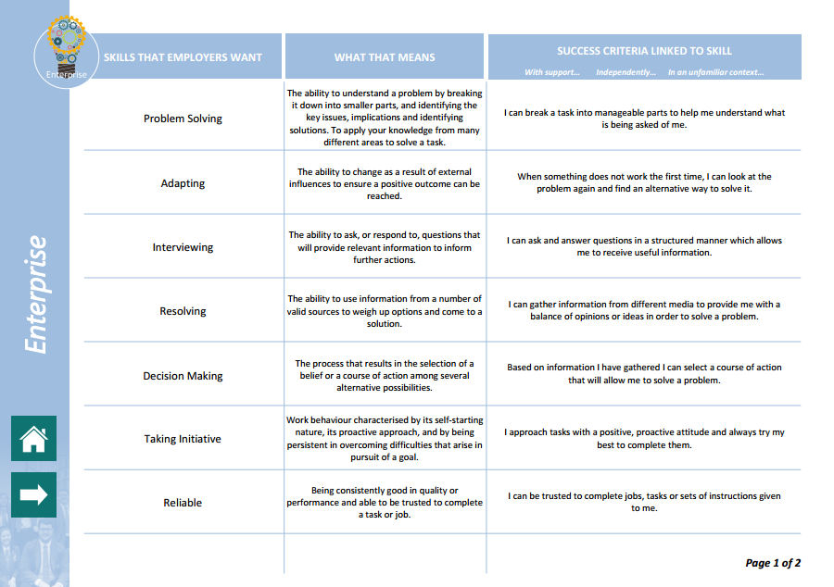
The Skills Framework
Each section of the framework lists a series of skills as well as a concise explanation of what each skill is and finally a success criteria suggesting how you could demonstrate that skill.

Slide 7
The Skills Framework
For reporting purposes, each of the success criteria can be used with the terms:
  With support…
  Independently…
  In an unfamiliar context…

Slide 8
The Benefits
A common language for skills will help pupils form a better understanding of the relevance and importance of developing skills to support their learning.
A better understanding of skills will help pupils become more able to articulate skills to teachers/parents/universities/future employers.
Learning Conversations can be more easily framed around skills development given the increased awareness and understanding.
Staff can access the Skills Framework resource to quickly and easily to find information relating to skills they might be developing.
Staff have opportunity to use Skills Framework resources to clearly show skills development in their classroom and help pupils see links to skills in other subjects/curricular areas.

Slide 9
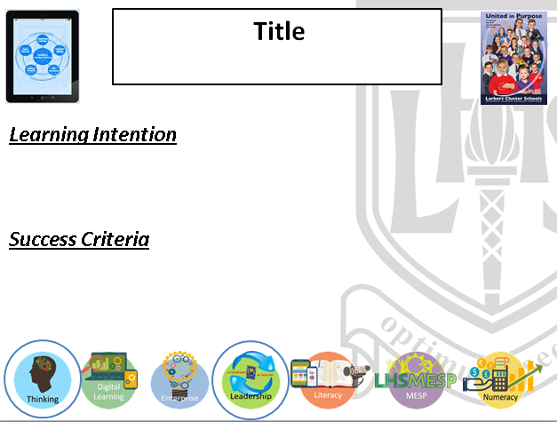
Implementation
Skills should be explicitly referenced at the beginning of every lesson in the Learning Intentions and Success Criteria.

Slide 10







Implementation
The skills icons should be integrated into learning and teaching.
All subject profiles have a skills focus which allows pupils to comment on how they are developing their skills in each curricular area. This is also a focus of the learner conversations.
Wider Achievement Opportunities in all year groups focus on two key skills which are tracked by the teacher though OTB.
The skills developed through the Wider Achievement Opportunities form the basis for pupil reports.
Whole school skills profile to collate ‘best’ examples of skills development.

Slide 11



