Slide 1


Slide 2
Where do you think the most effective learning
takes place?
For Scotland's learners, with Scotland's educators
Notes:
Discussion slide that can be used with any stakeholders within your school community.

Slide 3
What are the key drivers in your unique context?
Notes:
Where are the opportunities in your context?
Who is able to contribute to your curriculum design?
Where does the learning take place?
What are the key influences?

Slide 4
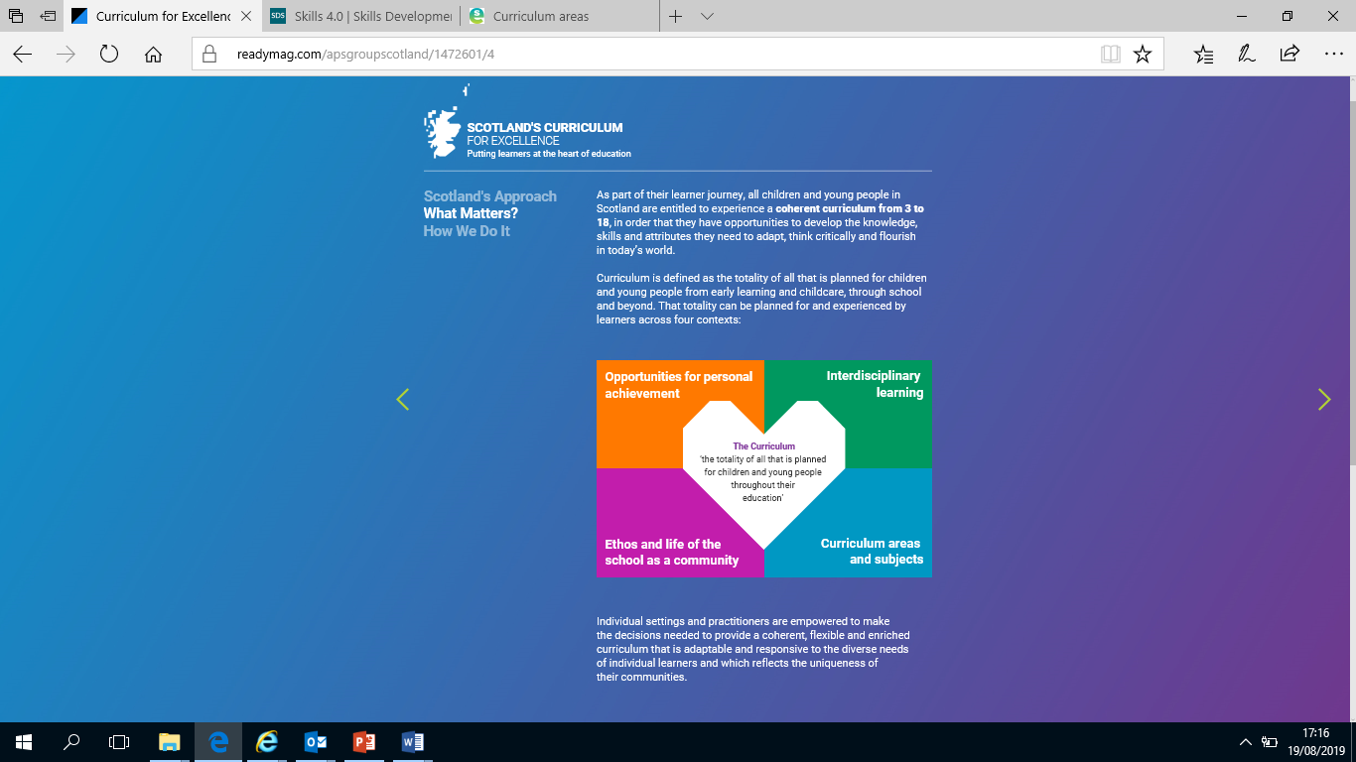
Maths and Numeracy across the four contexts
  Maths competitions e.g.(UK Mathematics Trust,
  Scottish Mathematical Challenge,
  Mathematiques sans Frontieres,
  Maths Week Scotland
  Online weekly puzzles e.g. Parallel Nrich Puzzle of the Week
  Sumdog Contests
  Pupil Maths Ambassadors
  Maths Mentors
  Cross stage working
    STEM projects
    Enterprise Activities e.g. Virgin Money
    School credit unions e.g. Credit Union
    STEM ambassador inputs
    Employer engagements
    Financial Education e.g. Money Talks
    Digital / technology skills
    Social Studies
    Home economics e.g. Family Food Group
  Maths Week Scotland
  Parental Engagement e.g. Beattock Primary Pizza Maths
  Celebration days e.g. Pi Day /Fibonacci day at Grange Academy
  Numeracy across learning
  Partnership e.g. Glasgow Science Centre Big Chef, Little Chef
  Community learning
  Homework support initiatives e.g. Homework Kits
  Transitions – possible use of
    Making Maths Count
    Highland Numeracy Blog
    Early foundations in numeracy e.g. Cbeebies Number Blocks Number Talks
    SEAL, numeracy frameworks e.g. Clacks Framework
    Use of Applications of Maths and the new Higher
    Pedagogical approaches
    Outdoor learning ideas, creativity ideas
    Teacher forums, online resource sharing
Current research – link to usable collection
For Scotland's learners, with Scotland's educators
Notes:
Created by Maths / Numeracy colleagues – what would this look like in different schools / clusters / authorities / RICS?
What would this look like for other curricular areas?
What would this look like for DYW / Outdoor Learning / STEM?
What would a week in your school / department / class / community look like?

Slide 5
For Scotland's learners, with Scotland's educators
Notes:
Blank template to use

