Slide 1






Slide 2
Today’s session
What is Read, Write, Count?
Information about this year’s Read, Write, Count bags
Resources available
Inspiration and national examples
Notes:
Today we’ll go through a brief overview of read, Write, Count and let you see some examples of the resources we have available to support the programme as well as showcasing national examples. With an element of Read, Write, Count included, the activities aim to encourage children and families to think about learning outside of the classroom. Reading, writing and counting are everyday skills that children can use – and we want to ensure that they have fun while learning about them!

Slide 3
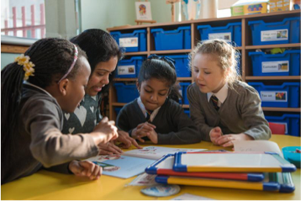
Read, Write, Count is…
a campaign to improve the literacy and numeracy skills of Scotland’s children.
It aims to help parents support their child’s learning by incorporating simple, fun activities in to everyday life.
Notes:
Read, Write, Count is a campaign by the Scottish Government, supported by Scottish Book Trust and Education Scotland. It focuses on the importance of families, parents and carers in children’s education and aims to give advice and materials to help families get involved in their children’s learning.
As part of the campaign, every child in Primary 2-3 receives a free bag with books and activities to support their learning. In addition, the campaign provides advice and support for learning professionals and families through Scottish Book Trust and Parent Club, in the form of training events, online resources and useful advice. It is a key part of the Scottish Government’s commitment to raise attainment for all.
A key part of the campaign is parental and family engagement with children’s learning. Research tells us that if parents are involved in their child’s learning, their child does better in school. The campaign therefore aims to ensure that parents and carers are empowered to get involved in their child’s learning and recognise the importance of this.

Slide 4
Read, Write, Count aims to. . .
Help parents and carers to be confident enough to be involved in their child’s learning; to understand why they are important in their child’s learning and how to get involved
Increase families’ use of their local library
Help to close the attainment gap between the most and least advantaged children in Scotland

Slide 5
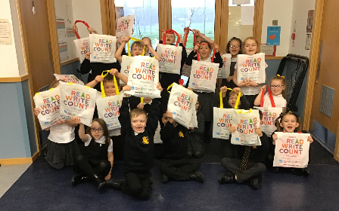
Read, Write, Count: Gift Bags
Free gift bags to all Primary 1, 2 and 3 children in Scotland
Containing books and materials for writing and counting
Information for parents and carers on how to use the bags with their children
Notes:
One of the biggest parts of the Read, Write, Count campaign is the free bags which are gifted to every Primary 2 and Primary 3 child in Scotland. There is also an element of Read, Write, Count in the P1 bags, which are an extension of the Bookbug programme and include three picture books as part of the Bookbug Picture Book Prize.
The bags contain a selection of books and materials for writing and counting. These materials have all been carefully selected so that they are fun to use at home and can be incorporated into activities in both classrooms and libraries.

Slide 6
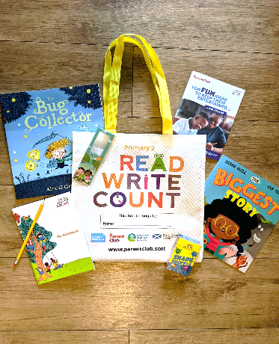
What’s in the Primary 2 bag?
Two picture books: The Bug Collector by Alex G Griffiths & The Biggest Story by Sarah Coyle & Dan Taylor
A Shape Shuffle card game with Talk it Out conversation starters and Act it Out charades on the reverse
A ruler and magnifying glass
A notebook and pencil
A parent guide booklet

Slide 7
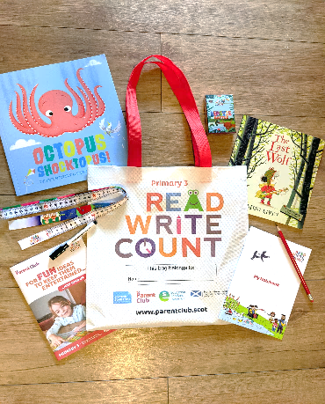
What’s in the Primary 3 bag?
Two picture books: The Last Wolf by Mini Grey & Octopus Shocktopus by Peter Bentley & Steven Lenton
A Beastie Battle card game with storytelling and routine cards on the reverse
A tape measure
A dry-wipe pen
A notebook and pencil
A parent guide booklet

Slide 8
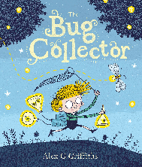

Read, Write.. Activities
Design and make your very own bug sanctuary
Make an insect out of Lego!
Find out some facts about insects using the internet or non-fiction texts
Make paper plate masks of the different animals and act out Errol’s story
Where do stories take you? Draw some settings from your favourite books and make a display

Slide 9
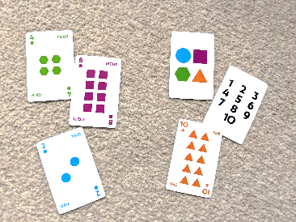

Count.. Activities
Play Shape Shuffle at your next Games Club
Create your on wildcard to include in your next game
Film yourselves doing the Shape Shuffle dance and share it with us!
Go on a scavenger hunt looking for insects and plants around the local library
Use the magnifying glass in books such as Where’s Wally?
Make a mini book that you have to read with a magnifying glass
Notes:
Board game

Slide 10
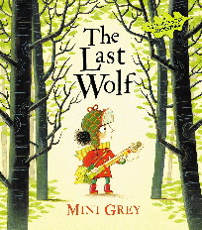

Read, Write.. Activities
Design a poster about an environmental issue you care about
Draw some alternative fairy tale characters like Red e.g. a princess who saves a prince!
Create your own octopus using a paper plate and streamers
Create some invitations to a party for the octopus to welcome him
Draw along with Steven Lenton on Authors Live
Make a sock-topus

Slide 11
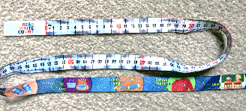
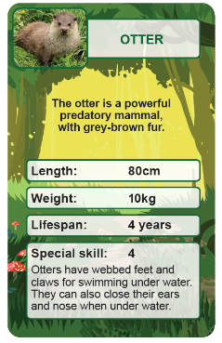
Count.. Activities
Play Beastie Battle at your next Games Club
Find out facts about the beasties you’ve not come across before
Draw a card and find a picture of the animal in one of the library books
Create your own card with an animal local to your area
Create a scavenger hunt around the library of items to measure
Measure your head size and create a mask inspired by one of the animals on the cards
Notes:
Game clubs and quiz sessions are a great way to introduce some of the numeracy-based items in the Read, Write, Count bags. Some of the activities you could incorporate are as follows:
- Beastie Battle is a Top Trumps style card game that features lots of beasties and creatures that are native to Scotland! It can be included in game clubs or as part of some fun activities about animals and numbers. Children can create their own beastie cards to add to the deck.

Slide 12
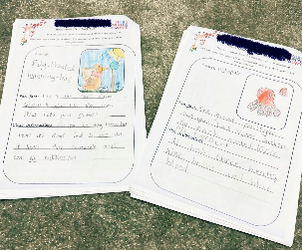
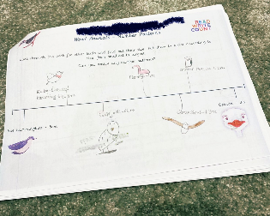
Worksheets and inspiration
Worksheets and home-learning challenges available
Supporting family learning
Home Activities Hub and Scottish Book Trust learning resources
Notes:
Worksheets available on SBT website to download.

Slide 13
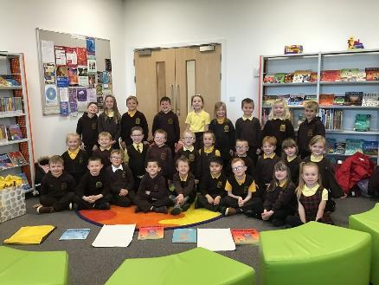
Creating partnerships
Create links with learning outside school
Providing a variety of resources for children and families that support campaign outcomes
Inspiring families to try out the bags at home
Support gifting of bags and
gifting events
Notes:
Libraries can play a key role in promoting learning outside the classroom and parental involvement – one of the priorities of the RWC programme.
Collaborate with local library for gifting events – example from Milnathort PS of gifting event being held in local library
Library staff can read RWC books, recommend new books for children to read, sign them up for library card

Slide 14
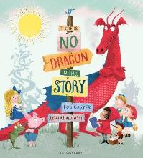
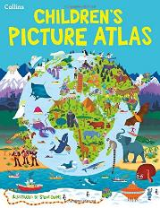
Working with libraries
Peterhead Central School & Peterhead Library
School and library using books in Primary 3 bags to create collaborative project
Primary 3 class attended author event at local library and held gifting session
Tied in with existing projects in the school
Library created themed displays, read recommended stories, created a quiz and game for children to attend
Notes:
Case study example from Stacey Strachan, P3 teacher, Peterhead Central School
When the class received the bags, There is No Dragon In this Story was read to pupils. The class had already created a dragon as part of their Christmas concert, and after we read the story involving the dragon, we realised that it created a fantastic opportunity to use the dragon as part of their topic for the third term, using the story as a stimulus.
They then decided to create a topic that involved the dragon going to different parts of the world (using the Collins Picture Atlas to look up countries), trying to find the perfect place for him and finally landing in China, where the dragon met the Chinese dragon which we had already created in Term 2.
They created a story about our journey. The storyline was created together, as a whole class and throughout the term they looked at the phrases and wording within the original story to help create a play involving the dragon.
It was then presented as a play to parents at a community café and held a display of the bags and their contents for parents to see.
Throughout the term, the school worked closely with the library and created a display based on Chinese New Year (the year of the pig). The library staff worked closely with the school and had ordered books linked to Chinese New Year for the children to borrow during the topic.
The pupils were invited to the library for a visit towards the end of the topic, and the staff had created a themed display, read a story about a dragon to the class, created a quiz for them and had a game involving a Chinese Lantern to see what the children had learned. Local dancers also got involved to perform traditional Chinese dance.
This example shows how taking a couple of elements from the RWC packs can have an effect on children’s learning but also the wider community’s involvement in the RWC programme. Not necessarily a case of using all the items to create a great project, but finding links and themes that work well for both school and library. Staff and children enjoyed the project and the campaign was promoted throughout the school term, maximising impact and utilising local library staff to add interest and experiences.

Slide 15
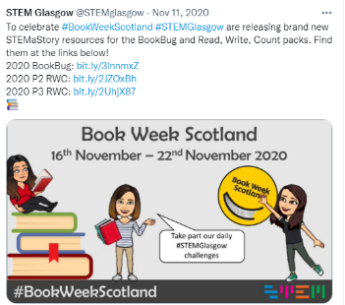
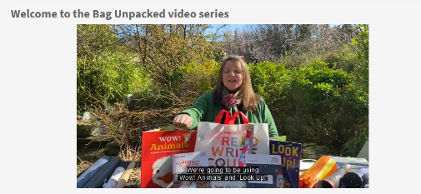
National Resources
Glasgow City Council STEM team
Angus Council RWC App
Edinburgh Moray House Collaborative
Notes:
Glasgow City Council Stem team launches extra resources on their website each year.
Angus Council are developing a RWC app
- Edinburgh MH Collaborative which is an ongoing collaborative project involving SBT, Moray House, Edinburgh University and Edinburgh Council family learning team, which has shown the value of teachers and family learning staff making videos to show how the contents of the bags can be used. These films introduce the bag contents and then a series of separate films describe to parents some of the activities they can do with each item.
This offers a really positive way of making links between home and school, even in the present circumstances.

Slide 16
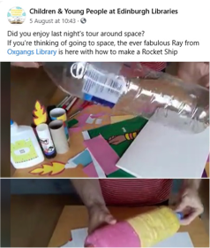
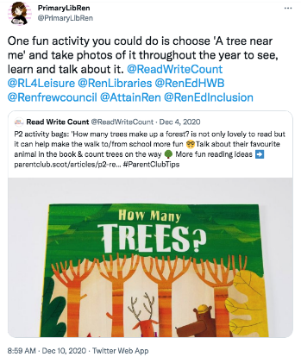
Social media
Notes:
Edinburgh Libraries started to think about introducing RWC sessions in advance of lockdown, and were quick to think of ways to continue activities remotely. They used their Facebook group for Children & Young People to promote activities related to RWC to families at home. All of these activities were fun and creative, but promoted literacy and numeracy skills. Each week there were different Read, Write, Count-related challenges – some where rhyming, calculations, crafts activities and challenges related to words for every letter of the alphabet. They’re all interactive too, encouraging families to share their creations in the comments. This example shows the possibility for using RWC as a basis for activities even remotely for libraries in the current circumstances, and will help to encourage learning at home as part of children adjusting to returning to school.
Renfrewshire Libraries also created activities based on the books – here is an example of a nice, seasonal activity idea, encouraging children to take photos of trees throughout the year to see how they change. Feel free to get creative and link it in with the existing work you’re doing!

Slide 17
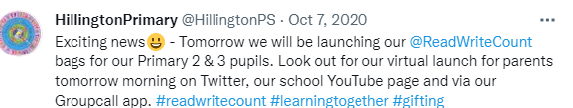
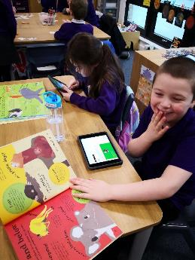
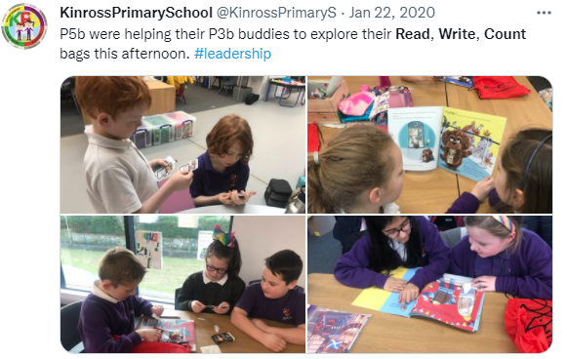
Social media
Notes:
Hillington Primary School in Glasgow did online introductory events for parents where they could see what was in the bags and get ideas on what activities they could do.
That’s a picture from Kinross Primary School in Perth and Kinross – they couldn’t invite parents in last year so they involved their P5’s to work with the P3 buddies to explore the bags and complete some SBT learning activities!

Slide 18
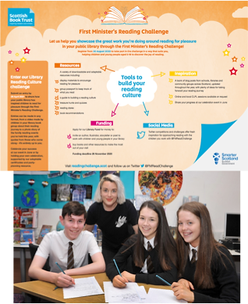
Resources & Opportunities
Online resources for staff to inspire gifting events and ideas for activities
Home Activities Hub
Apply for Live Literature funding
Apply for Arts Alive
Notes:
SBT provide a number of resources to support staff with the Read, Write, Count programme.
Each school will have received a pack with a set of the RWC books and a teacher letter to inspire RWC session planning.
Online resources can also be found on our website. These include videos of the RWC books being read aloud, home-learning challenges and ideas for hosting a gifting event.

Slide 19
Key dates for your diary
September-October: Read, Write, Count bags arriving in local schools (Bookbug P1 bag arrives a little later in Oct)
15-21 November: Book Week Scotland & Read, Write, Count gifting events
Notes:
Read Write Count bags are arriving in schools over the coming months and teachers should also all receive a teacher pack with the three books and a Read Write Count introduction letter (which can be download online as well). Bookbug P1 bags (which are delivered by a separate Scottish Book Trust team) will arrive in October.
Our suggested time for gifting the bags is during Book Week Scotland which this year is on the 15th-21st of Nov. Tying the gifting of the bags to a national celebration of books and reading can help to raise the profile of reading more widely, highlight the benefits that reading gives, and enhance engagement with social media (as you can link with others all doing the same thing). It also gives schools and pupils time to use the bags over the following months for classroom activities and home learning opportunities.

Slide 20

Thank you
Questions?
Contact
readwritecount@scottishbooktrust.com

