Slide 1

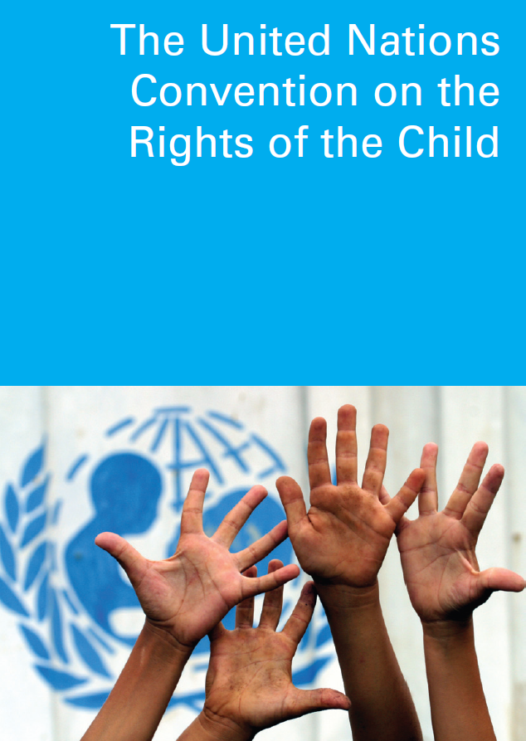
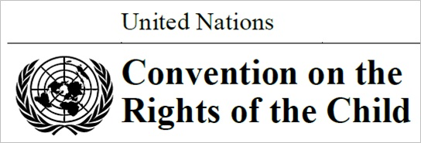

2021
For Scotland's learners, with Scotland's educators
Do luchd-ionnsachaidh na h-Alba, le luchd-foghlaim Alba

Slide 2

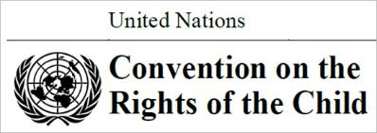
What is the UNCRC?
Every child has the right to survival, protection and education. The United Nations Convention on the Rights of the Child (UNCRC) is a legally-binding international agreement setting out the civil, political, economic, social and cultural rights of every child, regardless of their race, religion or abilities.

Slide 3

The Articles
54 Articles:
Part 1 (1-42): Provisions
Part 2 (42-45): Implementation and monitoring
Part 3 (46-54): Final clauses
Universal
Unconditional
Inalienable
Inherent
Indivisible
Notes:
Human rights are Universal:
The UNCRC applies to ALL children, regardless of race, religion, abilities or family circumstances
.
Rights are Unconditional
All children everywhere in the world are entitled to rights – they do not have to be earned
They are not dependant on responsibilities – children have them regardless
Human rights are Inalienable
Thy cannot be given or taken away
Inherent
They are permanent and cannot be separated from the individual
Human rights are Indivisible:
Rights are completely interdependent and depend on each other for their effectiveness. So for example children have the right to relax and play and they also have the right of free assembly. They need to exercise both these rights for either one to work properly
Description taken from the Save the Children material produced for ‘Children’s Rights Wales’
(http://www.childrensrightswales.org.uk/userfiles/file/Teachers_new.ppt)

Slide 4

Article Activity
54 Articles:
3 domains/themes:
  Provision
  Protection
  Participation
Notes:
Background information:
The UNCRC has 54 articles in total:
1 to 41 are substantive articles describing specific rights, the majority of which impact on services provided by Local Authorities.
42-54 talk about how the UN and National Governments work to ensure those rights.
The rights can be organised around 3 domains, often referred to as the 3 Ps.
PROVISION of services, such as education or healthcare –access to play and cultural activities are also included – provision often involves the allocation of a budget
PROTECTION of children and young people from abuse or from dangerous drugs (for example).
Promoting the PARTICIPATION children and young people so that their views are sought, heard and actively influence decisions or outcomes.
Activity – facilitator reads out a right and everyone types in the chat pane which domain they think it is, and share at the same time. Repeat for about 5 or 6 rights

Slide 5

General Principles
(underpinning rights) -
Article 2 – without discrimination
The Convention applies to EVERYONE.
Article 3 – best interests of the child
The best interests of the child must be a top priority in all things that affect children.
Article 6 – survival & development
Every Child has the right to life.
Governments must do all they can to ensure that children survive and develop to their full potential.
Article 12 –
respect for the views of the child
Every child has the right to say what they think in all matters affecting them, and to have their views taken seriously.
Notes:
But there are underpinning rights which are described as general principles
Background information:
Although the articles are indivisible and interdependent, there are 4 underpinning rights which can be seen to support all the others:
Article 2 covers the principle of Universality.
Article 3 puts the best interest of the child first – before any other consideration – in all actions concerning children.
Article 6 recognises that every child has the inherent right to life and that States must ensure ‘to the maximum extent possible the survival and development of the child’.
Article 12, the right to be heard, is seen as a gateway right. Without Article 12 it is very difficult for children and young people to exercise their other rights. Participation therefore is often the first step to raising awareness of rights.
An example: when you look at article 9 for instance, which says you should not separated from your parents unless it is for your own good, you have to remember that this applies to all children, without discrimination, that any decision about taking a child away from it’s parents has to be in the best interests of the child, that all children have the right to life and to survive and develop healthily and that children and young people have the right to be heard and express their views about any decision to separate them from their parents.
You can go through this exercise for each of the 41 substantive rights, demonstrating the underpinning nature of these rights.
Now take some time to sort some of the rights into how they relate to each of these underpinning rights

Slide 6

Goals of Education
3 main articles
  28 – Right to an education. This must respect children’s dignity
  29 – Education must develop every child’s personality, talents and abilities to the full
  31 – Relax, play and take part in a wide range of cultural and artistic activities

Slide 7
Wants, needs and rights
Want - a desire for something
Need - the state of requiring help, or of lacking basic necessities such as food
Right - a moral or legal entitlement to have or do something
Notes:
Body of Rights Activity (continued)
Discuss the following with participants:
Are we clear on the difference between these? Are they easily confused?
Understanding what rights really are is an essential part of leading colleagues through this professional learning experience; it is quite easy for wants, needs and rights to become confused when talking about children’s rights. Rights are not mere wants: they are core entitlements.
Recap main learning points:
Wants refers to something you don’t need but would like to have. Looking at something from a position of wants can make the person wanting something appear greedy.
A need is an aspiration that can be quite legitimate, but it is not necessarily associated with an obligation to cater for it; satisfaction of a need cannot be enforced. Looking at something from a perspective of need may put the person in need in a position of weakness, as it may rely on the benevolence of others to share that which is needed.
Rights come from needs, but not all needs have rights associated with them. A human right is something to which someone is entitled solely by virtue of being alive; it is something which enables a person to live with dignity. A right can be enforced before the government and entails an obligation on the part of the government. Looking at something from a perspective of rights puts the person with that right in a position of strength: it protects their core entitlements.

Slide 8


What are rights?
Human rights are rights inherent to all human beings, whatever our nationality, place of residence, sex, national or ethnic origin, colour, religion, language, or any other status. We are all equally entitled to our human rights without discrimination. These rights are all interrelated, interdependent and indivisible.
Human rights are the basic rights and freedoms which everyone is entitled to. We are all entitled to human rights in order to live with dignity.
Oxford Online Dictionary:
A moral or legal entitlement to have or do something
Notes:
What Are Rights?
Given that participants have been asked to think about what makes a right, ask them now to think about these two terms: right; human right.
Invite groups to discuss these two terms and come up with a clear definition of each.
Ask groups to appoint a scribe to note the definitions, and be able to share them in a plenary.
Give participants time to discuss and write up their definitions.
Share the definitions from the SHRC; OHCHR; and the young people (SCCYP – on next slide)
Some points for leading discussion:
The term ‘right’ may conjure up images of compensation-claim lawyers’ adverts, but it is important that the vision of dignity and respect, which rights seek to protect, is not lost.
‘Rights’ can be seen from the perspective of the bearer, but much of the work undertaken to bring about the protection of children’s rights has come about from experiences of atrocity, poverty and abuse; it is in this context that children’s rights can be seen from the perspective of the adults, the duty-bearers, in ensuring that the dignity, respect and basic requirements for development of children are all protected and promoted.

Slide 9
What is a rights based approach?
‘A children’s rights based approach is a principled and practical framework for working with children and young people, grounded in the UNCRC and other international rights conventions. It is about placing the UNCRC at the heart of planning and service delivery and integrating children and young people’s rights into every aspect of decision making, policy and practice’
- State of Children’s Rights Report, 2017
Notes:
Together Scotland – an alliance of children’s charities that work to improve the awareness, understanding and implementation of the UNCRC – produce an annual state of children’s rights report about how children and young people are experiencing their rights in Scotland – part of the reporting committee

Slide 10
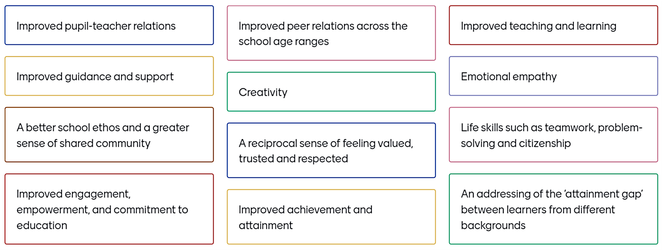
Benefits of rights-based approaches and effective learner participation

Slide 11
In June 2019 the Deputy First Minister announced that the United Nations Convention on the Rights of the Child (UNCRC) would be incorporated into law.​
Following a consultation period MSPs unanimously agreed to the general principles of the Bill following the Stage 1 debate, where it was noted the Bill provides a strong foundation for putting children’s human rights at the heart of decision making and enabling them to assert their rights.​
The Bill passed Stage 2 on 11th February 2021. A series of amendments were made which will further strengthen the legislation. ​
The Bill passed stage 3 on 16th March 2021, and was unopposed in parliament and there were no abstentions. Commencement will take place by 1st November, and from this point public authorities will be required to fulfil this duty in areas of their responsibility including their decisions, actions and inactions. This will have the effect of creating further accountability and empower children and young people. If their rights are not being fully respected they can, if they chose to do so, seek to pursue that through the legal system.​
Notes:
In June 2019 the Deputy First Minister announced that the United Nations Convention on the Rights of the Child (UNCRC) would be incorporated into law.
Some articles will not be able to be included as they are not devolved matters (for example, the provision on military recruitment). However, all other matters are included, and all public bodies (such as health boards, the police and local authorities), will be required to uphold the law. The final vote on 16th March was ground breaking due to absolute cross party support – this legislation is being looked at very closely by other countries

Slide 12

Education Scotland
Denholm House
Almondvale Business Park
Almondvale Way
Livingston EH54 6GA
T +44 (0)131 244 5000
E enquiries@educationscotland.gsi.gov.uk
For Scotland's learners, with Scotland's educators

