Slide 1


The Curriculum Story Project:
5. Collaborative Professional Learning
Discussion Activities
For Scotland's learners, with Scotland's educators
Notes:
This is a front cover page and can only be used once. Use the corresponding green internal and back pages if you are using this page. You may add a title and a subtitle if needed only. Do not add anything else or move elements around.

Slide 2
How to use this download pack
The discussion and practical activities in this pack connect to the case studies and ideas around interdisciplinary learning of
The Curriculum Story Project 5:
Collaborative Professional Learning.
While there is value in using them as standalone resources, we encourage teams to read the case studies, together, as part of their own reflective practice.
From 2020-22, The Curriculum Story Project from Education Scotland brought together nearly 200 practitioners to understand the components, processes, and thinking behind successful interdisciplinary learning and the development of broader learner pathways.
The case studies and activities are designed by NoTosh, a firm specialised in helping people think differently and choose the way they learn and work.

Slide 3
Discussion activities
First read the case studies for The Curriculum Story Project – Collaborative Professional Learning.
Then use one of these discussion points for a learning session or team meeting.
Discussion 1. How do you ringfence time and space for collaborative professional learning in your school or setting?
For example, do you regularly manage to timetable opportunities for curriculum planning and dialogue during staff meetings?
Discussion 2: What new strategies could you consider that facilitate more collaboration amongst educators?
For example, how could you use ideas such as speed dating, book clubs, or the design of learning provocations for IDL to bring educators together?
Discussion 3: How will you support staff who may struggle with the speed of change or the new demands that an emphasis on collaboration might require?
For example, could you use the example of allowing educators to plan individually or across shared online documents before sharing and making choices as a group?
For Scotland's learners, with Scotland's educators
Notes:
This is an internal page in green and can be duplicated to create additional pages. Always keep the heading and footer as shown. Use the corresponding green front and back pages if you are using this page.

Slide 4

The Curriculum Story Project:
5. Collaborative Professional Learning
Practical Activities
For Scotland's learners, with Scotland's educators
Notes:
This is a front cover page and can only be used once. Use the corresponding blue internal and back pages if you are using this page. You may add a title and a subtitle if needed only. Do not add anything else or move elements around.

Slide 5
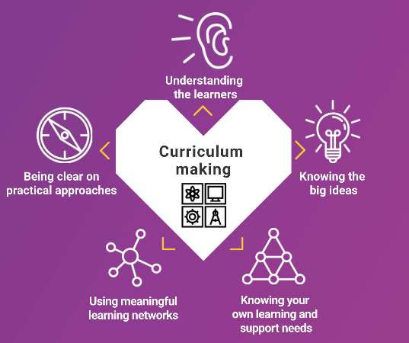
1. Parts, People, Interactions – reflect on the existing system of collaborative learning in your setting
Collaboration is a fundamental feature of IDL for educators, learners and partners. To be successful, it requires a dedicated space and time to meet, and a shared sense purpose and values.
Curriculum-making guidance highlights the importance of educational settings knowing your own learning and support needs. Including, ‘belonging to communities of practice and enquiry’ and ‘developing collaborative practice locally, nationally and globally.
For Scotland's learners, with Scotland's educators
Notes:
This is an internal page in blue and can be duplicated to create additional pages. Always keep the heading and footer as shown. Use the corresponding blue internal and back pages if you are using this page.

Slide 6
1. Parts, People, Interactions – reflect on the existing system of collaborative learning in your setting
Parts, People, Interactions is a thinking routine from Project Zero at the Harvard Graduate School of Education.
This thinking routine will help you look closely at the system of collaborative learning in your setting.
Before starting, it is helpful to give examples and understanding of what a system is. Concrete examples work best: subway systems, town recycling systems, the lunch line system at school, etc.
Systems are made up of subsystems, and are themselves parts of broader systems.
Working in groups, it is helpful to first make a list of all of the parts, and people involved in a system, and then to map out their system on chart paper to make the interactions between all of the parts and people in their system visible. Then answer the questions on the next slide.
For Scotland's learners, with Scotland's educators
Notes:
This is an internal page in blue and can be duplicated to create additional pages. Always keep the heading and footer as shown. Use the corresponding blue internal and back pages if you are using this page.

Slide 7

1. Parts, People, Interactions – reflect on the existing system of collaborative learning in your setting
Thinking about the system of collaborative learning in your setting, ask:
What are the parts of the system?
Who are the people connected to the system?
How do the people in the system interact with each other and with the parts of the system?
How does a change in one part of the system affect the various parts and people connected to the system?
For Scotland's learners, with Scotland's educators
Notes:
This is an internal page in blue and can be duplicated to create additional pages. Always keep the heading and footer as shown. Use the corresponding blue internal and back pages if you are using this page.

Slide 8
2. Unpack assumptions about the barriers and benefits of collaborative learning for IDL on an Assumptions Wall
It is important to spend time collectively unpacking assumptions about the barriers and benefits of collaborative learning.
Ask educators to list their assumptions about the barriers and benefits of collaborative learning for IDL. For example, the challenges of time, support and access to resources.
Participants choose one barrier and one benefit that most informs their behaviour and attitude towards collaborative learning.
Write the assumptions on post-it notes and post them on a wall.
Allow time to read and explore the various contributions.
Invite educators to select an assumption they are curious about and use this as the basis for discussion.
Where barriers are discussed, focus the discussion towards possbile solutions and compromise.
For Scotland's learners, with Scotland's educators
Notes:
This is an internal page in blue and can be duplicated to create additional pages. Always keep the heading and footer as shown. Use the corresponding blue internal and back pages if you are using this page.

Slide 9

Education Scotland
Denholm House
Almondvale Business Park
Almondvale Way
Livingston EH54 6GA
T +44 (0)131 244 5000
E enquiries@educationscotland.gsi.gov.uk
For Scotland's learners, with Scotland's educators
Notes:
This is a back cover page in blue. You may edit the address if needed only. It can only be once and at the end of the PowerPoint presentation. Use the corresponding blue internal and back pages if you are using this page.

Slide 10

Notes:
This is a front cover page and can only be used at the beginning of a PowerPoint presentation once. Do not add anything else to this screen if it is being used.

