Slide 1




EQUITY: Mitigating the impact of poverty
on Scotland’s children and young people
Group session 4:
Action planning for impact
Notes:
This PowerPoint is intended to support local authority facilitators to deliver the final group session on the Equity: Mitigating the impact of poverty on Scotland’s children and young people. This session will take place ideally once programme participants have completed PLAs 5 and 6.
This PowerPoint is a template that facilitators can adapt to suit their own context and style of presenting. It can be added to, but please do not remove any slides as they are all essential to the Introductory session. You may wish to add the date, a logo alongside the Education Scotland one, and /or to add a link to a feedback form into the last slide.
Within the slides, suggested timings, key messages to get across, facilitator notes and reflective questions are included.
The session this PowerPoint is intended to support has been designed to be delivered by facilitators in 60/90 minutes, depending if the session is being delivered in person or online. We would encourage you to use that time for (more) discussion of the reflective questions and perhaps invite some feedback. Suggested approximate timings can be found in the notes for each slide.
IMPORTANT NOTES:
This PowerPoint refers to the Education Scotland Equity: Mitigating the impact of poverty on Scotland’s children and young people (Equity: Mitigating the impact of poverty on Scotland’s children and young people | Leading professional learning | Professional Learning | Education Scotland). It is anticipated the presenter will be familiar with the content of these pages. It will be particularly useful to be familiar with PLAs 5-6, before delivering this session.
While use of the Equity PL Reflective Workbook is optional, we would encourage its use as part of this facilitated programme. If used, it will be helpful for participants to have it to hand during this session.
You might also want to consider planning follow up sessions to check in/support those engaged in the learning and to share learning from Professional Learning Activities undertaken throughout the programme.

Slide 2

Ways of working together
We all work together
We learn from, with and on behalf of each other
We create a safe space to share ideas and build learning
We agree that everyone is an equal and valued participant
We remain ‘in the room’ (follow email and phone protocol)
Notes:
Slide 2
Suggested timing:
3 minutes
Key Messages:
Take a moment to revisit the group protocols. Are they still working for us?
Ask participants to comment on anything they would like to add or amend.
Is there anything that participants feel is missing or anything they would like to remove?
The protocols on the slide are suggestions to be amended for your context.
(Notes from previous sessions- you shouldn’t need these by now!)
Why establish group protocols
Effective professional learning goes beyond simply delivering information. It fosters a learning community where educators can learn with, from, and on behalf of one another. To achieve this, the facilitator of this learning should establish clear protocols and a positive learning environment at the outset. The general notes below will support the facilitator to help everyone feel comfortable participating and contribute to a rich learning experience.
1. Contract a Safe Space: Co-create a Safe Space agreement with your group. This agreement outlines expectations for respectful communication and active listening. A safe space allows trust to flourish, fostering a collaborative environment where everyone feels comfortable sharing ideas and taking risks.
2. Shift from Top-Down to Collaborative Learning: Move beyond the traditional model where one person imparts knowledge. Embrace a collaborative approach where all participants actively engage. This means learning with, from, and on behalf of one another. By leveraging the diverse perspectives within the group, gaining a richer understanding and creating a more impactful learning experience for everyone.
3. Holding the Ladder: Shared Expertise and Recognition : Holding the ladder signifies a two-fold approach: Sharing Expertise: Those with experience can share their knowledge and insights. Recognize Everyone's Contribution: Actively listen and be open to learning from the unique perspectives and experiences of colleagues. Build on each other's ideas to foster a collaborative environment where everyone feels valued, and their contributions are respected.
4. Hold Space for Silence and Respectful Discussion: Hold space for silence after someone speaks or asks a question. It can be tempting to jump in to fill silence but allowing time for quiet can avoid interrupting thought and produce more thoughtful responses. Everyone deserves to be heard and understood. Adapt the time allocation based on the size of the group and the complexity of the topic.
5. Schedule Regular Breaks: Schedule regular breaks throughout the session. This allows participants to process information, refocus, and return with renewed energy, leading to a more productive learning experience.
6. Centre Learning in Real Life: Connect the learning to real-life experiences by encouraging participants to share relevant personal anecdotes or applications. This strengthens understanding and makes the learning more relatable and impactful for all.

Slide 3


Today’s final group session
In this session we will:
Take part in a connector activity
Reflect on and share learning from PLAs 5 and 6
Collaborative enquiry - reflect on progress
Think about our next steps/action planning
Celebrate our completion of the programme
Notes:
Slide 3
Suggested timing:
1 minute
Facilitator notes:​
​
This slide shows what will be looked at in this session, to be shared with participants. Invite any questions they may have.

Slide 4
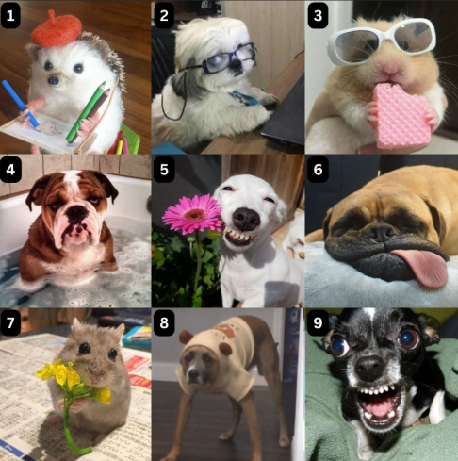
Connector
How do you feel today?
Notes:
Slide 4
Suggested timing:
6 minutes
Connector: How do you feel today?
This activity is a bit if fun as hopefully by now participants all know each other and we are at the end of a long term/year/programme!
Invite the group to say which image most resonates with how they are feeling today and why. This should be a light-hearted start to the session. Depending on the size of the group, you could ask each person individually or, if working with a large group, go through each image and ask for hands up and take any comments people might want to share. Another way is to pair up to chat first then share.

Slide 5
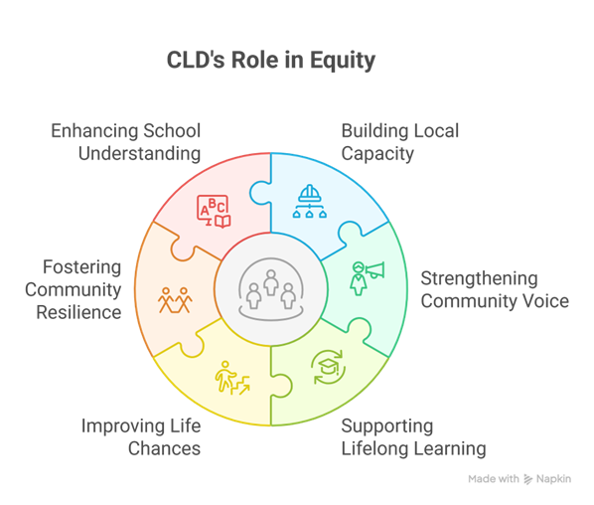
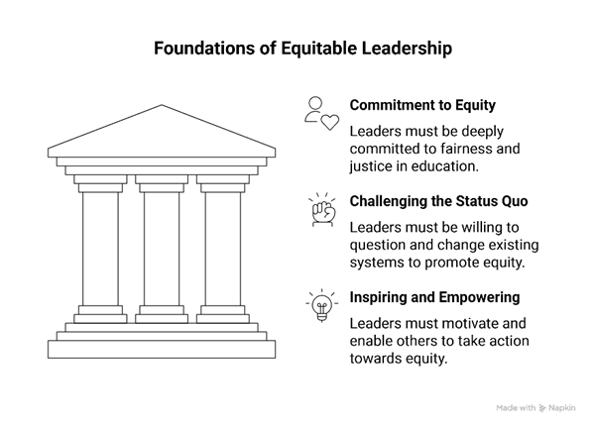
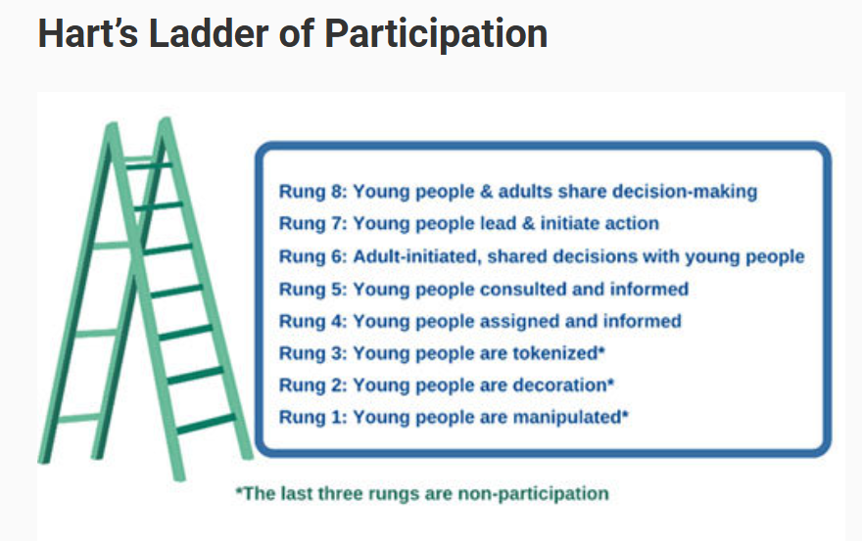


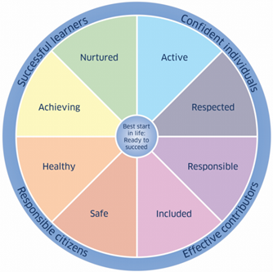

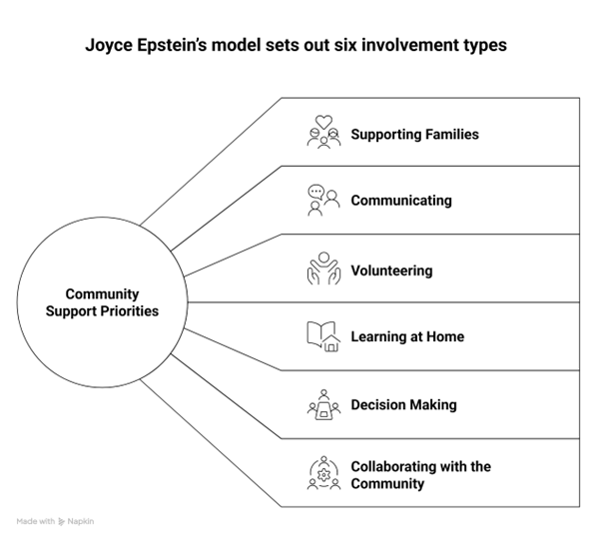




Reflecting on PLA 5 : Developing an equitable ethos and culture
Notes:
Slide 5
Suggested timing:
10 minutes
Key messages:
This part of the session is for looking back at prior learning and sharing key insights, surprises, anything that challenged thinking. Learning from PLA 5 is intended to build confidence and capability in creating the culture and ethos for equity . Leaders bring varied levels of experience and this can contribute to rich discussion. The learning steps form a cycle rather than a checklist, supporting continuous improvement.
Learning outcomes of PLA 5
Explore a range of whole school/setting approaches that support equitable practice and ethos
Increase knowledge and understanding of how to build an equitable culture
Understand why relationships and partnerships are central to achieving equity
Reflect on your values as a leader in education
The images on the slide are to remind the group about the content of PLA 5.
Learning steps
Whole school/setting approaches
Learners’ voices
Working with parents and families
Partnerships and wider interventions
Living your values
Facilitator notes:
Remind the group about the learning steps in PLA 5 and some of the resources they looked at. The images on the slide should help remind them.
Your role here is simply to facilitate a group discussion. This could be in pairs or groups if in person, or in breakouts if you’re working online. You may prefer to stay as a whole group and use the prompt questions below to invite reflections and discussion.
You could use a selection of prompt questions (some are drawn from the Reflective Questions from PLA 5).
What were the key take aways from this learning step?
Were there any surprises that challenged your thinking?

Slide 6



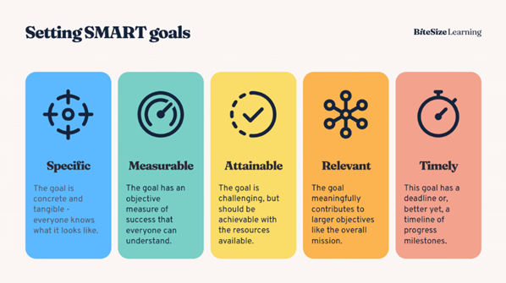
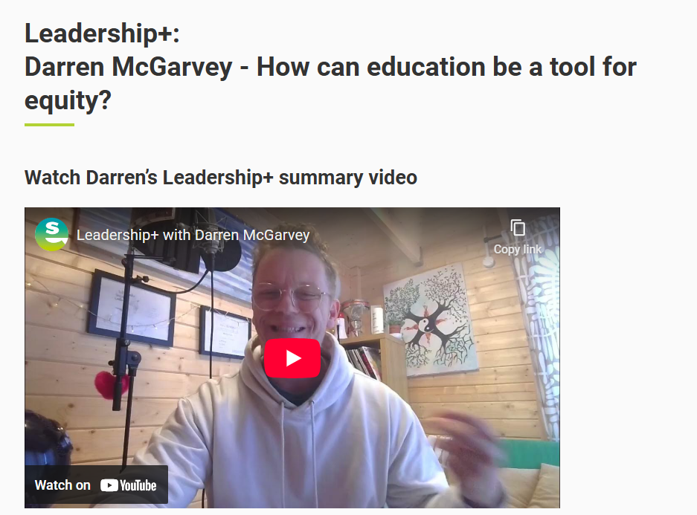
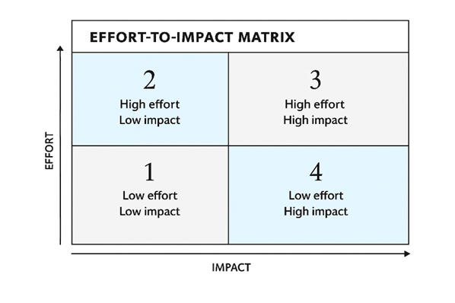
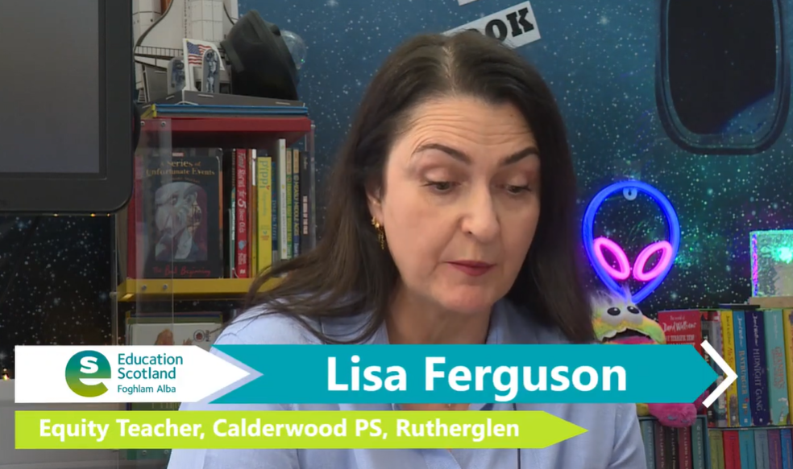


Reflecting on PLA 6: Pedagogy and practice to mitigate the impact of poverty
Notes:
Slide 6
Suggested timing:
10 minutes
Key messages:
This part of the session is for looking back at prior learning and sharing key insights, surprises, anything that challenged thinking. Learning from PLA 6 focuses on practice and pedagogy to mitigate the impact of equity. Leaders bring varied levels of experience and this can contribute to rich discussion. The learning steps form a cycle rather than a checklist, supporting continuous improvement.
Learning outcomes of PLA 6:
Completing this PLA will increase your knowledge, skills and confidence in:
what the evidence tells us about pedagogy for equity
what this looks like in practice
reflecting on your current practice to ensure every learner’s needs are met
using tools and methodologies that maximise impact on learners.
Reflecting together helps build a consistent and coherent approach across the authority or sector.
The images on the slide are to remind the group about the content of PLA 6. The learning steps were:
Learning steps:
The role of pedagogy in mitigating the impact of poverty
Do our current ‘go-to-approaches' support learners effectively?
Pedagogy to support every learner and close gaps in learning
Impact and evidence
Facilitator notes:
Remind the group about the learning steps in PLA 6 and some of the resources they looked at. The images on the slide should help remind them.
Your role here is simply to facilitate a group discussion. This could be in pairs or groups if in person, or in breakouts if you’re working online. You may prefer to stay as a whole group and use the prompt questions below to invite reflections and discussion.
You could use a selection of prompt questions (some are drawn from the Reflective Questions from PLA 6).
What resonated with you most in the videos?
How can we become more impact-rich?

Slide 7
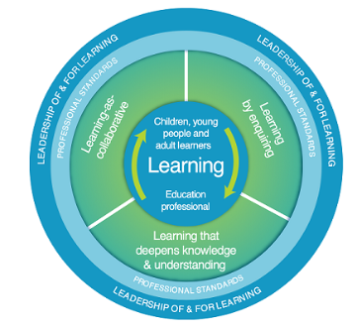
Collaborative enquiry key steps
Identify the focus and formulate the question
How effectively do we use data to target interventions for children and families impacted by poverty?
Example: How does systematic use of attainment and wellbeing data influence equity outcomes for Q1
learners?
Gather Evidence Use triangulation:
    Quantitative data (attainment, attendance, wellbeing).
    Stakeholder views (pupil voice, family engagement).
    Observations of practice.
Analyse and Reflect
  Apply Bernhardt’s 4 Lenses: Demographics, Perceptions, Inputs, Outputs.
  Use Data Dialogue Template for structured analysis.
Plan and Implement Change
  Identify interventions informed by data (e.g., targeted literacy support, family engagement strategies).
  Align with PEF priorities.
Evaluate Impact
  Use STAR model (Situation, Task, Action, Result).
  Report findings to inform next steps.
Notes:
Slide 7
Suggested timing:
5 minutes
Facilitator notes:
This slide is from the last group session. Tell the group this is a chance to revisit the collaborative enquiry process which was introduced last time, and to consider how far they have got back in their school/setting. The expectation/hope was they would have addressed the first 3 steps shown in the slide. Important note: they may not have got very far with this yet and this is okay, as we are picking this up again today. Reassure the group about this- we are going to spend a bit more time on this now. It is not for the programme participant to do this in isolation, but rather to go through the enquiry process together with their team.
This process will inform what they do next (beyond the life of the programme).
So as a reminder, they key steps of the collaborative enquiry process are:
Start by identifying an equity‑focused issue from your data and turning it into a clear enquiry question.
Gather evidence through triangulation, combining quantitative data with learner and family voice and observations of practice.
Analyse this together using Bernhardt’s lenses and the Data Dialogue structure.
Plan and implement targeted interventions that align with your PEF/SIP priorities (we will look at this shortly at slide 10).
Finally, agree how you will evaluate impact using the STAR model so your actions lead to meaningful improvement for children and families affected by poverty.

Slide 8


Reflection activity
Progress with collaborative enquiry question and/or evidence gathering since group session 3 -
Where are you up to?
Notes:
Slide 8
Suggested timing:
1 minute
Facilitator Notes:
Tell the group there's now some time to work in pairs or small groups to share with each other where they are up to (or what they have in mind/what data they are looking at if they have not started/not got very far yet). Once you have shared this slide/activity, move to slide 9 which shows the collaborative enquiry process again, and leave it up for the duration of this discussion.

Slide 9
Collaborative enquiry key steps
Identify the focus and formulate the question
How effectively do we use data to target interventions for children and families impacted by poverty?
Example: How does systematic use of attainment and wellbeing data influence equity outcomes for Q1
learners?
Gather Evidence Use triangulation:
    Quantitative data (attainment, attendance, wellbeing).
    Stakeholder views (pupil voice, family engagement).
    Observations of practice.
Analyse and Reflect
  Apply Bernhardt’s 4 Lenses: Demographics, Perceptions, Inputs, Outputs.
  Use Data Dialogue Template for structured analysis.
Plan and Implement Change
  Identify interventions informed by data (e.g., targeted literacy support, family engagement strategies).
  Align with PEF priorities.
Evaluate Impact
  Use STAR model (Situation, Task, Action, Result).
  Report findings to inform next steps.
Notes:
Slide 9
Suggested timing:
10 minutes
Facilitator notes:
Organise the group into pairs or small groups and ask them to reflect on how they have applied the collaborative enquiry steps in their own school or service following the data‑informed dialogue at the last session.
What was their enquiry question and what has happened to work towards some answers? Has any data been gathered, and if yes, has any analysis taken place? Everyone will be at different stages; there may still be lots of work to do on this and that's okay, but the findings from the collaborative enquiry key steps 1 – 3 (shown in the orange box) will inform the action plan that’s coming next (the 'plan and implementation' and 'evaluate impact' key steps shown on the slide).
Emphasise that although this is the final group session, and the PLAs have been completed (or nearly completed!), that what happens next is just as important, if not more so. (We have done the programme, okay, but so what?) The last 2 key steps from the slide are the work going forward from now on.
Allow time for sharing of work to date, acknowledging that some will be further along than others, and that is fine. For those who may not have started, or are at the early stages, how is it going? What do they hope to see and from the data and perhaps do differently? If you have time, invite some sharing of discussions at the end.
Next steps:
Remind the group of the need to return to this collaborative enquiry approach with their team once back in their school or setting, and continue from the point they are at.

Slide 10
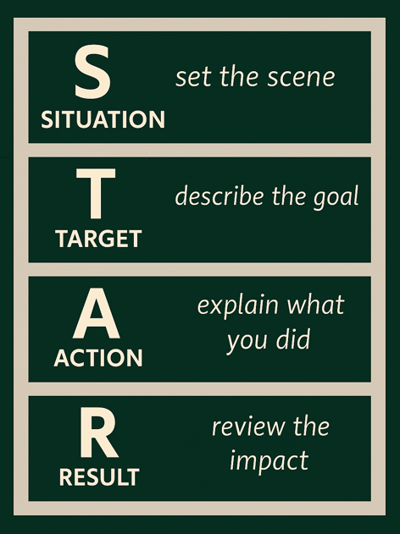
Action planning
Plan and Implement Change
  Identify interventions informed by data (e.g., targeted literacy support, family engagement strategies).
  Align with PEF priorities.
Evaluate Impact
  Use STAR model (Situation, Target, Action, Result).
West Lothian example video clip
Notes:
Slide 10
Suggested timing:
5 minutes
Key messages:
Tell the group we will now think about the final 2 key steps of the process – planning and implementing change and evaluating impact. Read through the 'Plan and Implement Change' bullet points on the slide and invite comments. Depending on the focus, one intervention may be enough at this point. It can be tempting to try to do everything at once, but think about what intervention/s is most appropriate? Is it evidence-based? Does it take learner voice into account? Is there something from PLA 6 that might inform decisions about this?
When it comes to evaluating impact, this should be thought about at the planning stage, not after the intervention has happened. How are you going to know if it has been effective? The STAR model for evaluating impact has been used in West Lothian and works well.
Video clip link St Mary’s Primary School, Polbeth, West Lothian. The STAR model
Invite any comments before moving on. Participants may have tried and tested methods of evaluating impact, other than the STAR model, and that is fine.

Slide 11

Programme completion
Well done! You have been working on this programme for most of the session and have shown a great commitment not just to your own professional learning, but to mitigating the impact of poverty for the children and young people you work with..
The work isn’t finished....
It will continue back in your setting....
But take a moment to reflect on what you have already achieved, the impact you've already seen, and the potential impact that is yet to come....
Notes:
Slide 11
Suggested timing:
2 minutes
Key messages:
Acknowledge all the work that has gone into the group getting to this point – it is quite an achievement. Thank the group for their engagement and participation and remind them of the whole point: to improve outcomes for learners.
Facilitator notes:
IEducation Scotland will provide a digital certificate of completion for the facilitator/s to issue to all those who have completed the programme.
Suggested completion requirements are:
PLAs 1-6 completed - * Please ensure all participants have ticked complete at the end of each PLA.
Group sessions 1-4 attended.

Slide 12

Aims review
Take part in a connector activity
Reflect on and share learning from PLAs 5 and 6
Collaborative enquiry - reflect on progress
Think about our next steps/action planning
Celebrate our completion of programme
Notes:
Slide 12
Suggested timing:
7 minutes
Key Messages
Have we met the aims of today’s session?
Facilitator Notes
What are our key takeaways? As the session ends, encourage participants to take a few minutes to reflect quietly. Think about what resonated with you, what challenged you, and how you’ll set aside time to space out action planning in your context.

Slide 13


Feedback
Notes:
Thank the group for their time and engagement once more and make sure they know who to approach with any questions and how to contact them. You may wish to add these details to the slide.
You may also wish to add a link or QR code for your own feedback form at this slide.
If you would like to provide feedback on this resource, as a facilitator, please go to this evaluation
Post-programme evaluation forms for both participants and local authority facilitators.

