Slide 1



Scarfed For Life
Workshop One - Definitions
Sense Over Sectarianism
Sense Over Sectarianism

Slide 2
Targeting 4 Key Behaviours
Sense Over Sectarianism
Sense Over Sectarianism
Prejudice
Discrimination
Bigotry
Sectarianism

Slide 3
Mind Map
SECTARIANISM

Slide 4


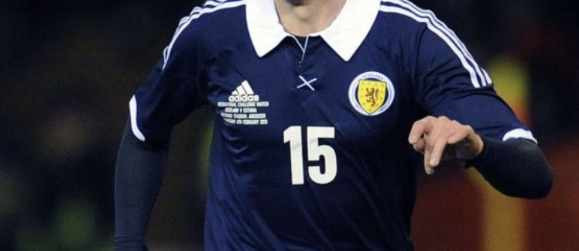
PREJUDICE

Slide 5

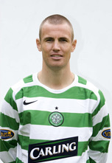
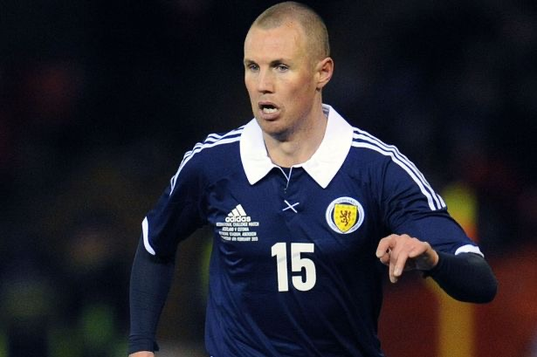
Kenny Millar

Slide 6
Social Theory
The Seven Seconds of Prejudice?

Slide 7
Definition
Work together to come up with a definition of Prejudice.

Slide 8
Definition
Prejudice: preconceived opinion that is not based on reason or actual experience

Slide 9
Examples
Work together to come up some examples of Prejudice.

Slide 10
Definition
Work together to come up with a definition of Discrimination.

Slide 11
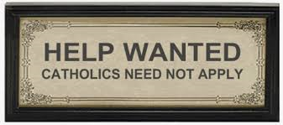
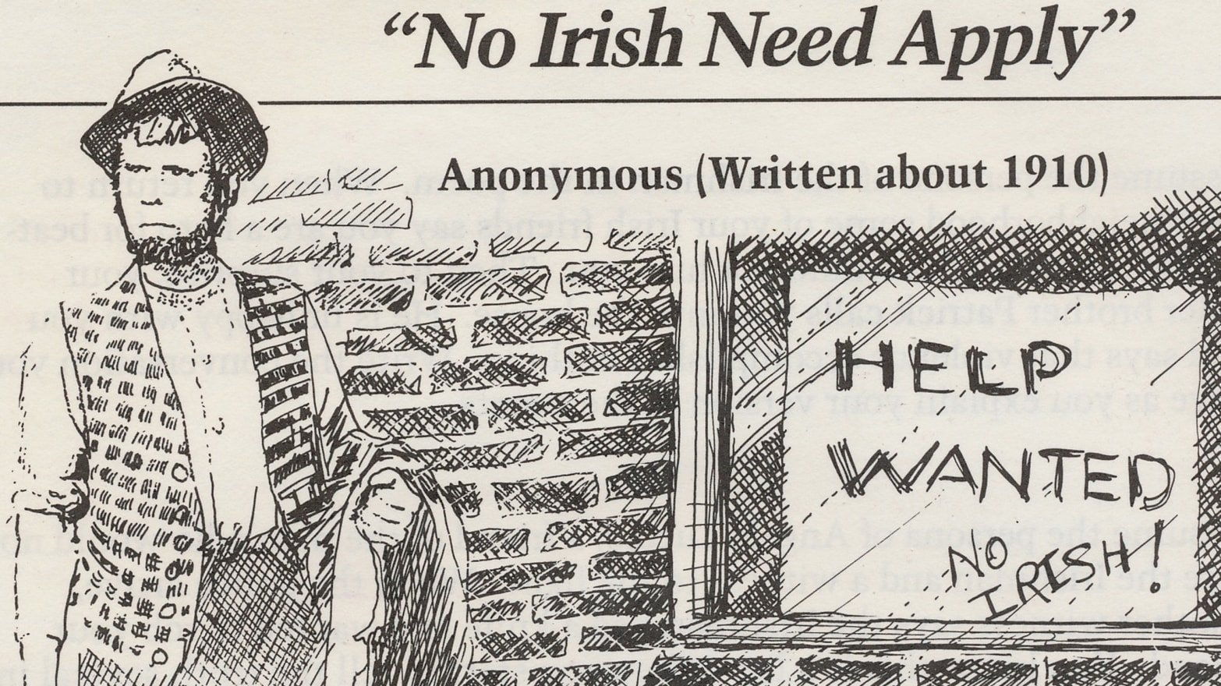
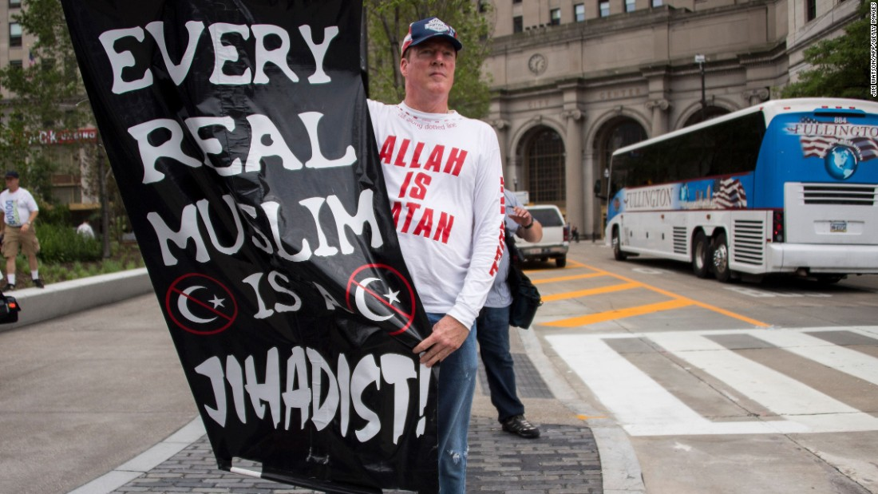
Discrimination

Slide 12
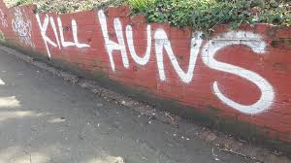
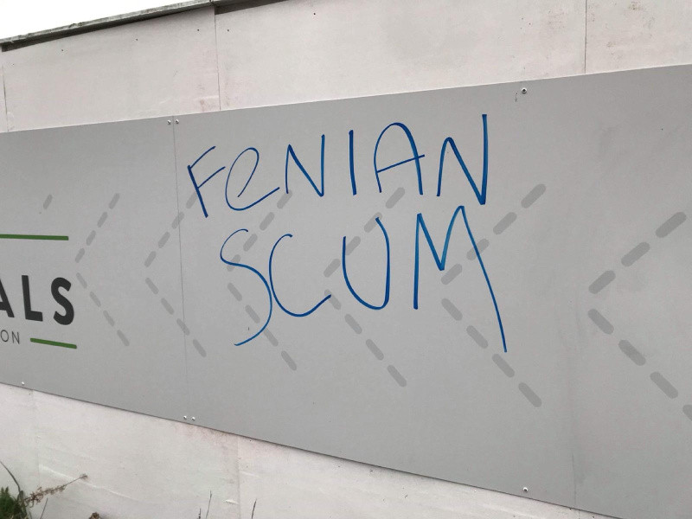
Discrimination

Slide 13
Definition
Discrimination: the unjust or prejudicial treatment of different categories of people, especially on the grounds of race, age, or sex

Slide 14
Examples
Work together to come up some examples of Discrimination.

Slide 15
Definition
Work together to come up with a definition of Bigotry.

Slide 16
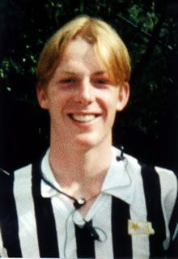
Bigotry
Mark Scott

Slide 17
Definition
Bigotry: intolerance towards those who hold different opinions from oneself

Slide 18
Examples
Work together to come up some examples of Bigotry.

Slide 19
Sectarianism

Slide 20
Sectarianism
Catholic

Slide 21
Sectarianism
Catholic
Protestant

Slide 22
Sectarianism
Christianity
Catholic
Protestant

Slide 23
Sectarianism
Christianity
Islam
Sunni
Muslim
Shia
Muslim
Catholic
Protestant

Slide 24
Definition
Work together to come up with a definition of Sectarianism.

Slide 25
Government Definition
Sectarianism in Scotland is a mixture of perceptions, attitudes, actions, and structures that involves overlooking, excluding, discriminating against or being abusive or violent towards others on the basis of their perceived Christian denominational background. This perception is always mixed with other factors such as, but not confined to, politics, football allegiance and national identity.

Slide 26
Working Definition
Sectarianism is Prejudice, Discrimination and Bigotry between 2 or more groups within the same religion, which is often experienced through football.

Slide 27
Examples
Work together to come up some examples of Sectarianism.

Slide 28
Any Questions???

