Slide 1


Effective use of data
2. Defining and classifying data
Senior and middle leaders
Notes:
All information is correct as of May 2024
These slides are intended to support senior leaders, middle leaders and practitioners in schools and local authorities to explore the effective use of data for improvement. This is the second in a set of six workshops available for senior leaders and middle leaders. The workshops were co-designed with educators from across Scotland and are based on an Education Scotland literature review: The Effective use of data for improvement in education.
Establishing the purpose and use of data
Defining and classifying data
Creating effective processes and systems
Interpreting and analysing data
Developing a data informed culture
Using data for improvement
(hyperlinks for each workshop can be found on the next slide)
The PowerPoint is a template that presenters can adapt to suit their own context and style of presenting.
The workshops can be delivered individually or grouped together and delivered in a longer session. Individual workshops have been designed for facilitators to deliver in 1 to 2 hours.
Suggested timings for each workshop can be found on the content coverage slide.
Within the slide notes key messages, suggested tasks, ‘talking-points’ and reflective questions are included.
It is anticipated the presenter will have read the Education Scotland literature review: The Effective use of data for improvement in education.

Slide 2
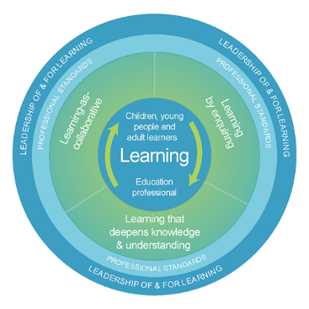

The national model of professional learning
The national model of professional learning | Professional Learning | Education Scotland
Notes:
Key Messages
This module has been designed using the national model of professional learning and the principles of adult learning or andragogy. It has been designed to think about:
The why – opportunities for participants to understand the rationale through professional standards, research, current policy landscape and national/local priorities.
The what – opportunities for participants to consolidate and develop relevant knowledge and skills
The how – opportunities for participants to take part in peer discussion, explore case studies or share experiences
Apply – a chance to reflect on learning, next steps and further support
A link to further information about the national model of professional learning can be found below.
edscot-model-of-professional-learning-outline.pdf (education.gov.scot)

Slide 3

Draft Group Agreement and Protocols
Work together
Learn from, with, and on behalf of each other
Create a safe space to share ideas and build learning
Agree that everyone is an equal and valued participant
Remain in the room (emails and phone protocol).
Notes:
Key messages
Take a moment to establish group protocols.
Ask participants to check and comment on anything they would like to add or amend.
The protocols on the slide are suggestions and may be amended for your school context.

Slide 4

Connector
In groups/pairs:
Share your favourite film or TV show.
Notes:
Key Messages
This is an example of a simple connecter activity. It is recommended that facilitators use a connector activity that allows participants to take part in an informal discussion.
This is to ensure that participants are relaxed, focused and ready for an interactive workshop.

Slide 5

Re-cap
In workshop 1 we looked at the purpose and use of data including: the meaning of data and evidence, the ways in which data is used and what we mean by ‘big’ and ‘small’ data.
Notes:
Key Messages
This slide summarises coverage in previous workshops.

Slide 6

Aims
In this workshop we will consider:
the importance of developing a shared language around data
the role of data and evidence in improvement
different data categories
why we might intersect data to support improvement; and
how to intersect data to understand an identified gap, pattern or trend
Notes:
Key Messages
This slide shows the aims of the session to be shared with participants.

Slide 7
Content coverage
National guidance and research
Developing a shared language
Categories of data
Intersecting data
Group activity
Reflection and feedback
Notes:
Key Messages
This slide shows the content covered throughout the workshop. Further details and suggested timings are provided below. Facilitators can amend content and timings to suit their needs and context.
National guidance and research – allow 10 minutes for this section. It can be extended to 15-20 minutes if facilitators wish to include an extra activity that allows participants to read the relevant section of the national evidence review.
Developing a shared language – allow 30 minutes for this section which contains two tasks. The first task where participants discuss terminology should take 10-15 mins. The second task where participants reflect on a short video clip should take approximately 15 mins.
Categories of data – allow 15 minutes for this section. This section contains a data categories quiz for participants to embed understanding of different data types.
Intersecting data – allow 10 mins for this section.
Group activity – allow approximately 20-30 mins for this group activity in which participants consider the data that they would intersect to understand a whole school pattern, gap or trend.
In total, this workshop can be expected to take between 1 hour 30 and 1 hour 45 minutes to complete.

Slide 8
GTCS Standards for Middle Leadership and Headship
Professional responsibilities
2.2.3 know how and when to make decisions and use a wide range of robust and credible data to support and inform your judgements
The Standard for Headship
Standard for Middle Leadership
Notes:
Key messages
The GTCS Standard for middle leadership and headship highlights the importance of the use of data in decision-making.
The standard is the same for both groups.
This standard emphasises the importance of data being robust and wide ranging to inform judgement.
Being clear about definitions and ways of classifying data will help with this process.
Reflective Questions
How wide ranging and robust is the data you are using in school? How do you know?
Are you triangulating data to inform judgements or relying on a limited number or an individual source?

Slide 9

Data as defined in HGIOS 4
HGIOS 4 references the use of data in relation to effective triangulation for the evaluation of quality.
Quantitative data is combined with people's views and direct observations to allow for the evaluation of quality.
How Good is our School? 4
Notes:
Key messages
HGIOS 4 references the use of data in relation to effective triangulation for the evaluation of quality. Quantitative data is combined with people's views and direct observations to allow for evaluation of quality. To make this process reliable and informative, a shared approach must be taken.
This is emphasising the importance of using multiple sources of data to support any evaluative judgements.
Understanding different categories of data will help educators to select from a range of sources and effectively triangulate.

Slide 10


Rapid Evidence Review Paper
Section two of the Education Scotland Rapid Evidence Review on defining and classifying data highlights that:
It is important to develop a shared language around data and have clarity of key terminology.
Time should be taken to ensure all educators, partners, learners and key stakeholders understand the key terminology as appropriate and necessary to each role.
Data can be classified as demographic, input, output and perception.
Notes:
Key Messages
Section two of the rapid evidence review on establishing the purpose and use of data highlights that:
It is important to develop a shared language around data and have clarity around key terminology.
Time should be taken to ensure all educators, partners, learners and key stakeholders understand the key terminology as appropriate and necessary to each role.
Data can be classified as demographic, input, output and perception.
The Effective use of data for improvement in education
Talking Points
This may be a good point to ask participants to read section two on establishing the purpose and use of data.
Reflective Questions
What does ‘data’ mean to you? Is that meaning consistent across your setting?

Slide 11

Terminology / Shared Language
Key Terminology:
attainment, achievement, progress, value added, statistical significance, triangulation, summative, formative, quantitative, qualitative, intersecting data, demographic data, perception data, input data, output data, trends, patterns, range and variation.
TASK
Notes:
Key messages
This is a discussion task. The terms are taken from the rapid research review glossary.
Shared language is critical to the effective collection, processing and use of data. Without this, discussing, analysing and using data becomes an exercise in jargon, rather than information.
On the screen there are several key terms which are regularly associated with data use in education. Please spend 10 minutes doing the following:
Discuss and define each term in as basic language as possible. This is about checking that everyone in the room has a shared understanding of the terms. Emphasise this is a safe space, and that it is normal for language to be used and understood differently.
Identify the three terms which are most likely to need clarification in a departmental/staff meeting.
Talking Points

Slide 12

What is data?
"Data is information, especially facts or numbers, collected to be examined and considered and used to inform decision making.” Cambridge Dictionary
Quantitative data refers to data that deals with numbers and can be measured.
Qualitative data refers to data that deals with descriptions. It can be observed and recorded but not necessarily measured.
Notes:
Key Messages
This is a recap from workshop 1.
Data is information, especially facts or numbers, collected to be examined and considered and used to inform decision making.
In education we often refer to data as quantitative or qualitative.
Quantitative data refers to data that deals with numbers and can be measured.
Qualitative data refers to data that deals with descriptions. It can be observed and recorded but not necessarily measured.
Reflective Questions
What types of data do you use in your school or setting?
Do you use quantitative and qualitative data? Do you use one more than another?

Slide 13

What is evidence?
"Evidence can be described as information used to demonstrate impact and support decision making. Evidence can be data, in many forms, and a knowledge base about what works."
Rapid Evidence Review
Notes:
Key Messages
This is a recap from module 1.
Evidence can be described as information used to demonstrate impact and support decision making. Evidence can be data, in many forms, and also a ‘knowledge base about what works’.
A knowledge base can be drawn from a number of sources including research, shared practice and case studies.
Talking Points
Consider the difference between evidence and felt knowledge. Why is evidence important?
Reflective questions
How do you form your ‘knowledge base about what works’ in your school or setting?
How effectively do you use a range of evidence to demonstrate impact?

Slide 14
Evidence
TASK
In this short video, Sir Kevan Collins highlights the dangers of schools operating without a robust, data-informed culture.
What dangers does he highlight? Do you agree?
Notes:
Key messages
Read slide and watch the short video clip. This is Sir Kevan Collins talking about the use of evidence in schools in England. It is taken from the Education Endowment Foundation.
Sir Kevan Collins: evidence-informed practice in the classroom (youtube.com)
What are your thoughts on this video clip? Do you agree that there are dangers for schools if data and evidence are not used effectively? Discuss as appropriate.
Talking points
Facilitators may wish to draw out:
The idea that teachers have a right to know what works and children have a right to receive it.
The potential consequences of variation in practice between schools. Are there also times when variation is important?
Being evidenced-based as increasing value for money and demonstrating impact. Does it increase the likelihood of success?
If we aren’t using evidence, what are we using? Is there an alternative? Are there any challenges to being data informed and evidenced-based?

Slide 15
Categories of data (Victoria Bernhardt)
School processes (Input)
Views (Perceptions)
Demographics
Defines what teachers are doing. Pedagogy, interventions, relationships, curriculum offer etc.
Descriptive information about the school community. SIMD, FME, CE, EAL, ASN, etc.
Helps us understand what all stakeholders think. Surveys, questionnaires, feedback, etc.
Attainment and achievements. Can be ‘big’ data such as CfE, SCQF or ‘small data’ such as jotters, observations and reading records.
Pupil learning (Output)
Notes:
Key messages
Victoria Bernhardt proposes four data sets or categories of data as shown on the screen
Demographic data is data that provides descriptive information about the school community.
School process data or input data, defines what educators are doing or what provision is being provided to and for learners.
Pupil learning or output data refers to the attainment and achievement of learners. This may be big data or small data.
Perception data refers to the views of key stakeholders such as learners, families, educators and partners.
Bernhart places attendance within the demographic category however it may be an example of something that can cross categories as in education we also think of attendance as an output.

Slide 16

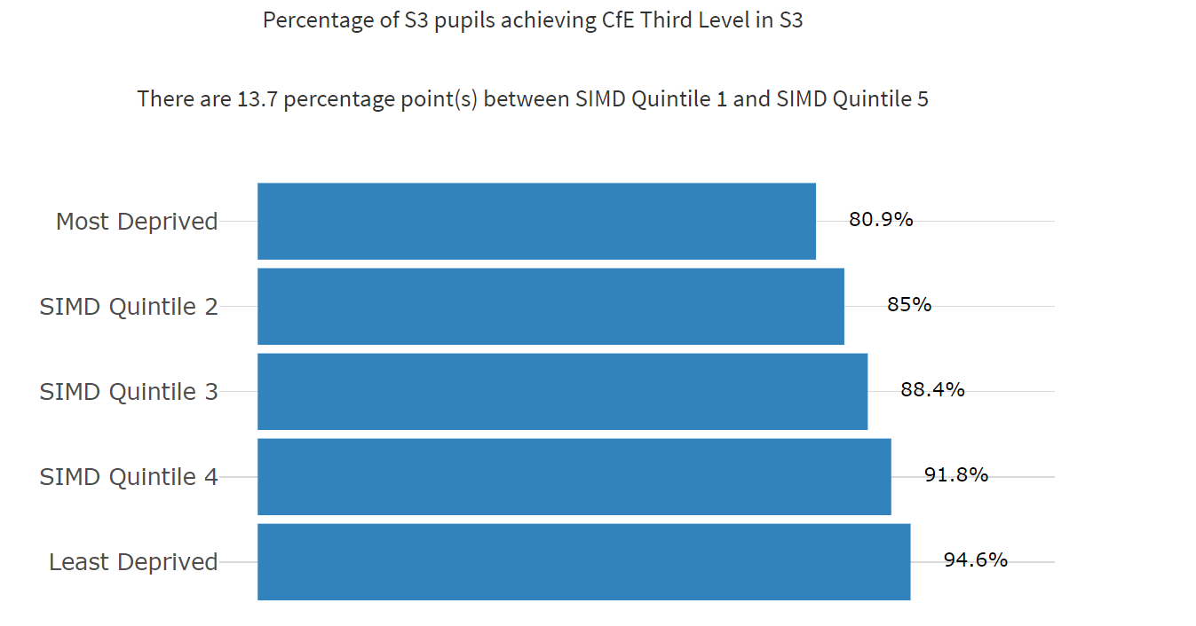
Name the data type example 1
Demographic
Perception/views
Input/school processes
Output/pupil learning?
NIFIER Dashboard (shinyapps.io)
Data for illustrative purposes only
Notes:
Key Messages
This is a quick quiz task to embed understanding of different categories of data.
Ask participants - Which category of data is this?
Talking Points
This is output data as it shows the percentage of S3 pupils achieving level 3 in S3.
This is ‘big’ data.

Slide 17
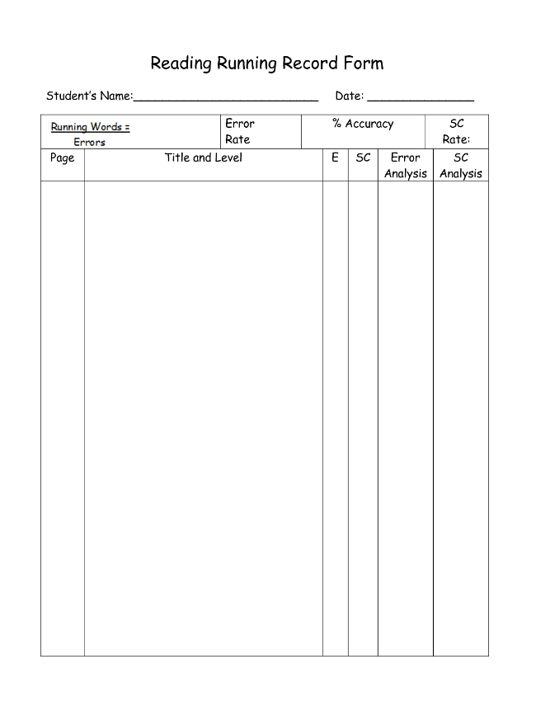
Name the data type example 2
Demographic
Perception/views
Input/school processes
Output/pupil learning?
Notes:
Key Messages
This is a quick quiz task to embed understanding of different categories of data.
Ask participants - Which category of data is this?
Talking Points
This is output data as it is a template for a running reading record. This is ‘small’ data collected by educators working closely with a learner.

Slide 18
Name the data type example 3
Summary pupil survey | Disagree | Agree | Don’t know
Most of the time my work is not too hard or too easy | 37% | 58% | 5%
I know my next steps and my learning targets | 22% | 78% | 0%
I am involved in planning my own learning | 78% | 12% | 10%
I have opportunities for personalisation and choice | 22% | 73% | 5%
I have opportunities to use digital technologies to help support my learning | 49% | 51% | 0%
(a) Demographic (b) Perception/views (c) Input/school processes (d) Output/pupil learning?
Data for illustrative purposes only
Notes:
Key Messages
This is a quick quiz task to embed understanding of different categories of data.
Ask participants - Which category of data is this?
Talking Points
This is perception data as it shows a summary taken from a pupil survey.
Perception data can be gathered in lots of ways such as smaller focus groups or surveys.

Slide 19

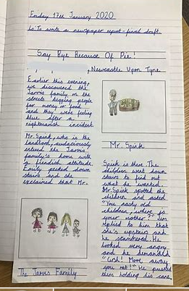
Name the data type example 4
Demographic
Perception/views
Input/school processes
Output/pupil learning?
Notes:
Key Messages
This is a quick quiz task to embed understanding of different categories of data.
Ask participants - Which category of data is this?
Talking Points
This is learner output data as it shows a page of writing from a child in a primary school.
Output data can be ‘big’ such as ACEL, SCQF or ‘small’ such as evidence taken from observations, jotters etc.

Slide 20

Name the data type example 5
The provision of manipulative resources in numeracy.
(a) Demographic
(b) Perception/views
(c) Input/school processes
(d) Output/pupil learning?
Notes:
Key Messages
This is a quick quiz task to embed understanding of different categories of data.
Ask participants - Which category of data is this?
Talking Points
This is learner input data as it references the use of manipulative resources to support learning in numeracy.
Afl or observations of learners using the equipment would be output data.

Slide 21
Name the data type example 6
Focus of learning walks | Observed %
Clear success criteria and learning objectives | 60%
Appropriate use of scaffolds and supports | 100%
Clear modelling | 80%
Positive relationship strategies | 100%
Learner engagement with feedback. | 50%
a)Demographic (b)Perception/views (c)Input/school processes or (d)Output/pupil learning?
Data is for illustrative purposes only
Notes:
Key Messages
This is a quick quiz task to embed understanding of different categories of data.
Ask participants - Which category of data is this?
Talking Points
This is output data as it summarises findings from a fictional learning walk carried out by a leadership team.
Pedagogy and pedagogical approaches are inputs.

Slide 22
Name the data type 7
Demographic
Perception/views
Input/school processes
Output/pupil learning?
Notes:
Key Messages
This is a quick quiz task to embed understanding of different categories of data.
Ask participants - Which category of data is this?
Talking Points
This is learner output data as it shows a page of writing from a child in a primary school.
Output data can be ‘big’ such as ACEL, SCQF or ‘small’ such as evidence taken from observations, jotters etc.

Slide 23
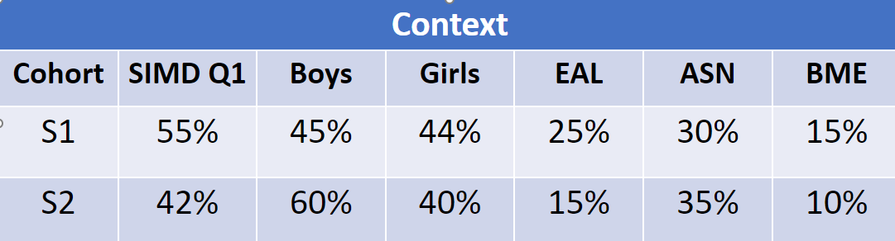
Name the data type 8
(a) Demographic (b) Perception/views
(c) Input/school processes (d) Output/pupil learning?
Data for illustrative purposes only
Notes:
Key Messages
This is a quick quiz task to embed understanding of different categories of data.
Ask participants - Which category of data is this?
For reference:
SIMD Q1 – Scottish Index of Multiple Deprivation Quintile 1 (learners living in most deprived areas).
EAL – English as an additional language
ASN – Additional Support Needs
BME – Black, minority ethnic.
Talking Points
This is demographic data as it summarises the demographic context of two-year groups in a secondary school.

Slide 24
Intersecting data
Demographics
Perceptions
Inputs/ school processes
Outputs/pupil learning
Notes:
Key messages
The key to the effective use of data is in how we intersect or cross reference different sources of data to fully understand an identified issue, gap, pattern or trend.
This helps us to triangulate information and ensure that we have a clear picture of an identified area of improvement or the progress we are making against an improvement outcome.

Slide 25
Intersecting data - part 1
Intersecting data categories allows us to ask and answer different questions about:
the profile of learners
who is progressing
what is working well to support progress
what learners, parents and others say about their learning
No School Left Behind, Using Data To Improve Student Achievement, Victoria Bernhardt, 2003
Demographics
Perceptions
Inputs/ school processes
Outputs/pupil learning
Notes:
Key messages
Intersecting data categories in education allows us to ask and answer different questions about:
the profile of learners
who is progressing
what is working well to support progress
what learners, parents and other say about their learning

Slide 26
Intersecting data – part 2
Intersecting data also supports us to:
Demographics
Perceptions
Inputs/ school processes
Outputs/pupil learning
fully understand an identified gap or area of improvement.
check and challenge our assumptions or ‘felt knowledge’
question whether our data reflects common patterns or ‘bucks a trends’.
improve our knowledge, understanding and outcomes for learners.
Notes:
Key messages
Intersecting data also supports us to:
fully understand an identified gap or area of improvement.
check and challenge our assumptions or ‘felt knowledge’ (felt knowledge is knowledge based on a feeling, belief or a ‘hunch’)
question whether our data reflects common patterns or ‘bucks a trends’.
improve our knowledge, understanding and outcomes for learners.

Slide 27
Intersecting data to answer questions
Is the attainment of learners who participate in outside-of-school activities higher? (achievement/output, activities/input, attainment/output)
Do boys’ attitudes to science differ from those of girls in secondary school and does that difference influence the decisions that they make regarding course selection? (achievement/output, demographic, programme/input and perception)
Notes:
Key messages
Intersecting data can help us to answer questions. Two examples are explained below.
Is the attainment of learners who participate in outside of school activities higher? This would involve intersecting activities undertaken (input data) against achievement data and attainment data (outputs) to see if there is a correlation.
Do boys’ attitudes to science differ from those of girls in secondary school and does that difference influence the decisions that they make regarding course selection? This would involve consideration of demographic data by selecting boys and girls, comparing output data in science by looking at their attainment, collecting perception data to find out what they think about science and considering input data by looking at course content and selection.
Reflective Questions
What other questions can you answer by intersecting data?

Slide 28
Intersecting data to understand a gap, a pattern or a trend
Boys are underperforming in literacy.
EAL boys are underperforming in writing.
Staff questionnaires and lesson observations indicate that staff confidence in supporting EAL learners is low.
The attendance of this group of learners is below 90%.
Notes:
Key Messages
This diagram shows how we can intersect data to understand an identified gap, pattern or trend. (Example data)
In this example, ‘big’ attainment data has suggested that boys are underperforming in literacy.
By intersecting data and looking further at the demographic breakdown we can see it is EAL boys. By looking further at the input, we find out that the element of literacy that this group are underperforming in is writing.
By intersecting more data, we may find out that staff confidence in teaching EAL learners is low and they may need further support or that the attendance of this group is low. In this case an attendance rather than a literacy intervention may be most appropriate in the first instance / alongside improvement to universal or targeted literacy approaches.

Slide 29
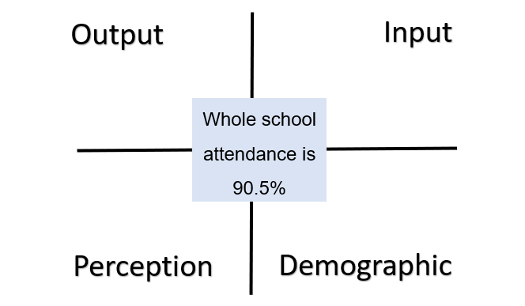
Group task
TASK
Example data for illustrative purposes only
Notes:
Key Messages
This is an intersecting data group activity.
Ask participants to consider the whole school attendance gap/issue (or select their own as appropriate).
What data would they collect to find out why this gap or issue exists?
This activity can be completed using an online interactive tool or practically using post it note, lip chart paper and pens.
It may be helpful to print our slide 15 so that participants can refer to the definitions of the data categories.

Slide 30
Aims Review
In this workshop we will consider:
the importance of developing a shared language around data
the role of data and evidence in improvement
different data categories
why we might intersect data to support improvement; and
how to intersect data to understand an identified gap, pattern or trend.
Notes:
Key Messages
This slide shows the aims of the session to be reflected upon at the end of the session.
Reflective Question
Did we cover all our aims?

Slide 31
Reflection Activity
TASK
How and when might it be helpful to intersect data in school?
Who would be involved in intersecting data?
Notes:
Reflective Questions
A final reflective task. Ask participants to consider the question and then feedback into the room.

Slide 32

Feedback
Insert you own evaluation code here
Notes:
You can insert your own feedback link here.
Thank-you. We hope that you found this resource useful.
Please provide feedback on the materials here https://forms.office.com/e/viKTsvQj9d
Your comments are appreciated and will be used to inform future resources.
This link should not be shared with the audience.

