Slide 1


EMPLOYABILITY AWARD UNITS:
UNIT 1: Responsibilities of Employment
UNIT 2: Preparing for Employment: First Steps
UNIT 3: Building Own Employability Skills

Slide 2

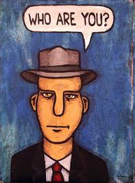
Topic One
Who are you?
Learning Intention
Reflect on your past and present experiences
Success Criteria
Create a collage or mind map to show your interests and hobbies

Slide 3

Making decisions
Choosing a job or career is a big decision and should be based on proper research and self reflection
What is the message behind the video when it comes to decision making?
http://www.youtube.com/watch?v=AYFPOS44dMw
(Double click on the link)

Slide 4
Create a collage, presentation or mind map in which you write down all your hobbies and interests.
Include things you do in school, at home, in clubs.
Use different colours to show things you have done in the past, present and ones you would like to do in the future.
You will need a key and use illustrations or pictures
Present
Past
Future

Slide 5


Group Discussion
Compare your collage with others in your group and answer the following questions:
1. Do you notice and similarities or any differences?
2. Why do you think employers want to know about your interests and hobbies?
3. Write down what your interests and hobbies tell us about the kind of person you are.

Slide 6

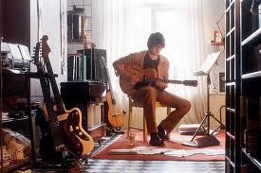
Feedback to the rest of the class what you have been discussing.
Employers can often tell what kind of personal qualities and skills you have from your interests and hobbies.
This helps them to get to know you better and make sure you are suitable for a specific job.
What interests or hobbies could you take up in the future to help with job applications?

Slide 7

Topic Two
Your Personal Qualities
Learning Intention - Can use straightforward vocabulary.
Reflect on your personal qualities
Success Criteria
Create a mind map to show the personal qualities you have and those you wish to develop

Slide 8

Personal Qualities
the kind of person you are
Reflecting on these will
help you to:
Understand yourself better
Link your personal qualities to a possible future career option
Identify the personal qualities you need to develop/ improve

Slide 9
Create a mind map from the personal qualities below.
Write down the qualities that you already have using one colour and then the ones that you would like to develop through your FOXLAKE placement with another colour.
Reliable | Quick learner | Practical | Talkative | Helpful | Determined
Healthy | Generous | Loyal | Punctual | Open minded | Hard working
Honest | Energetic | Creative | Careful | Funny/witty | Tactful
Tidy | Bossy | Passive | Friendly | Enthusiastic | Responsible
Quiet | Dependable | Caring | Good natured | Trustworthy | Well organised
Patient | Popular | Persuasive | Selfish | Adaptable | Compass-ionate
Intuitive | optimistic | Thoughtful | Happy | Problem solver | Assertive
Ask your teacher about any words you don’t know.

Slide 10

Group Discussion
Compare what you have on your mind map with the rest of the group. Answer the following questions in your jotter:
1. For each personal quality you already have, write down an example of a time when you have shown this.
2. For each personal quality you would like to develop, write down how you think your FOXLAKE placement can help you develop this. These could become targets.
Extension:
Choose 5 different jobs and write down the most important personal qualities you think are needed for each one.

Slide 11


Topic Three
Your Skills
Learning Intention – Identify 2 strengths and 2 developments Nat 4 – EVALUATE.
Reflect on your skills
Success Criteria
Create a mind map to show the skills you have and those you wish to develop

Slide 12


A skill is something you are able to do.
These will also help you to:
Understand yourself better
Link your skills to a possible future career options
Identify the skills you need to develop

Slide 13
Create a mind map from the skills below.
Write down the skills that you already have using one colour and then the ones that you would like to develop through your FOXLAKE placement with another colour.
Building things | Working with others | Planning | Repairing things | Helping others | Artistic skills
Designing | Listening to people | Making decisions | Speaking another language | Remembering information | Dancing
Growing things | Negotiating | Making music | Reading maps | Creating new ideas | Budgeting
Using a calculator | Caring for others | Sports | Managing money | Working with numbers | Spelling
Problem solving | Locating information | Performing arts | Organising projects | Communicating in writing | Photography
Helping others resolve problems | Communicating by talking | Working in a team | Recalling facts | Investigating
Explaining your ideas | Speaking in public | Making things by hand | Using IT | Instructing others
Ask your teacher about any words you don’t understand

Slide 14
Group Discussion
Compare what you have on your mind map with the rest of the group. Answer the following questions in your jotter:
1. For each skill you already have, write down an example of a time when you have shown this.
2. For each skill you would like to develop, write down how you think your FOXLAKE placement can help you develop this.
Extension:
Choose 5 different jobs and write down the most important skills you think are needed for each one.

Slide 15

What do employers want?
Watch this video clip and make a note of the important skills and qualities that employers look for.
Why do you think these are important for each type of job?
http://www.youtube.com/watch?v=YuZfmRoLlN8
(Double click on the link)

Slide 16

Topic Four
My World of Work Website
Learning Intention
Become familiar with My World of Work
Success Criteria
Create an account and use the website to start research
http://www.myworldofwork.co.uk/

Slide 17

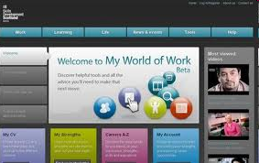
Create a new email account that you will use for job applications and registering on websites – i.e. Googlemail or icloud etc.
Create an account on Myworldofwork.co.uk and keep your username and password details in your jotter.
We will be using this website again during the course.
http://www.myworldofwork.co.uk/

Slide 18

Personal Qualities and
Skills in the World of Work
Watch these videos on My World of Work and write down what personal qualities and skills you think these jobs require:
Police Cadet
Veterinary Nurse
Fireman
Plumber
HOMEWORK TASK:
Research a job that you are interested in. What personal qualities and skills do you need to have? Make notes so you can report back next week.

Slide 19


Topic Five
My DNA/
My Strengths
Learning Intention
Reflect on the type of person you are
Success Criteria
Use My DNA and My Strengths features on My World of Work
http://www.myworldofwork.co.uk/

Slide 20

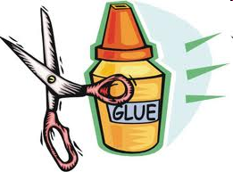
Make notes in your jotter about any insights into the kind of person you are.
You may be able to print out the results from My DNA/ My Strengths and stick them in your jotter.
Share your feedback in groups and in the class as a whole.

Slide 21

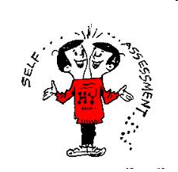
Topic Six
My performance at school
Learning Intention
Analyse strengths and areas for development at school
Success Criteria
Carry out self evaluation

Slide 22


Try and get a copy of your most recent report or other evidence of your progress such as test results or feedback
Look at it and highlight your strengths and areas for development
This is called self reflection

Slide 23


TASK: Copy the table into your jotter
and fill in for all your current subjects.
Tick the appropriate boxes. Be HONEST!
SUBJECT | I work as hard as I can |  | I do my homework |  | I understand what I should be doing |  | I enjoy |  | My top 5 subjects
 | A | S | A | S | A | S | A | S
English
Maths
KEY: A = always S = sometimes

Slide 24


Pupil Booklet
Now it is time to complete tasks 1 and 2 in your Pupil Booklet.
Remember this is the evidence for your Employability Award
It must be neat and tidy.

Slide 25

Topic Seven
My Boaster Poster
Learning Intention
Reflect on all the various aspects of yourself
Success Criteria
Create a large and detailed poster which reflects everything you have done in this unit.

Slide 26


“My Boaster Poster”
On an A3 piece of white paper, use words or pictures to illustrate your:
Top 5 personal qualities and skills
5 subjects you are doing at school
Any careers you think you might want to do

Slide 27
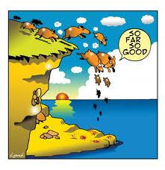
Topic Eight
My FOXLAKE Placement the story so far…
Learning Intention
Reflect on how you have developed on the FOXLAKE Programme so far.
Success Criteria
Write a personal essay.

Slide 28


ESSAY
Use the help sheet and paragraph plan to write your essay which should be between 500 – 800 words long.
Think about both the content and style of your writing.

Slide 29

Topic Nine
Last steps…
Learning Intention
Complete First Steps Unit
Success Criteria
Complete Task 3 in the Pupil Booklet
Fill in Evaluation

Slide 30


We have now got the end of this unit on First Steps.
Your last task is to fill in the Evaluation section of your Pupil Assessment Booklet.
Your teacher will then let you know if you have passed the unit.

