Slide 1
Why do rights matter?
Consider relevance of UNCRC and how it connects to everyday life and current issues​
​
Understand the legislative and policy context that underpins UNCRC
For Scotland's learners, with Scotland's educators
Notes:
Return from break at 2.30pm

Slide 2
UNCRC – Articles Activities
For Scotland's learners, with Scotland's educators
Notes:
Moving into discussion around the articles within the UNCRC.

Slide 3
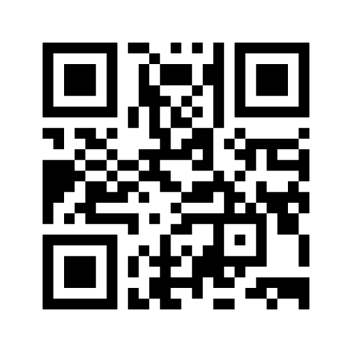

Articles Activities
SOMEWHERE
IN THE
MIDDLE
AGREE
DISAGREE
Menti Code: 25 66 30 3
Link
https://www.menti.com/cdo96yk5s4
For Scotland's learners, with Scotland's educators
Notes:
Agree – Disagree Prompts:
Children and young people need to be taught about their responsibilities when learning about their rights.
Children and young people already know enough about their rights.
Promoting children’s rights endangers the rights of the adults looking after the children.
Giving children and young people a voice can make their behaviour more challenging for adults sometimes.
Children and young people from disadvantaged backgrounds should be given greater support to realise their rights than children and young people from advantaged backgrounds.
Children and young people should be seen as active partners in their education rather than service users. (Participation)

Slide 4

The Articles
54 Articles
Part 1 (1-42): Provisions
Part 2 (42-45): Implementation & Monitoring
Part 3 (46-54): Final Clauses
UNIVERSAL
UNCONDITIONAL
INALIENABLE
INHERENT
INDIVISIBLE
For Scotland's learners, with Scotland's educators
Notes:
Human rights are Universal:
The UNCRC applies to ALL children, regardless of race, religion, abilities or family circumstances
All people everywhere in the world are entitled to human rights.
Human rights apply regardless of anything else. You do not need to have done anything for them to apply, they cannot be taken away from you and you cannot give them up.
Rights are Unconditional
All children everywhere in the world are entitled to rights – they do not have to be earned
They are not dependant on responsibilities – children have them regardless
Human rights are Inalienable
Thy cannot be given or taken away
Inherent
They are permanent and cannot be separated from the individual
Human rights are Indivisible:
Rights are completely interdependent and depend on each other for their effectiveness. So for example children have the right to relax and play and they also have the right of free assembly. They need to exercise both these rights for either one to work properly

Slide 5

Article Activity
54 Articles:
3 domains/themes:
  PROVISION
  PROTECTION
  PARTICIPATION
  Discuss in the chat – from these themes, what do think is most important?
For Scotland's learners, with Scotland's educators
Notes:
Background information:
The UNCRC has 54 articles in total:
1 to 41 are substantive articles describing specific rights, the majority of which impact on services provided by Local Authorities.
42-54 talk about how the UN and National Governments work to ensure those rights.
The Convention contains 42 substantive articles that cover all aspects of a child’s life and set out the civil, political, economic, social and cultural rights that all children everywhere are entitled to.
Examples of these are: • to be heard and have their opinion considered (Article 12)
• freedom from violence, abuse and neglect (Article 19)
• a proper house, food and clothing (Article 27)
• access to primary and secondary education (Article 28)
• ability to have fun through play and to rest (Article 31) Is sets out children’s individual rights- such as to a name and nationality, and to an adequate standard of living - alongside additional rights for specific groups of children, such as disabled children, children who have been exploited or mistreated, refugee and migrant children, children in custody, and children in care
The rights can be organised around 3 domains, often referred to as the 3 Ps.
PROVISION of services, such as education or healthcare.
PROTECTION of children and young people from abuse or from dangerous drugs (for example).
Promoting the PARTICIPATION children and young people so that their views are sought, heard and actively influence decisions or outcomes.
Menti Activity: 100 points – From the 3 Ps, what rights do you think are most important? What would you prioritise most?

Slide 6

Article Activity
54 Articles:
3 domains/themes:
  PROVISION
  PROTECTION
  PARTICIPATION
  BREAKOUT ROOMS
  Article Activity – Jamboard
  Using your UN Article Sheet - create sticky notes for an article and sort into the three P’s.
For Scotland's learners, with Scotland's educators
Notes:
Background information:
The UNCRC has 54 articles in total:
1 to 41 are substantive articles describing specific rights, the majority of which impact on services provided by Local Authorities.
42-54 talk about how the UN and National Governments work to ensure those rights.
The rights can be organised around 3 domains, often referred to as the 3 Ps.
PROVISION of services, such as education or healthcare.
PROTECTION of children and young people from abuse or from dangerous drugs (for example).
Promoting the PARTICIPATION children and young people so that their views are sought, heard and actively influence decisions or outcomes.

Slide 7
Four General Principles
Article 2 – without discrimination
The Convention applies to EVERYONE.
Article 3 – best interests of the child
The best interests of the child must be a top priority in all things that affect children.
Article 6 – survival & development
Every Child has the right to life. Governments must do all they can to ensure that children survive and develop to their full potential.
Article 12 – respect for the views of the child
Every child has the right to say what they think in all matters affecting them, and to have their views taken seriously.
For Scotland's learners, with Scotland's educators
Notes:
Background information:
Although the articles are indivisible and interdependent, there are 4 underpinning rights which can be seen to support all the others. These are described as the general principles:
Article 2 covers the principle of Universality.
Article 3 puts the best interest of the child first – before any other consideration – in all actions concerning children.
Article 6 recognises that every child has the inherent right to life and that States must ensure ‘to the maximum extent possible the survival and development of the child’.
Article 12, the right to be heard, is seen as a gateway right. Without Article 12 it is very difficult for children and young people to exercise their other rights. Participation therefore is often the first step to raising awareness of rights.
An example: when you look at article 9 for instance, which says you should not separated from your parents unless it is for your own good, you have to remember that this applies to all children, without discrimination, that any decision about taking a child away from it’s parents has to be in the best interests of the child, that all children have the right to life and to survive and develop healthily and that children and young people have the right to be heard and express their views about any decision to separate them from their parents.
Menti Activity - What would you prioritise most from these 4 underpinning rights?

Slide 8
Articles - some conclusions
What are your thoughts on the articles following these sorting and discussion activities?
For Scotland's learners, with Scotland's educators
Notes:
Depending on time – answer in chat pane or breakout rooms or jamboard

Slide 9
Recognising Children’s Rights Today
How are children supported and provided for?
Can you think of some real life examples either within school life or in the local community where children’s rights may still be infringed in some way?
How are children protected?
How might this right be restored?
How are children participating in wider society?
For Scotland's learners, with Scotland's educators
Notes:
Depending on time – answer in chat pane or breakout rooms or jamboard

Slide 10
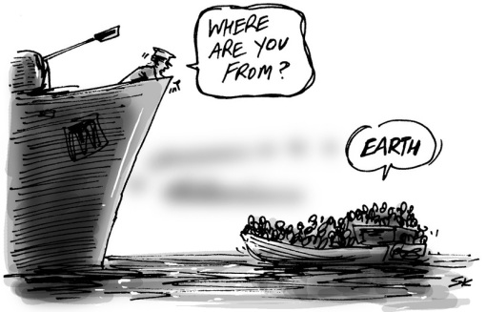
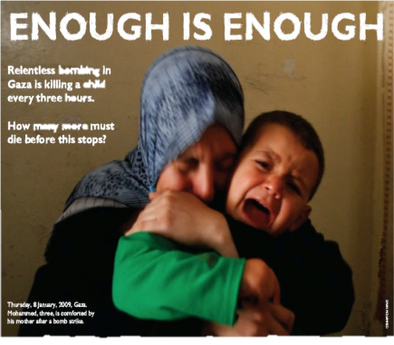
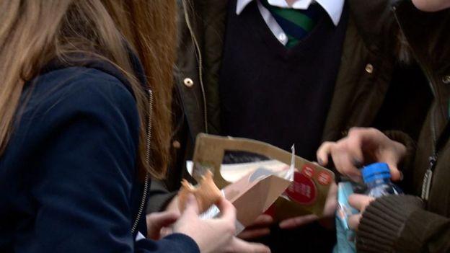


Recognising Children’s rights today
For Scotland's learners, with Scotland's educators
Notes:
There are lots of examples of when childrens rights are breached – locally, nationally and internationally.
Pick from 1 of the following 3 options, to discuss the 2 images.
Following images are examples are given of rights not being realised – ask participants to look at articles in their booklet and note down which rights (articles ) are not being realised, also ask them to think about any of these that might be helpful to explore with children and young people through learning activities and take comments at the end
COPYRIGHT CONFIRMED
http://i100.independent.co.uk/article/the-cartoon-that-sums-up-the-worlds-migrant-crisis--g12atJpSWZ Cartoon by Simon Kneebone.
Tesco denies pupil lunchtime discrimination at Edinburgh store
22 November 2016
https://www.bbc.co.uk/news/uk-scotland-edinburgh-east-fife-38065679
Pupils say Tesco lunch queuing system 'not really fair'
Pupils say Tesco lunch queuing system 'not really fair‘ Tesco has denied claims it has been discriminating against state school pupils at one of its Edinburgh stores.
Parents raised concerns that students from Boroughmuir High School had to queue outside at lunchtime while pupils from nearby private school George Watson's College were allowed in.
Tesco said there was no discrimination but it had to put restrictions in place at its busiest time.
One father told BBC Scotland he wanted an apology for his son.
Neil Pollock raised a complaint with Tesco on Twitter over the treatment of his son at the Tesco Metro store in the Bruntsfield area of the city.
He told BBC Scotland: "I raised the issue because I thought Tesco could find a better way to manage a flash crowd, which didn't require them to make one set of kids wait behind a barrier whilst they waved another set of kids into the shop.
"I understand entirely the organisational problem that Tesco has, but surely they can be more creative about resolving this problem."
Exclusion rates for pupils with ASN are more than 4 times higher than those with no ASN
Exclusion rates are 6 times higher for those in the 20% most deprived areas
Scotland’s children’s commissioner has condemned Scotrail for installing a sound device to deter young people from gathering at a train station in South Lanarkshire
http://www.togetherscotland.org.uk/pdfs/UNCRC_Scotland_NGO_Alternative_Report_2015.pdf

Slide 11
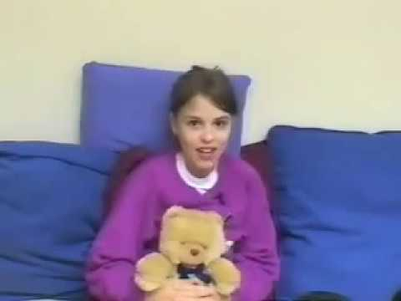
Recognising Children’s rights today – A Case study
Use your article summary sheets to help you.
Watch film clip
Identify which rights are engaged or are in jeopardy?
Discuss what might a rights-based approach look like for this young person recommend
View video on ES YouTube channel: https://youtu.be/3d1SJ8wnuNY
For Scotland's learners, with Scotland's educators
Notes:
Slide 13 – answers in chat pane, hands up if you want to speak.
Activity 6 (?) but can do as a large group and call out. Optional for longer session.
Do as a large group – Article summary sheets might be useful for this – ask participants to put answers in chat pane. Hands up if want to come in and speak.
Children’s Rights Scenarios
1. Which rights are being supported or infringed in this situation?
2. What can you or your team do to try and ensure young people’s rights are supported and not infringed here?
Tara (1 min 15 secs)
- Tara is a young carer who is not able to play and have fun – Article 15 – meet friends and join groups, article 31 – right to relax and play
Possible further example
Some S4 young people who you work with were invited to a community council meeting. When you ask them about it the next day they say that the meeting was boring, they didn’t get a chance to speak and that they don’t think they will go back . Article 12 – right to be heard and listened to

Slide 12
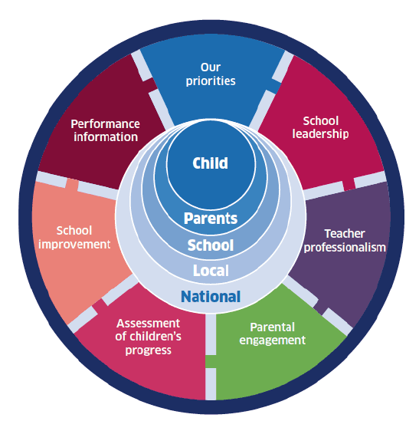

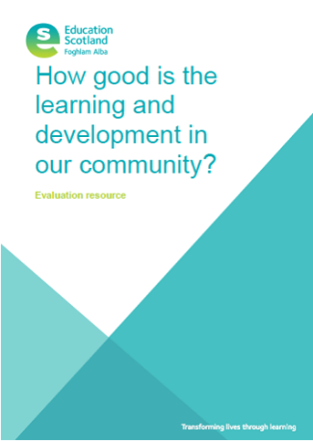
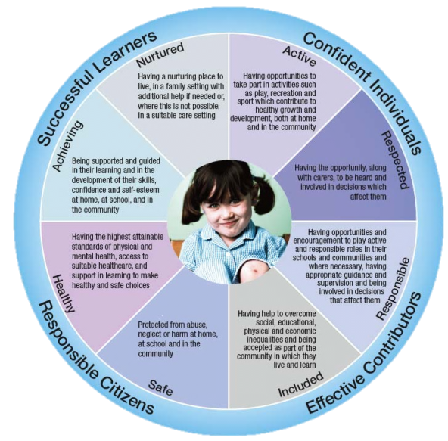
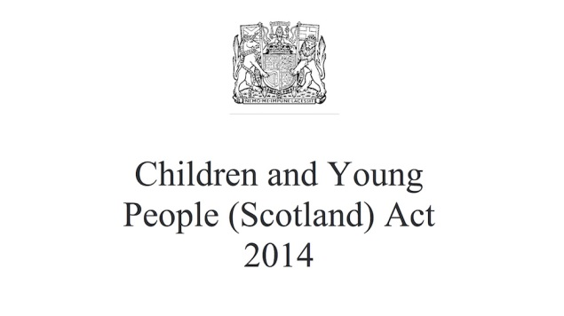

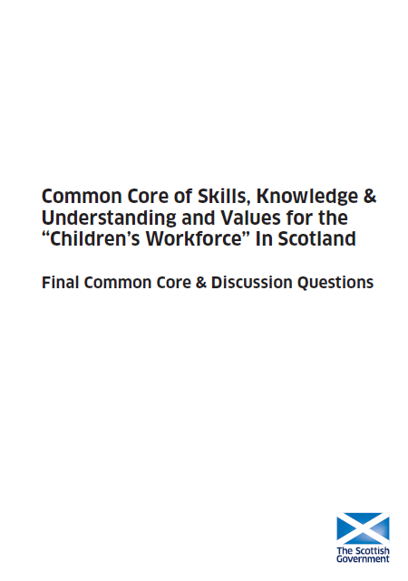

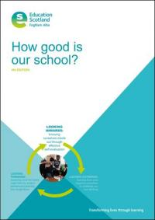

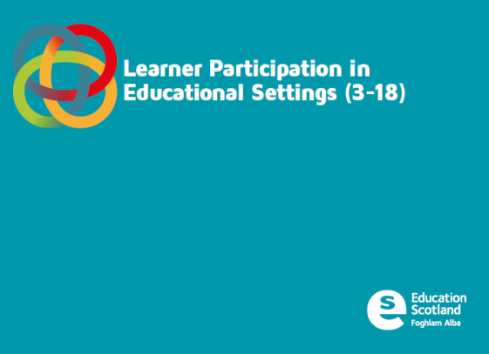

Policy Landscape
In what way does the education landscape provide opportunities for children’s rights to be realised?
For Scotland's learners, with Scotland's educators
Notes:
Important to understand the landscape in Scotland at the present time with regard to positive relationships and behaviour
The Promise -
You will all be aware of GIRFEC – getting it right for every child – one of the key policy documents that seeks to put the child at the centre and plan, assess and intervene around them using the wellbeing (SHANARRI) indicators – this recognises the importance of the childs environment and working in and through this but in a timely and proportionate way. We will explore GIRFEC – National Practice Model – resilience, My world Triangle in later modules.
Children and Young Persons Act pulls much of GIRFEC together and makes a number of aspects of it statute (law). This is underpinned by UNCRC (United Nation of the Convention of the Rights of the Child) ,an international agenda that puts the rights of children at the heart of everything we do, eg. Consider the views of child, a right to education, etc
CfE puts personalisation of learning at the heart and seeks to help children to develop the 4 capacities eg. Confident individuals, responsible citizens, successful learners and effective contributors, HGIOS 4 is the most recent self-evaluative framework that puts children and yp at the heart of the learning process. Greater focus on wellbeing and relationships, family learning and partnerships.
Developing a whole a positive whole school culture and ethos places relationships at the heart of effective learning and behaviour and advises LAs and schools to have a relationships policy and a relational approach.
NIF emphasises excellence and equity and has as 4 main priorities including closing the attainment gap and improving health and wellbeing.
Scottish Attainment Challenge has a key focus on closing the attainment gap by using evidence based approaches and directing funds towards areas of high SIMD.
We have a large array of legislation and policy in Scotland which impacts on how we realise children’s rights in practice and particularly how we take forward learner participation. Curriculum for excellence is a flexible curriculum which is pupil focused and allows practitioners to develop and adapt the curriculum in response to learners needs and indeed in response to learner feedback and participation. Many practitioners already involve children and young people in giving feedback on their own learning experience but some are involving them more widely in giving feedback on wider teaching and learning within the classroom.
The National Improvement Framework is designed to help deliver excellence and equity and secure educational improvement – it focuses on both raising attainment, closing the gap and supporting wellbeing to do this. Although participation is not a feature within it – one of the measures which is being used to focus on improvement is participation. Children’s attainment and wellbeing is unlikely to improve unless we are supporting them to participate fully in their educational experience.
Children and young people Act has a number of duties for ministers, local authorities and health boards to report on how they are supporting rights more broadly and also a definition of wellbeing and Part 3 – Local authorities and Health Boards need to take a strategic approach to the design and delivery of services used by children and families, ensuring they focus on improving children and young people’s wellbeing – Guidance on children’s service planning published. A focus on Getting it right for every child places children at the heart of services and ensures that children get the right help at the right time from the right people.
CLD
How Good is the Learning and Development in our Community?
National Youth Work Strategy
Youth Work Outcomes
CLD strategic guidance
Background information:
Taken from the common core document:
Common Core of skills, knowledge & understanding and values for the “Children’s Workforce” In Scotland
Self Evaluation
What “common” and “core” means
The Common Core is a description of the skills, knowledge and understanding and values that are valid for every employee and volunteer working with any child, young person or family. They are common because they apply to everyone, even though the detailed application may vary for different workers and/or different ages/groups of children, young people or families. They are core because they are fundamental if
workers are to help improve the lives of children, young people and families.
Strengths Based Approach and the Common Core
Our social policy frameworks (Early Years Framework, Equally Well and Achieving our Potential) promote an “assets” or strengths based approach to tackling poverty, inequality and ensuring that all of Scotland’s children get the best start in life.
Key principles of the strengths based approach include:
Working with people, rather than seeing them as passive recipients of services – “doing with”, rather than “doing to”
Helping people to identify and focus on the innate strengths within themselves and communities and enhancing and supporting them
Supporting people to make changes for the better through enhancing skills for resilience, relationships, knowledge and self esteem
Building networks and friendships so people can support each other, make sense of their environments and take control of their lives
Demonstrating the characteristics and values within the Common Core helps to ensure all workers are able bring a strengths based approach to their work.
“The Common Core draws on the views of children and young people about what they want from those who work with them. It also reflects the areas of agreement from respondents to a public consultation. So no-one should be surprised by the content of the Common Core, but the question to ask is not whether you demonstrate the characteristics within the Common Core, but how well you do it.”
AILEEN CAMPBELL
Minister for Children & Young People
The Common Core describes the skills, knowledge and understanding, and values that everyone should have if they work with children, young people and their families, whether they are paid or unpaid. The skills, knowledge and understanding are described as “essential characteristics” and are set out in two contexts; relationships with children, young people and families and relationships between workers. They are also explicitly cross-referenced to the guiding principles of the United Nations Convention on the Rights of the Child (UNCRC) and can be found on page 7. The values are taken from the Getting It Right For Every Child approach and can be found on page 8.
The Common Core is based on the consensus of views from organisations who contributed to a public consultation. It was further developed by a multi-disciplinary Working Group (see Annex A) and in workshops by workers from a diverse range of roles, organisations and parts of the children’s sector.

Slide 13
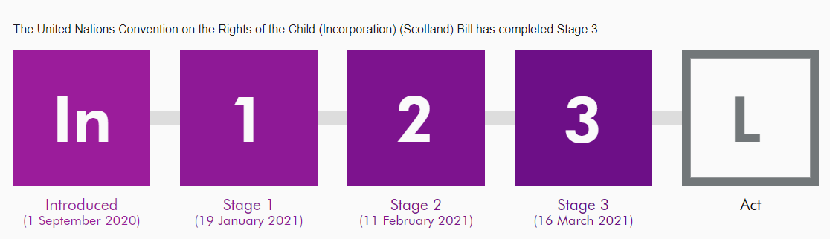
In June 2019 the Deputy First Minister announced that the United Nations Convention on the Rights of the Child (UNCRC) would be incorporated into law.
Following a consultation period, it has been agreed that full incorporation will go ahead by the end of the current parliamentary session (May 2021), and in September the Bill was presented to Parliament.
Some articles will not be able to be included as they are not devolved matters (for example, the provision on military recruitment). However, all other matters will be included, and all public bodies (such as health boards, the police and local authorities), will be required to uphold the law.
For Scotland's learners, with Scotland's educators
Notes:
In June 2019 the Deputy First Minister announced that the United Nations Convention on the Rights of the Child (UNCRC) would be incorporated into law.
Following a consultation period, it has been agreed that full incorporation will go ahead by the end of the current parliamentary session (May 2021), and in September the Bill was presented to Parliament. Some articles will not be able to be included as they are not devolved matters (for example, the provision on military recruitment). However, all other matters will be included, and all public bodies (such as health boards, the police and local authorities), will be required to uphold the law.
16 March 2021 will go down in history as a monumental day. On this day, the United Nations Convention on the Rights of the Child (UNCRC) Bill was passed in Scottish Parliament, promising to place children’s rights at the very heart of Scots law.
Watch it back online here: United Nations Convention on the Rights of the Child Incorporation Scotland Bill – Bills (proposed laws) – Scottish Parliament | Scottish Parliament Website

Slide 14
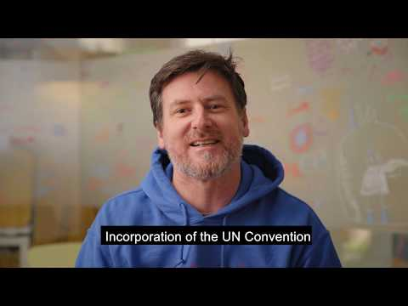

Incorporating the UNCRC into Scots Law
Children and Young People's Commissioner Bruce Adamson explains why putting the UNCRC into Scots law is so important for children's rights.
https://youtu.be/62XiLF3lAfo
For Scotland's learners, with Scotland's educators
For Scotland's learners, with Scotland's educators

Slide 15


Incorporating the UNCRC into Scots Law
Public authorities will be required to fulfil this duty in areas of their responsibility including their decisions, actions and inactions. This will have the effect of creating further accountability and empower children and young people, so if their rights are not being fully respected, they can, if they chose to do so, seek to pursue that through the legal system.
Practitioner resource page to be emailed out following this session with more information.
For Scotland's learners, with Scotland's educators
For Scotland's learners, with Scotland's educators
Notes:
Incorporation of the UNCRC will mean that public authorities, including Scottish Ministers, will be legally obliged to act compatibly with the rights and requirements of the UNCRC. And, if they don’t, the UNCRC Bill will enable children, and those acting on their behalf, to advance their rights in the Scottish courts. Public authorities across Scotland already take children’s rights considerations into day to day decision making and policies. This Bill will expand upon and formalise that good practice and places a duty on public authorities not to act incompatibly with the UNCRC rights as set out in the Bill. This is similar to the existing duty not to act incompatibly with the rights set out in the Human Rights Act.
The UNCRC Bill aims to ensure that there is a proactive culture of everyday accountability for children’s rights across public services in Scotland.

