Slide 1

Citizen Science
Creating a passion for science and Learning for Sustainability
That lasts a lifetime! ☺

Slide 2
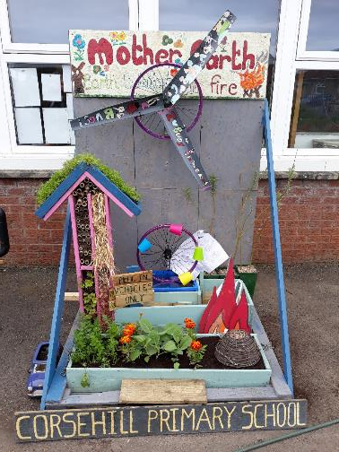
Session aims
Introduce the concept of Learning for Sustainability.
Citizen science and how it can be used in work with young people.
How to use apps and online resources to support experiences for young people.

Slide 3
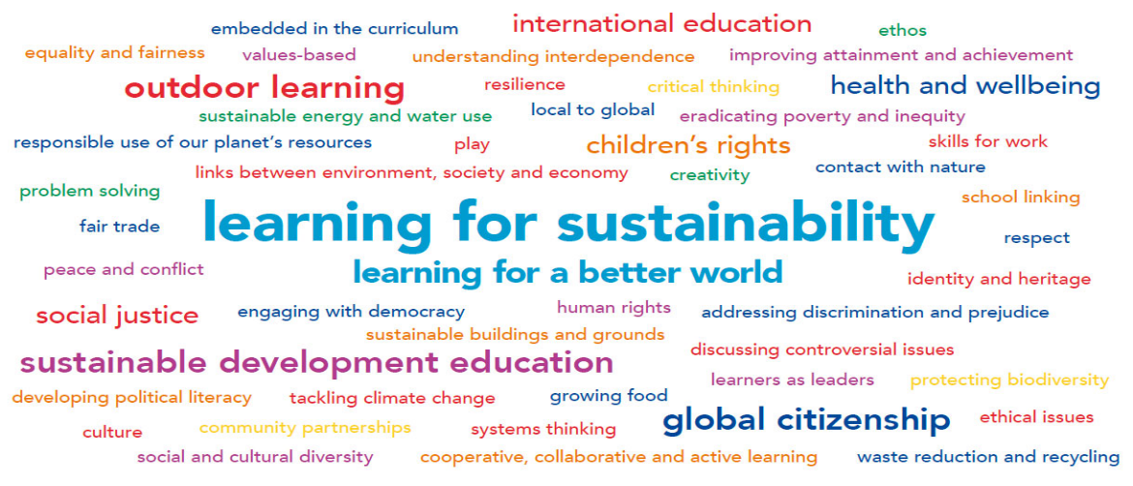
Notes:
Learning for sustainability is also an entitlement for all learners in Scotland.
Our expectation is that all young people should have daily contact with nature and that outdoor learning should be a progressive curriculum-led experience for all learners.
Citizen science is a great way to develop skills in science and promote a commitment to living sustainably.

Slide 4


4.7 by 2030 ensure all learners acquire knowledge and skills needed to promote sustainable development, including among others through education for sustainable development and sustainable lifestyles, human rights, gender equality, promotion of a culture of peace and non-violence, global citizenship, and appreciation of cultural diversity and of culture’s contribution to sustainable development.
Notes:
Scotland was also the first nation in the world to sign up to the United Nations Sustainable Development Goals.
Schools and community groups across Scotland are heavily engaged in learning about the SDGs.
Again, citizen science has a key role to play in helping us meet the goals including Goal 4.7 about quality education.

Slide 5


Three planets lifestyle….
Notes:
It has been estimated that for everyone to continue to live as we currently do, consuming natural resources and generating carbon emissions at the rate we do in Scotland, we would need three planets, not just one, to sustain us.
That is an enormous dirty carbon footprint for a comparatively small country!!
Learning for Sustainability is recognised as a priority in Scottish education and has a key role in helping us to tackle a wide range of challenges:
Increasing demands on the worlds resources…increasing global population coupled with consumerism.
Globalisation
Indisputable evidence of human impact accelerating climate change

Slide 6
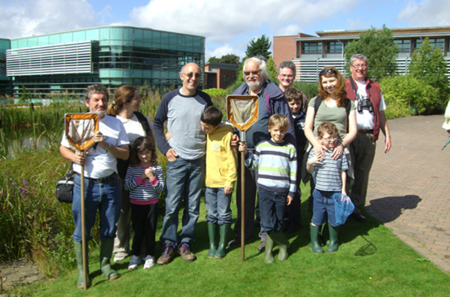
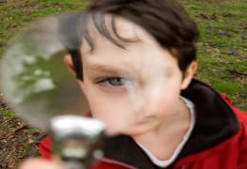
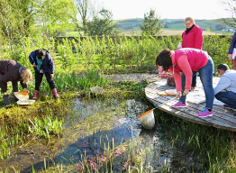
Turning citizens into scientists
Images: OPAL
Notes:
Citizen science is about giving members of the public, including children and young people, an opportunity to work in partnership with scientists to gather, record and share environmental and scientific data.
This image shows a community bio-blitz – where families, mums, dads, children, grandparents and other members of the community come out and record all the wildlife they can find in a specific area.
The Joint nature Conservation Committee estimate that there are 100,00 amateur naturalists in the UK who help to collect data.

Slide 7

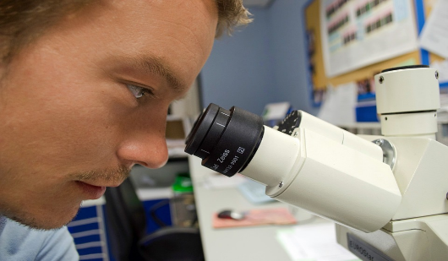
Challenging perceptions of scientists
Image: JJ at the English language Wikipedia
Notes:
Citizen science is great because it challenges perceptions of science:
That science is only for the few
That it is just for males
That you have to be super brainy, or a bit crazy to do it.
And that you can only do science when you wear a white coat and work in a laboratory.

Slide 8
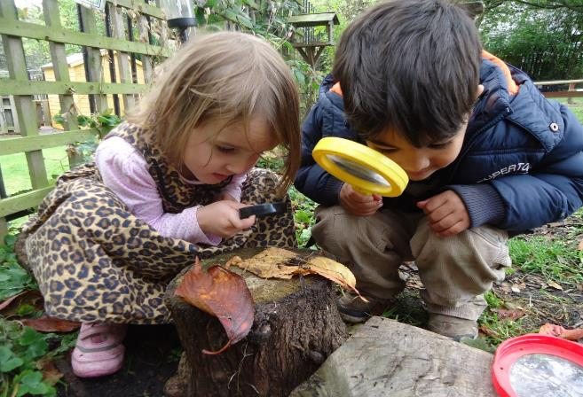
Science for all
Notes:
People of all ages can take part.
Meaningful citizen science activities can take place in the school grounds and community spaces in urban areas or anywhere…

Slide 9
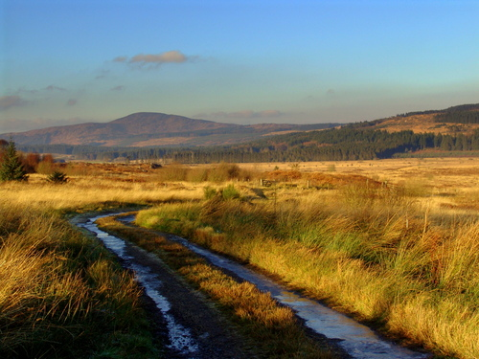
Out of the laboratory experiences
Photo: GJThomson
Notes:
…or in big wide open spaces – like a local greenspace that is round the corner from a school or even the local nature reserve or national park.
This is the Galloway Forest in Southern Scotland – it is a UNESCO Biosphere and Dark Sky Park for astronomy.
It is a fabulous resource for local schools and communities.
Citizen science is about giving the wider public an opportunity to learn more about the species and wildlife.
It also provides them with an opportunity to monitor and protect these areas.

Slide 10
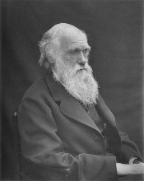
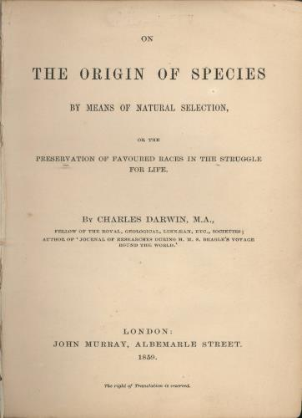
Not a new thing
Notes:
Citizen science is not new either.
This is Charles Darwin who wrote the Origin of Species which was published in 1859.
Darwin was a ‘gentleman’ scientist who built his Theory of Evolution with evidence supplied by hundreds of citizen scientists across the world.
In all he sent more than 15,000 letters in correspondence with breeders, gardeners, diplomats, explorers who helped him gather data.

Slide 11
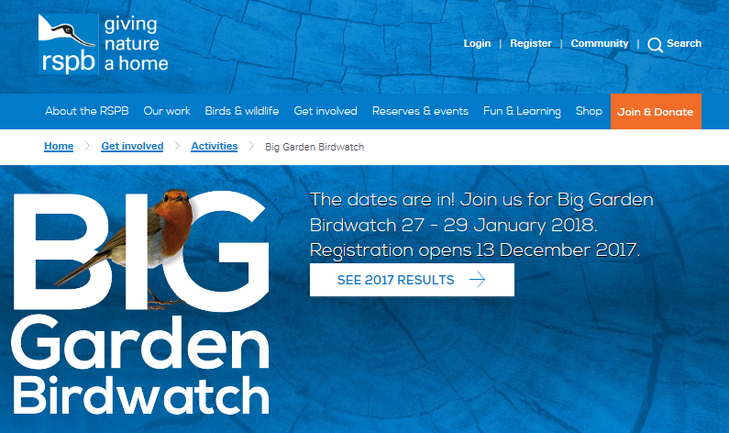
Citizen science surveys
https://ww2.rspb.org.uk/get-involved/activities/birdwatch
Notes:
In 2017, half a million people in the UK helped to record sightings of birds for the Royal Society for the Protection of Birds. Some 8 million bird sightings were recorded.
This shows the power of citizen science. Crowd-sourcing this data, with the support of hundreds of thousands of volunteers, gives scientists access to a huge amount of data they would otherwise not be able to collect.

Slide 12
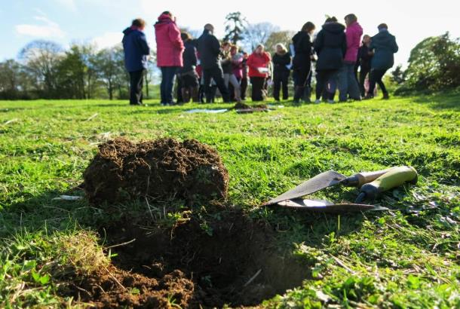

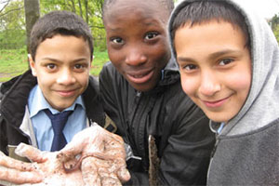
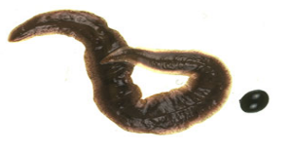
Citizen science surveys
Images: OPAL
https://www.opalexplorenature.org/surveys
Notes:
Open Air Laboratories is another popular citizen science programme in the UK
They have a range of simple surveys for schools and volunteers to do.
This is one example – the soil survey. Soil is the superhero of our world but relatively little is known about it.
For the soil survey, participants dig a simple hole then pour a mixture of water and mustard down the hole.
Various earthworms come to the surface very quickly which can then be identified.
Participants use identification cards to identify the worms and also do a simple soil test.
The data is uploaded to the OPAL website.
This is helping scientists to track the spread of invasive species such as the New Zealand Flatworm (shown in the slide).

Slide 13

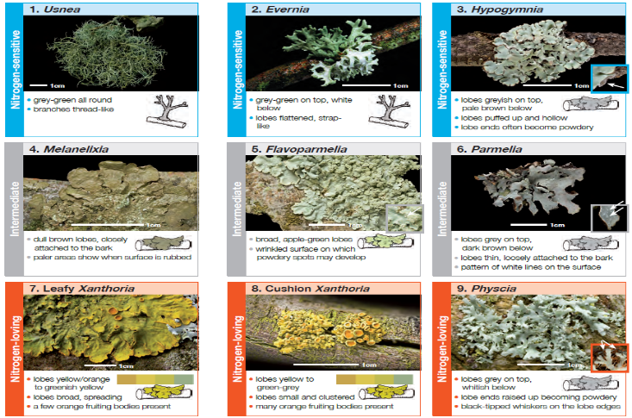
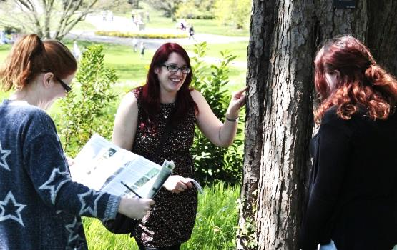
Citizen science surveys
Image: OPAL Scotland
Notes:
Lichen on trees is a good indicator of air quality.
Also tar spot fungus on Sycamore leaves.
If you don’t have an air detector this is a very simple way of gathering information.

Slide 14


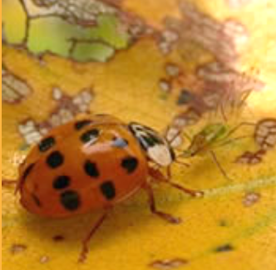
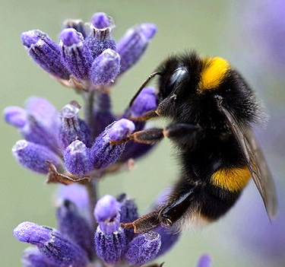
The (lady) Birds and the Bees!
Notes:
Uk Ladybird survey (https://www.coleoptera.org.uk/coccinellidae/home)
A new ladybird has arrived in Britain . But not just any ladybird: this is the harlequin ladybird, Harmonia axyridis, the most invasive ladybird on planet Earth.
The harlequin ladybird was introduced to North America in 1988, where it is now the most widespread ladybird species on the continent. It has already invaded much of north-western Europe, and arrived in Britain in summer 2004.
There are 46 species of ladybird (Coccinellidae) resident in Britain and the recent arrival of the harlequin ladybird has the potential to jeopardise many of these.
The Harlequin Ladybird Survey will monitor its spread across Britain and assess its impact on native ladybirds.
Monitoring ladybirds across the country has never been more important. We want YOU to get involved!
You can participate by downloading the Ladybird recording app for I-phone and Android phones, as well as by using an online form.
National Bee survey (https://www.bumblebeeconservation.org/surveys/)
We know that bees often go hungry and homeless. More than 20 UK bee species are already extinct and about a quarter of the remaining 267 species are at risk. But there’s currently no accurate national picture of bee health.
The National Bee survey was available for the month of August.
A smartphone app was designed to help users identify bee species and log sightings.
App was developed by Friends of the Earth, Buglife and B&Q.
The data that people collected for the Great British Bee Count will help scientists fill in the blanks about where bees are thriving – and where they’re in trouble.
The data submitted will go the National Biodiversity Network to help experts improve their understanding of bees’ health – and how to protect them.

Slide 15
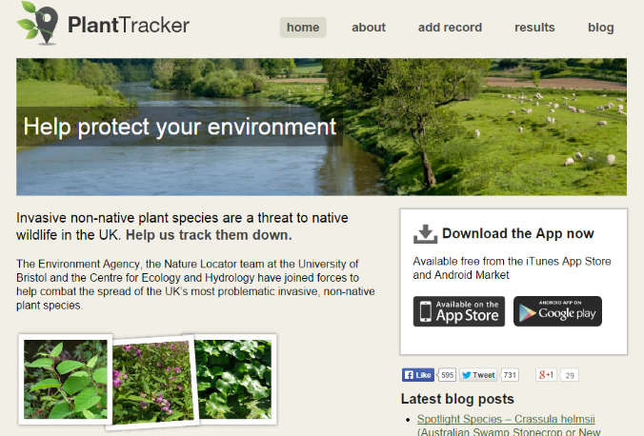
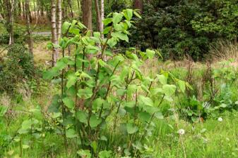
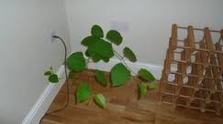
Plant Tracker
http://planttracker.naturelocator.org/
Notes:
Plant Tracker - http://planttracker.naturelocator.org/
Invasive non-native plants are a threat to native wildlife in the UK and are spreading quickly.
The invaders displace native plants and detrimentally affect the ecology of many vulnerable habitats. Some also pose a considerable threat to human health and infrastructure. These plants also present a large financial cost to the UK economy with the annual cost of all invasive, non-native species totalling some £2 billion.
The first step in tackling this problem is where these plants are….which is where citizen scientists come in!
The PlantTracker app shows you how to identify each plant and enables you to easily submit geo-located photos whenever you find one.
The smaller images on the right show pictures of Japanese Knotweed outside and inside! This plant can be particularly damaging to communities by affecting decisions taken around possible building developments.

Slide 16
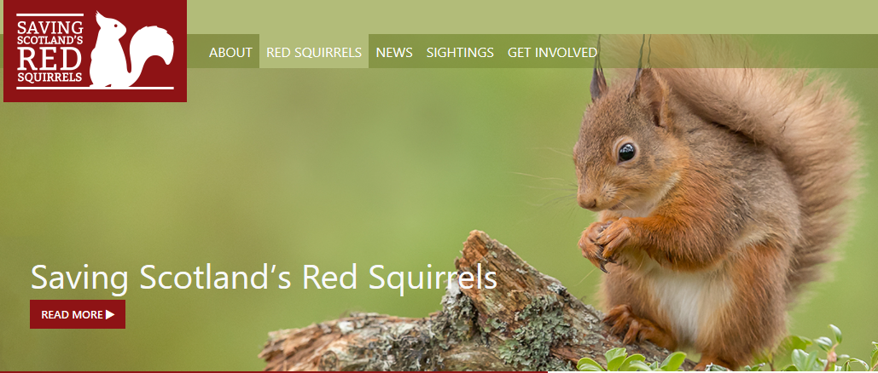
Red squirrels
https://scottishsquirrels.org.uk/
Notes:
Red squirrels (https://scottishsquirrels.org.uk/)
And now to our little furry friends.
Many of you may be aware that the red squirrel is native to Scotland and the UK.
And you may also be aware that the grey squirrel is an non-native species and is having a negative impact on red squirrel populations.
The Scottish Wildlife Trust is collecting information on the distribution of red and grey squirrels right across Scotland.
You can record your sightings on the SWT website and the information will help manage forestry and control measures in future years.

Slide 17
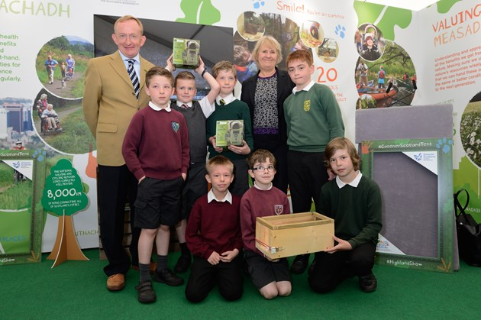
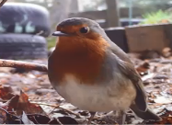
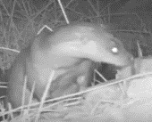
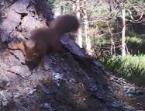
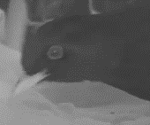
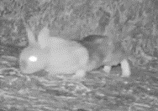
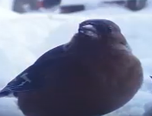
Citizen science projects
https://www.youtube.com/watch?v=AxxOTxID6kg&feature=youtu.be
Notes:
These schools were taking part in a camera trapping programme with Scottish Natural Heritage.
They set up cameras in school grounds and in nest boxes and made videos of the animals captured on video.
Again, it provides valuable data to government scientists but also open up a whole new world to the children.
Some of them captured otters, foxes, wild rabbits and many more species they wouldn’t normally see in a busy school playground!

Slide 18
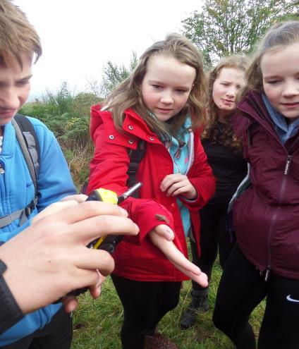

Citizen science projects
‘Taking part in this course has taught me stuff I could never have learnt in a class and I have really enjoyed making new friends.’
Our programme gives the young people a strong sense of what it’s like to work in the National Park, especially the challenges balancing conservation and environmental protection, with welcoming visitors and the needs of residents.
Image: LLTNP
Notes:
The National Parks in Scotland have been active too in involving schools and communities in their local areas in citizen science activities.
Children have had opportunities to work with rangers and ecologists to identify species, gather data, conserve local habitats, protect nests etc.
It helps connect them with the place they live and give them a love of nature and interest in conservation.
It also helps them learn more about the jobs and careers within conservation and the National Park.
The quote shows that children find this an engaging way to learn.

Slide 19
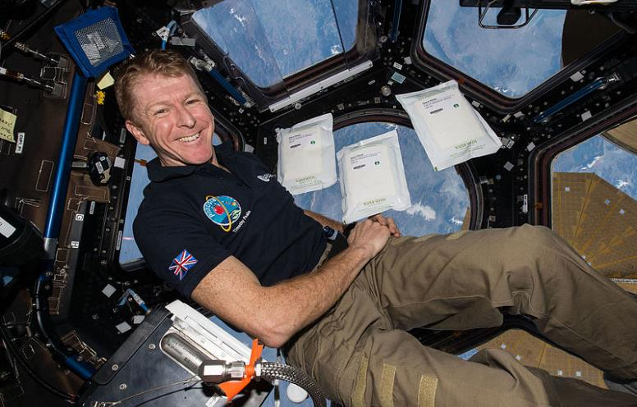

Notes:
Tim Peake, UK astronaut, travelled to the International Space Station in 2016 on the Principia Mission.
This created huge excitement in the UK.
He launched a massive citizen science experiment to look at how being in space affected the growth of seeds.

Slide 20
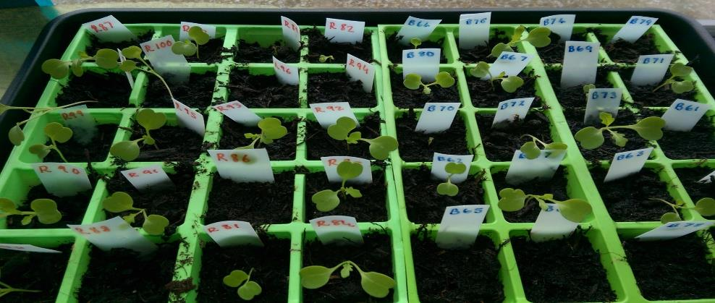
Rocket seeds from space
Image: Mearns Primary
Notes:
Some 8600 schools in the UK took part including Mearns Primary in East Renfrewshire.
Schools grew rocket plants from seeds that had been in space and compared them with normal rocket plants.
In total 320,000 measurements were collected by 600,000 learners.
The results showed only a slight difference in the seeds, showing that seeds are resilient to space travel and can be used potentially to provide a food supply on colonising missions, such as those being planned for Mars.

Slide 21

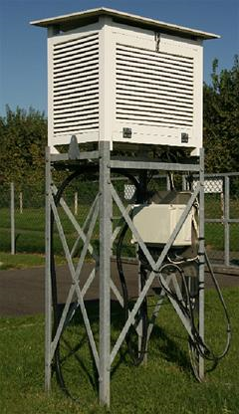



Citizen science goes digital
SDELG 2006
Met Office WOW
http://wow.metoffice.gov.uk/
Notes:
Collecting weather data has been a popular activity for citizen scientists throughout the last century or more.
In the past you would have needed a Stevenson Screen to collect useful information.
The mobile phone or device in your pocket opens up a whole new world of opportunity for scientists to accurately predict the weather exactly where you are.
Mobile apps allow hundreds of thousands of mobile device users to gather atmospheric pressure information from their phone sensors.
Scientists have also shown a link between battery temperature, which can be tracked in mobile devices, to outdoor air temperature too offering new possibilities.
The Met Offices, Weather Observation on the Web, encourages members of the public and school children to upload information, pictures etc about the weather where they are.

Slide 22
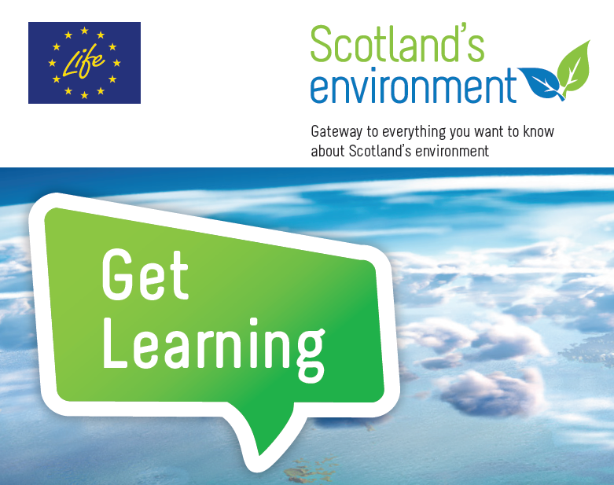
https://www.environment.gov.scot/get-involved/submit-your-data/mobile-apps/
Notes:
Scotland’s Environment website is a £5 million website developed through support from the LIFE Fund.
Education Scotland was on of many partners involved.
The website displays many valued data sets about Scotland’s landscape, biodiversity, pollution levels etc
Citizens can access the data and use it in many different ways. They can also submit their data gathered through citizen science activities.

Slide 23
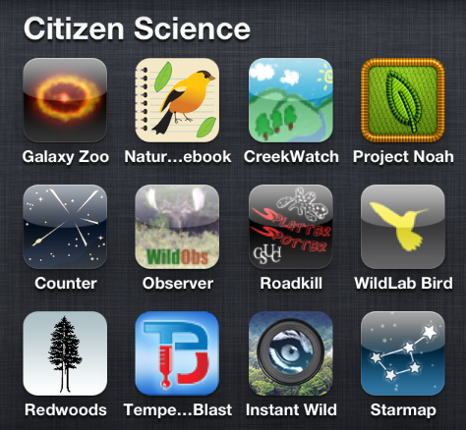
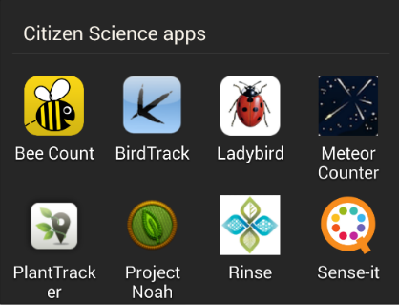
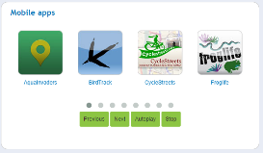

Notes:
To do digital citizen science you no longer need for fancy equipment – you only need to use a mobile phone
Examples of apps on the iPhone and android phones.

Slide 24
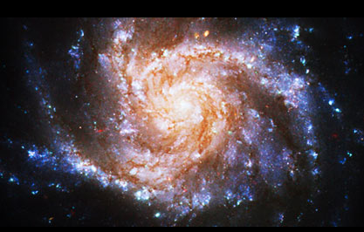
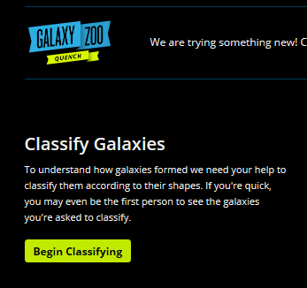
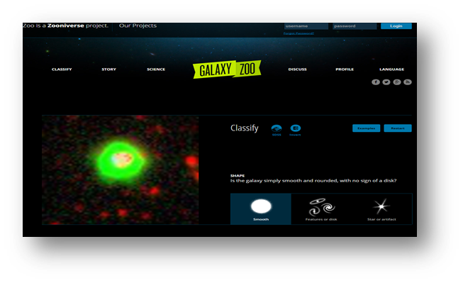
https://www.galaxyzoo.org/
Notes:
Question: How do you identify and classify over a million galaxies?
Answer: with the help of lots of friends.
Faced with a deluge of NASA data, a group of astronomers uploaded it for public analysis on Zooniverse.
Within 24 hours they were stunned to be receiving almost 70,000 classifications an hour.
150,000 Galaxy Zoo users made 50,000,000 classifications in the first year; the equivalent of employing a single analyst for more than 110 years!

Slide 25
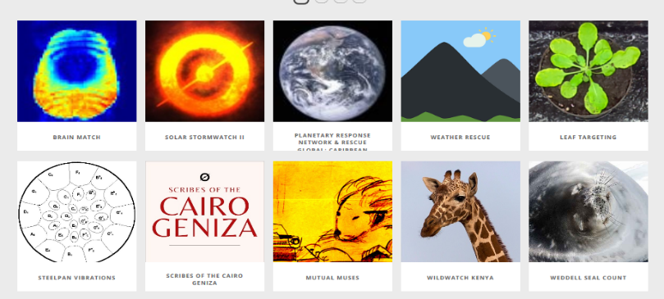
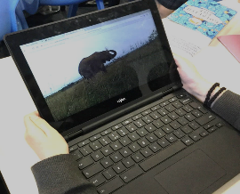
Zooniverse
SDELG 2006
https://www.zooniverse.org/
Notes:
Zooniverse is the world’s largest and most powerful platform for people-powered research.
Many different citizen science projects can be found on the site – covering a wide range of scientific disciplines.
Involving hundreds of thousands of people helps accelerate research and free up the valuable time and resources of our scientists.
Think what the following could do to support learning in the classroom:
Supporting the response to the hurricanes in the Caribbean
Counting lions or giraffes in the Serengeti
Analysing data from CERN’s particle accelerator.

Slide 26


Zooniverse
SDELG 2006
https://www.zooniverse.org/projects/mrniaboc/bash-the-bug
Notes:
Some of the surveys support medical research.
The Cancer Research UK survey provided an opportunity for people to classify cancer sells online over a period of 4 years.
The Bash the Bug survey is allowing volunteers to support efforts to fight resistance to antibiotics.

Slide 27
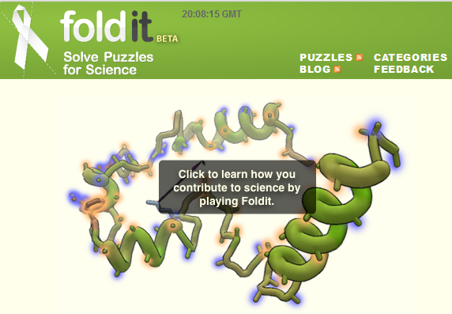
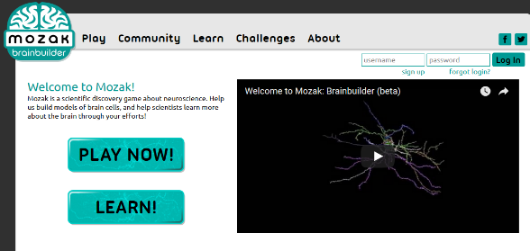
Citizen science games
SDELG 2006
https://fold.it/
http://www.mozak.science/landing
Notes:
Fold-it is an crowdsourcing computer game that enables users to contribute to scientific research.
As users play the game competitively, they help scientists better understand the structures of proteins and how they fold.
This helps prevent or treat important diseases.
Mozak works in a similar way to help scientists build models of brain cells to support neuroscience research.

Slide 28
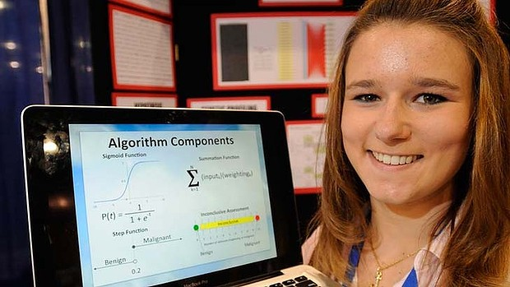
“The most amazing part about science is you can answer questions and really revolutionise the world and our knowledge base. “
Brittany Wenger, 18
http://bit.ly/1jRVrEY
Notes:
High school pupil in America, passionate about computers and programming and whilst still at school created an algorithm for testing for leukaemia after a member of her family affected.

Slide 29

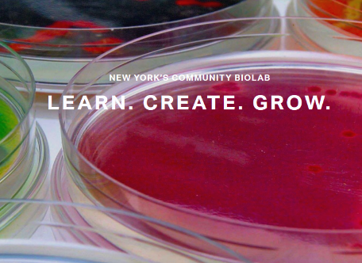
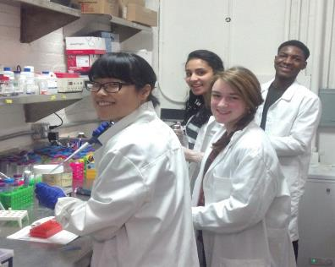
Community biolab
https://www.genspace.org/
Notes:
Community biolabs also provide a way for volunteers to develop their skills and passion for biotechnology.
They are not-for-profit organisations that provide open lab access to everyone.
Genspace was one of the first community biolabs to be set up in the world. It was established in New York in 2009.
The community biolobs provide a forum for entrepreneurs, citizen scientists, artists and scientists to come together.
As well as providing lab access, they support a wide range of community activities and outreach programmes with local high schools, open evenings, lecture series etc.

Slide 30
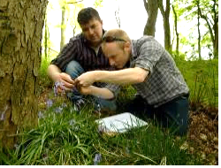
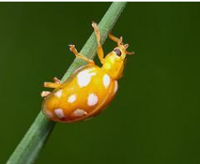
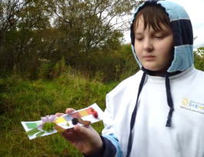
Citizen Science in work with young people
Branching out
Ballikinrain Residential school
Fort George – youth group
Notes:
Fort George – Youth Group
As part of their John Muir Award activity, a youth group chose to better understand the biodiversity of the local SSI known as Ardersier Common and to learn more about how it is used by people and wildlife alike.
Their explorations highlighted the presence of a rare sawfly – which was commended by the Highland Biodiversity Recording Group and recorded on I-spot.org.uk – A site which aims to help anyone identify anything in nature and share findings with others.
Branching Out (Forestry Commission) – (www.johnmuiraward.org)
Branching out has been described as an innovative programme offering woodland activities, on referral, for mental health service users in Greater Glasgow and Clyde.
As part of the John Muir Award, Branching Out groups have been able to tie in with lots of local and national events such as the National Bluebell Survey
Clients attend the project for an afternoon per week and take part in a wide range of activities - such as health walks, environmental art, conservation, bushcraft skills and relaxation - which provide a holistic approach to recovery.
Ballikinrain Residential School – Balfron Stirlingshire
Not strictly a CLD example, but wanted to highlight this example as an illustration of how experiences offered through award programmes and citizen science were complimentary.
School provides education for boys 8-14 experiencing significant social, emotional and behavioural difficulties.
One pupil decided to base his John Muir Discovery Award on conducting a ladybird survey for the second winter running.
The schools commitment to outdoor learning ensures that pupils receive regular, frequent, and planned outdoor learning experiences and pupils make use of a dedicated outdoor woodland classroom in the school grounds.
The pupil used the UK Ladybird survey to record his findings – ‘an impressive 84 individual ladybirds in total’ and informed school woodland management plans to help protect the orange ladybird in future.

Slide 31


What does Citizen Science in CLD look like?
Mapping for Change - Social enterprise
Local people involved in citizen science
Measure and map air quality
Results presented to local authority
Action taken as a result of findings.
https://mappingforchange.org.uk/
Notes:
Mapping for Change - social enterprise established in 2008.
Their mission - is to empower individuals and communities to make a difference to their local area through the use of mapping and the applications of geographical information.
The air quality monitoring took place in several communities across London, including Putney and Highbury.
In an innovative approach to tackling air pollution, Mapping for Change has been supporting communities across London to measure and map local air quality. Using a ‘citizen science’ approach, local residents have been able to see the real results of their monitoring activity and have now embarked on a campaign to demand the seriousness of the issue be addressed.Ts
Interested participants concerned about harmful levels of air pollution were recruited through the use of use of Twitter, local community festivals and seminars. Residents in Putney, south London, and Highbury in the north of the city took part in the study. A number of volunteers from Sustrans, a charity promoting sustainable transport, also participated. The aimwas to provide communities with a way to measure air quality using low-technical methods that can be replicated across the country and can engage all sectors of the community to participate. In addition, communities want reliable localised data which they can use to lobby local government, raise awareness, generate a better understanding of the issues and with which they can compare with other relevant datasets.
Using diffusion tubes
The pilot comprised seven locations across London. Nitrogen dioxide (NO₂) was selected as the focus primarily because of the affordability of the monitoring equipment. Levels of NO_{2,} are largely from vehicle exhausts in London, and are also a strong indicator of the presence of other air pollutants derived from vehicle emissions. In each location, a series of diffusion tubes, used to measure NO₂ levels, were set out across the area. The areas were divided up into grid squares to ensure there was sufficient coverage. Putney, with a total of thirty-eight sites, had the most monitoring locations. After a period of between three-to-four weeks the diffusion tubes were collected and analysed and the results mapped for each location.
Putney
The results from both Putney and Highbury indicated that levels along the main road network were up to 75% above EU limits for the period. They also highlighted several residential back-roads used as ‘rat runs’. The remaining five monitoring locations across London each comprised of one of London’s Greenways (safe, quiet routes through parks, green spaces and lightly trafficked streets) with an adjacent busy road. The results showed significantly higher NO₂ levels on the roads compared with the Greenways, despite their close proximity.
Part of the community engagement process involves feeding back the results to wider community.
Highbury’s report
The first was held in Highbury and was attended by over forty local residents, the Green Party London Mayoral candidate, the Local Authority and Clean Air London Director, Simon Birkett. Jenny Jones, the Mayoral candidate, said that the results were terrifying. She did say, however, that the turnout had brought her hope and she recognised that the issue was obviously important for local communities. APublic Protection Officer from the Local Authority who attended the meeting expressed her support for the study and highlighted the difficulties they have had in engaging the public in this discourse. She welcomed any move to raise awareness at the local level. The community was shocked to learn that even if they live in quiet back streets themselves, their children are still subject to dangerously high levels of pollution.
They came up with a list of measures which they and others in the community could adopt to reduce exposure to, and production of, harmful emissions. They also listed a number of suggestions to be put forward to the Mayor and Local Authority.
Engaging communities in these citizen science activities not only raises a greater understanding of the issues linked to air pollution, it encourages participation in civic and democratic processes, giving residents a confidence to call for change.
List of Measures
Mapping for Change is using its online interactive Community Mapping platform to display all of the results from the citizen science activities. We are also developing a toolkit that will enable communities across the UK to engage in air quality monitoring activities.

Slide 32

Wild Ways Well Project
http://cumbernauldlivinglandscape.org.uk/flagship-projects/wild-ways-well/
Notes:
Citizen science has so many benefits:
It can bring young and older people together
It connects them to their local communities
Girls in particular are attracted to the values-based approach and it can help to tackle gender-stereotypes in science.
Being outdoors and connected to nature also promotes physical and mental wellbeing. The Wild Ways Well project is helping to promote good mental health through citizen science.

Slide 33








Awards and recognition
Notes:
It is important for children, young people and adults to get recognition for the volunteering work they do and for the citizen science activities they participate in.
These awards build their confidence and give a record of the skills they have developed and contribution they have made.

Slide 34

Discuss
SDELG 2006
Can you identify some of the benefits of using citizen science?
What might the challenges be and how might you overcome them?
Think of an example of how you could use citizen science?
Image: OPAL Scotland

Slide 35

Citizen science in CfE
SDELG 2006
https://education.gov.scot/improvement/learning-resources/citizen-science-and-curriculum-for-excellence/

Slide 36
“No one will protect what they don’t care about; and no one will care about what they have never experienced”.
David Attenborough
“It’s really important for you to get involved in looking after the environment, because you’re part of it, everything you need comes from it, and everything you do changes it”.
environment.scotland.gov.uk

Slide 37



Get in touch
http://bit.ly/NIHSTEM
stem@educationscotland.gov.scot
STEM: @EdScotSciences @STEMedscot #STEMnation
LfS: @EdScotLfS #ThisisLfS
CLD: @EdScotCLD
For Scotland's learners, with Scotland's educators

