Slide 1







Inclusion Wellbeing & Equalities Professional Learning Framework
Relationships matter – Why?
Informed Level
@ESInclusionTeam
For Scotland's learners, with Scotland's educators
Do luchd-ionnsachaidh na h-Alba, le luchd-foghlaim Alba
Notes:
Purpose of these Slides
Read title​
This professional learning is pitched at an informed level and suitable for anyone working with children and young people in an educational context.
How to use the slides:
To be used to facilitate professional learning in a group or whole-setting, or as a self-directed learning activity as an individual.
General Guidance
There is a requirement to cover all the slides.
Please do not change the provided slides.
Facilitators are welcome to add slides or activities relevant to your own setting, to support discussion and exploration of the topic. Facilitators will know their participants’ needs best.
Anyone who works in an educational setting can be a facilitator and use these slides.
It is important to establish a safe space which encourages respect and honesty to ensure that everyone is able to participate.

Slide 2







Interconnectivity
Notes:
All of the professional learning in the Framework fits into one of these four themes. The four themes are interconnected and interdependent.​
This activity forms part of the professional learning in the Relationship theme.

Slide 3

How to use this resource
These slides can be used to facilitate professional learning in a group or
whole-setting, or as a self-directed learning activity as an individual.
Facilitation notes are included at the bottom of each slide.
Please do not remove or change any of the slides included.
Facilitators are welcome to add slides or activities relevant to your own setting, to support discussion and exploration of the topic. Facilitators will know their participants’ needs best.
Anyone who works in an educational setting can be a facilitator and use these slides.
For reflection or discussion activities, it is important to establish a safe space which encourages respect and honesty to ensure that everyone is able to participate.
Notes:
Option to skip slide as these are instructions for facilitators only. No need to read to audience.

Slide 4

National Model for Professional Learning
This professional learning resource will support you to deepen your knowledge and understanding.
You will have the opportunity to consider how to take this learning forward on your own and with others.
The National Model of Professional Learning (education.gov.scot)
Notes:
This professional learning forms part of the national model for professional learning and is designed to help you gain more knowledge and have a deeper understanding of inclusion, wellbeing and equalities​​
On completion of this professional learning, you will be asked to consider what your next steps will be​​.
Please take some time to consider the reflection questions at the end

Slide 5
Welcome
This session provides an opportunity to:
To consider the importance of relationships for wellbeing, learning, and behaviour
To consider how ethos and culture impact on relationships
To explore the skills and understanding we need to be able to strong trusting relationships
Notes:
Link activity to national model

Slide 6

It’s all about relationships!
3:09 mins
Barnardo’s Scotland
Film
Notes for practitioners
If viewing as a PDF please click this link to watch the film https://youtu.be/h1CzUO9yEtc
Notes:
Film 3.08 min

Slide 7

Relationships matter
Why?
Notes:
In the previous diagram we identified four overarching themes that we need to focus on if we are to get it right for every child. However without strong trusting Relationships it’s very difficult to realise others rights, experience or promote wellbeing, or to feel included or be inclusive. Relationships are often the conduit through which Rights, Wellbeing and Inclusion become reality.

Slide 8
Relationships matter for wellbeing, learning and behaviour
If relationships are where things developmentally can go wrong, then relationships are where they are most likely to be put right. (D. Howe, 2005)
There is now a wealth of research on the importance of connectedness in schools and on the specific qualities of in-school relationships that promote effective education. (Roffey, 2012)
From the 80 year Harvard Study of Adult Development – we know that connectedness and close relationships have more of an impact on health, development, happiness and longevity than money or fame, cholesterol levels, drinking or smoking.
The healing environment is a safe relationally rich environment. (Perry, 2008)
Staff and pupils agreed that teachers taking an interest in, and getting to know pupils as individuals, was key to developing relationships and managing behaviour’ BiSSR 2016(1.18)
Every relationship has the power to confirm or challenge everything that has gone on before. (Bomber, 2007)
Notes:
We know that relationships and social connection – the sense of belonging and being cared for - are essential for wellbeing – This is true for all of us regardless of age.
The study conducted over 80 years by Harvard University shows the life-long importance of relationships on our health and happiness.
The importance of relationships for wellbeing is particularly true for children and young people as they start and make their way through their educational journey.
Throughout their education learners will encounter many new things, meet many new people, and experience lots of change. Relationships and connection, particularly with trusted adults, are essential for all learners to navigate this journey well. Learners who haven’t previously experienced safety or care at home, who have experienced adversity or trauma, can often find school and education scary and challenging. Relationships with trusted adults can provide healing for these learners and can perhaps provide them with healthier and happier experiences.
This in turn provides a better environment for learning and promotes better behaviour.

Slide 9
Personally, and professionally, we need to: keep a relentless focus on the importance of relationships
1. Underpinning principle to all educational guidance in Scotland:
wellbeing, positive relationships and an inclusive ethos and culture are the foundation for learning
[There are two key policy drivers supporting the development and promotion of positive relationships in establishments – Curriculum for Excellence (CfE) and Getting it Right for Every Child (GIRFEC)]
2. Children and young people have told us they need (Morgan Review, 2020):
the support they receive to be consistent from all the people who work with them
Relationships are everyone’s business – a whole school priority/approach is needed
Whole-school approaches involve all parts of the school working together and being committed
Notes:
He previous film and quotes from researchers and psychologist demonstrate the importance of relationships for wellbeing, learning and behaviour. This provides us with a moral imperative however we have a professional responsibility keep focusing on relationships. Relationships and relational practice underpin all of the educational guidance and advice in Scotland. For practitioners who are regulated by a professional body such as GTCS or SSSC they have ‘the ability to build and nurture relationships’ embedded in their professional standards and for practitioners who are not regulated by a professional body ‘relationships’ are often cited within their employer vision and values.
But even more importantly, in ALL of the recent large scale reviews, such as the Morgan Review, The Promise, The National Debate and the Hayward review, children and young people told us that relationships are important to them and that they want to support they receive to be consistent from all the adults working with them.
So this is everyone’s business.

Slide 10
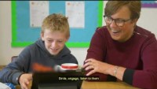
Building strong relationships
2:55 mins
Barnardo’s Scotland
Film
If viewing as a PDF please click this link to watch the film https://youtu.be/RbuggV7_h50

Slide 11
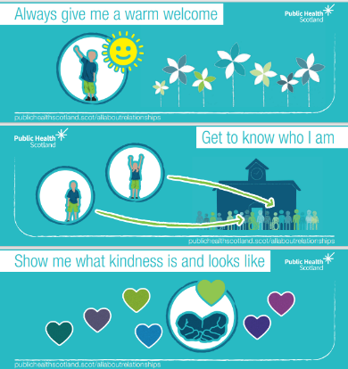
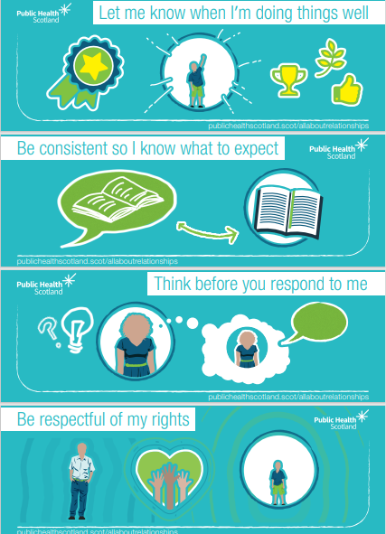
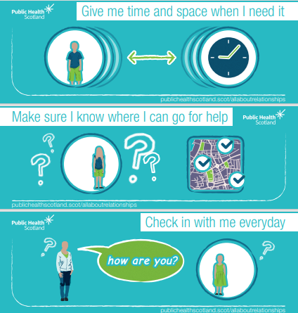
It’s the simple things:
From Public Health Scotland’s
It’s All About Relationships Top Tips
Notes:
The film shows that building relationships is not about being highly skilled in particular techniques or strategies.
It’s about the simple things: a smile, a warm welcome, being approachable, using someone’s name….
Relationships are important for all of us in terms of our happiness and our health. Public Health Scotland issued these Top Tips to promote healthy relationships
Always give me a warm welcome
Get to know who I am
Show me what kindness is and looks like
Let me know when I’m doing things well
Be consistent so I know what to expect
Think before you respond to me
Be respectful of my rights
Give me time and space when I need it
Make sure I know where I can go for help
Check in with me everyday
As already mentioned, these things are not specialist skills. They are things that we can all do, and in most situations we do already.
Doing these things only becomes a little more challenging to do when we encounter people that we find difficult either in personality or in behaviour.
In reality, this can include some of the children and young people we work with.

Slide 12
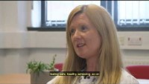
Safe environment and positive culture
4:15 mins
Barnardo’s Scotland
Film
A positive school ethos and culture is essential to developing good relationships and positive behaviour in the classroom, playground and wider community.
If viewing as a PDF please click this link to watch the film https://youtu.be/Q7ATPys2lBg
National Advice and Guidance: Developing a positive whole school ethos and culture: relationships, learning and behaviour’
Notes:
Culture and ethos, linked to shared vision and values of an education setting, are key determinants in maintaining positive relationships and wellbeing.
The mental, emotional, social, and physical wellbeing of everyone within a learning community can be positively developed by fostering a safe, caring, supportive, purposeful environment that enables the development of relationships based on mutual respect.

Slide 13
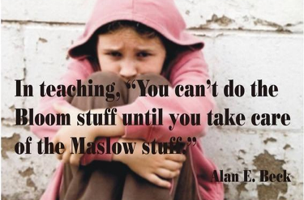
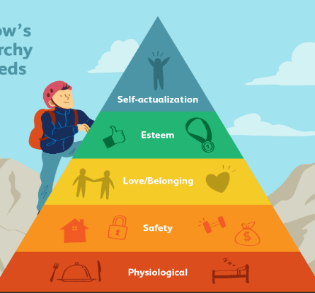
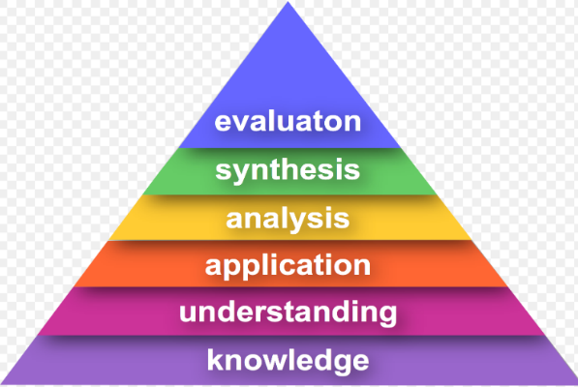
Needs Wellbeing Learning
Maslow before Bloom
Notes:
In several of the films and slides now the link between meeting our basic needs, wellbeing and learning have been mentioned.
This is quite simply illustrated here - ‘Maslow before Bloom’.
Are learners won’t be ready to learn until we can ensure their basic needs are being met.
For many learners most of these needs are met at home and in education we only need to reinforce this sense of wellbeing and care by showing them we are interested in them.
For other learners we may need to proactively help them feel physically and psychological safe – large overcrowded spaces, corridors and staircases, new people or tasks can all feel scary. Also many young people don’t have the experience of feeling loved or cared for. These are some of the things that we may need to support in order to get a child to a place where they can learn.
This is particularly important in a secondary setting where learners experience many more transitions on a daily basis than they do in a primary setting – with lots of movement about the setting and multiple changes of people and activities throughout the day.

Slide 14
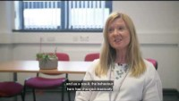
Reframing and modelling behaviour
2:24 mins
Barnardo’s Scotland
Film
If viewing as a PDF please click this link to watch the film https://youtu.be/GVwW0pGTnpw

Slide 15
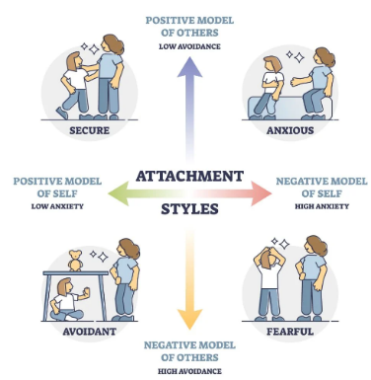
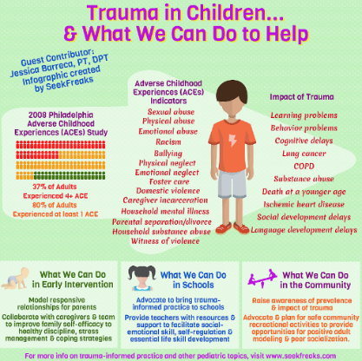
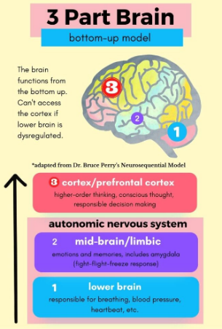
Understanding that supports relationship building
Attachment &
Nurture
Impact of Trauma &
Trauma Informed Practice
Brain Science &
Emotional Regulation
Simply Psychology
seekfreaks.com
Aheartforallstudents.com
Notes:
Understanding attachment, knowing what shame looks like in terms of behaviour, understanding the impact of trauma, and understanding how the brain functions, can help us understand emotional dysregulation and respond to behaviour.
Knowing about the nurture principles, trauma informed practice, and co-regulation can help us respond in a compassionate and caring way that promotes relationships, healing and better behaviour.

Slide 16
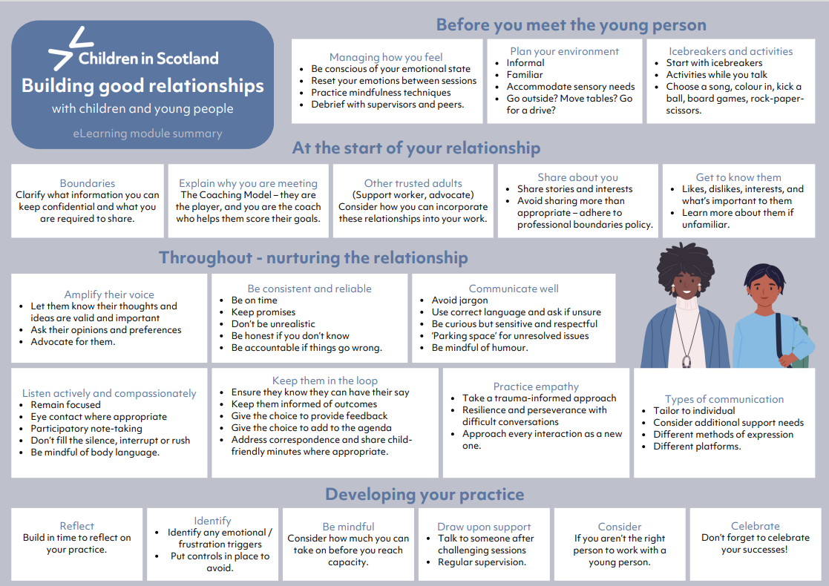
Children in Scotland
Children in Scotland
have created a simple, accessible and free:
E-Learning Module
(requires a login)
It takes approximately 15 minutes to complete but even for experienced practitioners it provides useful reminders of what works and what should be avoided.
Although the module was produced for a broad range of settings, the principles and many of the suggestions are relevant and can be incorporated into educational settings.
Module summary
Notes:
We all have a responsibility to build and nurture relationships with ALL the learners under are care. In this regard we all have different capacity and capability and often we can find it challenging with particularly learners who display behaviour that we struggle to reframe or manage. In these circumstances and periodically we can all benefit from refreshing things that help us build and nurture relationships.
There are many good tools and learning packages to support our personal and professional practice. For example,
Children in Scotland have created a simple, accessible and free:
E-Learning Module (requires a login)
It takes approximately 15 minutes to complete but even for experienced practitioners it provides useful reminders of what works and what should be avoided.
Although the module was produced for a broad range of settings, the principles and many of the suggestions are relevant and can be incorporated into educational settings.
This diagram provides a summary of the modules key points.

Slide 17
Relational approaches
Relationships
Trauma-informed approaches
Whole School Nurture
Restorative Approaches
Solution Oriented Schools
Relationships
Relationships
Responsibility of All
PSE and HWB Programmes
Learner Participation
Mentors in Violence Prevention
Recognising and Realising Children’s Rights
Compassionate and Connected Communities
Relationships
Notes:
At a whole school (learning community) level we use many different approaches to build and nurture relationships. For example:
Learning through the health and wellbeing aspects of the curriculum (Responsibility of All) reinforces and develops the knowledge and understanding, skills, capabilities and attributes which children need for mental, emotional, social and physical wellbeing now and in the future.
Professional learning around Trauma informed approaches, Nurture, Restorative aproaches, Rights and Participation, Equalities, and some of the more specialised programmes such as MVP, and SOS.
Remember no one approach is better than the others and they are not mutually exclusive, in fact they complement each other.
Combining approaches in response to different circumstances, or learners needs, is good relational practiceYou can find modules on most of these approaches at either at the informed or skilled level within this Professional Learning Framework. Some professional learning is only available through direct delivery at learning community or authority level or on a train the trainer basis.
Culture and values, however, is key! For any approach to be effective the lived experience of learners, staff, and visitors should be one of kindness, care, and compassion.
Remember it’s the simple things that make a difference and these don’t depend on hours of professional learning but on the values and qualities of the practitioner.
One final comment the approaches adopted by a setting should clearly articulate with, and be explicit in, their Relationships policy, i.e., the behaviour resulting from the approach is consistent with the values and expectations contained within the policy. Remember the goal should be to achieve consistency of approach across a whole learning community.

Slide 18

Reflection
From what you have learned so far, think about:
How has this made you feel?
What has this made you think about?
What one action would you like to take forward?
How can you link what you plan to do with others in your setting?
How you will know that this learning has made a difference?
Notes:
Facilitation notes:
You can do this in groups...
Encourage educators to take this forward in an enquiry
Consider impact of the actions / learning

Slide 19
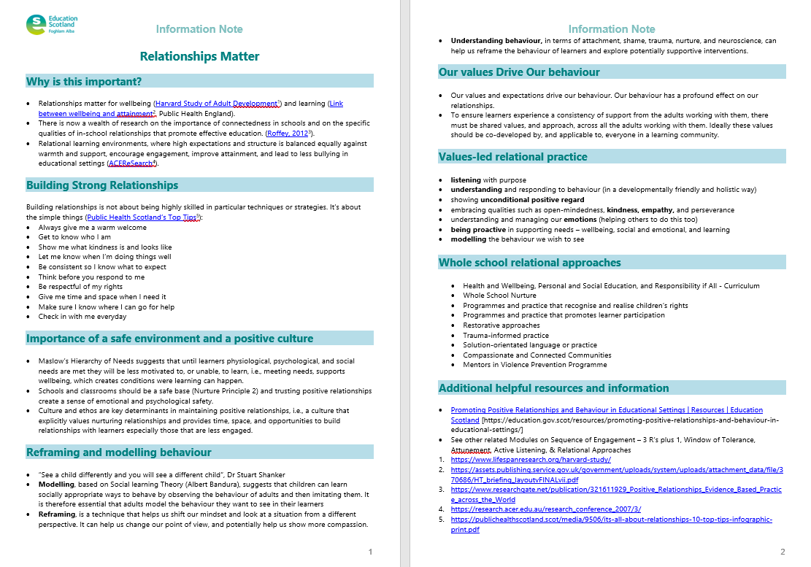
Resources and Information to help

Slide 20


We value your feedback
From now until March 2024 we will be taking feedback on these resources so that we can make changes in advance of a formal launch of the Professional Learning Framework in June 2024
Your feedback could help us improve this resource
Please complete this short form, using the link or QR code, to let us know what you thought of it and any suggestions you have on how it could be improved
LINK: https://forms.office.com/e/b5PCpJJJ3P

Slide 21

For Scotland's learners, with Scotland's educators
Do luchd-ionnsachaidh na h-Alba, le luchd-foghlaim Alba
Education Scotland
Denholm House
Almondvale Business Park
Almondvale Way
Livingston EH54 6GA
T +44 (0)131 244 5000
E enquiries@educationscotland.gsi.gov.uk

