Slide 1



Autism & Inclusive Practice
Professional Learning Module
Session 1. Introduction and Terminology
For Scotland's learners, with Scotland's educators
Do luchd-ionnsachaidh na h-Alba, le luchd-foghlaim Alba
Notes:
The module An Introduction to Autism and Inclusive Practice is designed to provide an introduction for educational staff and anyone with an interest in supporting autistic learners in the settings that they work and support. This introductory module aims to help you develop an awareness of what autism is, its impact and how it can be supported within an inclusive school community. It may also be of interest if you work in the voluntary sector or simply have an interest in autism and inclusive practice.

Slide 2
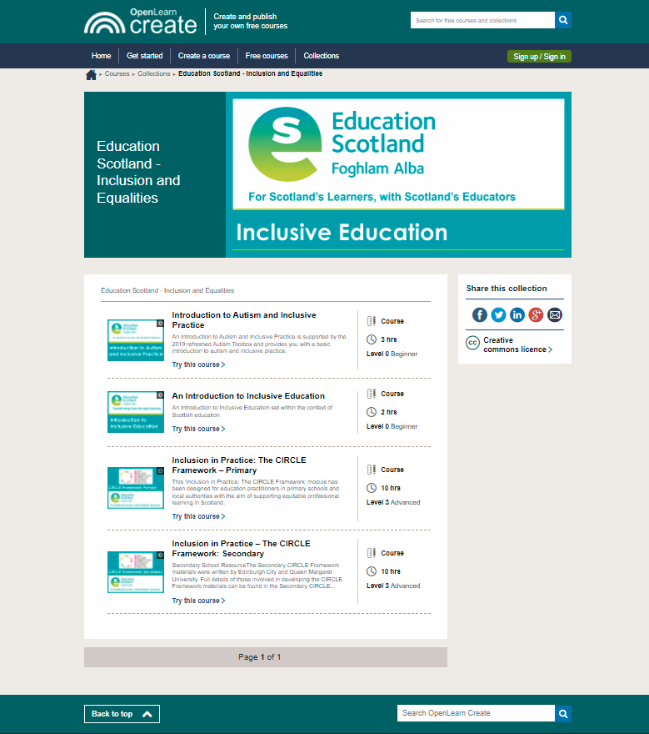
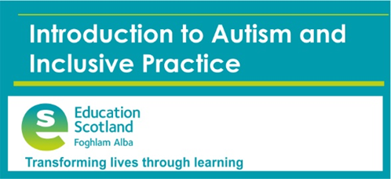
Module Overview
OLCreate: Education Scotland - Inclusion and Equalities (open.edu)
Notes:
Module is free to access – use the link on this slide
There are other free modules available from Education Scotland should you choose to access them
You need to register (free) with OU OpenLearn in order to access the module

Slide 3
Structure of Programme
Terminology
The Scottish context for autism and inclusion
Understanding Autism
Assessment and Monitoring
Supporting Learners and Families
Social and Emotional Wellbeing
Transitions
Notes:
The module and this supporting programme for reflection is split into seven sections:
Terminology
The Scottish context for autism and inclusion
Understanding Autism
Assessment and Monitoring
Supporting Learners and Families
Social and Emotional Wellbeing
Transitions
Today we will explore the first section of the module, Terminology.

Slide 4
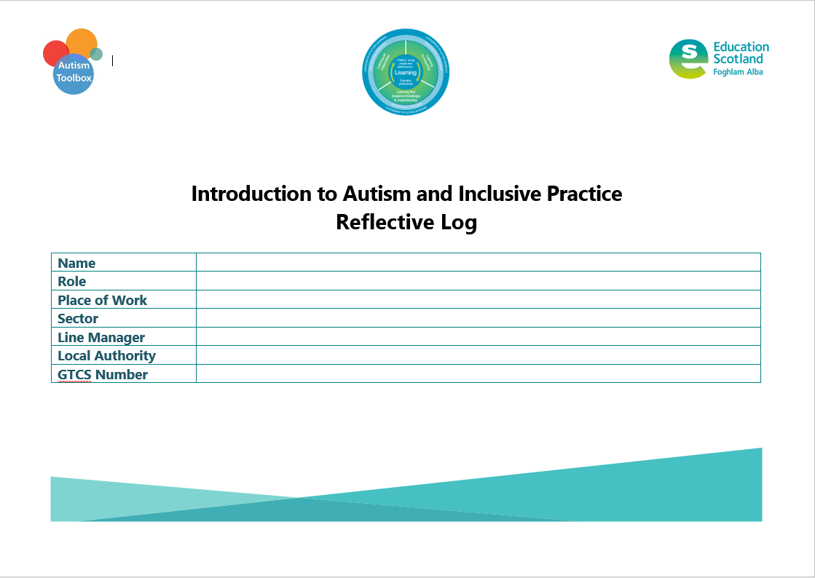
Introducing the Reflective Log
Notes:
A Reflective Log is available to download for you to evidence your professional enquiry and learning, The Reflective Log can also be used for collegiate discussions and will support Annual Reviews, GTCS Professional Update and contribute to applications for GTCS Professional Recognition.
As you work through this course, what you write in this log forms an important part of the learning process. You will want to revisit the log regularly and you may want to look at it again after you’ve completed the course, use it as evidence of what you’ve achieved, your development and as evidence of your professional development, reflective practice and critical self-evaluation. All of which contribute towards your GTC Scotland professional update.
Make sure that you save this reflective log after you start to fill it in. Use a file name like ’Introduction to Autism and Inclusive Practice Reflective Log’ so that it’s easy to find. The next time you are prompted to add to the log, you should open the file you saved and add the new material to it. You may choose to save a copy in ‘GLOW Microsoft Office 365’ so that you can access it from anywhere you have internet connection. (All public-school practitioners in Scotland have a GLOW login account).
Only the activities that require to be completed in this log are included.
Tables have been included with the activities to support your written answers; however, you can adapt this log and present your reflections in alternative ways to suit your needs.
A page for additional notes is at the end of this log.

Slide 5
This week’s session
Introduction to Module and Reflective log
Terminology
Notes:
In this session, we will introduce the module and the Reflective log for the first time, then cover the first section of the module, Terminology.

Slide 6
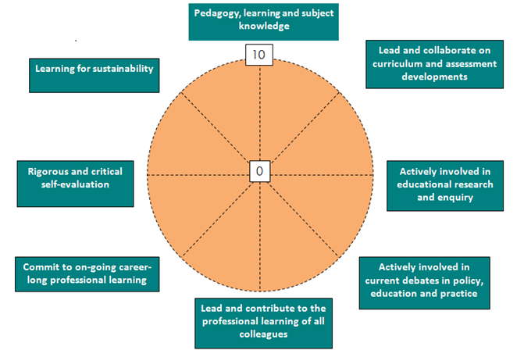
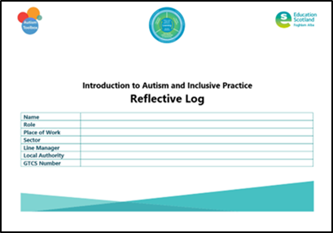
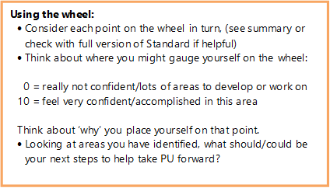
Activity 1: Self-evaluation wheel
Notes:
Reflective log, pages 4-7
Explanation of each point of the wheel is on page 6
Self-evaluation should support you to:
Reflect on what you have done
Think about what you might do next
Consider your own progress and development
Deeply understand your professional practice, your professional learning and the impact of this on your thinking, professional actions, those you work with/support and the pupils and their learning.
The Self-Evaluation Wheel is a useful tool for:
Exploring current reality
Supporting self-evaluation
Helping to critically reflect on yourself as a professional and your practice
Completing a simple gap analysis – for example, where you are now and where you would like to be?
The example on the screen highlights how to use the self-evaluation wheel.

Slide 7
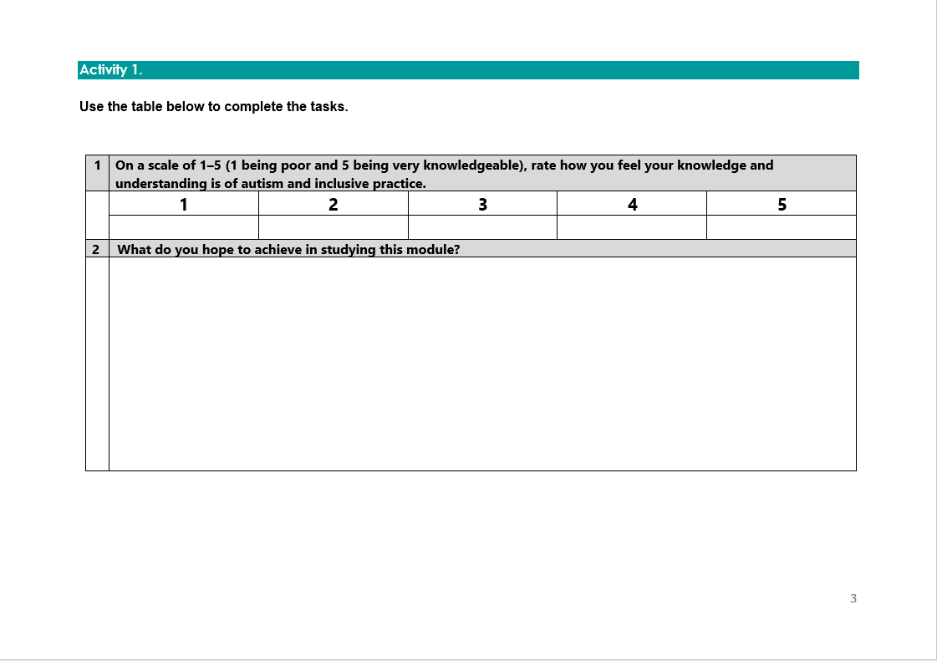

Activity 1
Notes:
Reflective log, page 3
On page 3 in your Reflective Log, you should start by:
Using a scale of 1–5 (1 being poor and 5 being very knowledgeable), rate your knowledge and understanding of autism and inclusive practice.
Consider and record what you hope to achieve in studying this module.
Complete the template for the self-evaluation wheel.

Slide 8
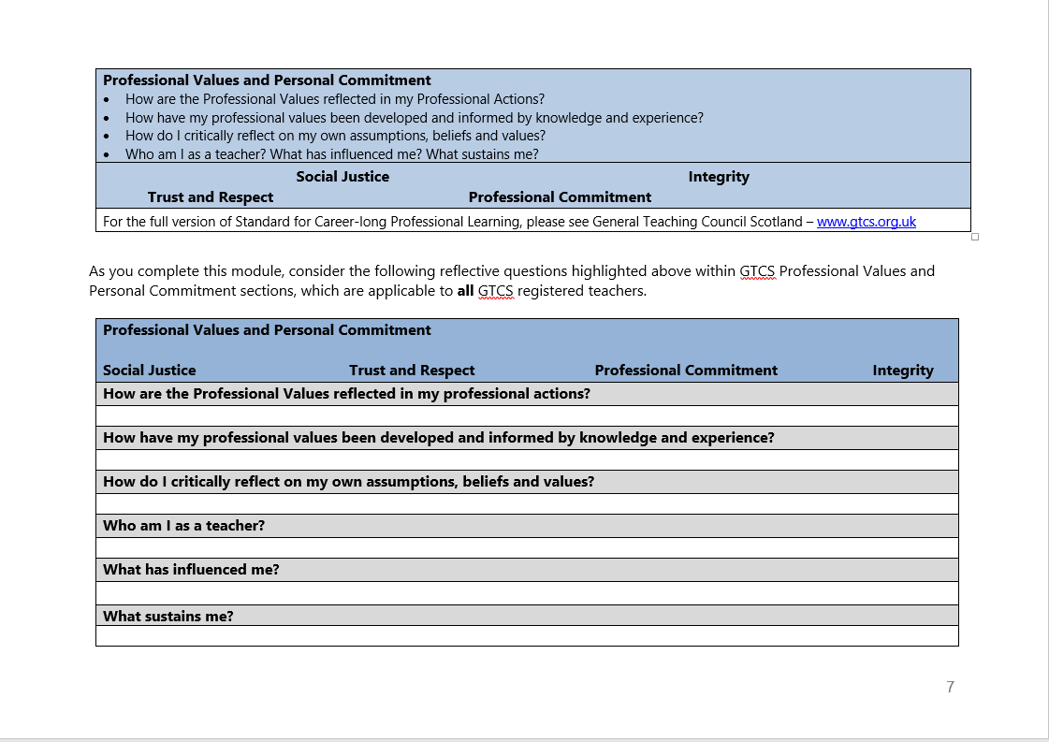
Notes:
Reflective log, page 7
As you complete this module, consider the following reflective questions highlighted above within GTCS Professional Values and Personal Commitment sections, which are applicable to all GTCS registered teachers.

Slide 9
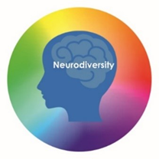
This week’s session
Terminology
The Scottish context for autism and inclusion
Understanding Autism
Assessment and Monitoring
Supporting Learners and Families
Social and Emotional Wellbeing
Transitions
Notes:
The module and this supporting programme for reflection is split into seven sections:
Terminology
The Scottish context for autism and inclusion
Understanding Autism
Assessment and Monitoring
Supporting Learners and Families
Social and Emotional Wellbeing
Transitions
Today we will explore the first section of the module, Terminology.

Slide 10
Recap of Section 1
Terminology
1.1 | Autism as an identity
1.2 | Neurodiversity
1.3 | Disability
Notes:
These are the subsections, included within the section on Terminology:
1.1 Autism as an identity
1.2 Neurodiversity
1.3 Disability

Slide 11
1.1 Autism as an identity
Notes:
Notes from module:
Many different terms are used to describe autism and there is no agreement within the community of autistic people, parents and their broader support network or the wider community on the best term to use.
Within the wider community, there seems to be most consensus for the terms ‘autism’ and also ‘on the autism spectrum’.
Within the autism community, many autistic people prefer the use of the term ‘autistic’, for example, autistic adult. The concept of autism spectrum disorder (ASD) has been rejected by some within the autism community because the term 'disorder’ presents the view that autism is a disorder; autism represents a difference not a deficit.
Within the education community, it is unusual to use a term which defines a diagnosis or identification before the words ‘learner’, ‘child’ or ‘young person’. For example, we would not encourage the term a ‘physically or mentally disabled learner’; we would instead encourage the learner to be understood as an individual first before any differences or difficulties. For example, ‘a child with autism’. However, some people within the autistic community have requested the term ‘autistic person’. The module therefore uses either the term ‘autistic learner’ or ‘autistic children’.
If the child, young person or family express a preference for a particular term, this should be respected.

Slide 12
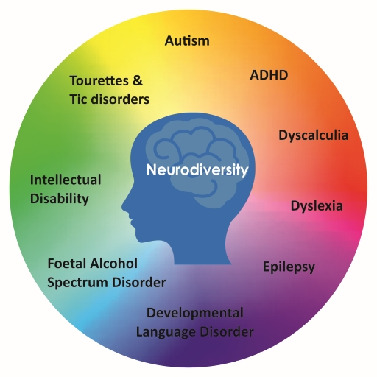
1.2 Neurodiversity
Notes:
Notes from module:
Neurodiversity is a relatively new term, thought to have been coined in the 1990s by Judy Singer (an autistic individual, parent of an autistic child and Sociologist). It was originally used by the autistic community who were keen to move away from the medical model and dispel the belief that autism is something to be treated and cured rather than an important and valuable part of human diversity.
The idea of neurodiversity has now been embraced by many other groups, who are using the term as a means of empowerment and to promote the positive qualities possessed by those with a neurodevelopmental difference. It encourages people to view neurodevelopmental differences such as autism, dyslexia and dyspraxia as natural and normal variations of the human genome. Furthermore, it encourages them to reject the culturally entrenched negativity that has typically surrounded those that live, learn and experience the world in a particular way that is sometimes perceived as different.
The whole of society is neurodiverse. Diversity is the trait of a whole group not of an individual. It is estimated that around 1 in 7 people (more than 15% of people in the UK) have neurodevelopmental differences, including autism, which are observed when they learn and process information in a particular way.
Autism often co-occurs with other neurodevelopmental differences, including:
attention deficit hyperactivity disorder (ADHD)
developmental coordination disorder (DCD), also referred to as dyspraxia
developmental language disorder (DLD)
epilepsy
foetal alcohol spectrum disorder (FASD)
intellectual disability
Tourette’s and tic disorders
specific learning disorder/differences e.g. dyslexia, dyscalculia.

Slide 13
1.3 Disability
What is disability?
Disability models
Social Model of Disability
Social Model Animation
Notes:
Notes from module:
What is disability?
It is helpful to understand what the term disability means and appreciate the sensitivity of the term and the range of associated feelings that learners and families may have. For example, some autistic people are very clear that they do not wish to be viewed as disabled, even if they may meet the criteria highlighted below.
A person has a disability according to the Equality Act 2010 if he or she has a physical or mental impairment and the impairment has a substantial and long-term adverse effect on his or her ability to carry out normal day-to-day activities.
This means that, in general:
the person must have an impairment that is either physical or mental
the impairment must have adverse effects which are substantial
the substantial adverse effects must be long-term
the long-term substantial adverse effects must be effects on normal day-to-day activities.
All of the factors above must be considered when determining whether a person is disabled.
Disability models
There are a number of ‘models’ of disability which have been defined over recent years. The two which are most frequently discussed and commonly used are the ‘social’ and the ‘medical’ models of disability; other models have evolved and developed from these two models. This module and the Toolbox focuses on these models.
The social model of disability and the Scottish context for education support the vision for inclusion in Scotland for all our learners, both disabled and non-disabled. Anticipatory thought is given to how disabled people can participate in activities on an equal footing with non-disabled people. Certain adjustments are made, even where this involves time or money, to ensure that disabled people are not excluded. For example, ensuring buildings, the curriculum and communications are accessible.
In terms of autism, the social and medical models overlap. While no support should be diagnosis dependent and should be timeously provided, understanding of support needs can be enhanced by diagnosis. Section 2 of this module provides an opportunity to explore the Scottish ‘needs led’ system, in which all children and young people are entitled to support with or without a diagnosis.
Research evidence from diagnosed individuals and families indicate a preference for timely diagnosis. The reality is that diagnosis helps with access to the most relevant information and support now and in the future.
Please note that education staff in Scottish educational establishments do not assess and determine if an autistic learner has a disability. This is usually done by health colleagues and should be in partnership with the family and the educational setting.

Slide 14
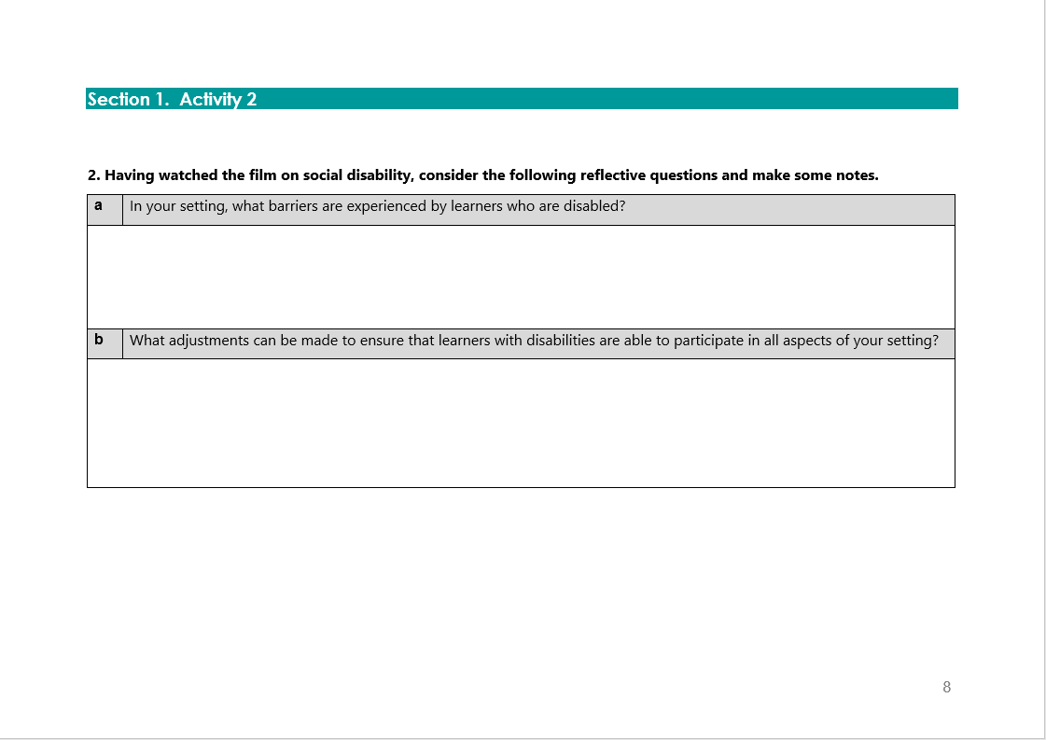
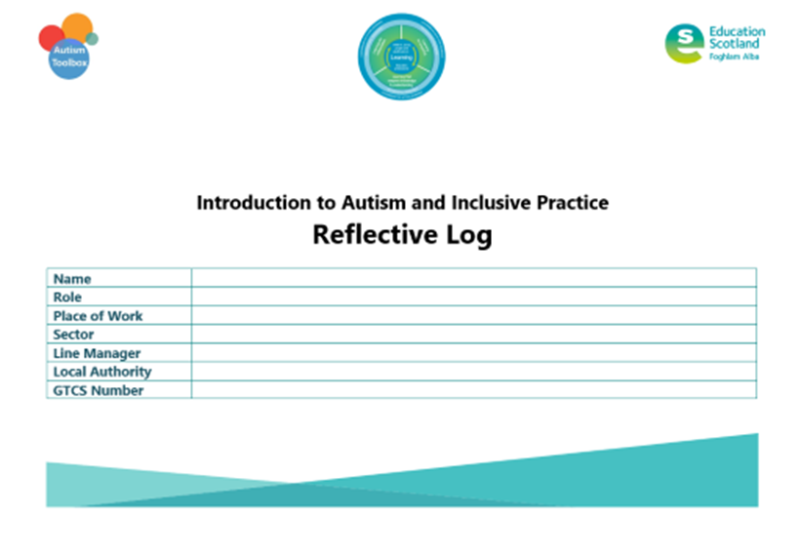
Activity 2
Social Model of Disability
Social Model Animation
Notes:
Reflective log, page 8
Social Model of Disablity: 3 mins approx
Social Model Animation: 1.5 mins approx

Slide 15
Gap Task
Register for module
Module Overview information
Complete sections:
Terminology
The Scottish Context for Autism and Inclusion
Reflective Log:
Activity 1, pages 3-7
Notes:
Tasks for completion between this session and next. 4-6 weeks between each group learning session is optimal.

Slide 16
Next session
Terminology
The Scottish context for autism and inclusion
Understanding Autism
Assessment and Monitoring
Supporting Learners and Families
Social and Emotional Wellbeing
Transitions
Notes:
Next session, we will explore the section The Scottish context for autism and inclusion.

Slide 17
Education Scotland
Denholm House
Almondvale Business Park
Almondvale Way
Livingston EH54 6GA
T +44 (0)131 244 5000
E enquiries@educationscotland.gsi.gov.uk
For Scotland's learners, with Scotland's educators
Notes:
This is a back cover page in blue. You may edit the address if needed only. It can only be once and at the end of the PowerPoint presentation. Use the corresponding blue internal and back pages if you are using this page.

