Slide 1




Relational Approaches Skills Building Programme
What happens when a child experiences SHAME?
Supporting practitioners to understand and address barriers to learning
For Scotland's learners, with Scotland's educators
Do luchd-ionnsachaidh na h-Alba, le luchd-foghlaim Alba

Slide 2

What happens when a child experiences SHAME?
Behaviour we see:
Withdrawal (socially withdraws, runs away, disengages…)
Aggression (towards others or themselves)
Uses avoidance strategies (denial, escapism,…)
Emotionally shutting down or dissociation

Slide 3
Brené Brown – Understanding Shame
Shame
is universal and is one of the most primitive emotions we experience
is the feeling of extreme embarrassment and humiliation
is the fear of disconnection – the fear that something we have done or failed to do makes us unworthy of connection
‘Shame is the intensely painful feeling or experience of believing that we are flawed and therefore unworthy of love’
- Brown, Daring Greatly

Slide 4
What is shame?
“When shame is experienced, it functions as an urgent signal that danger is here: the danger of rejection, failure, exposure and abandonment. It is an experience rooted in interpersonal relationships. It threatens the very experience of being alive and needing to belong, be loved and accepted.” de Thierry (2019)
If not comforted by an adult, the children can experience significant fear, stress and anxiety leading to harmful coping mechanisms and enduring toxic stress.

Slide 5
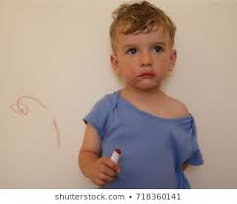

Guilt v Shame
Notes:
Guilt develops at around 2 to 2.5 years
Motivates child to make it up to person. Child wants to repair relationship.
Shame can be experienced from around 15 months. Such early experiences can be stored in the child’s preverbal, right brain sensory memories but without an accompanying story to help them make sense of the pwerful subconscious feeling.

Slide 6
Shame vs Guilt
Shame
Guilt
‘I am bad’
Can be destructive leading to lashing out, withdrawing, self-destructive behaviours
‘I feel bad’
Can help us change our behaviour in a positive way if we can accept responsibility

Slide 7
Different levels of shame
Type 1 – normal shame
Child experiences a short burst of shame but is quickly comforted by the adult.
Experience will stay in conscious memory but child will:
be able to overcome the unpleasant feelings relatively soon after the event.
often aim to avoid the same discomfort in the future but this endeavour is often a very conscious and cognitive one.

Slide 8
Different levels of shame
Type 2 : Unhealthy shame
Child experiences shame regularly and their emotional needs are not always met by an adult.
Early experiences of unhealthy shame:
are often remembered at subconscious level
can cause anxiety about being abandoned, rejected and not being good enough
can lead to different behaviours and coping mechanisms eg withdrawing, lying, or being a perfectionist

Slide 9
Different levels of shame
Level 3 : Toxic shame
Difference between type 2 and type 3 is marked by the length of time and the degree of humiliation and fear experienced
The more frightened, humiliated, and unprotected the child feels, the further down they have to push the unbearable feelings into the subconscious
These feelings are then harder to reflect on and make sense of
The child develops a “core sense of shame” and complex coping mechanisms also become part of their identity

Slide 10
Sources of shame
Behaviour techniques which use shame and fear for compliance
Abuse, neglect, secret family problems
Online peer pressure
Being compared
Having your needs dismissed
Self-blame
Expectation of being perfect
Adolescence
Confusing boundaries

Slide 11
Shame reactions (compass of shame)
WITHDRAWAL
Isolation
Running away
Hiding face
Disengagement
ATTACK
SELF
ATTACK
OTHER
Negative self-talk
Self-harm
Feeling of no control
Shouting
Blame others / ‘Not just me’
Aggression / Violence
AVOIDANCE
Denial
Masking the pain
Self-medicating
Sex, drugs, rock and roll
From Nathanson, 1992
Notes:
Review some of the triggers and examples of what this looks like in real life
Does this reflect participants’ experiences?

Slide 12
Braithwaite’s Hypothesis
Where individual wrong-doers are confronted within a continuum of respect and support, then a process of REINTEGRATION can begin. Braithwaite (1989)
Re-intregrative Shaming | Disintegrative Shaming
Acknowledges the intrinsic worth of the person and their potential contribution to society Separates the deed from doer -> “I like you……but not your behaviour” No need to augment shame – it happens naturally and should be managed with respect and support | Labels and stigmatises the individual as well as the behaviour Ostracises or excludes the individual from their wider community Degrades the individual and affects their social interactions. Often leads to repetition of the unacceptable behaviour
Notes:
John Braithwaite is a Professor in the Law Program, Research School of Social Sciences at Australian National University (ANU), and a member of ANU’s Centre for Restorative Justice. He is a leading light in the application of Restorative Practice principles.
Crime, Shame and Reintegration (1989)

Slide 13
Shame, resilience and healing
Ensure our schools are shame-informed
Create a nurturing ethos which prioritises positive relationships and emotional safety
Provide regular emotional connection with the child
Share vulnerabilities and make it safe to make mistakes
Model self-compassion
Separate out the problem behaviours from the child

Slide 14
The importance of language
Repair shame experiences through kindness and empathy
Include use of restorative language/conversations
Reinforce that your relationship isn’t impacted when things go wrong, and that things can be resolved most easily by going over them together.
Use both verbal and nonverbal language to communicate respect and support.
Help the child notice and speak about how shame feels (physically and emotionally)
-use the Emotion Sensation Feeling Wheel if the child needs support to identify feelings and how the physical sensations associated with them
Help the child understand how shame may have helped them in the past but may be a hindrance now

Slide 15
How do we manage shame?
WITHDRAWAL
Reflection Activity (individually or as a group):
What do we need when we experience shame?
What can we do to support a child or young person whom we suspect is being affected by shame?
Factors for consideration:
  Environmental
  Social
  Personal
ATTACK
SELF
ATTACK
OTHER
AVOIDANCE
Nathanson, 1992
Notes:
What do people need when they are experiencing shame?
Factors for consideration:
Environmental – physical space
Social – people involved/culture and ethos
Personal – their needs

Slide 16
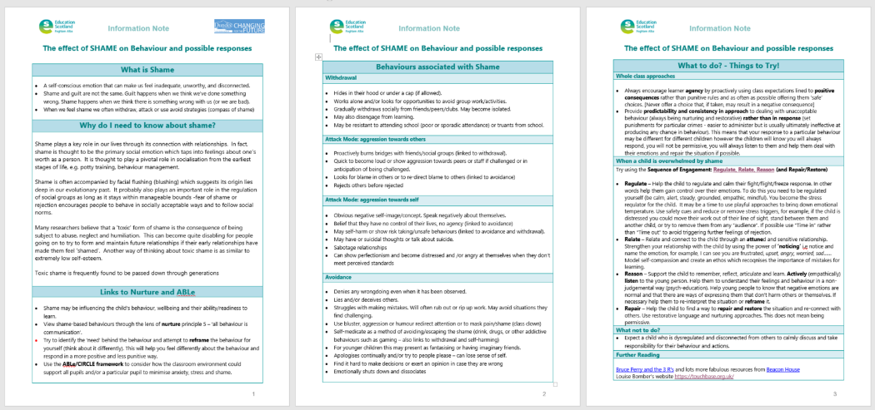
Further reading – SHAME Information Note

Slide 17
Education Scotland
Denholm House
Almondvale Business Park
Almondvale Way
Livingston EH54 6GA
T +44 (0)131 244 5000
E enquiries@educationscotland.gsi.gov.uk
For Scotland's learners, with Scotland's educators
Notes:
This is a back cover page in blue. You may edit the address if needed only. It can only be once and at the end of the PowerPoint presentation. Use the corresponding blue internal and back pages if you are using this page.

