Slide 1
Nurturing Nature
Longhaugh Nursery School
What are we trying to achieve?
How will we know that a change is an improvement?
What changes can we make that will result in improvement?

Slide 2
What was Nurturing Nature trying to achieve?
Ten (10) children and their parents, who participate in Nurturing Nature through Longhaugh Nursery School, have improved wellbeing, by June 2016

Slide 3
How would we know that NN was leading to improvement?
10 families will participate in Nurturing Nature
Families will enjoy outdoor activity in Middleton Woods
Families will use the woods independently beyond the project
Families will report improved wellbeing for themselves and their children
The lead Early Years Practitioner will report improved confidence in delivering Nurturing Nature

Slide 4
What changes did we make?
Introduced Grounds for Learning family learning project @ Middleton Woods
Learned from Grounds from Learning worker how to deliver Nurturing Nature
Encouraged parents and children to play and learn together in the local woods

Slide 5
Did the changes lead to improvement?
for the children and families?
for nursery staff?

Slide 6
The data - 8 families engaged – cycle 1

Slide 7
The data - Pam developed confidence

Slide 8
The data - Family feedback
20% would now use the woods once a month
80% would now use the woods once a week
100% agreed/strongly agreed that Nurturing Nature had a positive impact on their family
100% would recommend Nurturing Nature to another family

Slide 9
Cycle 2 – revising our aim
Six (6) children and their parents, who participate in 8 Nurturing Nature sessions through Longhaugh Nursery have improved wellbeing, by December 2016

Slide 10
Grounds for Learning Nurturing Nature
“This Nurturing Outdoor Play project uses outdoor free play in areas of local greenspace as an early intervention to support the wellbeing of vulnerable pre-school children; particularly in the emotional, social, cognitive and physical domains. The project has a strong emphasis on nature play as a way of supporting parent/child relationships and healthy attachment.”
Grounds for Learning, www.ltl.org.uk/Scotland, 2016

Slide 11
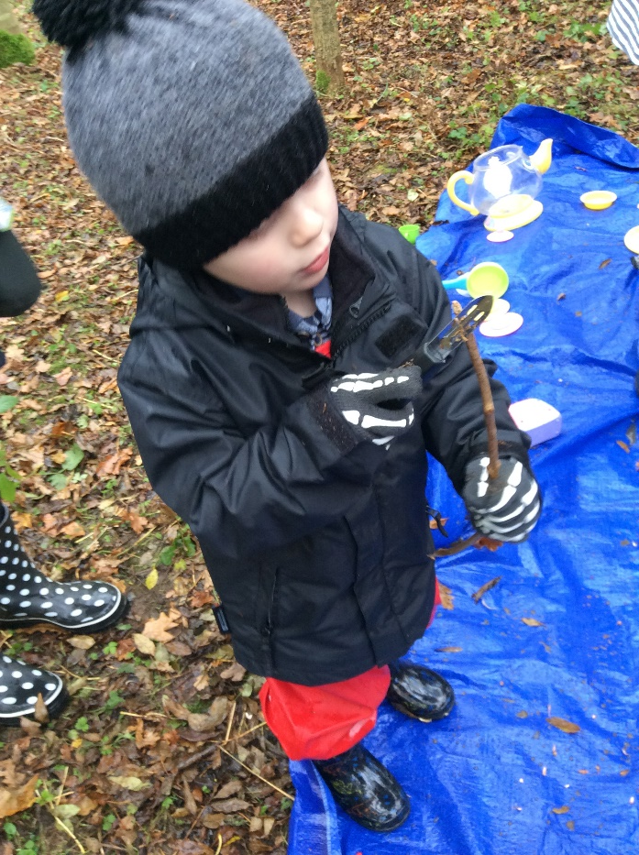
“Being outdoors has risks. The diversity of outdoor environments and the risks that come with them offer excitement and challenge for children and young people. They may cook on campfires, whittle sticks with knives, saw wood, construct dens with sticks, planks of wood, hammer and nails.”
(Care Inspectorate, 2016, p.16).

Slide 12
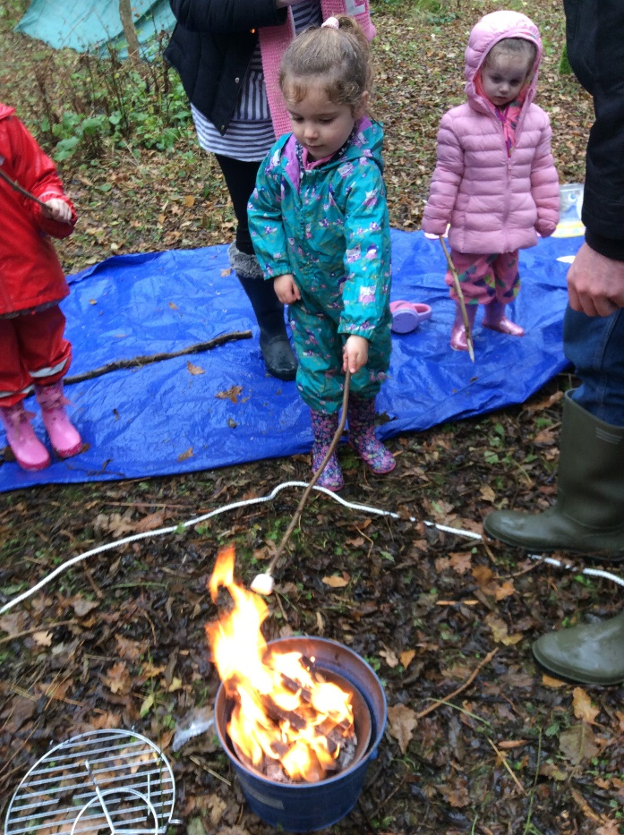
“Access to active play in nature outdoors – with it’s risks – is essential for healthy child development. We recommend increasing children’s opportunities for self-directed play outdoors in all settings – at home, at school, in child care, the community and nature.”
(Canadian Government, 2015, cited in Care Inspectorate, 2016, p.19).

Slide 13
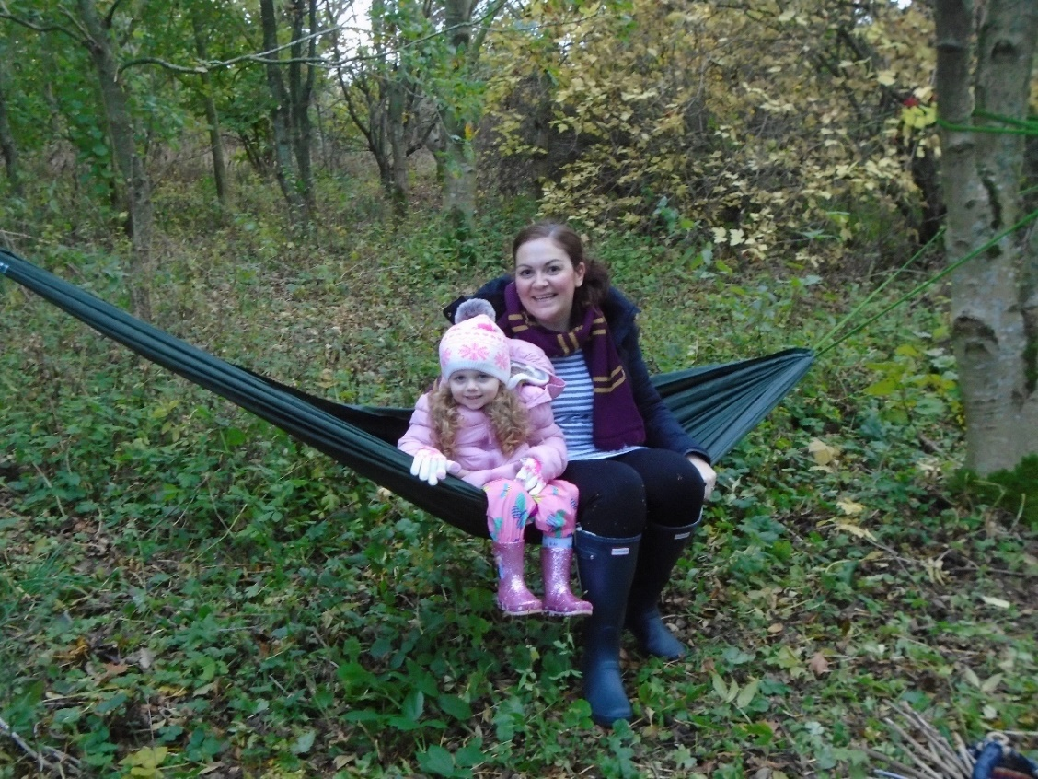
“Increasingly, research shows that being outdoors supports this nurturing experience. Particularly the additional stimulation of a rich, natural or naturalised outdoor environment; the increased possibilities and opportunities for exploration, developing curiosity, investigation and creativity has ‘profound benefits for children in terms of psychological wellbeing; buffering life stresses and boosting resilience.”
(R White, 2004 cited in Care Inspectorate, 2016, p.37).

Slide 14
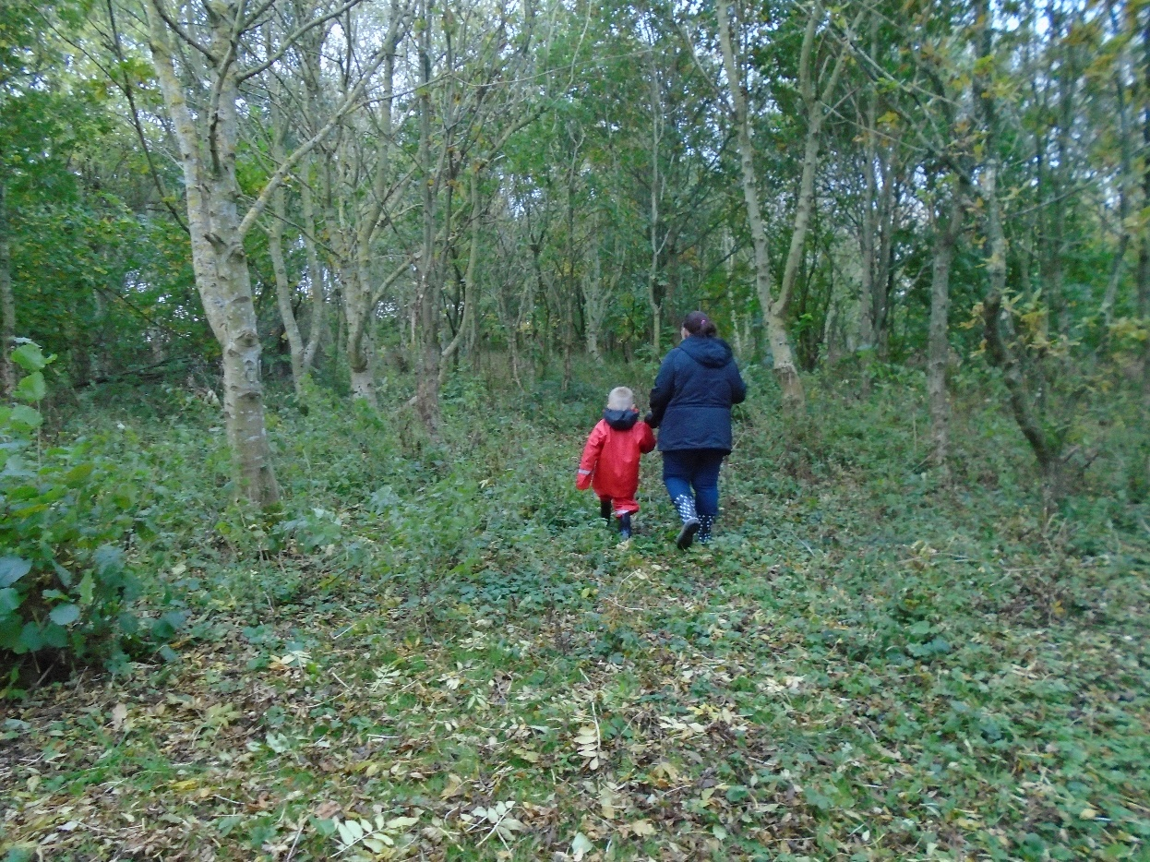
"He loves it. I love it. It is time for just me and him.”
Parent of Longhaugh NS

Slide 15
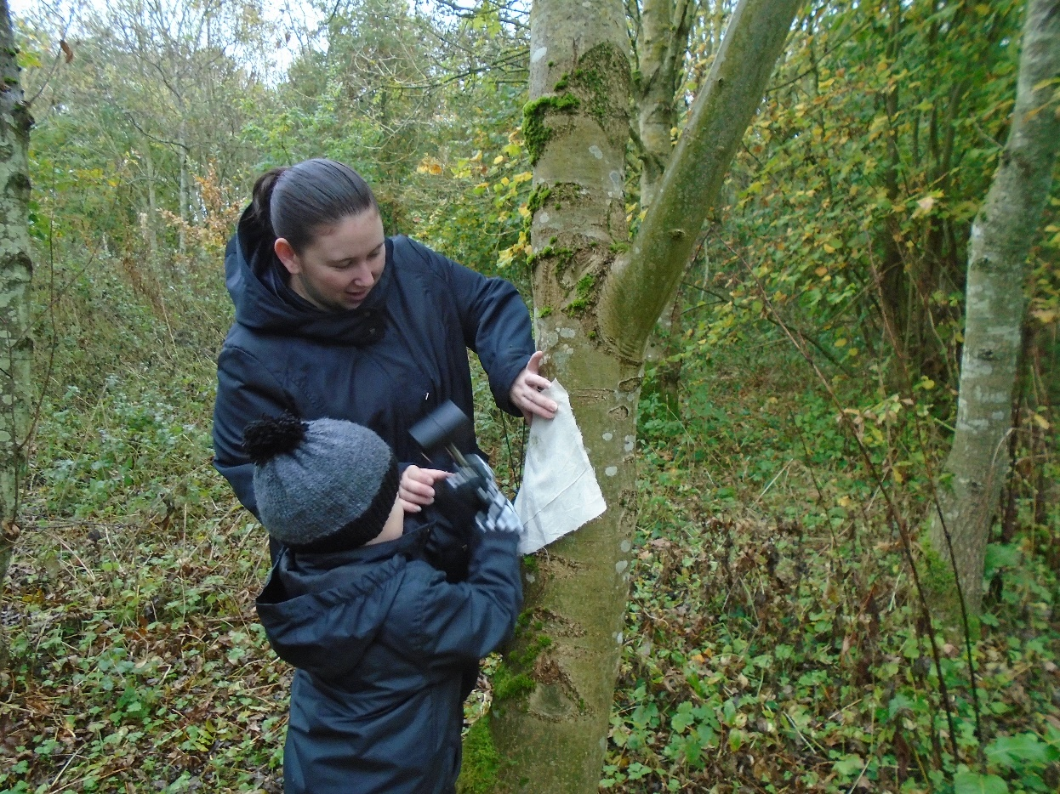
"This is time for you and Mum, without your brothers. He loved it in the woods.”
Parent of Longhaugh NS

Slide 16
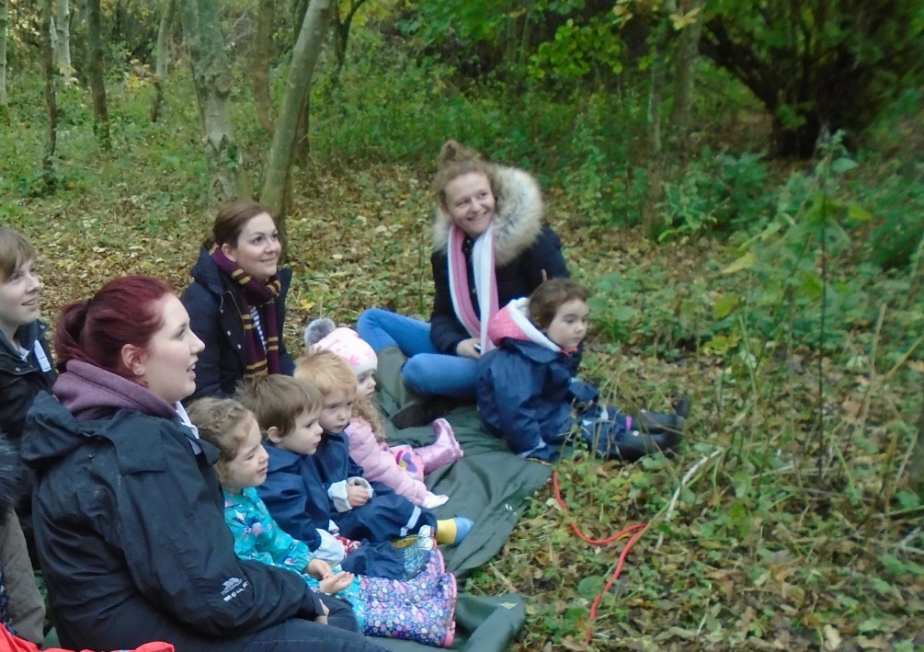
Parent's favourite activities included:
“Seeing my child have fun.”
“Learning different ways to engage with my child.”
“Making a fire and having fun - would do it again.”
“I enjoyed it all.”
“Just being there was brill.”
“Campfire.”

Slide 17
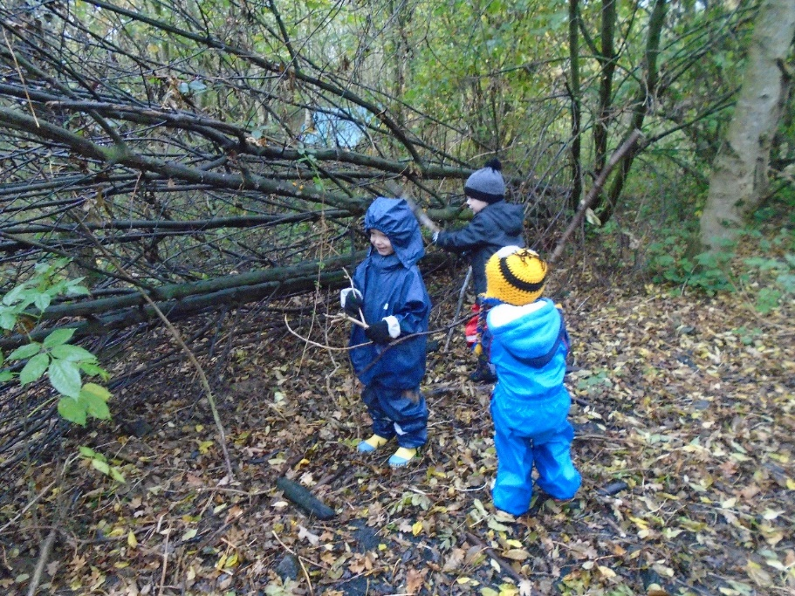
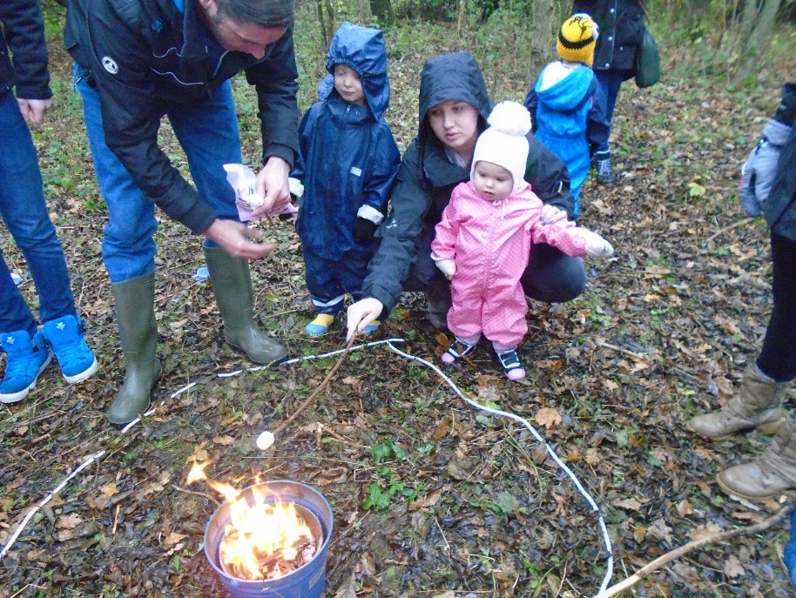
The children's favourite activities were:
“Making a fire and collecting wood and showing everyone where to go.”
“Waterslide and sword fighting.”
“Cooking on the fire.”
“The waterslide and eating the chocolate off of the pears meant to be for the bird feeders.”
“Making swords and hot chocolate.”

Slide 18
Engaging families – the 5 F’s to success
Family focussed
Friendly
Food
Free
Fun

Slide 19
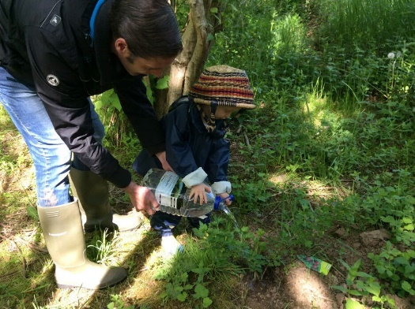
Statement and feedback from parent of Longhaugh Nursery School
(November 2016)
“I have been lucky enough to experience Nurturing Nature twice now, once as a parent and now as a co-leader. As a parent, I have learnt new skills and found the experience greatly rewarding. The course has taught me and my son how to enjoy and embrace our local outdoor spaces safely. I feel that my son has grown in confidence and it has also helped him with his social skills, both of which I found to be unexpected benefits. As a family we now regularly use the local woods which before nurturing nature we weren’t even aware that we had that facility just up the road from us.
The main thing I have taken from the course, is that with a bit of imagination and a free open space, my son and I can enjoy ourselves anytime.”

Slide 20
Statement and feedback from parent as a co-leader in Nurturing Nature
November 2016
“I have only been co-leading the course for a few weeks now, but have already noticed the effects it has had on the children’s confidence and abilities. It’s been interesting to see the other parents stepping out of their comfort zones and participating in activities such as putting up tents, tying ropes, camp fires and den building. All of these are activities they would never have taken part in had it not been for this course. I have been able to teach them how to let the children take ‘safe risks’ such as climbing trees and exploring the outdoor environment at their own pace. Parents on the course have mentioned that it has also allowed them to socialise with other parents from the nursery which is not something they would usually get the opportunity to do. I have enjoyed organising and planning the sessions and look forward to continuing to be able to enjoy the local outdoor spaces with both my child and others.”

Slide 21
Contacts
Susan.krachan@dundeecity.gov.uk
Hazel.bell@dundeecity.gov.uk

