Slide 1



Embedding Health and Wellbeing into Personal and Social Education
LI – To highlight a journey of good practice using
Wider Achievement
What impact has this had on supporting Mental Wellbeing?
2017/18 Enhanced Trans

Slide 2
PSE Curriculum
Project Trust
Rape Crisis Scotland
Substance Misuse
Sexual Health, relationships and parenthood
Mental Emotional Social and Physical Wellbeing
Planning for choices and changes
HOTS
Smokefreeyouth
Junction
SHARE
LGBT youth
Young Carers
Emergency services
Edinburgh College
Bright choices
CAHMS
Napier
LEAPS
Penumbra
Teenage Cancer Trust

Slide 3
    How is this relevant to improving Mental Wellbeing?

Slide 4
Steps to Work Award
Visit to our Lady’s High School (Lyn Zambonini)
Investigate possible Awards to fit PSE Curriculum
Decide possible units
Partnership
Progression of Awards
Staff development
Explore
Engage
Execute
Embed
Approval
Lessons
Student booklet
Staff resource booklet
QA / Verification procedures
Foxlake Fridays
Parental engagement
Staff (HT,DHT, Teaching)
Foxlake to create unit of work
Pupils

Slide 5
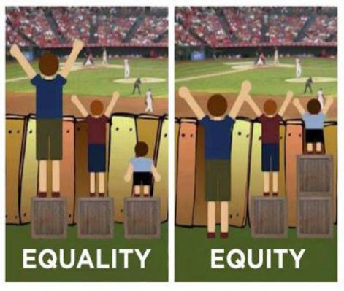
Excellence
Expect more than anyone thinks is possible…
Aim of attainment
challenge =

Slide 6


Marysia and Kainat

Slide 7
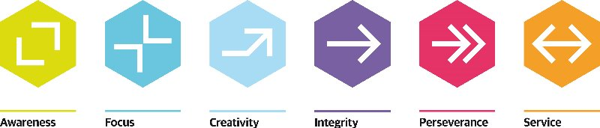
S2 journey: Columba1400

Slide 8
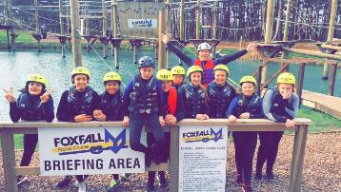

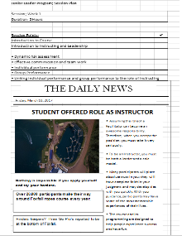
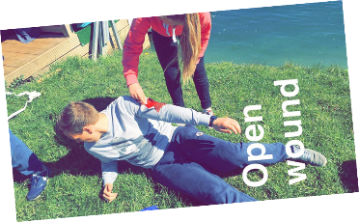

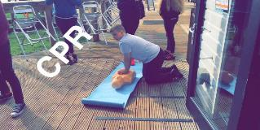
Marysia- Foxlake Friday’s
Foxlake Adventures is Scotland’s first cable wakeboarding park along with the UK’s only ropes course constructed over water.
8 week programme = Level 4
Steps to Work Award
1st
Social Enterprise
Armageddon (emergency situations = training in action)
Life skills, first aid, assisting an activity (foxfall), Briefing, risk assessments

Slide 9
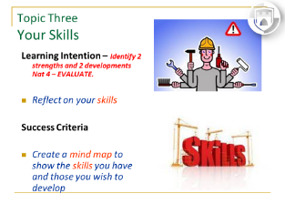

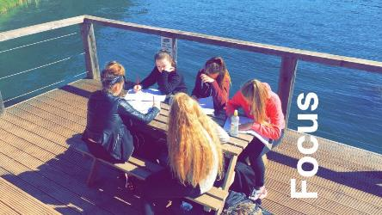
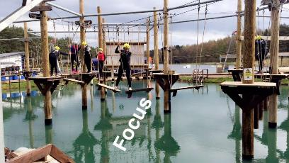
Marysia – Working Wednesday’s
3 Employability Units
Producing Excellent work = essay
Transferring skills from Foxlake to the classroom

Slide 10
Steps to work Units
Have a look through the level 4 units and see if you think any of the units can fit into your BGE/Senior curriculum.

Slide 11


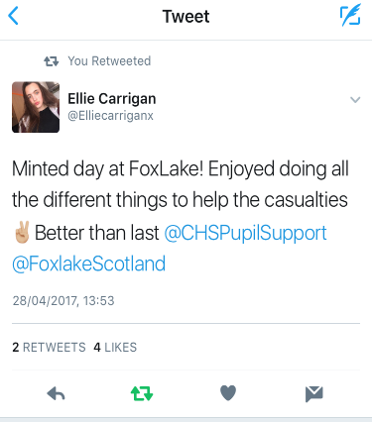

Learners Experiences

Slide 12
Learners Feedback
83% of pupils feel they have better communication skills
“I’ve learnt skills to save someone's life”
86% of pupils stated their confidence has improved throughout the JAL programme
“The programme has made me persevere, step out my comfort zone and help others”
“I hope to work at Foxlake in the future and I will miss the place”

Slide 13
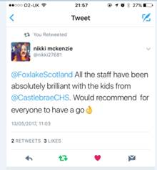
Parental Engagement
7 S2 family members attended the Friday sessions @ Foxlake.
27 out of 30 parents came to our Celebration breakfast = 90%
Average 34% at CCHS parents evening.
Feedback from parents has been overwhelmingly positive.

Slide 14
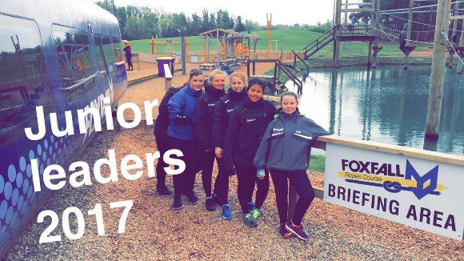
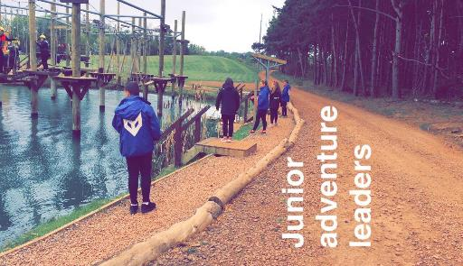
Attendance
Overall attendance in S2 has gone up by nearly 2%, which doesn’t seem a great deal, but it moves them from 93% to 95% over the 8 week Foxlake period. Those who have significantly improved have gone up by 10%.

Slide 15

Foxlake Adventures
S1
Steps to Work (Level 4)
Preparing for Employment – First steps
S2
Steps to Work Responsibilities of Employment Assisting a Leisure Activity Building Own Employability Skills
Health and Wellbeing Award Improving wellbeing (Level 4) Work placement (Level 4) Emergency First Aid at work (Level 4)

Slide 16


Columba1400
Princess Trust Award (Level 4) Presentation Skills Personnel development Community Project
S2
S2

Slide 17


Vision
Our vision is to provide a curriculum that will help
all learners achieve their potential.
We encourage our young people to work hard so that they have the confidence and motivation to make the most of every opportunity and to experience success.

Slide 18


Slide 19
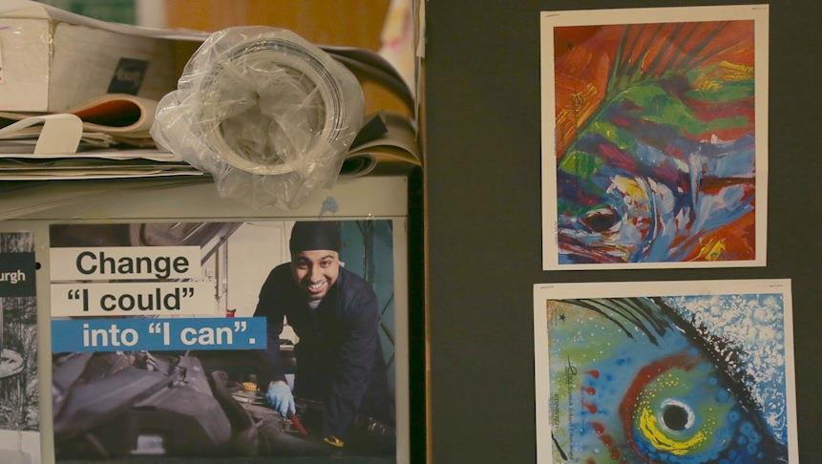

Slide 20
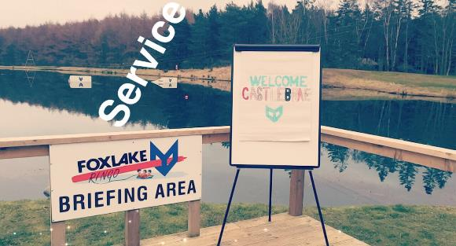
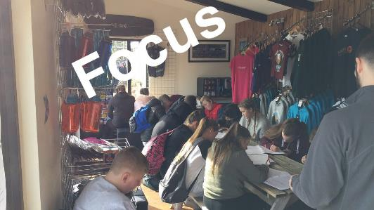
Achievement
Pupils in S2 have now completed their Steps to Work level 4 Award, Wellbeing Award and Emergency First Aid.
We need to continue to…
A constant message to pupils and parents…

Slide 21
What next = Progression
S3
Employability and Enterprise (level 5)
Enterprise Activity
S4
Personal Development : Self and Work
Employability and Enterprise
Work Placement
Working with others
Princess Trust Award (Level 4) Meaningful May!

Slide 22
Embedding Health and Wellbeing into Personal and Social Education
LI – To highlight a journey of good practice using
Wider Achievement
What impact has this had on supporting Mental Wellbeing?
2017/18 Enhanced Trans

