Slide 1

Certificate of Achievement
Awarded to
Cheeky Cookie Challenge
For being the quickest family at completing the cheeky cookie challenge.
Well done for demonstrating great team work and communication skills.
Date
By

Slide 2
Certificate of Achievement
Awarded to
Team Tower Challenge
For being the family to build the tallest structure in the team tower challenge.
Well done for demonstrating great team work and creativity.
Date
By

Slide 3
Certificate of Achievement
Awarded to
Wrap a Relative Challenge
For being the family to cover the most of their relative in the challenge.
Well done for demonstrating great team work and communication skills.
Date
By

Slide 4
Certificate of Achievement
Awarded to
Brilliant Balloons Challenge
For being the family to keep the balloons in the air for the longest time.
Well done for great team work and co-ordination skills.
Date
By

Slide 5
Certificate of Achievement
Awarded to
Group the Loop Challenge
For being the quickest family to split the cereal into colour groups.
Well done for demonstrating great team work and manual dexterity.
Date
By

Slide 6
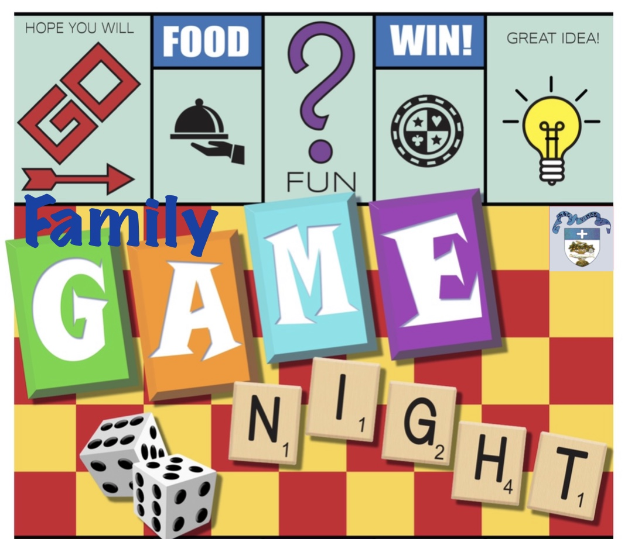
Instructions
Take a cookie and place it on your forehead
Move the cookie from your forehead to your mouth without touching it with your hands
The quickest family wins.
#minute to win it
Cheeky Cookie Challenge

Slide 7
Instructions
1. Take 12 strands of spaghetti and 6 marshmallows
2. Work as a family team and construct a tower
3. The tallest tower standing for one minute wins
#minute to win it
Team Tower Challenge

Slide 8
Instructions
Pick a relative then take a toilet roll
Wrap as much of their body as possible
The winning family are the quickest to cover the whole person
#minute to win it
Wrap a Relative Challenge

Slide 9
Instructions
Take 3 balloons
Work as a family to keep them up in the air
The family who keeps them up together for the longest time wins
#minute to win it
Brilliant Balloons Challenge

Slide 10
Instructions
Take the bowl of cereal and chop sticks
Work as a family to separate them into different colours
Place the cereal in the correct colour square quickest family to complete the challenge wins
#minute to win it
Group the Loop Challenge

