Slide 1

MILESTONES:
to support learners with complex additional support needs

Slide 2
Background to milestones
Need for national curricular guidance for learners with complex additional support needs, specifically those at the earliest stages of cognitive and all round development.
Benchmarks at early level not appropriate for learners with complex additional support needs.
Most schools don’t have the capacity to develop specialised curriculum guidelines on their own.
National guidance would promote greater consistency of assessment data and a commonality in language for assessment across Scotland.
Learning could be drawn from other education systems.
Notes:
National recognition of the need for further guidance and advice on meeting the curricular and learning needs of children and young people with complex additional support needs. In particular, specific guidance and support to help those learners at the earliest stages of cognitive and all round development. (Doran review, 2012, recommendation 9)
Early feedback from Benchmarks for literacy and English and numeracy and mathematics indicated that many practitioners felt that they were not appropriate for learners with complex additional support needs, being too demanding and not adequately providing a way of showing progress that can be slow and non-linear.
Learners who are not able to achieve any of the benchmarks within the early level of CFE still require us to track and monitor their progress and we needed a system to enable us to do that.
Although many special schools and Local authorities in Scotland had already begun to develop their own benchmarks and milestones based on the needs of children and young people working at the pre-early level of Curriculum for Excellence there was a national recognition that most schools would not have the capacity to develop specialised curriculum guidelines on their own. [For example, Fife Planning Tool took 7 years to develop]
A national initiative was required to draw on the work already achieved to produce national guidance. National guidance would promote greater consistency of assessment data and a commonality in language for assessment across Scotland.
Commonality of language can greatly ease transference of information during transition and by practitioners using the same language supports parents understanding of the progress their child is actually making.
Learning could be drawn from other education systems, outside of Scotland, who have already developed their own progression documents appropriate their own contexts and curriculum. For example Northern Ireland and the Quest system.
So we wanted Guidance to support practitioners who work with learners with complex additional support needs that was
Relevant to our sector
Recognises the vast range of our pupil’s needs
Written with and for practitioners
Something that could form the basis for professional dialogue
Something that was linked to theory but grounded in practice
Based on these drivers Education Scotland began the journey of co-producing, with practitioners, the milestones and accompanying guidance that we are presenting today.
Before we describe the process of developing the milestones I think we need to clarify some definitions, the purpose and principles and some key messages that sit behind the milestones work.

Slide 3
Milestones
A simple definition:
‘important points in a learner’s development which demonstrate progression.’
Notes:
So what are Milestones?

Slide 4
Purpose of the milestones
To support the tracking of progression for learners with complex additional support needs who are working at pre-early level; and
Promote consistency of language used in reporting progress and to inform planning/next steps.
Notes:
Simply put:
Read bullets
NB We will never be able to get consistency of planning and tracking and monitoring because these will be developed to suit the needs of the pupils within each context but what we can get is consistency of language in terms of tracking progress.

Slide 5
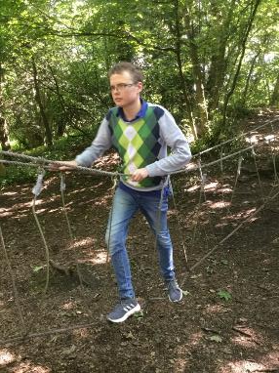
Principles behind the milestones
Tracking of progression should be based on and take account of:
a holistic view of the learner
the optimum learning environment
barriers to learning being understood and addressed (if possible)
what a learner can do not what they can’t
learning being purposeful, relevant, and building on prior experiences
assessment of the complex interaction of the learner’s needs
Notes:
A holistic view of the learner must be taken. Learning may not always occur in discrete curriculum areas and it may be necessary to carry out integrated learning in order to determine whether a particular milestone has been achieved.
Learners’ progression should be viewed in the context of the optimum learning environment for them. This requires a practitioner to have a clear understanding of the learners’ needs; and adapting the environment to meet these needs effectively. Supportive interactions will also form part of the optimum learning environment for a child or young person.
It is important to consider what barriers to learning there are for the learner and take whatever steps are necessary to overcome these (or if they can be overcome) in order to get an accurate picture of progression.
There should be a focus on what the learner can do not what they can’t. Progress may be made in very small steps. Success should be celebrated and shared where possible.
Learning must be relevant and purposeful and built on previous experiences. Taking account of interests, preferences and needs will help engage and motivate the learner.
Assessment should take account of the complex interaction between the different aspects of the learners’ needs including medical, sensory, physical, communication and learning needs. In some instances these assessments will require the support of parents (key partners) and our Allied Health Professionals such as speech and language specialists, occupational therapists, physiotherapists, doctors etc..

Slide 6
Key messages
Milestones should NOT be used as an exhaustive checklist
Milestones should ONLY be used to support learners with complex additional support needs who are working at a pre-early level
Milestones should NOT be used to track progression of typically developing children in early learning and childcare settings
Milestones are NOT intended to provide an alternative curriculum
Notes:
Milestones should not be used as an exhaustive checklist that needs to be completed by every learner with complex additional support needs.
Milestones should ONLY be used to support learners with complex additional support needs (see definition above) who are working at a pre-early level in all school settings including mainstream and specialist.
Milestones should NOT be used to track progression of typically developing children in early learning and childcare settings.
Milestones are NOT intended to provide an alternative curriculum – in other words wherever possible planning for learners should continue to be based on CfE E & Os. Indeed the E & O’s will usually provide the ‘context’ for learning even for CYP working at a pre-early level.
So now that we’ve established the Why’s and What’s and the purpose, principles and key messages behind the Milestones. We now need to describe the HOW. How were they created.

Slide 7
Schools involved
Working Group – Phase 1 (Literacy and numeracy) | Pilot Group – Phase 1 | Phase 2 (HWB)
Hillside – East Ayrshire | Croftcroighn and Langlands - Glasgow | Hillside – East Ayrshire
Callaiswood - Fife | Callaiswood - Fife | Callaiswood - Fife
Isobel Mair – East Renfrewshire | Hillside – East Ayrshire | Rosslyn School, Fife
The Scottish Centre for Children with Motor Impairment, Craighalbert | Kinnaird Primary - Falkirk | The Scottish Centre for Children with Motor Impairment, Craighalbert
Redburn – North Lanarkshire | Castleview - Stirling | Haysholm – North Ayrshire
St.Crispin’s, - Edinburgh | Beatlie School Campus – West Lothian | St.Crispin’s, - Edinburgh
 | Haysholm and James McFarlane – North Ayrshire
Notes:
The first groups developed the original Milestones for Literacy and Numeracy
The second group piloted them
The third group added aspects of HWB to the Foundation Milestones and refreshed all the guidance and supporting resources.

Slide 8






Support from partners
CALL Scotland
Fife Council
Edinburgh City Council
NHS Lanarkshire
NHS Lothian
Royal College for Occupational Health
Scottish Government

Slide 9
Timeline for Phase 1 (literacy & English and numeracy & maths)
Activity | Date
Scoping exercise. Group formed | Jan – Feb 17
Literacy and English milestones and accompanying guidance developed | Mar - Sep 17
Literacy and English milestones, foundation milestones and guidance piloted with schools | Oct – Dec 17
Milestones and guidance updated | Jan- Mar 18
Numeracy and mathematics milestones developed | Nov 17 – Apr 18
Numeracy and mathematics milestones piloted with schools | Jan 18– Sep 18
Feedback from first year of implementation | Mar 19
Notes:
First step – Scoping & Group established:
Scoping exercise involved looking at existing resources around planning and assessment such as P Scalee, Routes to Learning, Quest for Learning, The South Lanarkshire Framework for supporting pupils with severe and profound learning needs, Learning Tracks, & Fife progression frameworks
Second step:
The group initially developed the Literacy and English milestones and early guidance from:
the existing literature (fortunately the majority of the research for this group of learners is on communication skills development)
the groups combined knowledge of working with children and young people with complex ASNs
the early level benchmarks for literacy and English (referred to as a check that the milestones weren’t over-lapping them.
Third step - Pilot schools each developed their own way of introducing the Milestones to their practitioners and then with the learner’s in their school.
Here one example of how this was done.

Slide 10
Timeline for Pilot (literacy & English and numeracy & maths)
Activity | Date
Scoping exercise. Group formed | Jan – Feb 17
Literacy and English milestones and accompanying guidance developed | Mar - Sep 17
Literacy and English milestones, foundation milestones and guidance piloted with schools | Oct – Dec 17
Milestones and guidance updated | Jan- Mar 18
Numeracy and mathematics milestones developed | Nov 17 – Apr 18
Numeracy and mathematics milestones piloted with schools | Jan 18– Sep 18
Feedback from the school on implementation and use-ability of milestones | Mar 19

Slide 11
Piloting the Phase 1 Milestones
What pilot schools did:
Read and discussed the scoping paper
Thoroughly discussed the guidance
Discussed the continuum of engagement and types of support with all staff
Staff agreed to pilot the milestones
Identified pupils to be tracked using foundation milestones and pre early level milestones
Created a tracking document
Explored methods of moderation
Fed back the main pilot group findings
Notes:
As a pilot school: Refer to slide
Concurrent with this pilot of the Literacy and English milestones the Numeracy and Maths milestones were being developed.
The feedback from the piloting of the Literacy and English milestones allowed the group to update the Guidance and the Milestones.
In March 2018 a draft document was published of the foundation milestones and both sets of pre-early milestones
School were asked to use them with the intention of reviewing how this was going.

Slide 12
Timeline for Pilot (literacy & English and numeracy & maths)
Activity | Date
Scoping exercise. Group formed | Jan – Feb 17
Literacy and English milestones and accompanying guidance developed | Mar - Sep 17
Literacy and English milestones, foundation milestones and guidance piloted with schools | Oct – Dec 17
Milestones and guidance updated | Jan- Mar 18
Numeracy and mathematics milestones developed | Nov 17 – Apr 18
Numeracy and mathematics milestones piloted with schools | Jan 18– Sep 18
Feedback from the schools on implementation and use-ability of milestones | Mar 19

Slide 13
Feedback from the Pilot group on the draft Milestones
Staff found the documents really useful
Feedback showed an appetite among practitioners for additional Milestones for HWB
Danger exists for milestones to be used as a checklist
Milestones need to be used in conjunction with other planning tools*
Need for on-going moderation
Needed to develop a shared understanding of the continuum of engagement and supports
Need for greater recognition that a learner could be working concurrently at multiple levels
Challenging for schools who already have pre-existing/different trackers
Notes:
Positives
Staff found the documents really useful.
Feedback showed an appetite among practitioners for additional Milestones for HWB – social skills, functional movement
Risks to be aware of and things to take into account
Danger exists for milestones to be used as a checklist Why is it dangerous to use checklist – not holistic, doesn’t contextualise learning or recognise that very little learning happens in isolation in fact we put a great deal of effort into integrating learning. Progression not necessarily linear. Context, support etc. all needs to be in the accompanying NARRATIVE!!
Milestones need to be used in conjunction with other planning tools. Particularly when it is unclear if a learner has achieved a milestone.

Slide 14
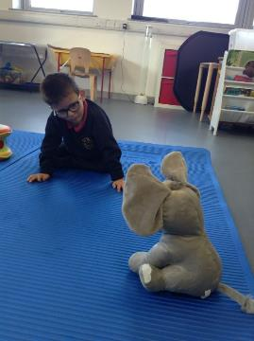
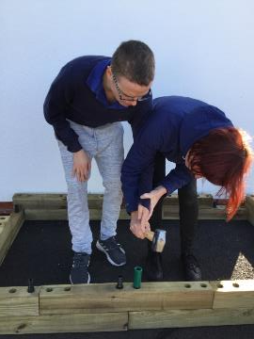
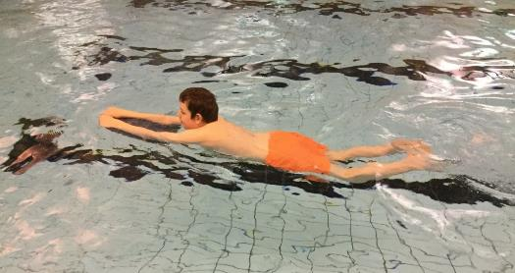
Next steps
Acting on the request of practitioners and recommendations from the Doran review we started the process again for Health and Wellbeing

Slide 15
Timeline for Health and Wellbeing (HWB) Working Group
Activity | Date
Scoping exercise. Group formed | Oct - Dec 18
Foundation milestones developed | Dec 18- Apr 19
Foundation milestones extensively reviewed and notes for new sections developed | May 18
Refreshed guidance developed | May - Jun 19
Refreshed foundation milestones and guidance piloted with schools | Jun – Sep 19
Feedback from early implementation (Jun-Sep) of refreshed foundation milestones | Sep 19
Foundation milestones and guidance updated and launched on National Improvement Hub | End of Sep 19
Notes:
Again we carried out an extensive review however there was nowhere near as much existing supporting research or documentation for HWB. What existed was mostly packages of resources around topics, such as, ‘Going to the shops’, ‘Personal Hygiene’ etc..
As a group we discussed in detail all aspects of HWB including things like personal care, sensory issues – things that are hugely important to our young peoples ability to, and readiness for, learning AND the things that take up a big part of a school day.
However when we started to hone in on the purpose of the Milestones – tracking progress – we realised that it wasn’t helpful to contextualise the milestones, as this would make the document huge and unwieldy, but to base the Milestones around skills which could be applied to many contexts.
Of course, the context is important and needs to be detailed in teachers planning and later referred to in any narrative for reporting progress.
For example – anticipate a familiar routines and situations – could be something you work on during snack time, or changing for an activity (not toilet)
Why don’t we have Milestones across all the HWB curriculum areas and organisers?
The main purposes of learning in health and wellbeing include (HWB Principles and Practise P1 of CfE guidance);
- make informed decisions in order to improve their mental, emotional, social and physical wellbeing
- experience positive aspects of healthy living and activity for themselves
- apply their mental, emotional, social and physical skills to pursue a healthy lifestyle.
Mental, emotional and social skills at a very early level were discussed and formed in relation to Self and emotion – Regulation and Awareness
Physical skills in order to pursue a healthy lifestyle at a very early level – Functional Movement
To extend the milestones past this would make the guidance again too unwieldy for staff to use.
It could open the discussion about taking all of the early level curriculum and developing Pre Early Milestones – this would not be helpful in targeting the progress of complex learners. If they were able to engage with the entire curriculum they would most likely be at an Early level.
Therefore the decision was made to extend the Foundation Milestones to include the skills required in these crucial areas for complex learners.

Slide 16
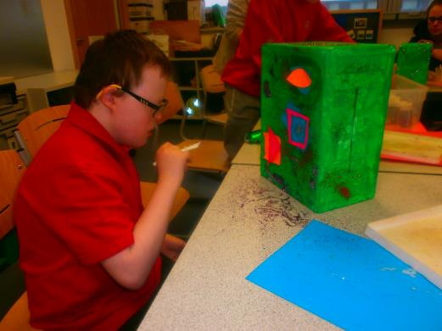
What does the refreshed resource consist of?
Guidance on using the milestones
Foundation milestones and Notes
Milestones for literacy and English
Milestones for numeracy and mathematics
Notes:
Four main parts of the document.
READ

Slide 17
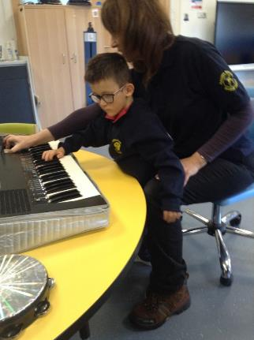
Background
What are ‘complex additional support needs’?
Understanding the profile of learners
Theoretical frameworks of development
Milestones
  Purpose
  Principles
  Key messages
  Learner support and engagement
  Reporting progress
Foundation Milestones and Notes
Literacy and English Milestones
Numeracy & mathematics Milestones
Notes:
How the documents is laid out.
The Blue section is the main part of the guidance and the orange section is the Milestones. The Foundation Milestones have some additional notes attached.

Slide 18
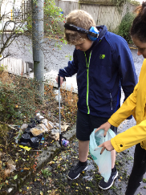
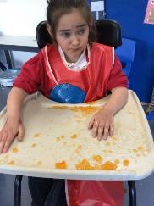
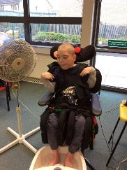
Understanding the profile of learners
We want to create the ‘optimum learning environment’ for learners. To do this we need:
to know them
  may require assessment of their communication, learning, sensory, behaviour, physical, medical needs…
to meet their basic needs for care and safety
to adapt the curriculum to meet their needs
Notes:
Practitioners need an in-depth knowledge of the children and young people with whom they work with to ensure that they are able to identify development and progression when it occurs.
Understanding the complex profiles of our learners can help us optimise their learning environment for them.
To do this we may need to assess their communication, learning, health, physical, behavioral, and sensory needs. Many of you will have in-house assessments that you use (as required) with your learners but in many mainstream or early learning centers or when the learners needs are particularly complex you may need specialist assessments from AHPs or other partners. Of course you also wouldn’t need to use all assessments with all learners.
We also know that in order to be ready to learn we need to meet our learners basic needs for care and safety. Knowledge of a child’s sensory preferences, such as what they seek and what they avoid, can enable adaptation of the environment, routines and activities to better suit their needs. For example, knowledge of any sensitivity to touch, sound, light, taste and even movement, and an awareness of what they need within their day to help them regulate, for example movement, proactive touch experiences or sensory play could significantly improve the child’s comfort and ability to learn.
In order to support learners with complex additional support needs, practitioners require an understanding both of typical learning development and of the curriculum. The atypical development of some learners with complex additional support needs means that they will not always progress through their learning in a linear or straightforward way.

Slide 19
Theoretical Frameworks of Develoment
Theories | Stages | Key messages
Learned behaviour | Habituation Early associative learning leading to classical conditioning Operant conditioning | Learners show a change in a response to a stimulus Learners anticipate and make associations between events Learners start to recognise that their action has a consequence
Stages of learning (Hierarchy) | Acquisition Fluency Maintenance Generalisation Application or adaptation | Learners acquire new responses Learners reach a level of mastery Learners consolidate and maintain a high level of competency Learners achieve mastery in different settings or contexts Learners recognise similarities and apply in new situations
Communication | Pre-intentional communication Voluntary communication Unconventional communication Conventional communication | Learners show involuntary/reflexive responses Learners imitate and react to situations Learners communicate intentionally but in unconventional ways Learners use gesture or vocalisation to communicate intentionally
Cognitive development | Sensorimotor Pre-operational Concrete operational Formal operational | Learning is based on motor activity and physical interaction. Object permanence develops at this stage (the knowledge that objects don’t disappear when out of sight). Learners begin to use symbols and words to represent objects as their memory and imagination develops Learners begin to develop logical thinking and can work things out in their own heads Learners can think abstractly and test hypotheses
Notes:
*Can use this and the next slide or not depending on confidence of presenter.
There are several pathways of learning, drawn from a theoretical understanding of development, which can inform practitioner’s understanding when working with learners at very early stages of development such as
Pavlov’s model of learned behaviour,
Haring’s Four Stages of learning (learning hierarchy),
the communication matrix, and
Piaget’s model of cognitive development.
This is obviously not an exhaustive list of some of the theoretical framework but it is a useful summary of the main theories which support out understanding of our learners progress.
Although they are all important the most relevant of these for assessing progress is Haring’s hierarchy of learning which considers whether a child or young person has simply acquired a skills, is fluent in using that skill or can generalize it, in other words use the skill in different contexts. Consideration of these stages are important when considering the achievement of a milestone.
We haven’t included this diagram in the refreshed milestones document but there is a link to it in the resources on the Milestones Page on the National Improvement Hub.

Slide 20
Theoretical frameworks of development
In summary, from our knowledge of the theoretical frameworks of development and the different pathways to learning young people can take we need to consider:
whether a child has simply acquired a new skill or knowledge, whether they are fluent in using this skill or knowledge and whether they can generalise it or apply it in different and new situations
the interaction between a learner and an adult being a key factor that could facilitate progression
Notes:
Reporting on the stages of learning are important when it comes to achieving a milestone. For this a practitioner may need to consult with other practitioners who work with the learner in different contexts or even with parents to see if the learners are using the skills they have been developing at home or in contexts outside school.
Also a recognition of the work of Vygotsky and an understanding of the zone of proximal development, for example the difference between what a learner can achieve independently and what they can achieve with adult help, is useful. The interaction between an adult and learner (or between learners) is a key factor that will facilitate progression. A skilled communication partner who is sensitive to the learner and can scaffold their learning, can impact on their ability to progress.
Both these considerations should support both planning next steps in learning and the decision making process about whether a learner has achieved a level.
For example, a learner may be able to generalize a skill but may always need adult support.
Functional Movement Skill – Grasps and releases a range of objects.
A range of objects could include cups, cutlery, diary/letter, P.E. equipment, etc.
A learner may be able to use this skill in new and unfamiliar settings; Posting a letter, returning a book at the library, exchanging money on the bus etc.
However if they had a visual impairment for example, they may require an adult to present the object in a certain way. Without the adults support in ‘setting up’ the environment to facilitate the learner they would be unable to demonstrate their ability to use this skill across contexts.
Of course our learners often make very slow progress towards a milestones so how do we need to report on every small increment of progress. For this we use a continuum of engagement.

Slide 21
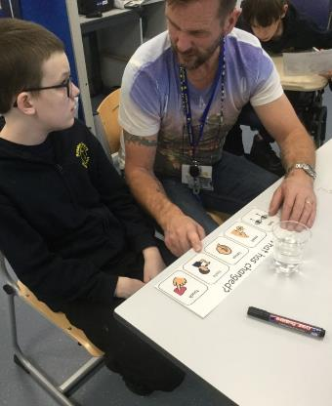
Continuum of engagement
Experiences | Encounters
 | Notices
 | Shows interest
Actively Engages | Responds
 | Focuses attention
 | Participates actively
 | Initiates
Applies and extends | Demonstrates understanding
 | Consolidates
 | Extends
Notes:
Learning/skills development and levels of engagement are not the same thing.
Ideally we want:
progressive learning and skills development; and
high levels of engagement.
However this will not always be the case.
This continuum provides us with a common language to describe progression in engagement in more detail. This is particularly useful for learners when progress is very slow or non-linear.
At this point we need to note that for some milestones you actually can’t use the continuum as the learner can either do the skill or they can’t, eg. ‘shows a simple reflex response to an individual stimuli’
But for the majority of the milestones the continuum can be used and using it will have the added advantage that it will help identify the effectiveness of different learning environments, strategies or resources.
It’s worthwhile remembering: even within an individual class a pupils level of engagement will vary. So it is really important to take an overview of their engagement over a period of time and to avoid micro-assessing.
Video – difference of encountering and noticing

Slide 22
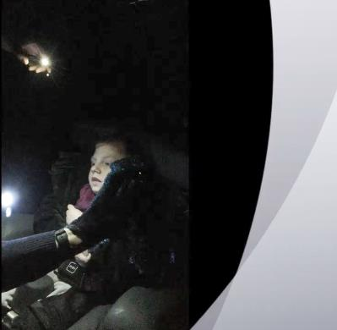
Demonstration in the use of the continuum
YouTube video: https://youtu.be/SJyGbqdV_7w
Notes:
*Can use this slide or not depending on confidence of presenter.
This pupil has an alternating divergent squint. This is filmed and assessed using the expertise of my VI support team.
Previous assessments have identified that the pupil could fix and track a moving red light. However it was clear after about 10 minutes that he no longer has this skill, (or was not able to demonstrate it today). Therefore we have introduced a movement and sound cue to help him find the light source.
Attention Skills – Shows an awareness of something happening; Gives a quick and fleeting response.
Context – Lights. Now with the addition of movement and sound to help him find the light. These additional cues would be phased out as his eyesight improves.
There are a few occasions during the clip where you might think he is aware of the light. However our expert has said that it is the squint, there are no deliberate eye movements. [59.05 seconds] Then just as the video finishes he appears to look for a second, however this was not definite.
Therefore he was assessed as Acquiring, with Verbal (sound), Visual (torch) and Gestural (movement) support, and is engaging at an Encountering level.
For us the important change in our minds was using the engagement codes. If we said yes/no to can he do this, we may well decide that there is no point on working on it. However the challenge of raising how we get him engaged further is ours, not his! He can relearn this skill, and the VI expert said that stimulating the eyes in this way would continue to have benefits for him.

Slide 23
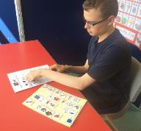
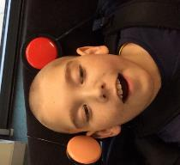
Types of support
Type of support | Examples of support
Physical support | Hand over hand, use of equipment
Gestural support | Simple signs or gesture, pointing, demonstrating
Visual support | Using objects, photos, pictures, symbols
Verbal support | Prompting and cues, expectant pause
Support via technology | Use of switches, apps, communication aids
No support | No support required. Can work independently.
Notes:
When supporting learners with complex additional support needs to access the curriculum, it is important for practitioners to take account of the additional physical, communicative, sensory and cognitive barriers to learning which the children and young people may experience.
This table describes the broad types of support that may be provided to a learner when assessing progress. The types of support given should be recorded and shared with others.
Again in this area it is important to work alongside Allied Health Professionals to determine what level and type of support is required in each learning context.
The document also provides an appendix with more detail on specialist equipment and approaches.
You may wonder why we have a section for no support but we figured that it was equally important for the different practitioners who work with an individual learner to know if the learner can work independently.
Give example. HT comment - I once observed a learner making Angel Delight, (a task that the learner had been practising for some time). She was being provided with visual, gestural, verbal, and physical support at times (hand over hand for pushing in the plug for the mixer). After observing I was curious about how much of the supports were being used/needed by the learner. I asked the support assistant to repeat the task the following week with no support to see what kinds of supports the learner would seek. After a short processing time, and a little prompting to start, the learner carried out the entire process independently. Yes the room was a mess, and there was the odd stomping of feet and groaning at us! But she did it.
The group felt it was important that for all learners we want the optimum level of support, and for some, this is no support.

Slide 24
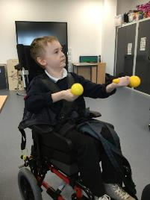
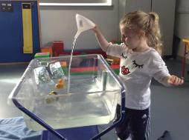
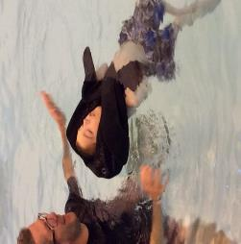
Reporting progress
Reporting narrative should include:
context
learner engagement (use the continuum)
type and amount of support needed/given to learner
Notes:
The milestones have been written deliberately without context, although we have had to give a few examples for clarity around what a milestone means so the reporting narrative becomes key to reporting the actual progress of the learner in terms of:
different contexts;
the learners engagement in each of those contexts and for each milestone; and
the supports needed in each of those contexts.
The narrative may also include whether the milestone has been achieved in one context, the learner is becoming fluent in the use of the skill learned in that one context, or whether they can use the skill in a variety of contexts, in other words they have generalised the skill.

Slide 25
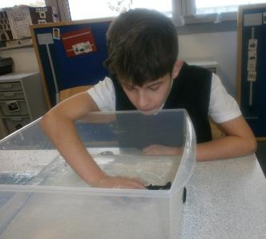
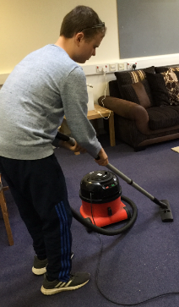
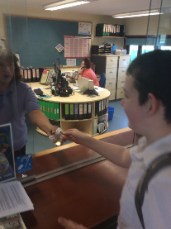
Foundation milestones
Basic skills progression that underpins all curricular areas:-
  Communication
    Attention skills
    Preference & choice
    Interaction
  Making connections (cognitive)
  Self and emotions
    Awareness
    Regulation
  Functional movement
    Gross & fine motor skills and coordination
Notes:
The Foundation Milestones are the key building blocks and skills for all learning. AND these are the skills that are most closely linked to the Health and Wellbeing curriculum and more specifically the Responsibility of All part of the HWB curriculum. As you know there are no benchmarks for the Responsibility of All section of the HWB curriculum as it is recognised that many of these skills and attributes can vary within all of us. So we may be able to talk about our feeling one day but not the next because the circumstances of our lives vary and mean that we aren’t always as able to cope with lives stresses.
In order to maintain the integrity behind and principles underpinning the CfE we have not mapped any of the Foundation milestones to specific E & Os. We also haven’t tried to cover all aspects of HWB as the Milestones are not an alternative curriculum. We should still be planning our programmes of learning around the CfE learning contexts whilst recognising that early skills development for our learners may only be at foundation level.
We have of course been able to map the literacy/English and numeracy/Maths milestones to E & Os

Slide 26
Milestones: key features
All milestones (foundation and pre-early):
Observable and clear to practitioners
Approximately demonstrate progression
Learners may skip some milestones and/or never achieve other milestones
Assessment of progression should be undertaken in a holistic and child centred way
Pre-early milestones (literacy and numeracy):
Follows same structure as benchmarks
Links to curricular organisers and experiences and outcomes
Notes:
Observable and clear to practitioners – will require on-going moderation
Approximately demonstrate progression – Approximate because the progression will apply to most learners (particularly for the Pre-early Milestones) but progression will not necessarily be linear for other learners – for example - next point!
Learners may skip some milestones and/or never achieve other milestones (it needs to also be recognised that some learners, due to health, may regress rather than progress
Assessment of progression should be undertaken in a holistic and child centred way – Due to all the previous points

Slide 27
Foundation Milestones
Pre-Refresh |  | Refreshed to include aspects of HWB
Attention Skills |  | Communication | Attention Skills
Communicating preference and choice |  |  | Preference and choice
Interaction |  |  | Interaction
Cognitive |  | Making Connections (Cognitive) | Cognitive
 |  | Self and emotions | Awareness
Milestones in BLUE unchanged in the refresh Milestones in GREEN added in the refresh |  |  | Regulation
 |  | Functional movement | Gross & fine motor skills and coordination
Notes:
The blue section on the left are the Foundation milestones from the existing Milestones documents. These have not be changed but they have been slightly relabelled.
The 3 sections which relate to communication have been grouped under a Communication banner.
AND cognitive skills have been renamed Making connections.
None of the actual milestones within these sections have changed so you won’t have to change any of your existing planners.
Here’s a quick reminder of what the communication and Making connections milestones contain.
.

Slide 28
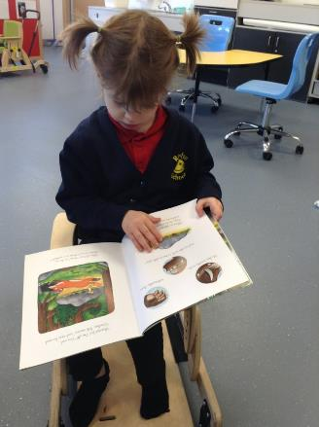
Communication
Skills which form the foundation for early communication
Relates to how learners respond to and receive information
Particularly important for the development of literacy skills
For some skills the continuum of engagement won’t apply
Notes:
This section includes the range of skills which form the foundation of early communication from attention skills, to communicating preference and choice and the basis of social interaction.
It relates to how learners respond to and receive information.
Development of skills in this area will form the foundation to progression in many other areas particularly to the development of early literacy skills.
As in other areas, the continuum of engagement will support practitioners to identify different levels of engagement in many of these skills but there are a number of very basic skills in this area for which the continuum of engagement won’t apply.
These include milestones such as ‘Shows a simple reflex response to an individual stimuli’ where the expectation is either that the learner is either able to do this or not.

Slide 29
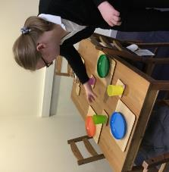
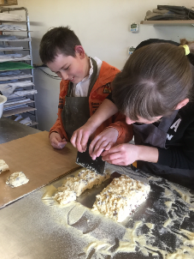
Making connections (Cognitive)
Relates to how learners explore and interpret the world
Learners with complex ASN may experience difficulties in making sense of the world
They therefore need opportunities to encounter, experience and engage …
As their skills develop they should be given opportunities to choose and show a preference
Focus on regular daily living activities and routines which will be needed for life/learning
Notes:
This section relates to how learners explore and interpret the world.
Learners with complex additional support needs can experience difficulties making sense of the world and may need many opportunities to encounter, experience and engage with stimuli, objects, people and activities in a range of ways; look for patterns and sequences in experience and generally extend their focus from the immediate and concrete to the less immediate and more abstract.
As learners begin to develop the understanding that they can have an effect on their world, they can be offered a much wider range of activities and objects to explore.
At this stage learners should be given opportunities to choose or show their preference for particular objects, people, or activities.
A focus on progression within regular daily living activities and routines can be helpful at this stage as developing skills in this context can be an important life skill for many learners.

Slide 30
Foundation Milestones
Pre-Refresh |  | Refreshed to include aspects of HWB
Attention Skills |  | Communication | Attention Skills
Communicating preference and choice |  |  | Preference and choice
Interaction |  |  | Interaction
Cognitive |  | Making Connections (Cognitive) | Cognitive
 |  | Self and emotions | Awareness
Milestones in BLUE unchanged in the refresh Milestones in GREEN added in the refresh |  |  | Regulation
 |  | Functional movement | Gross & fine motor skills and coordination
Notes:
The green sections are new.
So here’s what they contain.
.

Slide 31
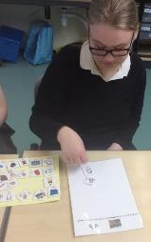
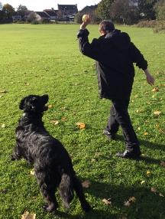
Self and Emotions
Explores how learners develop their awareness of themselves and of their emotions
Recognises the goal of developing self-regulation or the ability to seek out/accept support
Demonstrates the importance of understanding the profile of learners
Notes:
This section explores how children and young people will develop their awareness of both themselves and of their emotions. It is not expected that learners at this stage will necessarily have the language to express their emotions or to necessarily be able to access support with their emotions.
It is important, however, that as part of their progression within health and wellbeing that they are able to recognise that they are experiencing emotions and to be able to seek out support when they need it.
It is particularly important that they can find ways through their environment, and the adults within their environment, to begin to regulate any emotions or feelings that they have and accept the support of others if necessary to co-regulate.
This section really demonstrates the importance of ‘Understanding the Profile of Learners’ particularly around sensory issues and tolerances.
For example, Often learners with complex additional support needs may seek ways to self-soothe or regulate themselves in unconventional ways. Unconventional means of self-soothing or regulation may include making loud noises; moving around a lot and in some instances may include behaviors that cause harm to themselves and others, for example, banging their head; grabbing for others.
The skills which demonstrate progression in regulation will generally be towards more conventional means of regulation. It may be the case that some unconventional ways of self-soothing or regulating emotions still demonstrate progression but it is paramount that learners should move towards developing skills in this area which ensure the safety of themselves and others.

Slide 32
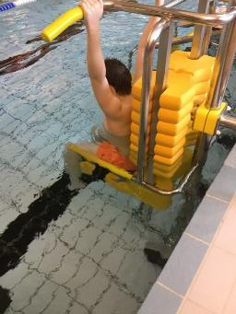
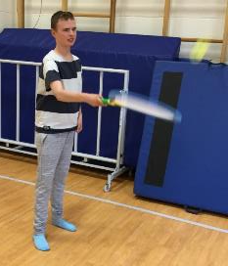
Functional Movement
Ultimately we want learners to maximise their physical and functional independence
Recognises that some learners may need high levels of postural support
Focuses on the functionality of movement rather than lists of physical skills and abilities
Planning may require the support of other agencies including Allied health professionals
Notes:
Functional Movement
This section emphasises the ultimate aim of each learner being able to maximise their physical and functional independence. Some learners may require high levels of physical support including postural management. Reporting should include the type and level of physical support required.
Physically able learners have a diverse range of physical skills and abilities and it is not the intention to represent all of the variation in these skills in these milestones. The milestones that are outlined here focus on the functionality of movement to support the development of independence and not on the quality of movement.
In order to fully support the progression of learners in a way that benefits them, practitioners should continue to plan in partnership with other agencies including Allied Health Professionals.
It should be recognised that the oral motor system is also a complex set of fine motor skills. The use of lips, tongue and jaw movements should be routinely encouraged, however, the description of the development of these skills are beyond the scope of these milestones.
It should be recognised that where there is paralysis some learners may not be able to develop functional movement with some or any of their limbs.

Slide 33
How do we turn this theory into practice?
Notes:
We’ve given you in some detail how we’ve arrived at the Milestones and the different sections of the resource.
Now what we’d like to do is help start the process of answering this question.
For example: (next slide)

Slide 34
How could we use Milestones to support planning…
Assess learner skills baseline using the Milestones
Identify next steps
Identify success criteria
Plan for learning
Report on progress using:
  the language of the milestones,
  continuum of engagement and
  types of support.
Notes:
We will discuss this in greater detail in one of the workshops.
The Milestones give us a clear assessment of the skills our learners have achieved, and what the next steps should be. Remembering that progress is most likely non-linear. This can inform Personal Learning Journey targets, as well as class plans as teachers are able to see patterns of skills across their group that they can focus on within literacy for example.
Using the Foundation Milestones alongside the Pre Early Milestones (Lit and Num) supports staff in differentiating the success criteria for the group, while remaining focussed on the experiences and outcomes within CfE. It is important that staff can articulate this and do not see the foundation milestones as an alternative curriculum.
The Milestones will inform planning as the skills identified impact on the context and activities/experiences. The Learning experiences must facilitate the outcomes. If teachers start with a ‘good idea’ or activity, the link to the LI and SC can become a little tenuous.
Using language that can be easily understood between professionals, families, and partners will ensure that we report in a way that is specific and ensures that we build on prior learning. Staff can assess progress either moving through the skills, continuum of engagement, or types of support. In this way we capture those small steps in progression and celebrate the achievements of our complex learners.
Having used the Milestones to inform planning I would say that my staff are feeling more confident.
This is not guidance that we have used solely to track and report, but it informs our practise and impacts on the quality of learning and teaching in our school.

Slide 35
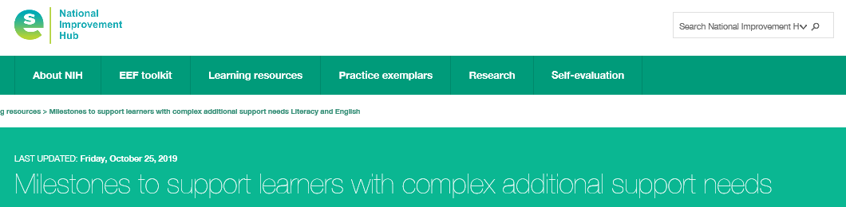
Further supporting professional learning
Films on the National Improvement Hub on:-
Tracking, Recording, Reporting and Planning - Film and Real examples
Continuum of Engagement & Types of Support - Film
Assessment and Moderation - Film and Power Point presentation
Differentiation and planning for multiple levels within a class – 4 Films and Power Point presentation
Notes:
I’ve just identified a process using the Milestones that could be used to support planning.
Were do we go next. Here’s some further professional learning which we could aces individually to do as a staff group.

Slide 36
Further resources on the National Improvement Hub
Power Point presentation for use in INSET/Implementation sessions in schools/provisions (this presentation)
Frequently Asked Questions
Some examples/links to profiles (learning, sensory, communication, behavior, physical ….)
Word copies of the Foundation and Literacy and Numeracy Milestones for schools to use and adapt for tracking purposes
Notes:
On the National Improvement Hub there is all some additional resources that we might find useful.

Slide 37
Questions or Group Activities

Slide 38

Education Scotland
Denholm House
Almondvale Business Park
Almondvale Way
Livingston EH54 6GA
T +44 (0)131 244 5000
E enquiries@educationscotland.gsi.gov.uk

