Slide 1

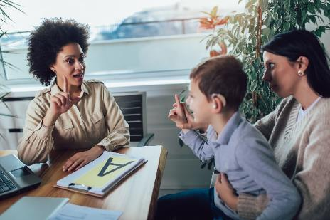
Good practice in working with
British Sign Language (BSL) users
For Scotland’s learners with Scotland’s educators
Notes:
This resource can be used as stimulus for a short awareness raising session or it can be the springboard to support reflection on practice, identify areas of improvement and agree actions which will deliver this improvement.

Slide 2
Background
This professional learning resource has been developed based on two of the British Sign Language (BSL) National Plan targets:
Learners who use BSL will get the support they need at all stages of their learning, so that they can reach their full potential.
Learners with deaf parents will get the support they need at all stages of their learning, so that they can reach their full potential.
For Scotland’s learners with Scotland’s educators
Notes:
What is this?
This professional learning resource is built around the films 'Working with deaf learners and their families' which were created by schools working with deaf learners and deaf parents. It shares advice and examples of good practice for education professionals and support staff about how to engage effectively with parents and learners who use BSL.
The resource comprises of film clips, a PowerPoint presentation for a professional learning session and a professional learning guide.
Context
The Scottish Government wants to make Scotland the best place in the world for BSL users to live, work and visit. This means that people whose first or preferred language is BSL will be fully involved in daily and public life in Scotland, as active, healthy citizens.
The BSL National Plan sets out ten long-term goals for BSL in Scotland, covering early years and education; training and work; health, mental health and wellbeing; transport; culture and the arts; justice and democracy.
The plan was developed with the active participation of D/deaf and Deafblind BSL users who worked with public bodies as part of the BSL National Advisory Group.

Slide 3
Overview
We will use the films and accompanying resource to:
Understand the views of a deaf learner and his deaf parent and a hearing learner and her deaf parent about what is working well and what could be improved in relation to inclusion for all deaf learners and their families.
Consider how we currently meet the needs of young deaf people and deaf parents in our early learning and childcare settings/schools.
Explore ways that we can make our early learning and childcare settings/schools more inclusive for all learners and their families.
For Scotland’s learners with Scotland’s educators
Notes:
This resource can be used as stimulus for a short awareness raising session or it can be the springboard to support reflection on practice, identify areas of improvement and agree actions which will deliver this improvement.

Slide 4
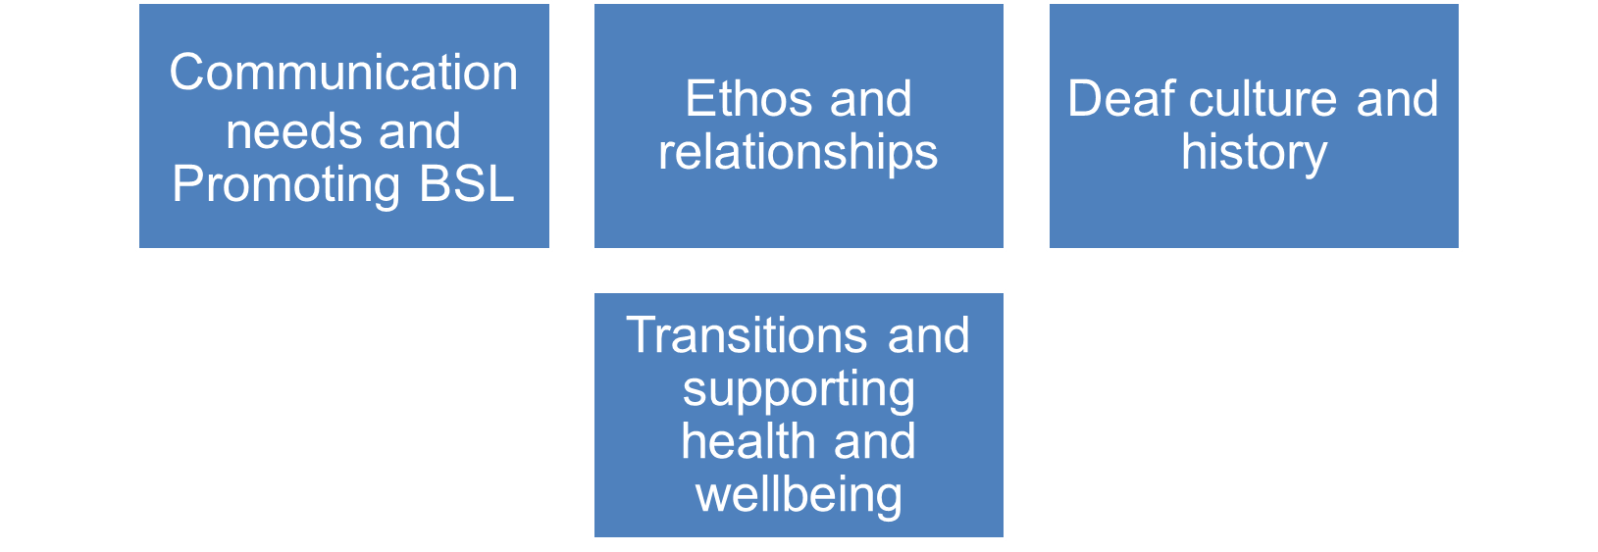
Themes
The following four recurring themes emerged from our consultation / conversation with a deaf learner and his deaf parent and a hearing learner and her deaf parent
For Scotland’s learners with Scotland’s educators
Notes:
Reviewing the films, a number of recurring themes emerged which we felt were important in relation to inclusion.

Slide 5
Scottish context for inclusion, equality and equity
Scottish education is based on the belief that education is a human right and that all children and young people should be supported to reach their full potential.
Scotland’s education system is designed to be an inclusive one for all children and young people in Scottish early learning and childcare settings/schools, with or without, additional support needs.
For Scotland’s learners with Scotland’s educators

Slide 6

General Teaching Council for Scotland – Professional Standards
Social Justice
1.1.2 I am committed to the principles of democracy and social justice through fair, transparent, inclusive and sustainable policies and practices in relation to: age, disability, gender and gender identity, race, ethnicity, religion and belief and sexual orientation.
Trust and Respect
1.3.3 I demonstrate a commitment to motivating and inspiring learners, acknowledging their social and economic context, individuality and specific learning needs and taking into consideration barriers to learning
For Scotland’s learners with Scotland’s educators
Notes:
The General Teaching Council of Scotland (GTCS) has developed standards that are required of all registered teachers and a set of professional values. These values include a professional commitment to social justice (see above exemplar) and to trust and respect (see above) including a commitment to taking the individual need of the child or young person into account.
The reflective log can be used to record your reflections and can contribute towards your folio for evidence for the GTCS Professional Update.

Slide 7
Promoting BSL and communicating effectively with learners their parents and families in our early learning and childcare setting/school
Make a list of the strategies you use to ensure parents and families feel welcome in your early learning and childcare setting/school.
Watch the clip where the Deputy Headteacher at St Roch’s Secondary School describes how parents and families are welcomed initially when their child joins the school. https://www.youtube.com/watch?v=DWxZEGA4QMM&list=PLcD2TdZ4bXSlLRiukfVsKAmgbyju__RZU
Watch the clip where the Principal Teacher at St Thomas’ Primary and Nursery Class describes how one family was welcomed initially when their child joined the school.
https://www.youtube.com/watch?v=dXd2FyNk5Co&list=PLcD2TdZ4bXSlLRiukfVsKAmgbyju__RZU&index=10
For Scotland’s learners with Scotland’s educators

Slide 8
Promoting BSL and communicating effectively with learners their parents and families in our early learning and childcare setting/school
4. Make a list of the strategies mentioned.
5. Go back to your initial list.
  How many strategies are the same?
  Which strategies are different?
You can use these lists to inform your policy around transitions for British Sign Language users, their parents and families.
For Scotland’s learners with Scotland’s educators

Slide 9
Optional reflection and evaluation activities
Slide 10
We promote BSL and communicating effectively with learners their parents and families in our early learning and childcare setting/school
Slide 11
We have a culture and ethos where deaf learners, parents and families thrive and succeed in our school
Slide 12
Our transitions policy and practice allows deaf learners in our early learning and childcare settings/schools to thrive and succeed
For Scotland’s learners with Scotland’s educators

Slide 10
We promote BSL and communicating effectively with learners their parents and families in our early learning and childcare setting/school
In groups: On a scale from 0 to 10, draw an X where you feel your early learning and childcare setting/school currently is in relation to this area.
Activity:
What is happening at present that lets you give your early learning and childcare setting/school this score? Imagine that you have moved one point up the scale. What would the learner/parent/family see happening that lets them know that things have improved? What will you be doing differently or be doing more of?
For Scotland’s learners with Scotland’s educators

Slide 11
We have a culture and ethos where deaf learners, parents and families thrive and succeed in our school
In groups: On a scale from 0 to 10, draw an X where you feel your early learning and childcare setting/school currently is in relation to this area.
Activity:
What is happening at present that lets you give your early learning and childcare setting/school this score? Imagine that you have moved one point up the scale. What would the learner/parent/family see happening that lets them know that things have improved? What will you be doing differently or be doing more of?
For Scotland’s learners with Scotland’s educators

Slide 12
Our transitions policy and practice allows deaf learners in our early learning and childcare settings/schools to thrive and succeed
In groups: On a scale from 0 to 10, draw an X where you feel your early level and childcare setting/school currently is in relation to this area.
Activity:
What is happening at present that lets you give your early learning and childcare setting/school this score? Imagine that you have moved one point up the scale. What would the learner/parent/family see happening that lets them know that things have improved? What will you be doing differently or be doing more of?
For Scotland’s learners with Scotland’s educators

Slide 13

Education Scotland
Denholm House
Almondvale Business Park
Almondvale Way
Livingston
EH54 6GA
T +44 (0)131 244 5000
E enquiries@educationscotland.gov.scot
For Scotland’s learners with Scotland’s educators

